Slide 1

LOOP Corp
Game Programming 1
Arsalan and Valentin

Slide 2

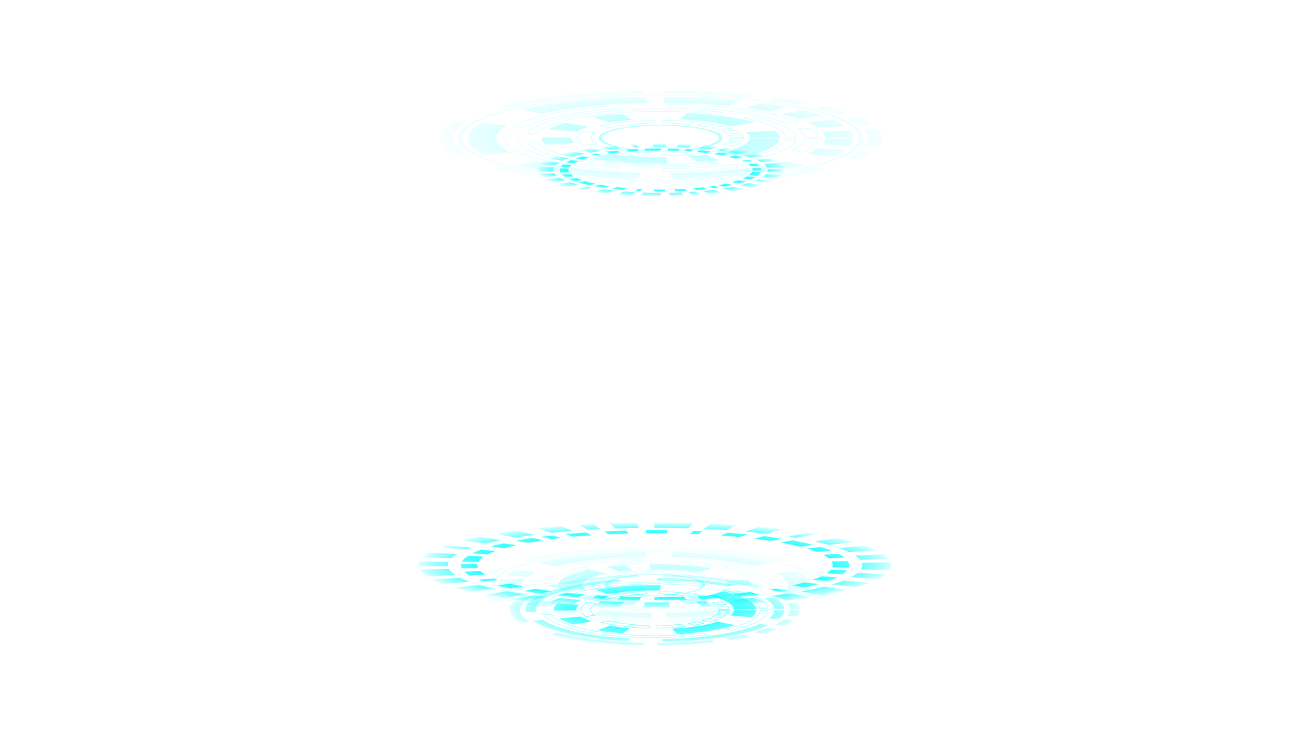
INTRODUCTION
The game is located in a dystopian world in the far future where each level is a simulated environment created by LOOP Corp. LOOP will play the role of the antagonist against the player.
Goal: To defeat enemies in each level and progress further into the game

Slide 3


OUR TEAM
MUHAMMAD ARSALAN SAEED
Level Designer
VALENTIN ATANASOV
System Designer

Slide 4
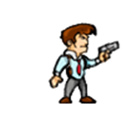



ENEMIES/ZOMBIES
PLAYER
Simulated enemies created by LOOP Corp to fight against the Player. Each “zombie” is simulated different from one another.
Zombie#1 (Regular)
Zombie#2 (Fast)
Zombie#3 (Slow)
This is you; You are the player of the game. You progress through the levels to fight against LOOP Corp.

Slide 5



Towers
There are two towers available to the player. Bullet Tower and Advanced Bullet Tower
Both towers destroy the enemies, but the advanced option is more effective against faster enemies
Controls:
Bullet Tower
Advanced Bullet Tower

Slide 6
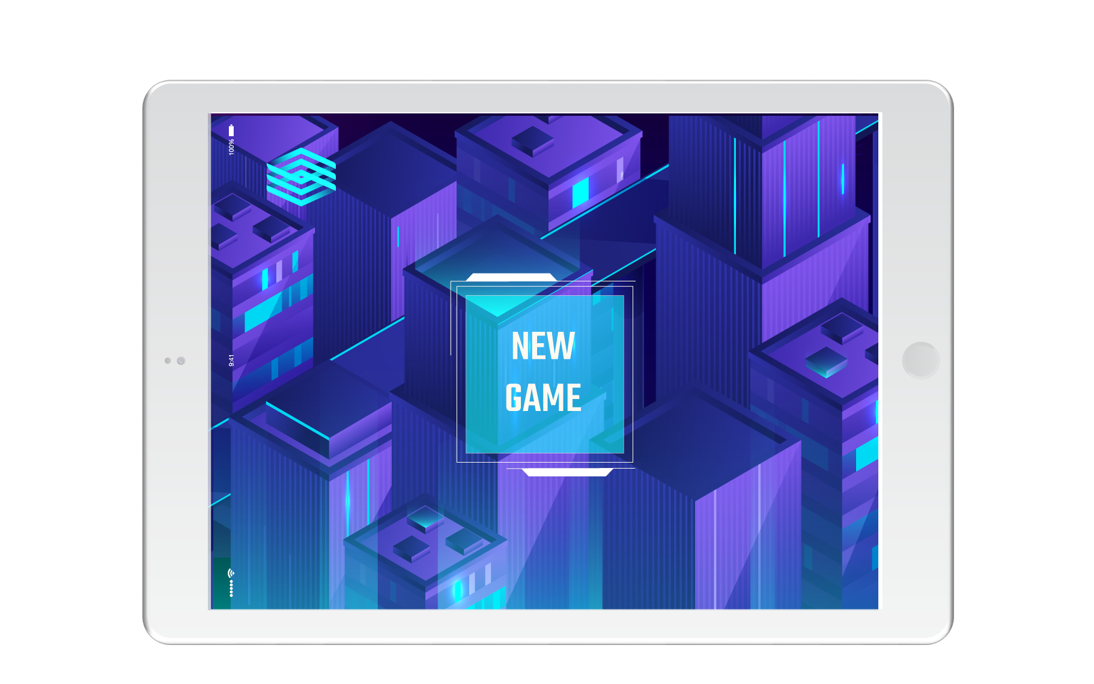
GUI
ENEMIES LEFT
LIVES
Indicates lives left until you die/lose level
Indicates the amount of enemies left in set level
CURRENCY
TOWERS LEFT
Indicates starting currency. Increases per enemy killed
Indicates the number of Towers left and how many you can place

Slide 7

Levels
LEVEL#2
TUTORIAL
LEVEL#3
LEVEL#1
Level#2 is in a Desert Field. This level will spawn in Enemy#1 and Enemy#2, who is faster
Level for players to understand how the game operated before commensing the main game
Level#3 is in an Ice Field. This level will spawn in all 3 Enemies. Enemy#3 is the slowest but highest health
Level#1 is in a Grass Field. This level will only spawn in Enemy#1

Slide 8
Other Screens
There are multiple different Worlds beside the levels.
StartScreen: Where player stars leading into the game, tutorial and controls
Controls: This tells the player what controls to use
3. LevelSelection: A little menu to help navigate and select through levels
4. GameOver: If failed on completion of level player will be sent here
5. WellDone: Once completing demo player will be sent here

Slide 9
CASE STUDY
SOLUTION
RESULTS
CHALLENGES
Created paths as individual actors, making enemies move straight to certain locations and then change directions once path runs out.
Scraped details out and would add later if this became a full game
Some class labs/demo’s where done in a diffrent version of Greenfoot
Couldn’t figure out how to get enemies to follow a set path
Implenting labs and Demo’s into our code.
Difficulties with transitions and enemy movements
Too much addictional details wanted to be added

Slide 10
Contributions
ROLES/TASK
ARSALAN SAEED
VALENTIN ATANASOV
System Designer
Level Designer
Documentation
Level Designer
Visuals
Sound
Transitions
Documentation
System Designer
Enemies
Towers
GUI
Level Mechanics

Slide 11
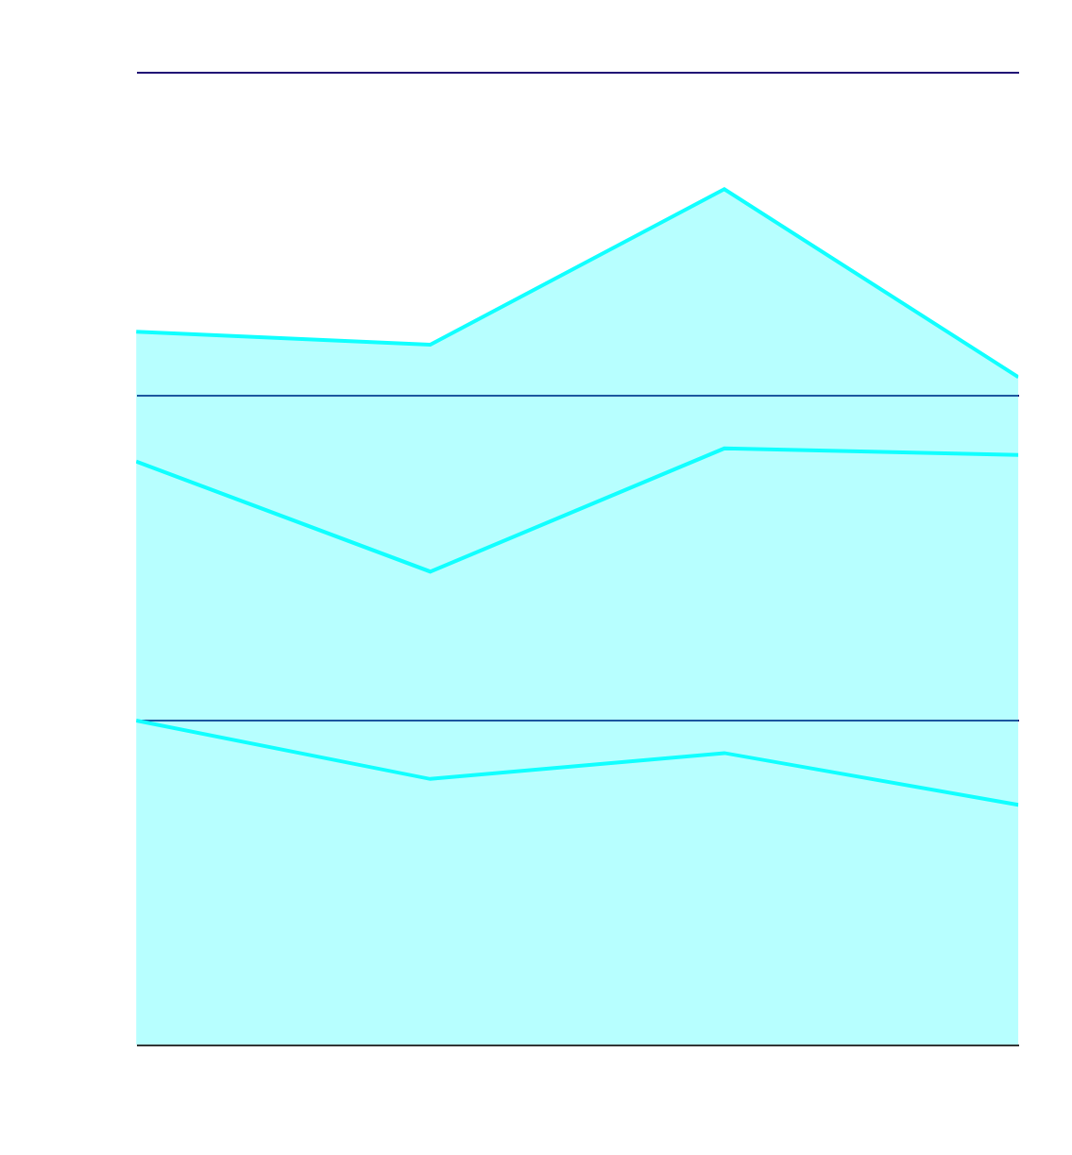
FUTURE ENHANCEMENTS
LORE/PLOT
Adding back a lore/plot should help allow the player to feel more submerged into the game and more clear objectives to each level.
LEVELS
Make levels more advanced then simply adding more enemies. Additional paths and tactics for players
MECHANICS
Addition of more towers and enemies. Towers can be destroyed and can contain health.

Slide 12

THANKS
Does anyone have any questions?
arsalan.m.saeed@outlook.com
https://github.com/2191818/GameFoot

Slide 13
RESOURCES
(Links on left, titles on right)
LINKS
https://itmedia.io/an-intro-to-css-image-sprites-theyre-easy-to-learn-and-great-to-know/
https://nl.freepik.com/premium-vector/zombie-boy-game-sprites_3674450.htm
https://goolnk.com/Qg3ojE
https://www.shutterstock.com/search/gaming+character
https://goolnk.com/Ry3oQW
https://goolnk.com/Er3ogw
https://www.vaniercollege.qc.ca/
https://www.desktopbackground.org/wallpaper/zombies-wallpapers-506148
https://www.shutterstock.com/it/video/clip-24330974-videogame-screen-text-well-done-8-bit
https://goolnk.com/Md3oJm
Player Images
Zombie#1 Image
Zombie#2 Image
Zombie#3 Image
Bullet Tower
Advanced Bullet Tower
Vanier Logo
Start Menu Background
Well Done, Background
Game Over Screen
Used GIMP for more Images editing
Sound files included on creation
Other Applications: PosterMyWall, Work, Powerpoint

Slide 14
CREDITS
This is where you give credit to the ones who are part of this project.
Presentation template by Slidesgo
Icons by Flaticon
Infographics by Freepik
Author introduction slide photo created by Freepik
Text & Image slide photo created by Freepik.com

Slide 15
RESOURCES
RECOURCES USED IN POWERPOINT, GIVEN BY TEMPLATE
(LINKS ON LEFT, TITLES ON RIGHT)
VECTORS
Futuristic hud background
Abstract futuristic glowing hologram background
Collection of futuristic infographic elements
Gradient technology logo template collection
Futuristic holographic infographic element collection
Artificial intelligence elements collection in flat style
Collection of futuristic infographic elements II
Flat futuristic city background
Isolated white tablet design
Futuristic hologram infographic element collection II
Flat futuristic city background II
Futuristic hud interface with gradient style
Futuristic holographic infographic element collection III
Trophies set in flat design
Futuristic hologram infographic element collection IV
Graphic elements of spaceship
Abstract futuristic glowing hologram background II
Pack nerd 36
Pack virtual reality 31
Pack virtual reality 67
Pack playing videogames
Pack avatar 15

Slide 16
Fonts & colors used
This presentation has been made using the following fonts:
Teko
(https://fonts.google.com/specimen/Teko)
Source Code Pro
(https://fonts.google.com/specimen/Source+Code+Pro)
#11FFFF
#0068e8

