Slide 1

STUDENT DETAILS
NAME: BURRE THEJASHWINI
ROLL NO: 21A91A05B3
EMAIL ID: thejaswini12062003@gmail.com
COLLEGE: ADITYA ENGINEERING COLLEGE ,SURAMPALEM
COURSE: ARTIFICIAL INTELLIGENCE AND MACHINE LEARNING [03-06-2024 To 15-07-2024]

Slide 2
PROJECT TITLE/PROBLEM STATEMENT
Project Title: EMPLOYEE BURNOUT PREDICTION
Problem Statement: Employee burnout is a state of physical, emotional and mental exhaustion caused by excessive and prolonged stress. It can have serious consequences on an individual's well-being and can lead to decreased productivity and job performance. This project aims to develop a predictive model using linear regression to forecast employee burnout rates based on various factors such as designation, resource allocation, mental fatigue score, company type, work-from-home setup availability, and gender. Identifying the factors leading to employee burnout and predicting it to help organizations take preventive measures. By proactively addressing these risk factors, organizations can help prevent burnout and promote the well-being of their employees.

Slide 3
AGENDA
Project Overview
End Users of the Project
Solution and Value Proposition
Customization and Personalization
Modeling
Results
References

Slide 4
Project Overview
Employee burnout is a critical issue that can lead to decreased productivity, increased turnover, and negative impacts on both employee well-being and organizational performance. This condition can have deleterious effects on individual well-being and organizational productivity.
Scope:
Developing a linear regression model to predict employee burnout using factors such as company type, WFH setup availablility, Number of working hours, stress levels, and job satisfaction, and validate its performance through data analysis and model evaluation.
Objectives:
Understand the causes of burnout
Develop a predictive model
Provide actionable insights to prevent burnout
Aim:
To develop a reliable model for predicting employee burnout, helping organizations implement proactive measures to improve employee well-being, productivity, and reduce turnover rates.

Slide 5
End Users of the Project
PRIMARY USERS:
Organizations:
Characteristics and Needs: Responsible for overall employee well-being, productivity, and organizational culture.
Benefits: Utilize the model to proactively manage and reduce employee burnout, enhance productivity, and foster a positive organizational culture that prioritizes employee health and well-being.
HR Departments:
Characteristics and Needs: Manage employee relations, policy development, and organizational health.
Benefits: Use the model to proactively identify at-risk employees, provide tailored support, and inform policies promoting work-life balance and mental health within the organization.
Employees:
Characteristics and Needs: Individuals experiencing work-related stress and seeking support for work-life balance.
Benefits: Gain insights into personal burnout risks, enabling proactive stress management, and benefit from initiatives promoting a healthier work-life balance within the organization's supportive environment.

Slide 6
Solution and its Value Proposition
Analyzing employee burnout is crucial for maintaining a healthy work environment and improving overall productivity.
Steps to Implement Burnout Analysis
Data Collection: Gather relevant data from various sources (surveys, HR records, etc.).
Data Preprocessing: Clean and prepare the data for analysis.
Feature Selection: Identify the most relevant features that contribute to burnout.
Model Building: Choose and implement the appropriate models.
Validation: Test the models using a separate dataset to ensure accuracy.
Interpretation: Analyze the results to derive actionable insights.
Intervention: Implement strategies to address identified issues and prevent burnout.

Slide 7
Value Proposition
For Organizations:
Values Proposed: Proactively manage and reduce burnout risks, optimize workforce efficiency, and foster a positive workplace environment that prioritizes employee health, leading to improved retention and organizational performance.
For HR Departments:
Values Proposed: Identify at-risk employees early, provide targeted support interventions, and formulate evidence-based policies that promote work-life balance and mental health, thereby fostering a healthier and more engaged workforce.
For Employees:
Values Proposed: Gain insights into personal burnout risks, receive proactive support measures, and benefit from initiatives aimed at promoting a healthier work-life balance within a supportive organizational culture, leading to increased job satisfaction and overall well-being.
Needs Addressed:
Enhance employee well-being, productivity, and organizational culture.
Effective management of employee relations and policy development.
Manage work-related stress and achieve work-life balance.

Slide 8
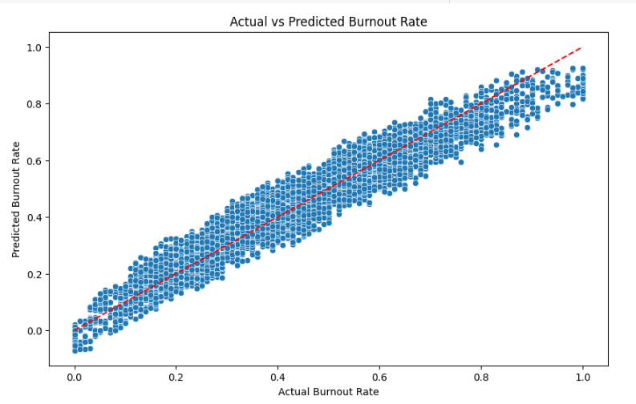
Customization and Personalization
The plot shows a generally linear trend where most points cluster around the red dashed line, suggesting that the linear regression model is reasonably capturing the relationship between the features and the burnout rate.
The project was customized by:
I have used different machine learning techniques to understand better about the trends of the dataset taken, in that Linear Regression technique stood out according to the dataset.
Based on this information I have attempted to visualize how the Predicted Values and the Actual Values differ with each other.
This visualization helps to evaluate the accuracy of the linear regression model by showing how close the predicted burnout rates are to the actual burnout rates. The closer the points are to the red dashed line, the better the model's predictions.

Slide 9
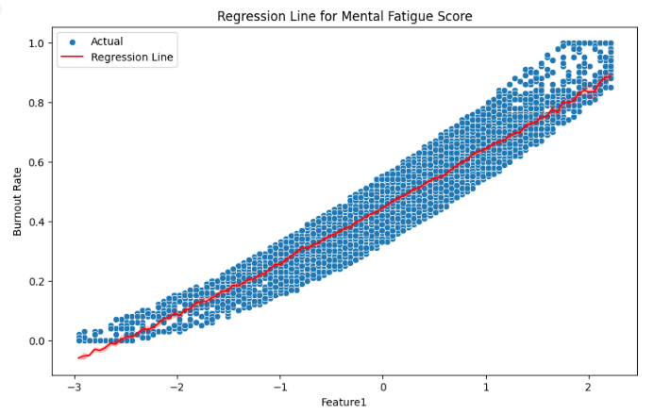
Personalization
Through the dataset the “Mental Fatigue Score” feature is the most crucial as it plays a important role in finding the burnout rate.
According to this I have visualized the “Mental Fatigue Score” with the “Burnout Rates”, this helps in understanding how both of them influence each other.
If the companies have other features that plays major role they can simply use that feature instead of “Mental Fatigue Score”.
This way organizations can understand what is causing the high burnout rate.
Through this they can make personalized recommendations to the employees.
The plot suggests that there is a generally linear relationship between the mental fatigue score and the burnout rate, as the points are clustered around the red regression line. This indicates that as the mental fatigue score increases, the burnout rate tends to increase as well.

Slide 10
Modeling
Supporting Techniques Used:
Feature Selection:
Included correlation analysis and dropping irrelevant columns to refine the model input.
Data Preprocessing:
Handling missing values, encoding categorical variables, and normalizing numerical features.
Model Evaluation Metrics:
Metrics used include Mean Squared Error (MSE), Root Mean Squared Error (RMSE), Mean Absolute Error (MAE), and R-squared (R²).
One-hot Encoding:
Transforms categorical features into binary vectors for model compatibility and improved accuracy.
Modeling Techniques Used:
Linear Regression:
Establish a linear relationship between independent variables (predictors) and the dependent variable (burnout score).
Support Vector Machine(SVM):
Utilized both Linear and RBF (Radial Basis Function) kernels for prediction and comparison with linear regression results.
Random Forest Regression:
Employed an ensemble learning technique to aggregate predictions from multiple decision trees for better accuracy.

Slide 11
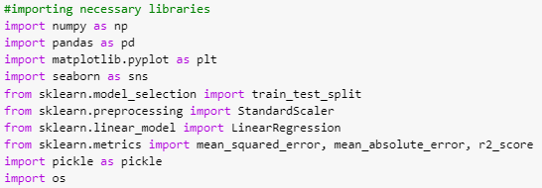
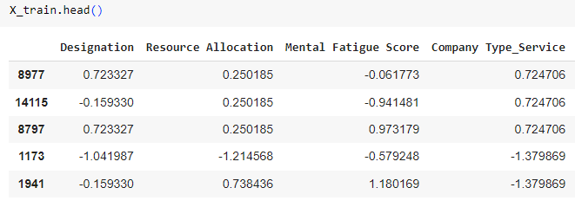
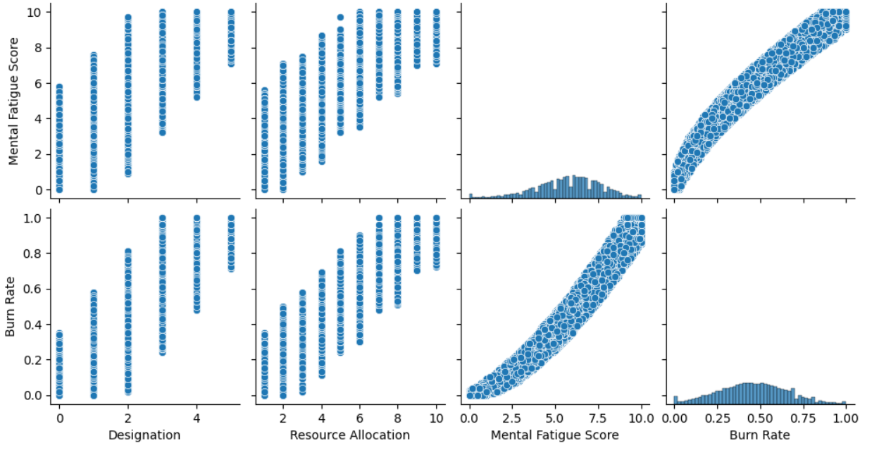

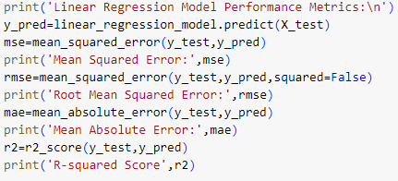
Modeling with linear regression
Importing Necessary Libraries
Exploratory Data Analysis
Data Preprocessing
Model Building

Slide 12
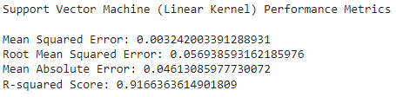
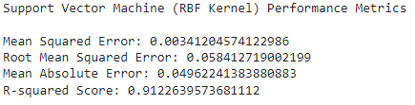
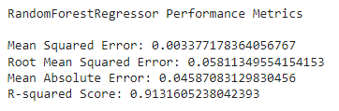
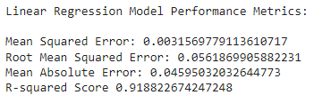
Result
Based on the evaluation metrics, the Linear Regression model appears to be the best model for predicting burnout analysis. So we are choosing this model for deployment.
It has the lowest mean squared error, root mean squared error, and mean absolute error, indicating better accuracy and precision in its predictions. Additionally, it has the highest R-squared score, indicating a good fit to the data and explaining a higher proportion of the variance in the target variable.

Slide 13
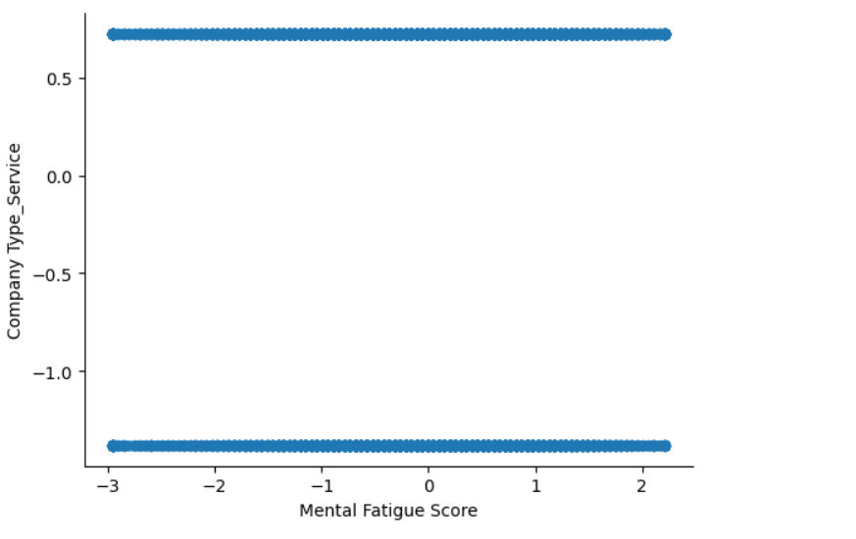
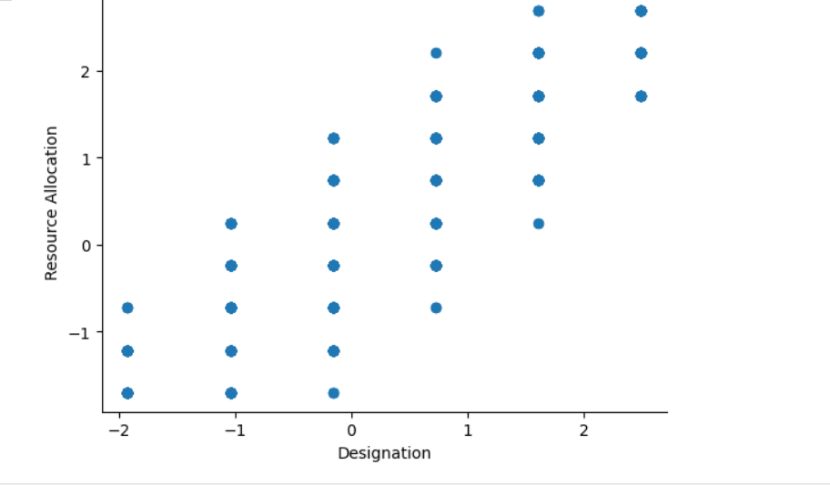
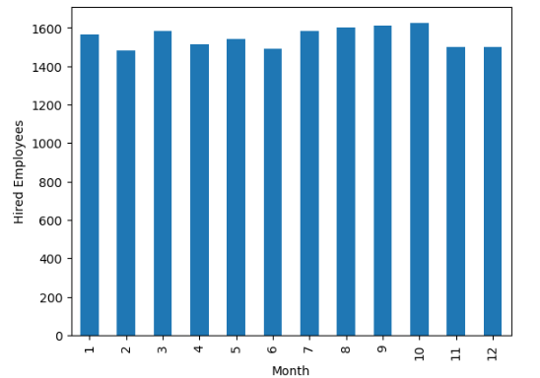
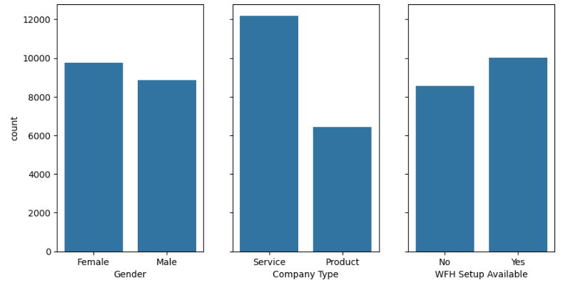
visualization

Slide 14
References
Links:
GitHub Link: https://github.com/21A91A05B3/APSSDC_AIML_PROJECT
https://www.geeksforgeeks.org/ml-linear-regression/
https://www.geeksforgeeks.org/support-vector-machine-algorithm/
https://www.geeksforgeeks.org/random-forest-regression-in-python/
https://www.kaggle.com/code/asanchezhernandez/employee-burnout-eda-and-prediction

