Slide 1
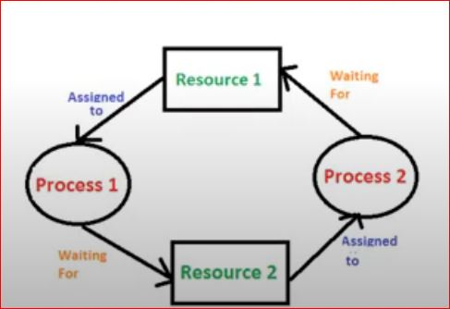
Deadlock
• A process requests resources for its execution,
• if the resources are not available at that time, the process enters a waiting state.
• Sometimes, the resources it has requested are held by other waiting processes, hence the current process never changes its (waiting) state.
• This situation is called a Deadlock.

Slide 2
Resources - System Model
• A system consists of a finite number of resources, to be distributed among several competing processes.
• The resources may be partitioned into several types, each consisting of some number of identical instances.
• CPU cycles, files, and I/O devices (such as printers and DVD drives) are examples of resource types.

Slide 3
Resources - System Model
• If a system has two CPUs, then the resource type CPU has two instances.
• Similarly, the resource type printer may have five instances.
• If a process requests an instance of a resource type, the allocation of any instance of the type should satisfy the request.
• If it does not, then the instances are not identical, and the resource type classes have not been defined properly.

Slide 4
System Model - Sequence of Resource Utilization
• Under the normal mode of operation, a process utilize a resource in only the following sequence:
• 1. Request.
• The process requests the resource.
• If the request cannot be granted immediately then the requesting process must wait until it can acquire the resource.
• 2. Use.
• The process can operate on the resource.
• 3. Release.
• The process releases the resource.

Slide 5
Necessary Conditions
• A deadlock situation can arise, if the following four conditions hold simultaneously in a system
• 1. Mutual exclusion.
• 2. Hold and wait.
• 3. No preemption.
• 4. Circular wait.

Slide 6
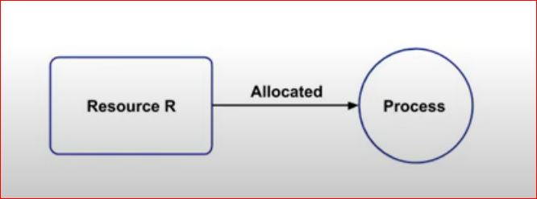
Mutual exclusion
• At least one resource must be held in a non sharable mode;
• that is, only one process at a time can use the resource.
• If another process requests that resource, the requesting process must wait until the resource has been released.

Slide 7
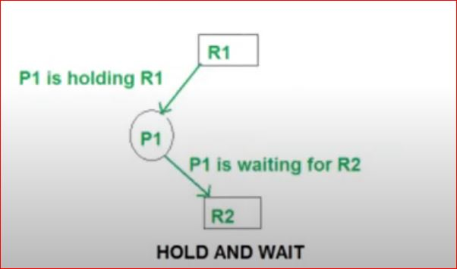
2. Hold and wait
• A process must be holding at least one resource and
• waiting to acquire additional resources
• that are currently being held by other processes.

Slide 8
3. No preemption.
• Resources cannot be preempted;
• that is, a resource can be released only voluntarily by the process holding it,
• after that process has completed its task.

Slide 9
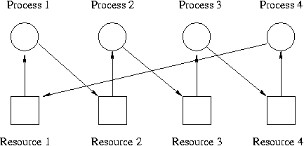
4. Circular wait.
• A set {P0, P1, ..., Pn] of waiting processes must exist
• such that P0 is waiting for a resource held by P1,
• P1 is waiting for a resource held by P2,...,
• Pn-1 is waiting for a resource held by Pn, and
• Pn is waiting for a resource held by P0.

Slide 10
Resource-Allocation Graph (RAG)
• A graph G consists of a set of vertices V and a set of edges E
• G={V,E)
• In Resource-Allocation Graph - RAG,
• V is partitioned into two types:
• P= (P1 P2, .., Pn), the set consisting of all the processes in the system
• R= {R1, R2 ..., Rm) the set consisting of all resource types in the system
• Two types of directed edge
• Request edge - directed edge Pi -> Rj
• Assignment edge - directed edge Rj -> Pi

Slide 11
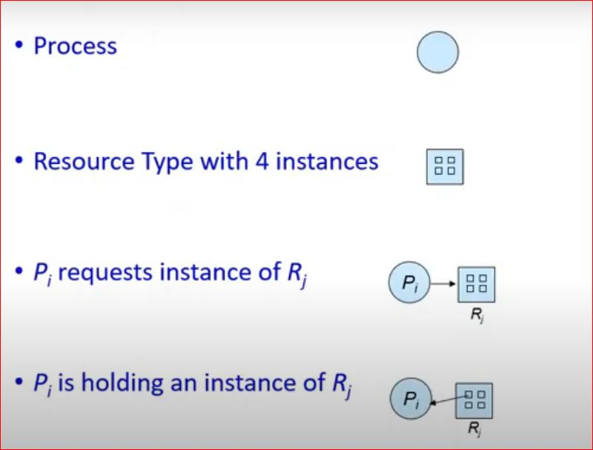
Resource-Allocation Graph (RAG)

Slide 12
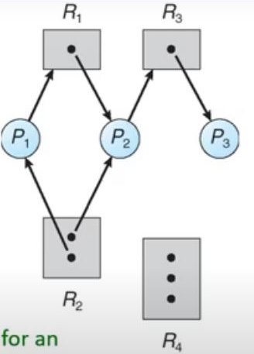
Resource-Allocation Graph (RAG)
• The sets P, R, and E:
• P = (P1, P2, P3)
• R = (R1, R2, R3, R4)
• E = (P1 -> R1, P2 -> R3, R1 -> P2, R2 -> P2, R2 -> P1, R3 -> P3)
• Resource instances:
• One instance of resource type R1
• Two instances of resource type R2
• One instance of resource type R3
• Three instances of resource type R4
• Process states:
• Process P1 is holding an instance of resource type R2 and is waiting for an instance of resource type R1
• Process P2 is holding an instance of R1 and an instance of R2 and is waiting for an instance of R3.
• Process P3 is holding an instance of R3.

Slide 13
Resource-Allocation Graph (RAG)
• If the graph contains no cycles, then no process in the system is deadlocked.
• In this graph, there is no cycle.
• The execution sequence of P1, P2 and P3 are
• 1. P3 executes first, then it releases the R3
• 2. R3 then assigned to P2, hence P2 completes its execution
• Then it releases the resources R1, R2 and R3
• 3. Now R1 assigned to P1, and P1 completes its execution.

Slide 14
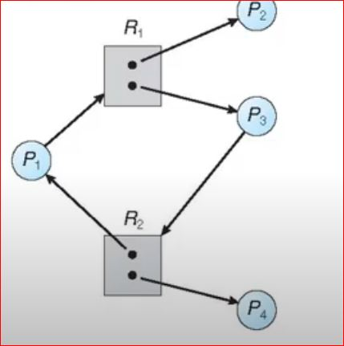
Graph With A Cycle But No Deadlock
• The execution sequence of P2,P1, P4 and P3

Slide 15
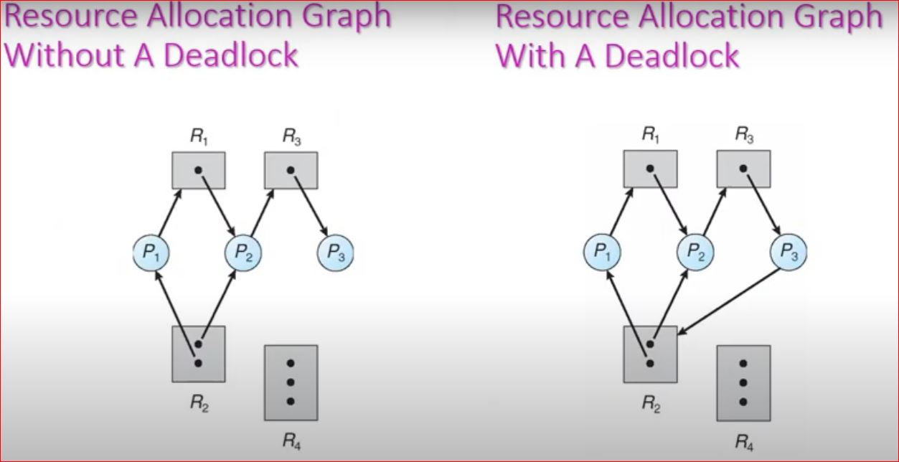

Slide 16
Basic Facts identified from Resource Allocation Graph
• If graph contains no cycles =› no deadlock
• If graph contains a cycle =›
• if only one instance per resource type, then deadlock
• if several instances per resource type, possibility of deadlock

