Slide 1
• A process is a program in execution.
• A program is a passive entity, but a process is an active entity
• A program becomes a process when an executable file is loaded into memory, by two ways
• By double-clicking an icon representing the executable file and
• entering the name of the executable file on the command line.
• A system consists of a collection of processes:
• Operating system processes executing system code and
• user processes executing user code.
• all these processes can execute concurrently, with the CPU (or CPUs).
• by switching the CPU between processes,
• hence, the CPU utilization increased.

Slide 2
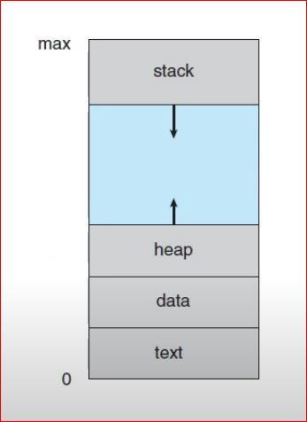
Structure of Process in Memory
• Process is otherwise called as Job or Task
• A process is more than the program code, which is sometimes known as the text section.
• The program counter and the contents of the processor's registers.
• A process includes the process stack, which contains temporary data (such as function parameters, return addresses, and local variables), and
• a data section, which contains global variables.
• A process includes a heap, which is memory that is dynamically allocated during process run time.

Slide 3
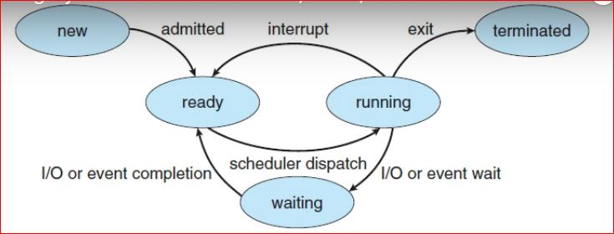
Process State
• As a process executes, it changes state. The state of a process is defined in part by the current activity of that process.
• New. The process is being created.
• Ready. The process is waiting to be assigned to a processor.
• Running. Instructions are being executed.
• Waiting. The process is waiting for some event to occur (such as an I/0 completion or reception of a signal).
• Terminated. The process has finished execution.

Slide 4
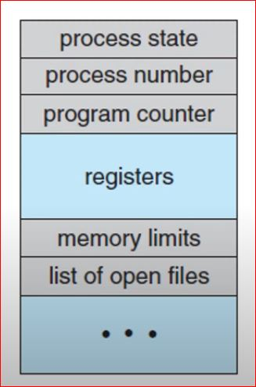
Process Control Block
• Each process is represented by a process control block (PCB)-also called a task control block.
• The PCB contains
• Process state
• Program counter
• CPU registers
• CPU-scheduling information
• Memory-management information.
• Accounting information
• I/O status information

Slide 5
Threads
• Thread is nothing but light weight process.
• When a process is running a word-processor program, a single thread of instructions is being executed.
• The user cannot simultaneously type in characters and run the spell checker within the same process, for example.
• A process may have multiple threads and executes more than one task at a time.
• This feature is especially beneficial on multicore systems, where multiple threads can run in parallel.
• On a system that supports threads, the PCB is expanded to include information for each thread.

Slide 6
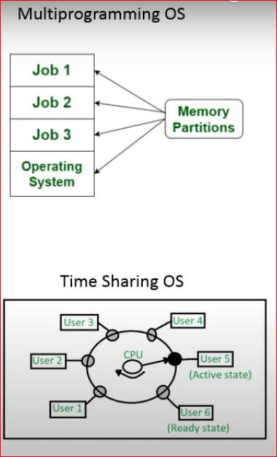
Process Scheduling
• The objective of multiprogramming is to have some process always running, to maximize CPU utilization.
• The objective of time sharing is to switch the CPU among processes so frequently, that users can interact with each program while it is running
• To meet these objectives, the process scheduler selects an available process to execute on the CPU.
• If there are more processes, the rest will wait until the CPU is free.
• Eg. Running Java Programming, Media Player and Chrome to download eclipse at the same time

Slide 7
Scheduling Queues
• As processes enter the system, they are put into a job queue (process queue), which consists of all processes in the system.
• Two types of queues
• 1. Ready Queue
• 2. Device Queue.
• The processes that are residing in main memory and are ready and waiting to execute are kept on a list called the ready queue.
• The list of processes waiting for a particular 1/O device is called a device queue.
• Each device has its own device queue (magnetic tape, disk, I/O devices etc.)

Slide 8
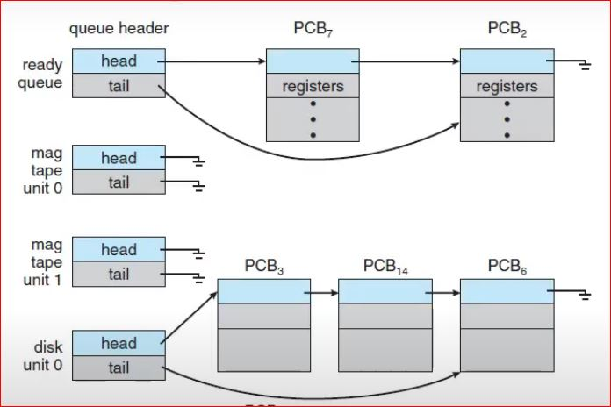
The ready queue and I/O Device queue
• This queue is generally stored as a linked list.
• A queue header contains pointers to the first and final PCBs in the list.
• Each PCB includes a pointer field that points to the next PCB in the ready queue.

Slide 9
Schedulers
• A process migrates among the various scheduling queues throughout its lifetime.
• The selection process is carried out by the appropriate scheduler.
• Three types of schedulers
• 1. Short term scheduler,
• 2. Long term scheduler and
• 3. medium term schedulers.
• The short-term scheduler, or CPU scheduler, selects the processes that are ready to execute and allocates the CPU.
• These processes are spooled to a mass-storage device, where they are kept for later execution.
• The long-term scheduler, or job scheduler, selects processes from this pool and loads them into memory for execution.

Slide 10
Medium-term Scheduler
• a medium-term scheduler to remove a process from memory, to reduce the degree of multiprogramming.
• Later, the process can be reintroduced into memory, and its execution can be continued where it left off.
• This scheme is called swapping.

Slide 11
Operations on Process
• The processes in most systems can execute concurrently, and they may be created and deleted dynamically.
• Hence, we have two operations
• 1. Process Creation
• 2. Process Termination (deletion)

Slide 12
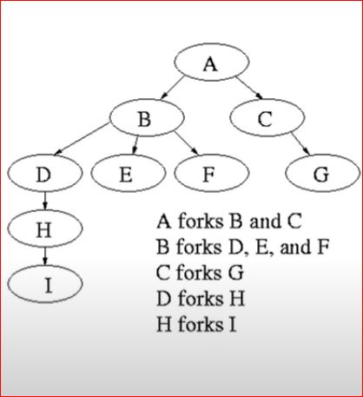
Process Creation
• During the process execution, a process may create several new processes.
• The creating process is called a parent process, and the new processes are called the children of that process.
• Each of these new processes may in turn create other processes, forming a tree of processes.
• Operating systems identify processes with a unique process identifier (or pid), which is typically an integer number.

Slide 13
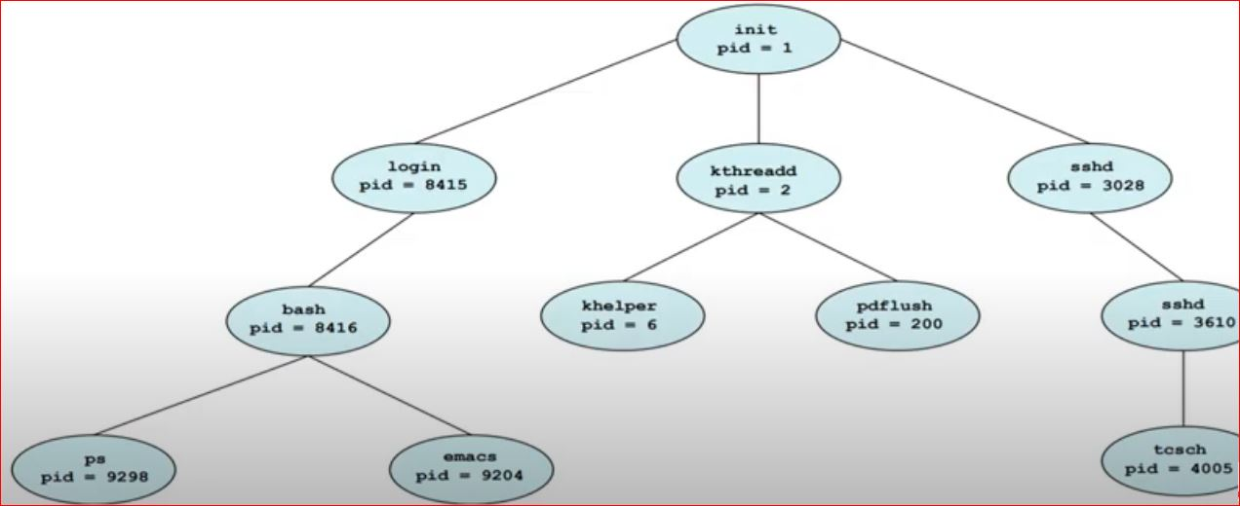
A tree of process on a typical Linux system

Slide 14
Resource allocation to child process
• When a process creates a child process, that child process will need certain resources (CPU time, memory, files, I/O devices) to accomplish its task.
• A child process may be able to obtain its resources directly from the operating system, or it may be constrained to a subset of the resources of the parent process.
• The parent may have to partition its resources among its children, or it may be able to share some resources (such as memory or files) among several of its children.

Slide 15
Process termination
• A process terminates when it finishes executing and asks the operating system to delete it by using the exit() system call.
• At that point, the process may return a status value (typically an integer) to its parent process (via the wait() system call).
• All the resources of the process-including physical and virtual memory, open files, and l/O buffers-are deallocated by the operating system.

Slide 16
Process termination
• A parent may terminate the execution of one of its children for a variety of reasons, such as these:
• The child has exceeded its usage of some of the resources that it has been allocated.
• The task assigned to the child is no longer required.
•The parent is exiting, and the operating system does not allow a child to continue if its parent terminates.
• If a process terminates (either normally or abnormally), then all its children must also be terminated.
• This phenomenon, referred to as cascading termination, is normally initiated by the operating system.

Slide 17
• Processes executing concurrently in the operating system may be either independent processes or cooperating processes.
• Independent process: if the process that cannot affect or be affected by the other processes executing in the system.
• Any process that does not share data with any other process, is independent.
• Cooperating process: if it can affect or be affected by the other processes executing in the system.
• Clearly, any process that shares data with other processes is a cooperating process.

Slide 18
Need of Inter Process Communication
• There are several reasons for providing an environment that allows process cooperation:
• Information sharing.
• Since several users may be interested in the same piece of information (a shared file), we must provide an environment to allow concurrent access to such information.
• Computation speedup.
• If we want a particular task to run faster, we must break it into subtasks, each of which will be executing in parallel with the others, is called multiple processing
• Convenience.
• Even an individual user may work on many tasks at the same time. For instance, a user may be editing, listening to music, and compiling in parallel.

