Slide 1
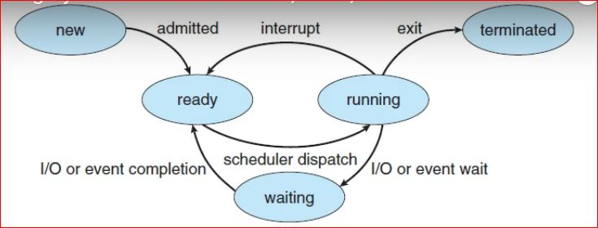
CPU Utilization
• In a single-processor system, only one process can run at a time.
• Others must wait until the CPU is free and can be rescheduled.
• A process may require I/O during execution, hence it must wait, for the completion of I/O request.
• CPU scheduling is central to operating-system design.

Slide 2
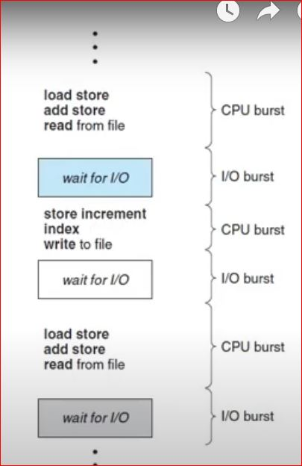
CPU Burst and I/O Burst cycle
• Process execution consists of a cycle of CPU execution and I/O wait.
• Process execution begins with a CPU burst. (the time taken to complete CPU Execution)
• That is followed by an I/O burst, (Time taken for completing I/O request) which is followed by another CPU burst, then another I/O burst, and so on.
• The final CPU burst ends with a system request to terminate execution

Slide 3
CPU Scheduler - Short-term Scheduler
• Whenever the CPU becomes idle, the operating system must select one of the processes in the ready queue to be executed.
• The selection process is carried out by the short-term scheduler, or CPU scheduler.
• a ready queue can be implemented as various scheduling algorithms like a FIFO queue, a priority queue, a tree, or simply an unordered linked list.

Slide 4
Non-preemptive Scheduling
• In non-preemptive mode, once if a process enters running state, it continues to execute until it terminates or blocks itself to wait for Input/Output or by requesting some operating system service.
Preemptive Scheduling
• In preemptive mode, currently running process may be interrupted and moved to the ready State by the operating system.

Slide 5
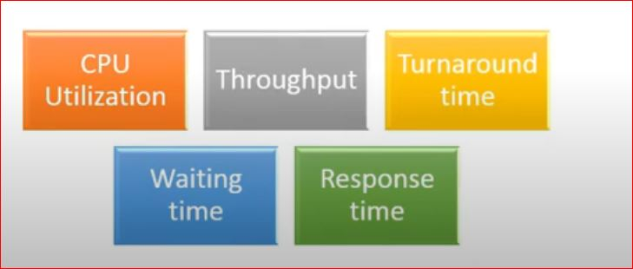
Properties of Scheduling algorithm
• Scheduling criteria is also called as scheduling methodology.
• Different CPU scheduling algorithm have different properties.
• The criteria used for comparing these algorithms include the following:

Slide 6
CPU Utilization:
• Keep the CPU as busy as possible, by scheduling more processes continuously.
• It range from 0 to 100%. In practice, it range from 40 to 90%.
Throughput:
• Throughput is the rate at which processes are completed per unit of time.
• i.e. number of processes executed by CPU per unit of time.
• For long processes, this rate may be one process per hour;
• for short transactions, it may be ten processes per second.

Slide 7
Turnaround time
• This is the how long a processor takes to execute a process.
• It is calculated as the time gap between the submission of a process and its completion.
• Turnaround time = finish time - arrival time

Slide 8
Response time:
• Response time is different from turn around time,
• Response time is the time it takes to start responding from submission time.
• It is calculated as the amount of time it takes to start responding, not the time it takes to output the response.
• It is otherwise called as start time.

Slide 9
Waiting time:
• Waiting time is the sum of the time periods spent in waiting in the ready queue.
• Waiting time = start time - arrival time

Slide 10
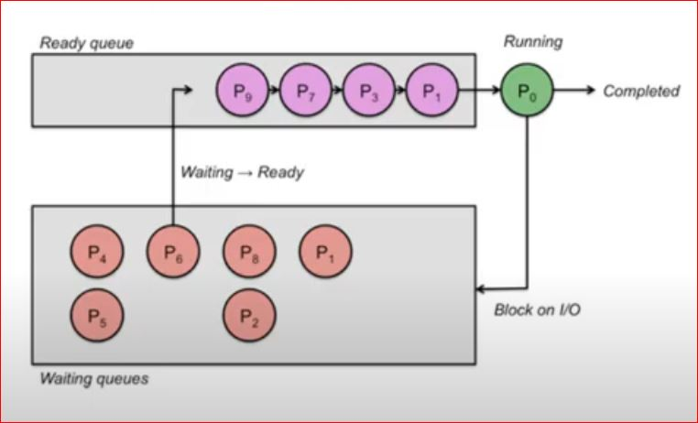
Optimum Scheduling Algorithm
• Max CPU utilization
• Max throughput
• Min turnaround time
• Min waiting time
• Min response time

Slide 11
CPU Scheduling Algorithms
• Scheduling algorithms or scheduling policies are mainly used for short-term scheduling, and assume only a single processor is present
• The main objective of short-term scheduling is to allocate CPU time to processes in optimized way.
• Scheduling algorithms decide, which of the processes in the ready queue is to be allocated to the CPU, is basis on the type of scheduling policy.
• The scheduling policy is either preemptive or non-preemptive.

Slide 12
List of scheduling algorithms are as follows
• First-come, first-served scheduling (FFS) algorithm - Non-Preemptive
• Shortest Job First Scheduling (SF) algorithm - Non-Preemptive
• Non-preemptive priority Scheduling algorithm - Non-Preemptive
• Shortest Remaining time (SRT) algorithm – Preemptive
• Preemptive priority Scheduling algorithm – Preemptive
• Round-Robin Scheduling algorithm – Preemptive
• Multilevel Queue Scheduling algorithm – Preemptive
• Multilevel Feedback Queue Scheduling algorithm - Preemptive

Slide 13
First-come, first-served scheduling (FCFS) algorithm
• First Come First Serve, is just like FIFO (First in First out) Queue data structure,
• where the process which comes first to the ready queue, is the one who served first by the CPU.

Slide 14
Shortest Job First Scheduling (SF) algorithm
• Shortest Job First (SJF) is an algorithm in which
• the process having the smallest execution time is chosen for the next execution.

Slide 15
Priority Scheduling algorithm
• Priority scheduling is a non-preemptive algorithm and one of the most common scheduling algorithms in batch systems.
• Each process is assigned a priority.
• Process with highest priority is to be executed first and so on.
• Processes with same priority are executed on first come first served basis.

Slide 16
Shortest Remaining time (ST) algorithm
• Shortest Remaining Time, SRT is a preemptive scheduling.
• In SRT, the process with smallest runtime to complete (i.e remaining time) is scheduled to run next, including new arrivals.

Slide 17
Round Robin Scheduling Algorithm
• Round Robin is the preemptive process scheduling algorithm.
• Each process is provided a fix time to execute, it is called a quantum.
• Once a process is executed for a given time period, it is preempted, and other process executes for a given time period.
• Context switching is used to save states of preempted processes.

Slide 18
Multilevel Queue Scheduling algorithm
• Multilevel queue scheduling, in which the processes in the ready state are divided into different groups,
• each group having its own scheduling needs.
• The ready queue is divided into different queues according to different properties of the process like memory size, process priority, or process type.
• All the different processes can be implemented in different ways, i.e., each process queue can have a different scheduling algorithm.

Slide 19
Multilevel Feedback Queue Scheduling algorithm
• In a multilevel queue-scheduling algorithm, processes are permanently assigned to a queue on entry to the system and processes are not allowed to move between queues.
• This setup has the advantage of low scheduling overhead,
• But on the other hand, disadvantage of being inflexible.
• Multilevel Feedback Queue Scheduling (MLFQ) keeps analyzing the behavior (time of execution) of processes and according to which it changes its priority.

