Slide 1

COLLEGE WEBSITES MAINTENANCE TRACKING SYSTEM
TEAM 42 :
BINDHU MADHAVI
VIVEK REDDY
DURGA BHAVANI
RAMA KISHORE REDDY
SAI SRAVANTHI
LAKSHMI ANUSHA

Slide 2
PROBLEM STATEMENT IDENTIFIED:
Struggling to find a suitable platform for centralized maintenance tracking across multiple college websites, spanning various levels of abstraction and user access through logins.
Monitoring the maintenance of diverse college websites entails the development of a web platform utilizing HTML, CSS, Mongo DB and React JS, with deployment facilitated through the Azure cloud platform.

Slide 3
BENEFITS :
Optimal Performance
Efficiency in Task Delegation
Clear Communication
Automated Notifications
Comprehensive Monitoring
Centralized Management
Regular Updation
Efficient Data Organization
Time Saving
Clear login abstraction

Slide 4
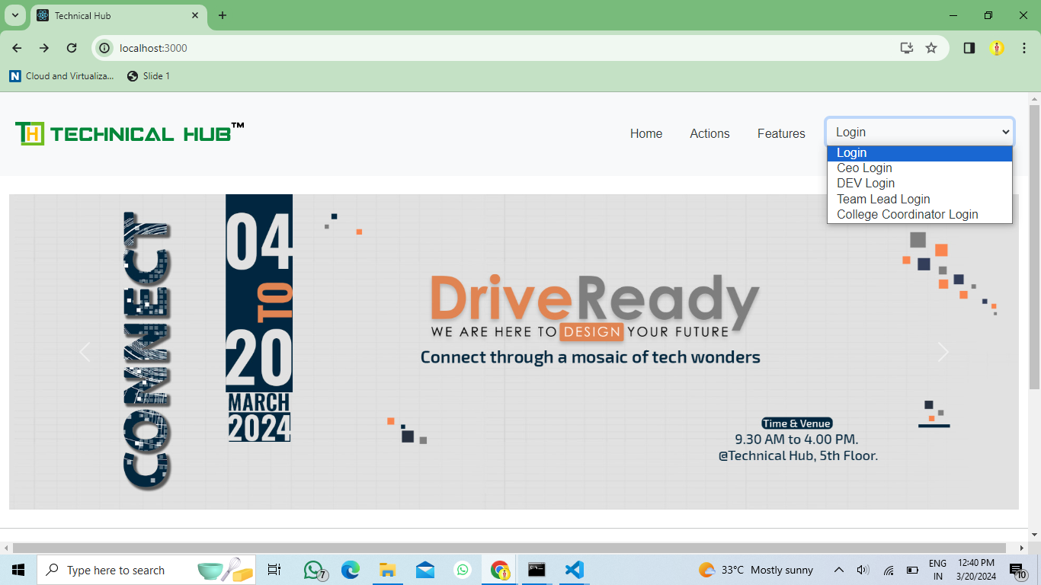
IMPLEMENTATION :

Slide 5
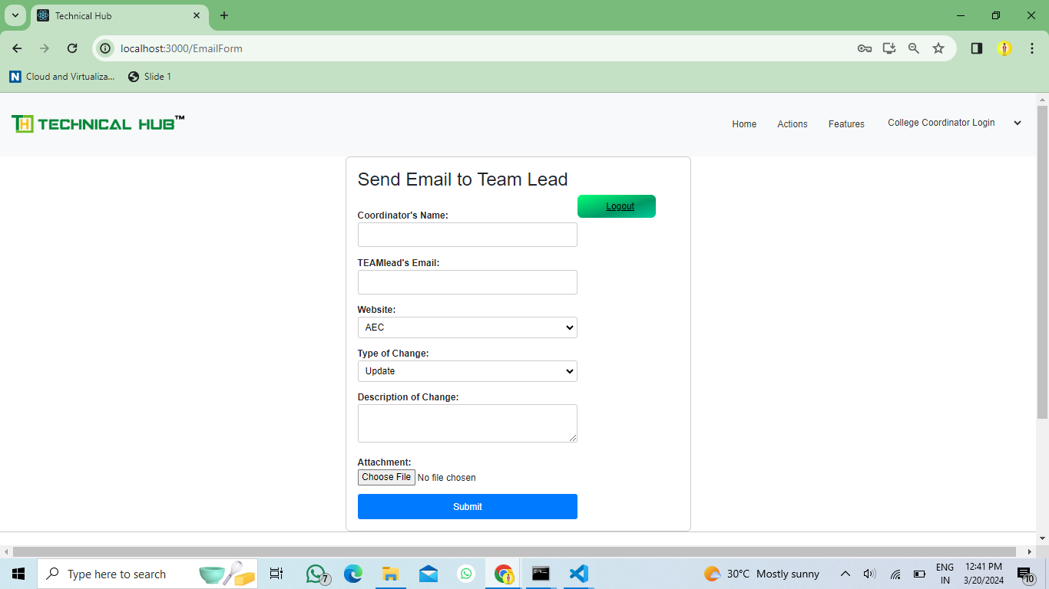

Slide 6
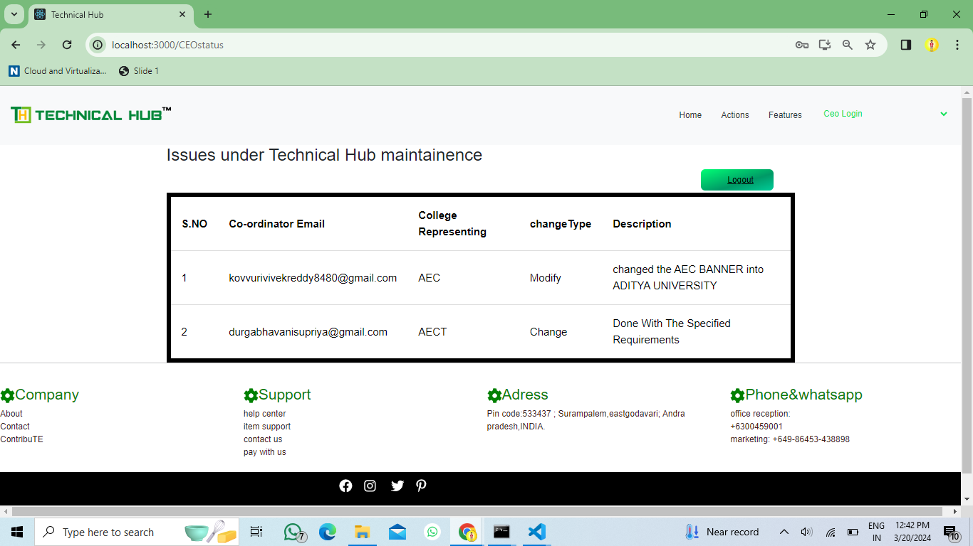

Slide 7
ABOUT :
Our website facilitates four different user roles: Admin, Developer, Team Lead, and Coordinator. The Coordinator, an authenticated end user, submits requests to include or exclude specific features from various college websites, such as AEC, ACET, AEOC, Pharmacy, and Diploma.
These requests are then assigned to the Team Lead, who delegates the task of modifying the websites to the Developer. The Developer is responsible for implementing necessary changes to both the frontend and backend of the websites. Upon completion of the task, an email notification is sent to the Coordinator who initiated the request.

Slide 8
CONCLUSION :
Our website is responsible for maintaining and organizing the data associated with each website, ensuring smooth and efficient operations.
The core functionality of our website revolves around managing and maintaining a variety of websites listed within our system. It serves as an intermediary between users, specifically coordinators and developers, facilitating communication and task delegation.
Additionally, our platform tracks and monitors all changes made to these websites, providing regular updates on the progress and status of tasks to coordinators.

Slide 9


