Slide 1
DATA BACKUP
ASSISTANT
TEAM MEMBERS:
SYAM SANKAR
SAI SANTOSH
SUBBA REDDY
SAI SAKETHRAM
HARATHI
CHARISHMA

Slide 2

INTRODUCTION
The AWS Backup Assistant project is a comprehensive solution designed to streamline and optimize data backup processes within Amazon Web Services (AWS) infrastructure. By leveraging AWS services such as AWS Backup, Lambda functions, and CloudWatch Events, the project aims to automate backup tasks, enhance data protection, and minimize downtime.
Key features may include automated backup scheduling, customizable retention policies, and integration with AWS monitoring services for proactive alerting. The project’s goal is to empower AWS users with a robust backup solution that is scalable, cost-effective, and easy to manage.

Slide 3

AN OVERVIEW OF THE PROBLEM
An overview of the problem for the AWS Backup Assistant project is the complexity and manual effort involved in managing backups for AWS (Amazon Web Services) resources. This includes challenges such as scheduling backups, ensuring data integrity, defining retention policies, and orchestrating disaster recovery processes.
It introduces the idea that there is a specific issue or challenge that needs to be addressed or understood. It sets the stage for further explanation or discussion about the problem at hand.

Slide 4
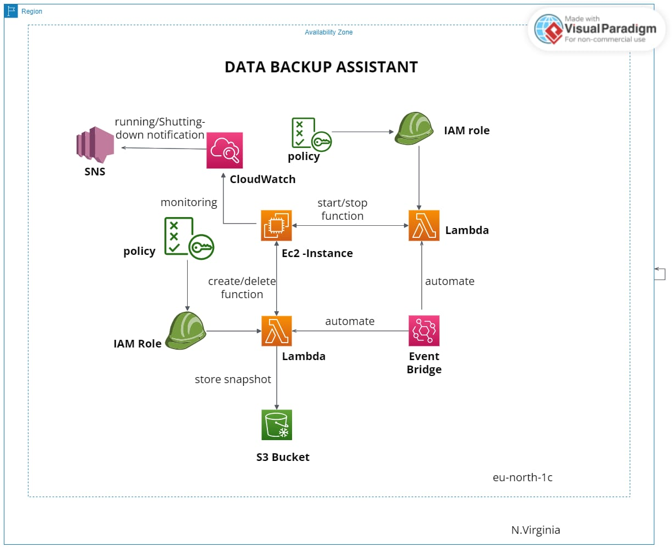
Architecture
The AWS databackup assistant project architecture is built upon a cloud-native framework, leveraging Amazon Web Services’ robust infrastructure. It incorporates scalable storage solutions like Amazon S3 for data storage and retrieval. Automated backup processes are orchestrated using AWS Lambda functions, ensuring efficiency and reliability. Data encryption and access control mechanisms are implemented to maintain security and compliance standards.

Slide 5
Our Expected Growth Path
Ensuring the backup assistant can seamlessly handle increased data volumes & user demand without compromising performance
Scalability
Continuously adding new features and capabilities to enhance the backup assistant’s functionality
feature Expansion
Integrating the backup assistant with other AWS services or third-party tools to streamline workflows
Integration
Increasing automation capabilities to minimize manual intervention, optimize resource utilization, and improve overall efficiency
Automation

Slide 6
Sending Alerts
Cost Effective
What We Are Looking To Achieve
Automated process
Automated Server Maintenance

Slide 7




AWS SERVICES USED:
The services that played crucial roles in implementing the Data Backup Assistant include AWS Lambda and AWS CloudWatch for maintaining servers, AWS IAM for creating roles, AWS Backup for automating snapshots, and Amazon SNS for notifications, all contributing to the development of a comprehensive data backup solution.
EC2
Lambda
Eventbridge
SNS

Slide 8



CloudWatch can monitor your S3 bucket for any changes or anomalies in data activity. S3 buckets serve as the storage destination for your backups, securely storing your data. IAM ensures proper access control, managing permissions for users interacting with the backup system. Together, CloudWatch, S3, and IAM form a robust framework for efficient and secure data backup operations in AWS.
In summary,EC2 instances can run backup scripts, Lambda functions automate tasks like data transfer to S3 buckets, snapshots provide point-in-time backups for volumes, and SNS delivers notifications on backup status and errors
CloudWatch
S3 Bucket
IAM

Slide 9


Technology Stack
AWS SERVICES Like EC2,Lambda, Cloud watch, Event Bridge
AWS SNS Service
PYTHON

Slide 10
ADVANTAGES:
Fast Response And Recovery
Security & compliance
Automated Backups &Cost Effectiveness
Scalability &Reliability
Monitoring And Logging
Serverless Architecture

Slide 11
PROJECT WORKFLOW
Data Identification: Identify data sources and determine what needs to be backed up, including databases, files, and configurations.
Backup Configuration: Configure backup settings such as frequency, retention policies, and encryption options for each data source.
Execution and Transfer: Execute backup processes according to the configured settings, transferring data securely to designated S3 buckets or storage locations.
Monitoring and Notification: Monitor backup operations for errors or anomalies using CloudWatch, and set up notifications via SNS to alert stakeholders of backup status and any issues that may arise

Slide 12
CODE SNIPPET
// To Start the instance
Import boto3 region = ‘eu-north-1’ instances = [‘i-0be702762a2bc8b2a’] ec2 = boto3.client(‘ec2’, region_name=region) def lambda_handler(event, context): ec2.start_instances(InstanceIds=instances) print(‘started your instances: ‘ + str(instances))
// To Stop the Instance
Import boto3 region = ‘eu-north-1’ instances = [‘i-0be702762a2bc8b2a’] ec2 = boto3.client(‘ec2’, region_name=region) def lambda_handler(event, context): ec2.stop_instances(InstanceIds=instances) print(‘stopped your instances: ‘ + str(instances))

Slide 13
USE CASES:
❖ Automated Data Backup ❖ Disaster Recovery ❖ Data Archiving ❖ Version Control ❖ Ransomware Protection ❖ Data Recovery from Cyber Attacks

Slide 14
ISSUES CONFRONTED
Complexity of Data Sources
Data Security and Compliance
Backup Frequency and Retention
Backup Validation and Recovery Testing
Cost Management

Slide 15
FUTURE ENHANCEMENTS
❖ Intelligent Backup Policies: Implementing AI or machine learning algorithms to analyze data usage patterns
❖Automated Disaster Recovery:Enhancing the backup assistant to automate the process of spinning up recovery environments and restoring data in the event of disasters or system failures, minimizing downtime and data loss.
❖ Cross-Cloud Backup Support: Extending backup capabilities to support data replication and backup across multiple cloud providers, providing customers with flexibility and resilience in their backup strategies.
❖ Enhanced Reporting and Analytics: Providing comprehensive reporting and analytics features to track backup performance, storage usage, compliance metrics

Slide 16
Conclusion
➢ In conclusion, the AWS databackup assistant project has achieved its objectives of improving data backup efficiency, reducing downtime, and enhancing data security. Through thorough evaluation, it has demonstrated superior performance in terms of speed, reliability, and scalability compared to previous backup methods.
➢ Cost analysis confirms its cost-effectiveness, considering factors such as storage costs and operational expenses. User feedback has been positive, highlighting the assistant’s ease of use and effectiveness. Recommendations for further enhancements have been made, ensuring the continued success of the AWS databackup assistant.

Slide 17


Slide 18


