Slide 1

BTC / USDT
QUANT TRADING · INTERNSHIP PROJECT 2026
CryptoSight
Quantitative Crypto Trading Platform
Afnan Shoukat
Presenter

Slide 2







OVERVIEW
What is CryptoSight?
This is a quant platform for crypto markets.
Data Ingestion
Indicators
Signal Engine
Backtesting & ML
Live Execution
Sentiment AI

Slide 3




THE CHALLENGE
The Problem
BEFORE
WITH CRYPTOSIGHT
Can't watch charts 24/7
Watches the market 24/7
Too many indicators to track manually
Auto-checks every signal & indicator
Signals missed = opportunities lost
Tests, executes, reports - one dashboard
Trades placed on gut feeling, not a tested strategy
Every strategy backtested on historical data first
No way to compare strategies before risking capital
Backtests across multiple assets to find what works

Slide 4




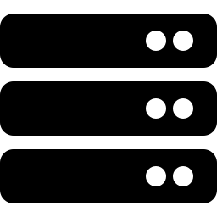
SYSTEM ARCHITECTURE
How It Works
Indicators
& Signals
Live
Execution
Market
Data
Dashboard
Backtest
& ML
Database

Slide 5
MY JOURNEY
What I Learned
Skills gained building CryptoSight from scratch.
Data Engineering
No Future Leakage
ML Pipeline
Clean, reliable market data
Backtests use only past data
From features to predictions
Risk Metrics
Sentiment AI
Live Trading
Sharpe, drawdown & more
Reads market mood from Reddit
Connects to a real exchange

Slide 6

FUTURE VISION
What We Can Add
4 ideas to make CryptoSight even smarter.
AI ENHANCEMENT
AI Copilot
Build strategies by typing in plain English
AI ENHANCEMENT
ENHANCEMENT
Signal Ranker
Multi-Exchange Support
Ranks trades by chance of winning
Connect and trade across more exchanges

Slide 7
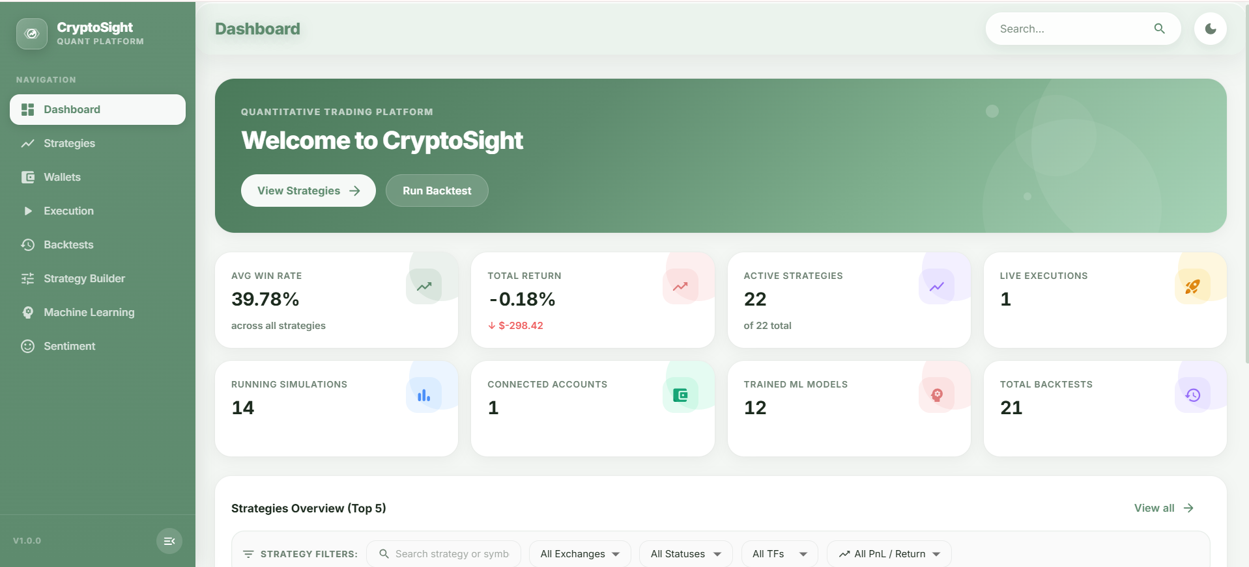
PRODUCT
Dashboard

Slide 8
CRYPTOSIGHT
Thank You
Questions?
Afnan Shoukat

