Slide 1

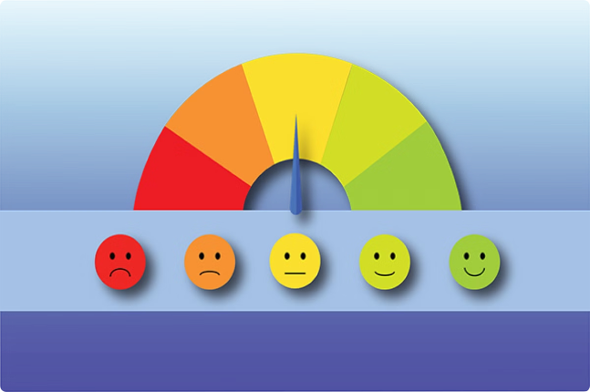
Sentiment Analysis on PUBG Reviews using LSTM Model

Slide 2
Overview of PUBG
PUBG is a popular multiplayer battle royale game that has gained significant importance in the gaming industry. It's known for its intense gameplay and realistic graphics, making it a favorite among gamers worldwide.
Importance of Player Sentiment
Understanding player sentiment is crucial for game developers to enhance user experience and engagement. By analyzing the feedback and emotions of players, developers can identify areas of improvement and make necessary changes to the game.

Slide 3
Project Objective
The objective of this project is to conduct sentiment analysis on PUBG reviews using NLP techniques and LSTM model. The analysis will help us gain insights into the players' emotions and opinions about the game, which can be used to improve the game's overall quality and performance.

Slide 4
Sentiment Analysis in Gaming Reviews
Supervised Learning Approaches: Utilized techniques like Support Vector Machines (SVMs) and Naive Bayes classifiers. Achieved good accuracy but relied on manually labeled training data. References: [Jin et al., 2016] and [Sha et al., 2009].
Lexicon-Based Approaches: Explored sentiment analysis using pre-defined sentiment lexicons. Language-dependent and may not capture nuanced sentiment. Reference: [Liu et al., 2012].
Deep Learning Techniques: Demonstrated effectiveness of models like Recurrent Neural Networks (RNNs) and LSTMs. Improved performance due to learning complex relationships within text data. References: [Zhang et al., 2018] and [Yao et al., 2019].

Slide 5
NLP Techniques for Sentiment Analysis: Tokenization, POS Tagging, Stemming/Lemmatization, Stop Word Removal, N-grams, and Word Embedding. Enhance understanding of sentence structure and capture semantic meaning for sentiment analysis.
Long Short-Term Memory (LSTM) Models: Well-suited for analyzing sequential data like text. Address the vanishing gradient problem in RNNs, capturing long-range dependencies. Benefits in sentiment analysis include: Learning Long-Term Dependencies, Contextual Understanding, and Effective Feature Learning.

Slide 6
Data Loading and Preprocessing
PUBG Review Data: Acquire PUBG review data from a suitable source, such as an online platform or database.
Initial Inspection: Begin by inspecting the data to understand its structure and format.
Feature Selection: Identify relevant features for sentiment analysis, such as review content, helpfulness ratings, and other metadata.
Text Preprocessing:
Convert to Lowercase: Ensure uniformity by converting all text to lowercase.
Tokenization: Split review content into individual words or tokens for further processing.
Stop Word Removal: Eliminate common stop words like "the", "a", and "is" to focus on meaningful content.
Stemming/Lemmatization: Reduce words to their base or dictionary form to normalize the text and improve consistency.
Other Preprocessing Steps: Depending on the specific requirements, additional preprocessing steps such as removing punctuation or special characters may be performed.

Slide 7
Vectorizing Text Data
When working with textual data, it's important to convert it into a numerical format that can be used for model training. This process is known as vectorization.
One common technique for vectorizing text is using TF-IDF (Term Frequency-Inverse Document Frequency) vectorization. This method represents the textual content numerically while preserving semantic meaning. It assigns weights to each word based on how often it appears in the document and how important it is in the entire corpus of documents. This allows the model to capture the context and meaning of the words, rather than just their frequency.
Vectorizing the text data is a crucial step in preparing it for input into the LSTM model for training. By representing the data numerically, the model can learn from it and make predictions based on the patterns it learns from the training data.

Slide 8
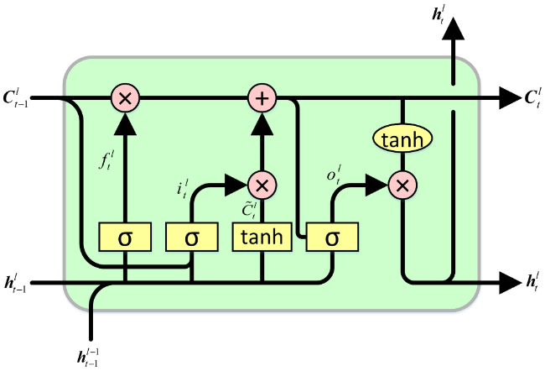
LSTM Model Architecture
Overview
The LSTM model utilizes a recurrent neural network architecture to analyze sentiment in PUBG reviews.

Slide 9
Layers
Embedding Layer: Converts the vectorized text data into a format suitable for input into the LSTM layers.
LSTM Layers: Implements the core functionality of the model by processing the input data and generating output sequences.
Fully Connected Layers: Transforms the output sequences into a binary sentiment prediction.
Parameters
Hidden Units: 128
Activation Function: Hyperbolic Tangent (tanh)
Dropout Rate: 0.2

Slide 10
Training and Evaluation
Training Process
The LSTM model is trained using the training data with the following settings:
Optimizer: Adam optimizer
Loss Function: Categorical cross-entropy
Number of Epochs: 10

Slide 11
Evaluation Metrics
The performance of the trained model on the testing data is assessed using the following evaluation metrics:
Accuracy
Precision
Recall
F1-score
Importance of Model Saving
It is crucial to save the trained LSTM model and TF-IDF vectorizer for future use. This allows for reusability and scalability of the sentiment analysis system.

Slide 12
Key Findings
Effective Sentiment Analysis: Implementing LSTM models for sentiment analysis on PUBG reviews yielded promising results, accurately categorizing player sentiments as positive, negative, or neutral.
Insights into Player Sentiment: Through sentiment analysis, valuable insights were gleaned regarding player satisfaction, preferences, and concerns across various aspects of PUBG gameplay and user experience.
Identification of Improvement Areas: The analysis pinpointed specific areas for potential enhancement, informed by player feedback and sentiments expressed in the reviews.

Slide 13
Implications
Informed Decision-Making for Developers: Sentiment analysis offers game developers data-driven insights into player sentiments, empowering them to make informed decisions on game updates, feature enhancements, and community engagement strategies.
Enhanced User Experience: Understanding player sentiments allows developers to address concerns and create a more enjoyable gaming experience, leading to increased player satisfaction and retention.
Community Engagement and Feedback: Sentiment analysis fosters constructive dialogue between developers and the gaming community, facilitating open communication, feedback collection, and collaborative efforts to improve the game based on player preferences.
Overall Impact
Empowering Developers: Leveraging sentiment analysis enables developers to respond effectively to player sentiments and proactively shape future developments in alignment with player expectations, fostering a stronger and more engaged gaming community around PUBG.

Slide 14
TEAM DETAILS :
K S H V Sai Hari Krishna 21bce8069
S Ganga Roshitha 21bce8691
Ch.Abhiram 21bce8707
D. Harsha Kundan 21bce7587
G Reena Rani 21bce8453
C L V Saradhi 21bce7816
Varshitha Gundluru 21bce7657
Saara Anand 21bce8156
Ram Kripalu Neelmani 21bce7201
Sanjana Mitra 21bce8418

