Slide 1
SURYA K.B 711721244056 III B.Tech CSBS KGiSL Institute of Technology
CAPSTONE PROJECT
STOCK PRICE PREDICTION
Final Project
Presented By
3/21/2024 Annual Review

Slide 2
PROJECT TITLE
STOCK PRICE PREDICTION
3/21/2024 Annual Review

Slide 3


AGENDA
1. Problem Statement
2. Project Overview
3. End Users
4. Solution and Value Proposition
5. The Wow Factor in Your Solution
6. Modelling
7. Results
3/21/2024 Annual Review

Slide 4

PROBLEM STATEMENT
Predicting stock prices is complex despite tools & data. Insights from forecasts empower decisions in finance.
3/21/2024 Annual Review

Slide 5

PROJECT OVERVIEW
The main aim of this project is to create a reliable predictive model for stock price forecasting, using advanced machine learning algorithms.
In the dynamic realm of financial markets, predicting stock prices is crucial for investors, traders, and analysts. Accurate predictions offer insights for informed decision-making, portfolio optimization, and risk management.
3/21/2024 Annual Review

Slide 6

WHO ARE THE END USERS?
Individual investors: Those managing personal investment portfolios.
Institutional investors: Entities like hedge funds, mutual funds, and pension funds.
Traders: Both day traders and swing traders seeking to capitalize on market movements.
Financial analysts: Professionals analyzing stock performance for investment recommendations.
Risk managers: Individuals responsible for assessing and mitigating financial risks.
Algorithmic trading systems: Automated systems executing trades based on predictive models
3/21/2024 Annual Review

Slide 7

YOUR SOLUTION AND ITS VALUE PROPOSITION
Employs advanced machine learning algorithms to examine past stock data, market trends, and pertinent variables, yielding precise forecasts of future stock movements.
Provides up-to-the-minute stock price forecasts, empowering users to stay abreast of market shifts and adapt their strategies promptly.
Facilitates customized alerts tailored to individual preferences, alerting users to specific stock price thresholds or forecast outcomes, facilitating timely responses to potential trading opportunities or risk management needs.
3/21/2024 Annual Review

Slide 8

THE WOW IN YOUR SOLUTION
Our platform integrates a dynamic learning engine that constantly adjusts and improves, absorbing insights from market behavior, user engagement, and current events to enhance its predictive accuracy progressively.
Going beyond raw data and forecasts, our platform offers intuitive insights that offer nuanced understanding and contextual analysis.
Picture having a personalized AI assistant attuned to your individual investment objectives, risk appetite, and preferences.
3/21/2024 Annual Review
8

Slide 9
MODELLING
A commonly used statistical technique for examining and predicting time-series data. It encompasses various elements of time series, including seasonality, trend, and noise.
A straightforward model that establishes a linear connection between dependent and independent variables.
A category of neural networks specifically crafted for sequential data, adept at capturing temporal relationships within time-series data.
3/21/2024 Annual Review
9

Slide 10
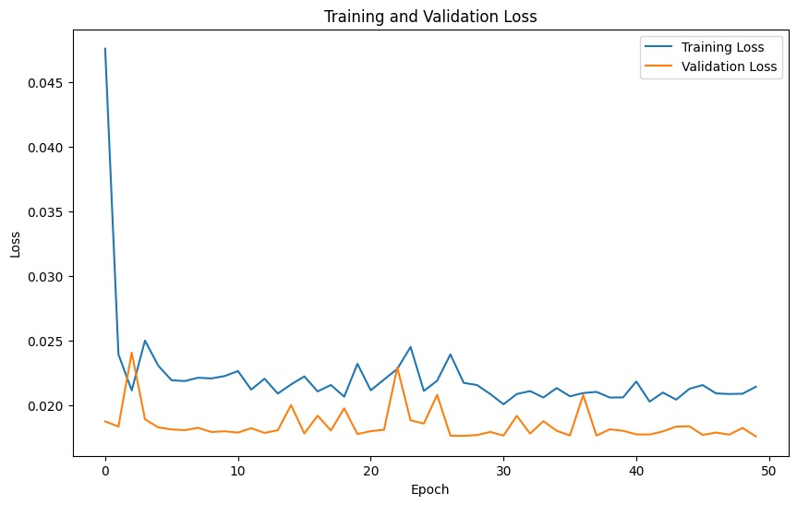
RESULTS
https://drive.google.com/file/d/1IrPQWM3xEQwQ4SzJk_tm11NFAVxCirzu/view?usp=sharing
3/21/2024 Annual Review
10

