Slide 1

What are soft skills anyway?
MGMT 1103

Slide 2

Soft skills

Slide 3
Definition

Slide 4

SOFTSKILL#1

Slide 5
Definition

Slide 6

SOFTSKILL#2

Slide 7
Definition

Slide 8

SOFTSKILL#3

Slide 9
Definition

Slide 10
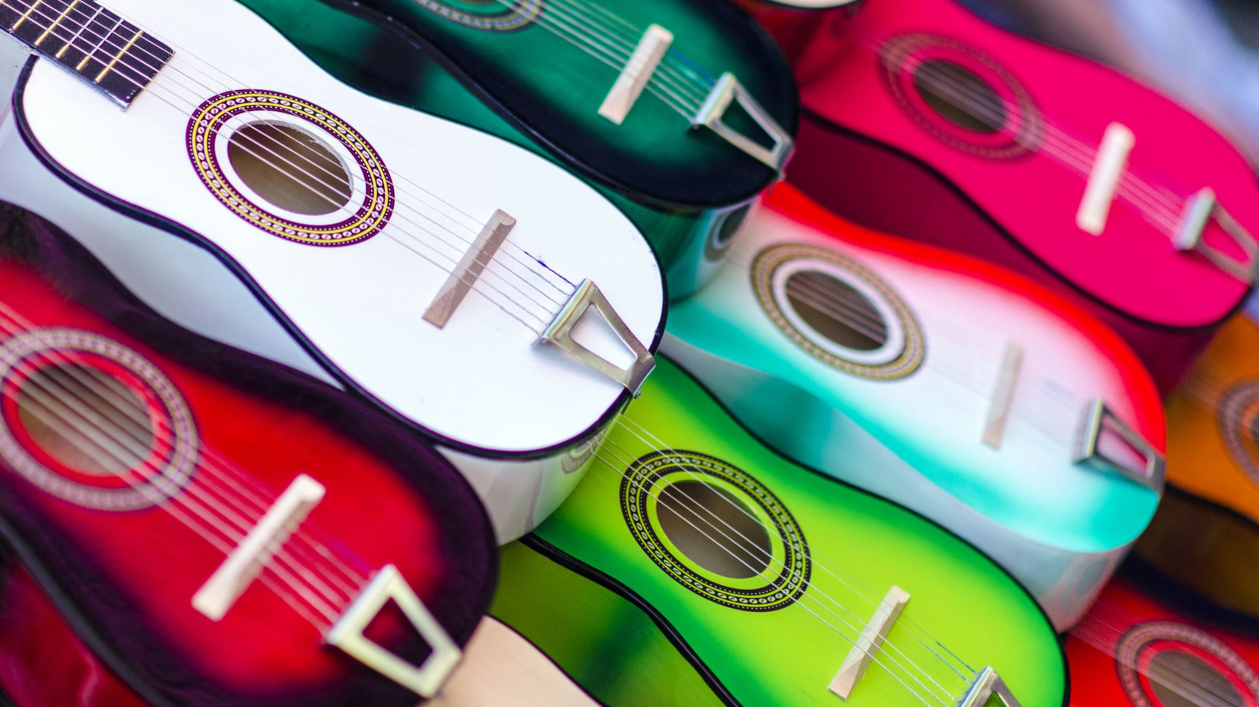
SOFTSKILL#4

Slide 11
Definition

Slide 12

SOFTSKILL#5

