Slide 1

SMART HEALTHCARE SYSTEM
Siddique umer, M Haadi, Ali Hamza | 21i-0519, 21i-0384, 21i-0846 | CS-C

Slide 2

AGENDA
Introduction of System
Architecture
Project Planner
User Stories
Testing
Further Improvements
Conclusion

Slide 3
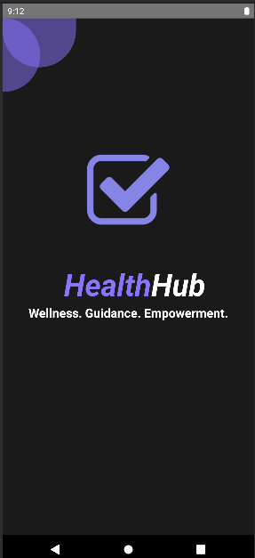
INTRODUCTION
Our project is a Smart HealthCare System called Health Hub
It is a Mobile application built using Kotlin, XML, Firebase and mysql.
It incorporates the use of external API such as Agora for it features.

Slide 4
Problems with existing systems.
Geographical constraints acts as a barrier in communication
Long wait times for appointments
Limited channels for communication between patients and providers.
Overwhelming and confusing health information online

Slide 5
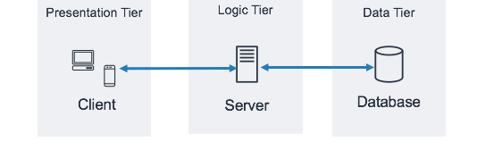
ARCHITECTURE
The Smart Health Care System has a three-tier layered architecture
presentation layer (XML)
business logic layer (kotlin)
database layer (mysql).

Slide 6
Modules:
Sign up / Login | Personalized Health Assessment | Lifestyle and Diet Advice | Consultation Scheduling
Participate in Wellness Challenges | Attend Online Virtual Classes | Fully Functional Chatting system with doctors | Search Functionality

Slide 7
USER STORIES
32 user stories in total
12 were implemented in 3 sprints
5 in Sprint 1
5 in Sprint 2
2 in Sprint 3

Slide 8
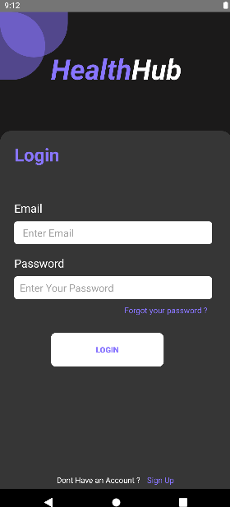
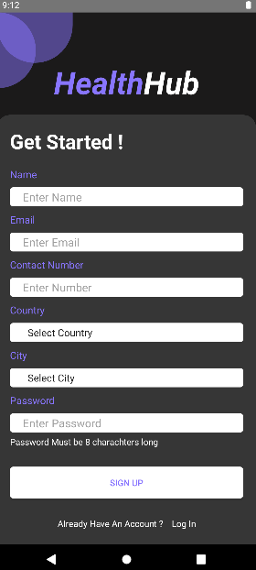
USER STORY 1
As a user
I want to create a HealthHub account
so that I can access personalized health features

Slide 9
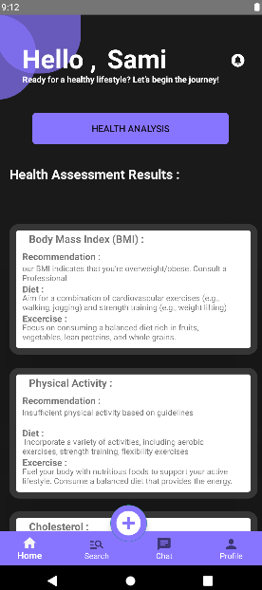
USER STORY 2
As a user,
I want to complete a personalized health assessment so
so that I can understand my current health status.

Slide 10
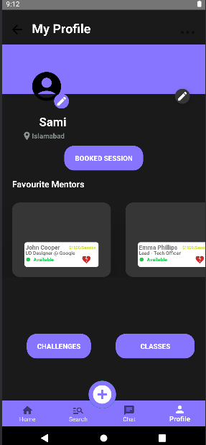
USER STORY 3
As a user,
I want to schedule a telehealth consultation with a doctor
so that I can have a virtual medical check-up.

Slide 11
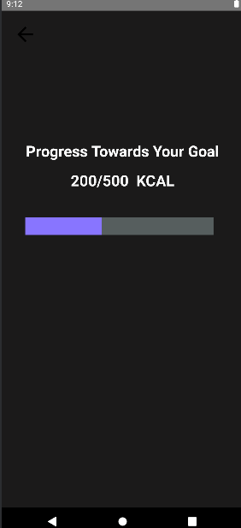
USER STORY 4
As a user,
I want ,to participate in wellness challenges on HealthHub
so that I can achieve health goals.

Slide 12
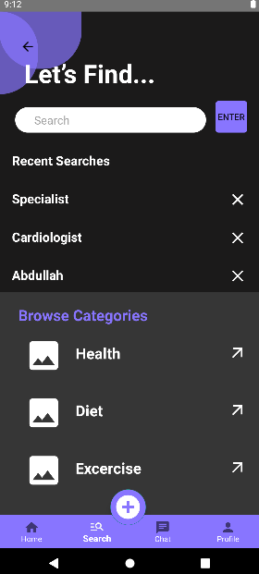
USER STORY 5
As a user,
I want a user-friendly interface on HealthHub that simplifies the process of managing my health information
so that I can easily navigate and manage my health data without any complexity.

Slide 13
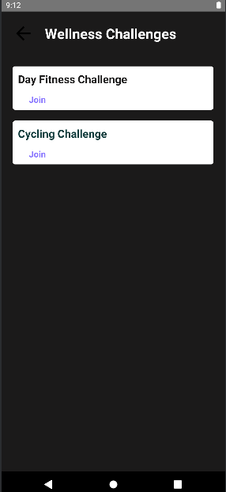
USER STORY 6
As a user,
I want HealthHub to offer a feature that allows me to book and attend virtual health and wellness classes and workshops
so that I can access relevant health resources and participate in educational events.

Slide 14
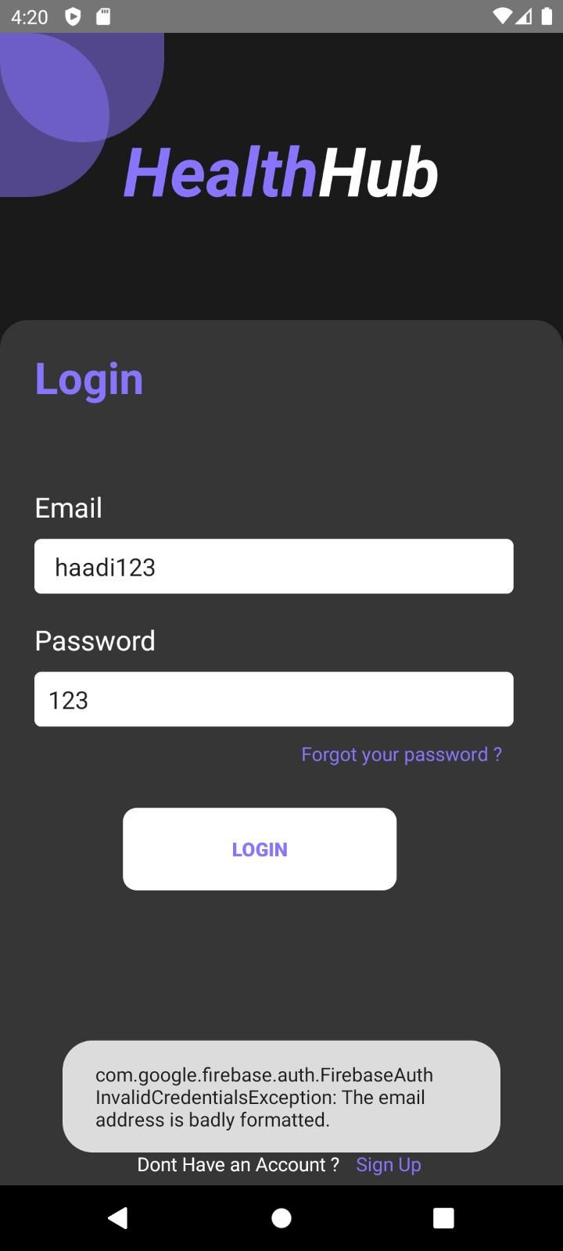
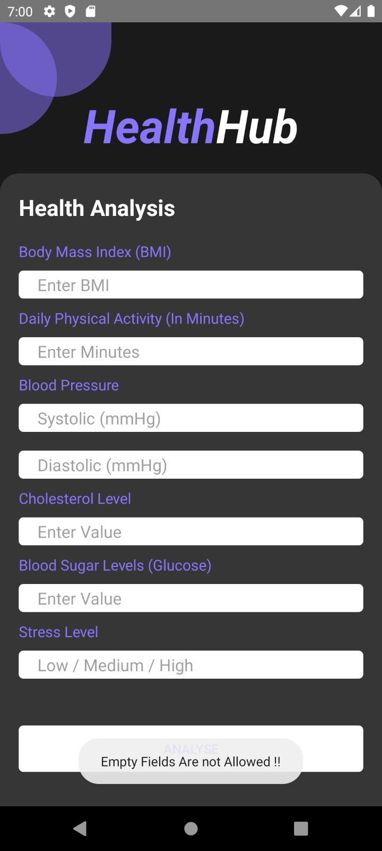
TESTING
We have done testing on all pages and have validated workings through expresso test cases.
We assigned different rules for different input.

Slide 15
Future Goals:
The product could have been improved further by doing the following:
The product can be improved by using more advanced technologies.
The Chat System could be made more efficient and complex e.g. sending videos , pictures , editing messages etc.
The product is just a Mobile app currently, it could be rolled out as a Web app further in the future.
Our App could also support offline data availability in the future

Slide 16
THANK YOU

