Slide 1
Secure data hiding in images using steganography
CAPSTONE PROJECT
Presented By:
Student Name : Kamini T
College Name & Department : Velalar College of Engineering and Technology – B.tech Information Technology

Slide 2
OUTLINE
Problem Statement
Technology used
Wow factor
End users
Result
Conclusion
Git-hub Link
Future scope

Slide 3
Problem Statement
Secure communication is at risk due to cyber threats and surveillance. Encrypted data can attract attention, making it a target for attacks. Steganography conceals information within digital media (images, audio, video) to keep it hidden. However, existing techniques face issues like low capacity and easy detection. This project aims to create a more effective steganography system for safe and hidden data transfer.

Slide 4
Technology used
Libraries
OpenCV
Numpy
Google.colab.files
Google.colab.patches.cv_imshow
Platform
Google Colab

Slide 5
Wow factors
LSB Steganography for Secure Data Hiding – Uses the Least Significant Bit (LSB) method to embed a secret message within the image pixels without noticeable changes.
Automated Encryption & Decryption – Converts text into binary, hides it in an image, and extracts it later using a simple and efficient algorithm.
Google Colab Integration – Supports file upload, processing, and download within Google Colab, making it easy to use without additional software installation.

Slide 6
End users
Cybersecurity Professionals
Journalists & Activists.
Government & Military Personnel
Individuals Concerned with Privacy
Digital Watermarking & Copyright Protection

Slide 7
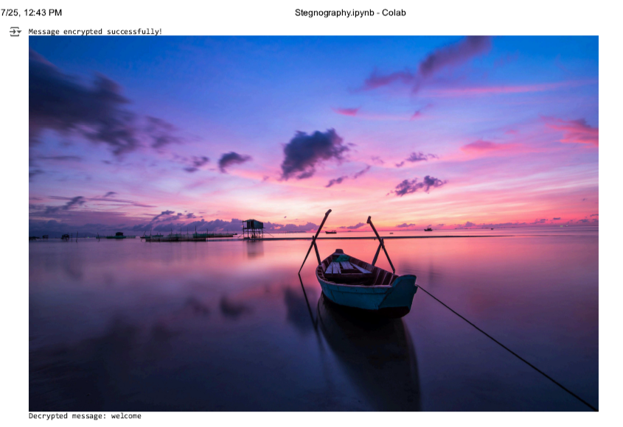
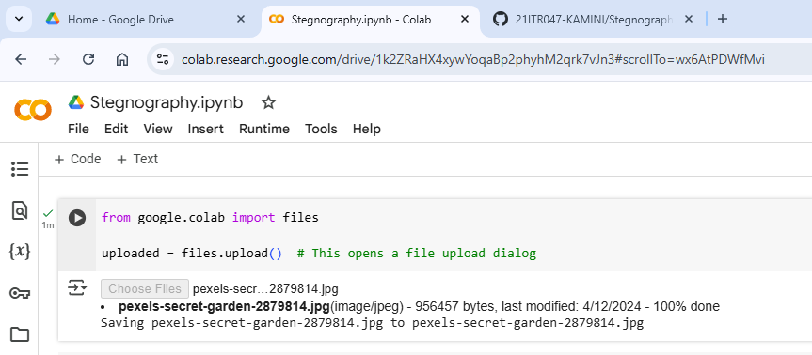
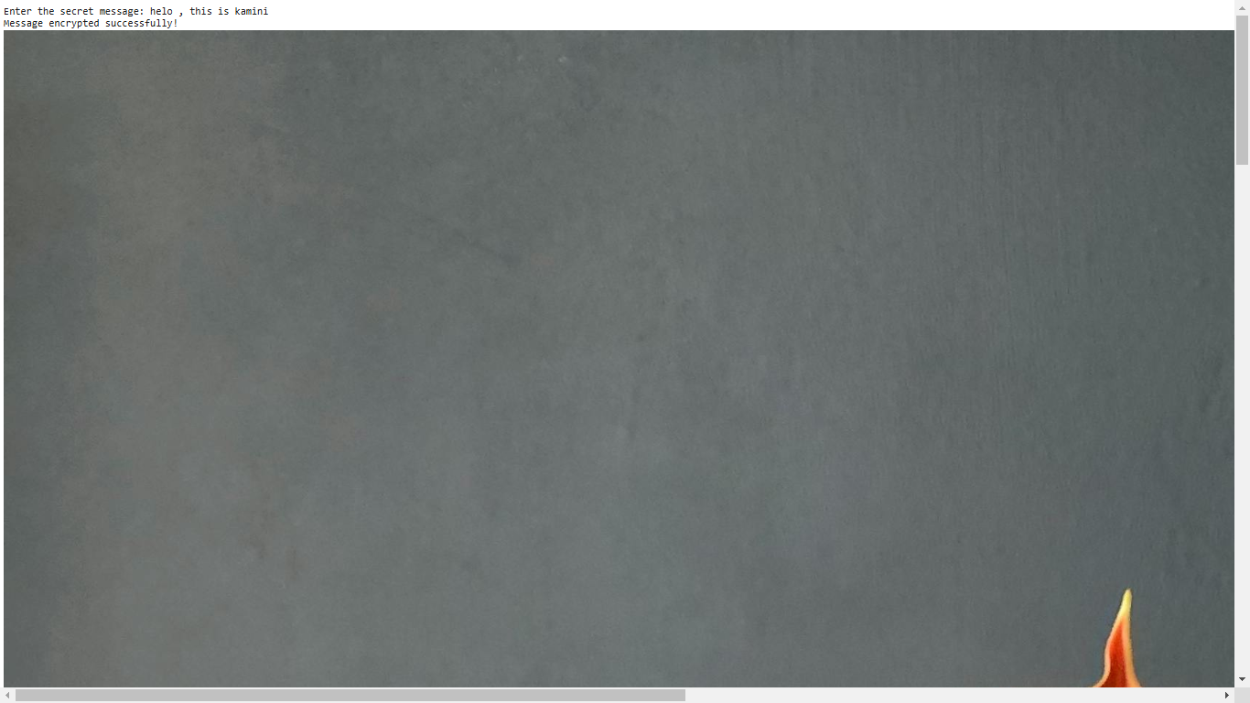
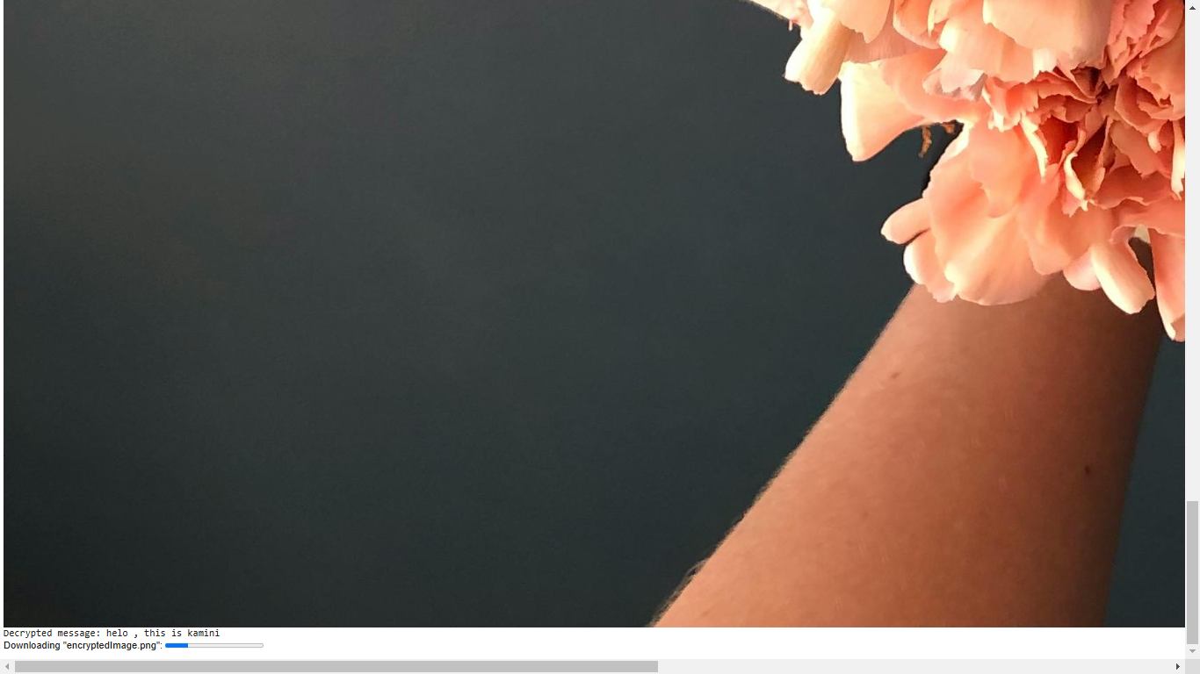
Results

Slide 8
Conclusion
This project provides a simple and effective way to hide secret messages inside images using LSB steganography. Unlike traditional encryption, it keeps the data hidden without attracting attention. The system ensures secure encoding and decoding while maintaining image quality. With Google Colab integration, it is easy to use and accessible. This method is useful for private communication, cybersecurity, and digital watermarking, making data transfer safer and more discreet.

Slide 9
GitHub Link
https://github.com/21ITR047-KAMINI/Stegnography

Slide 10
Future scope(optional)
This project can be enhanced by implementing AI-based steganalysis resistance, making it harder for advanced detection tools to identify hidden messages. Additionally, support for other media types like audio and video steganography can expand its applications for more secure and versatile data hiding.

Slide 11
THANK YOU

