Slide 1
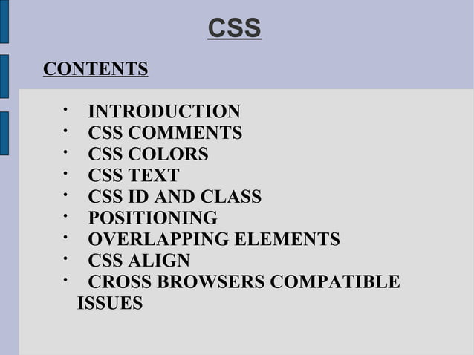

Slide 2
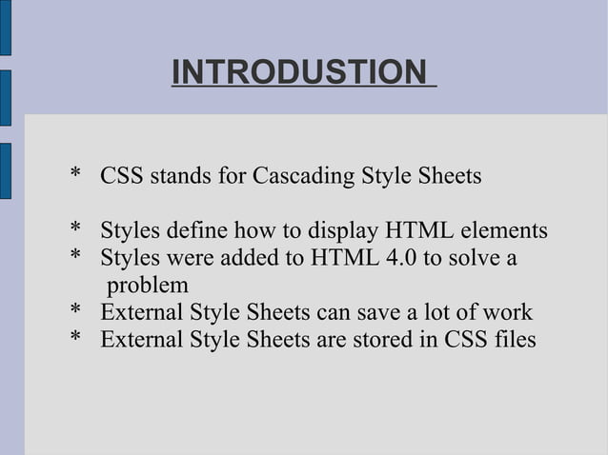

Slide 3

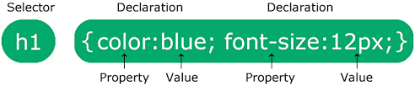
CSS Syntax
The selector points to the HTML element you want to style.
The declaration block contains one or more declarations separated by semicolons.
Each declaration includes a CSS property name and a value, separated by a colon.
Multiple CSS declarations are separated with semicolons, and declaration blocks are surrounded by curly braces.

Slide 4
There are three types of CSS which are:
Inline CSS
Internal or Embedded CSS
External CSS

Slide 5
Inline CSS
Inline CSS contains the CSS property in the body section attached to the element is known as inline CSS.
This kind of style is specified within an HTML tag using the style attribute.

Slide 6


Syntax of Inline CSS
<h1 style="background-color:yellow">
Hello coder
</h1>
<h1 style="font-family:arial">
Hello coder
</h1>

Slide 7
Internal or Embedded CSS:
This can be used when a single HTML document must be styled uniquely.
The CSS rule set should be within the HTML file in the head section i.e. the CSS is embedded within the <style> tag inside the head section of the HTML file.

Slide 8
Syntax of Internal CSS
<head>
<style>
.main {
text-align: center;
}
#first {
color: #009900;
font-size: 50px;
font-weight: bold;
}
</style></head>

Slide 9
External CSS:
External CSS contains separate CSS files that contain only style properties with the help of tag attributes (For example class, id, heading, … etc).
CSS property is written in a separate file with a .css extension and should be linked to the HTML document using a link tag.
It means that, for each element, style can be set only once and will be applied across web pages.

Slide 10
How to link .css file with HTML file?
<head>
<link rel="stylesheet" href="mystyle.css">
</head>

Slide 11
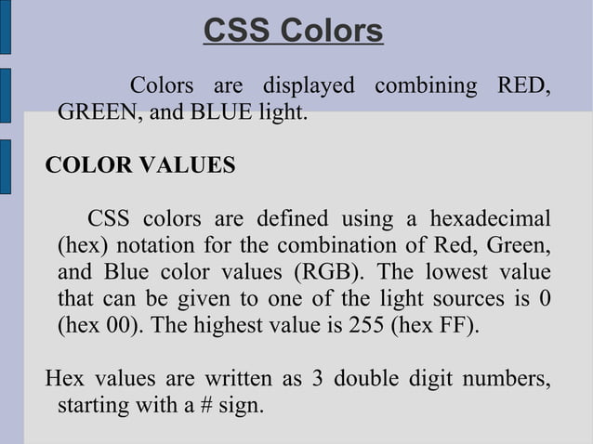

Slide 12
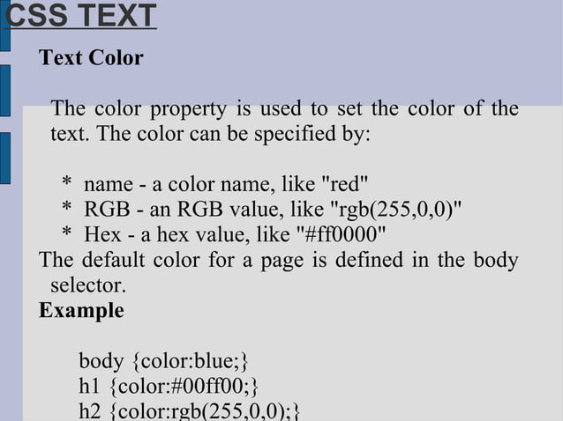

Slide 13
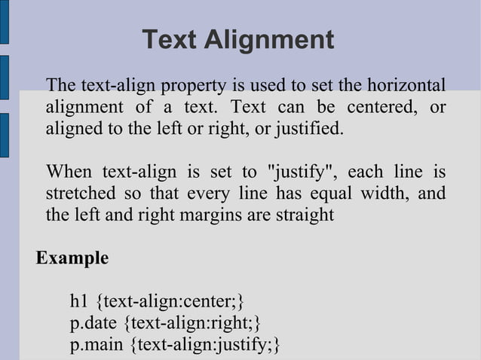

Slide 14
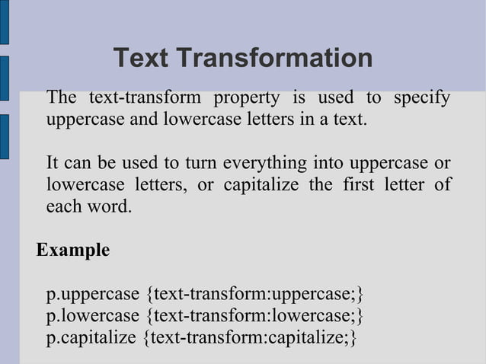

Slide 15
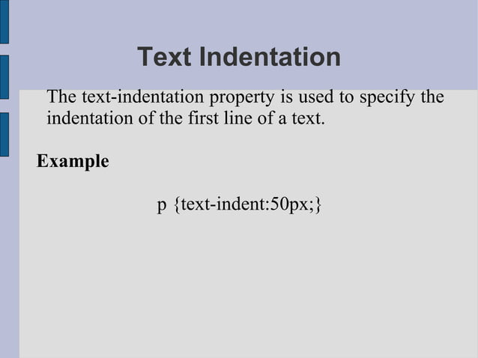

Slide 16
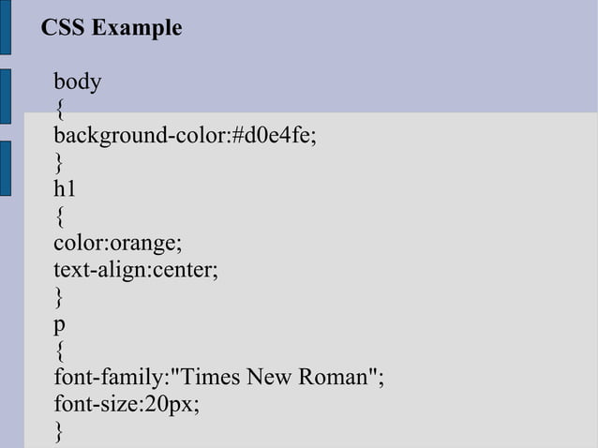

Slide 17
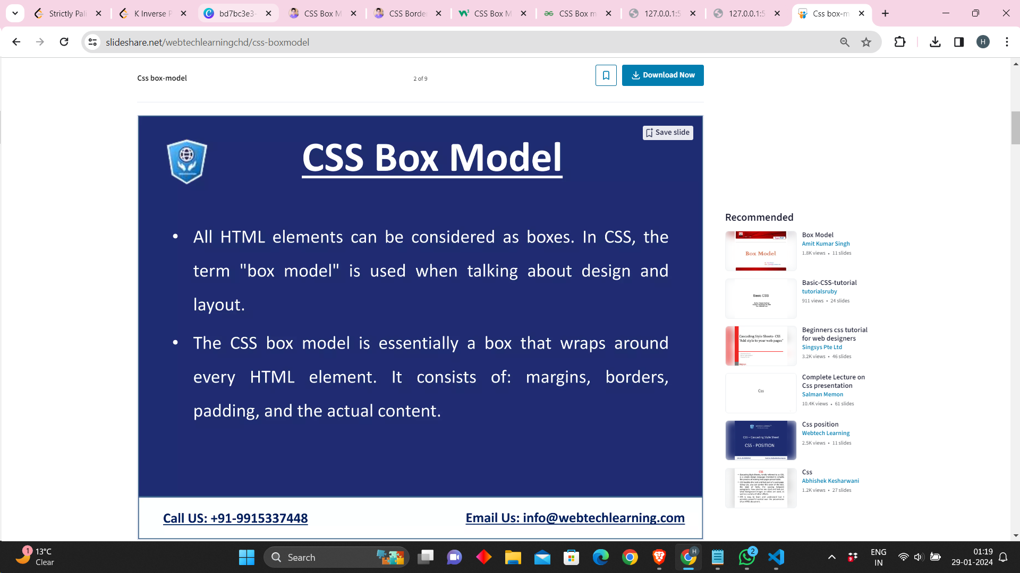

Slide 18
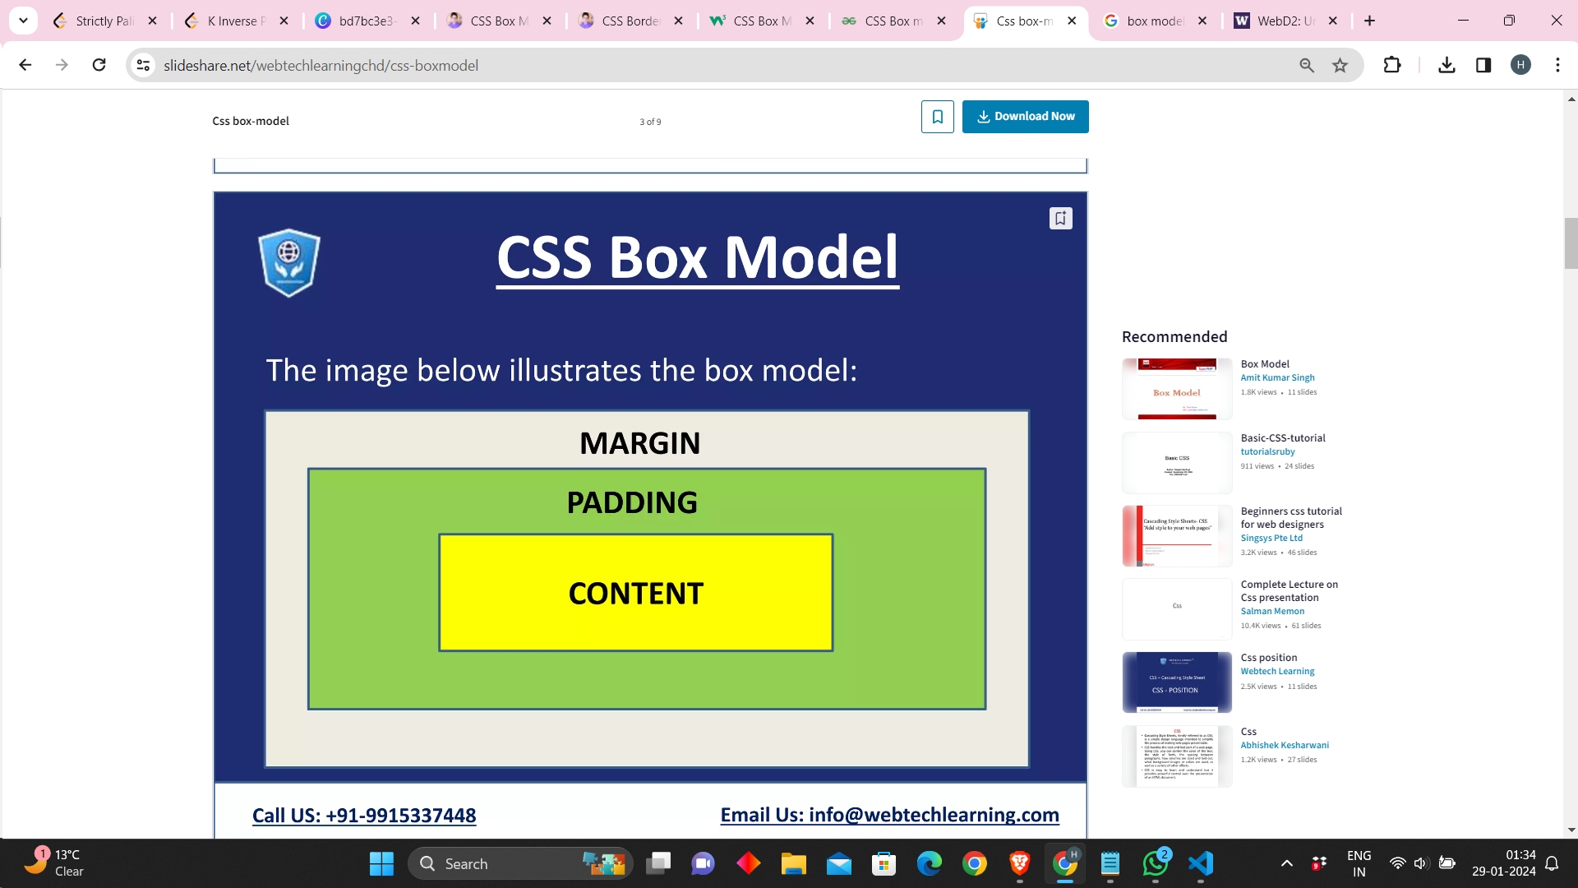
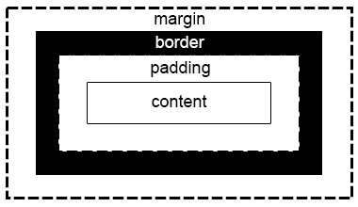

Slide 19
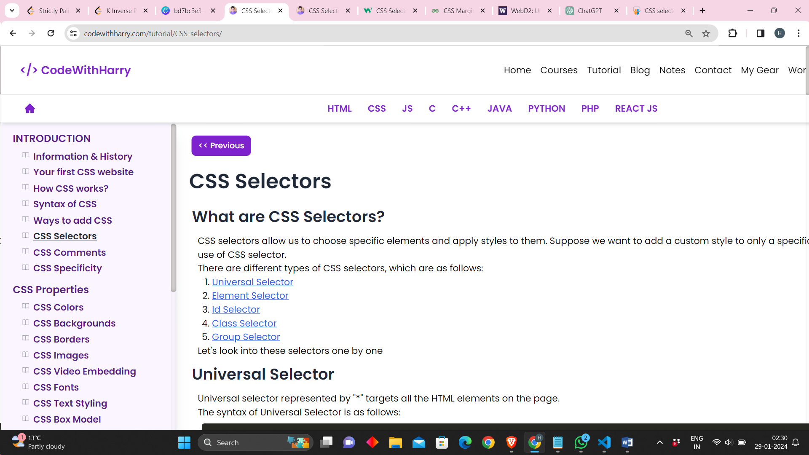
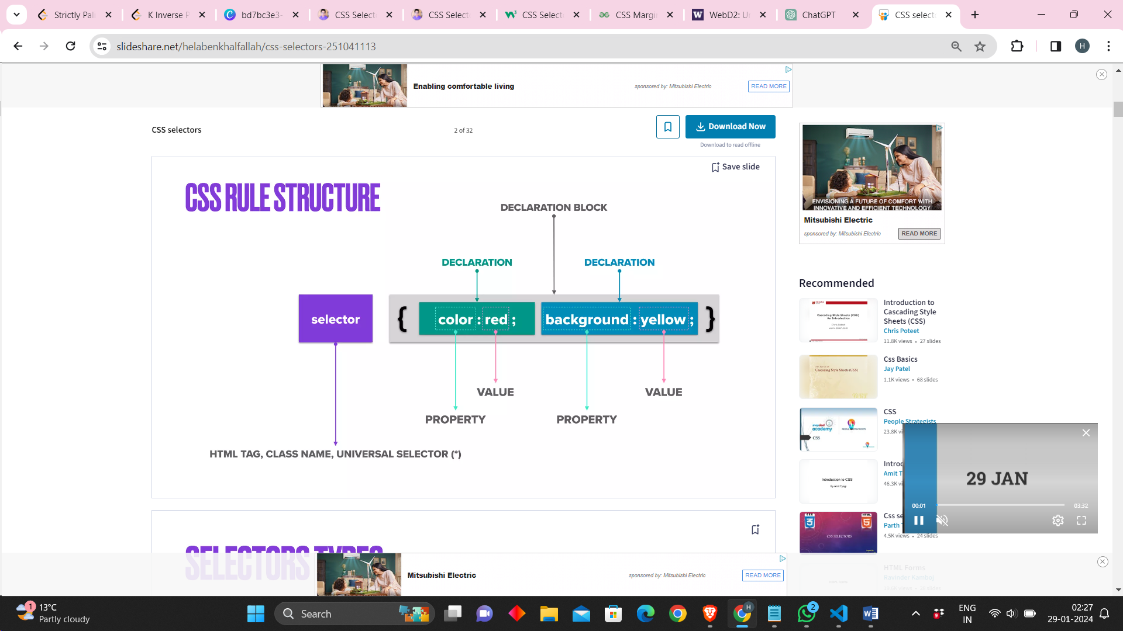
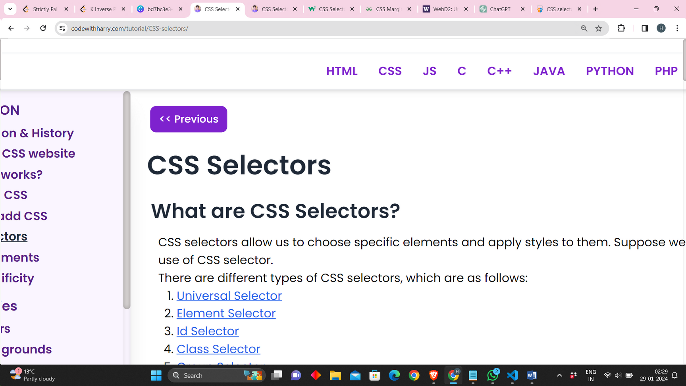

Slide 20
CSS Selectors
Types of Selectors
Universal Selector(*)
Element Selector(p)
Id Selector(#id)
Class Selector(.class)
Group Selector(h1,h2,p)

Slide 21
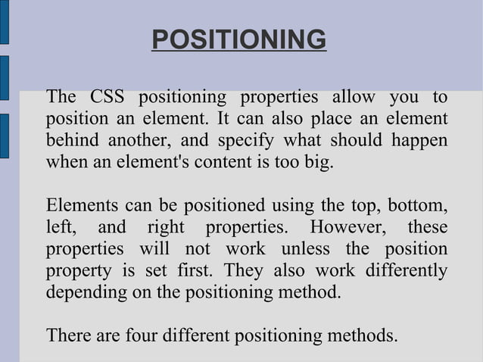

Slide 22
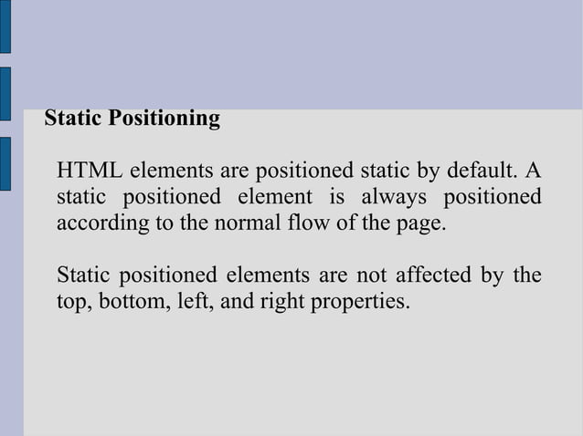

Slide 23
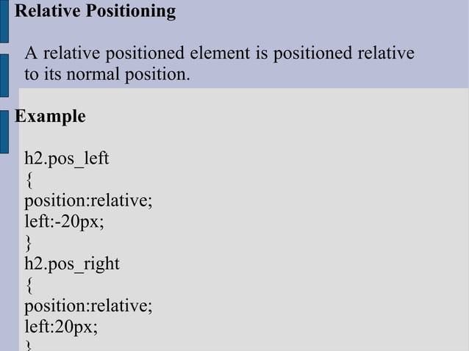

Slide 24
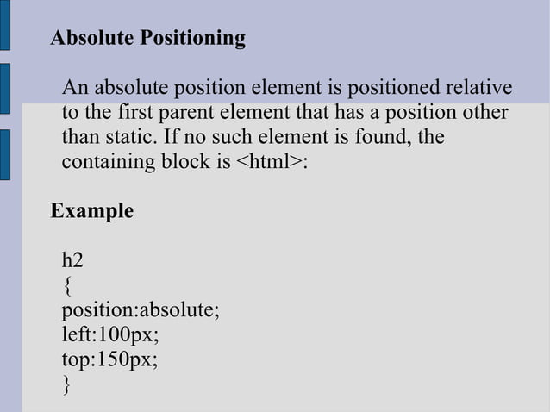

Slide 25
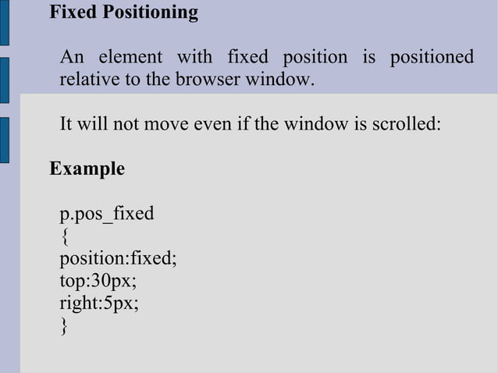

Slide 26
CSS LAYOUT
CSS page layout techniques allow us to take elements contained in a web page and control where they're positioned relative to the following factors: their default position in normal layout flow, the other elements around them, their parent container, and the main viewport/window. The page layout techniques we'll be covering in more detail in this module are:
Normal flow
The display property
Flexbox
Grid
Floats
Positioning
Table layout
Multiple-column layout

Slide 27
Flexbox
Flexbox is the short name for the Flexible Box Layout CSS module, designed to make it easy for us to lay things out in one dimension — either as a row or as a column. To use flexbox, you apply display: flex to the parent element of the elements you want to lay out; all its direct children then become flex items.

Slide 28
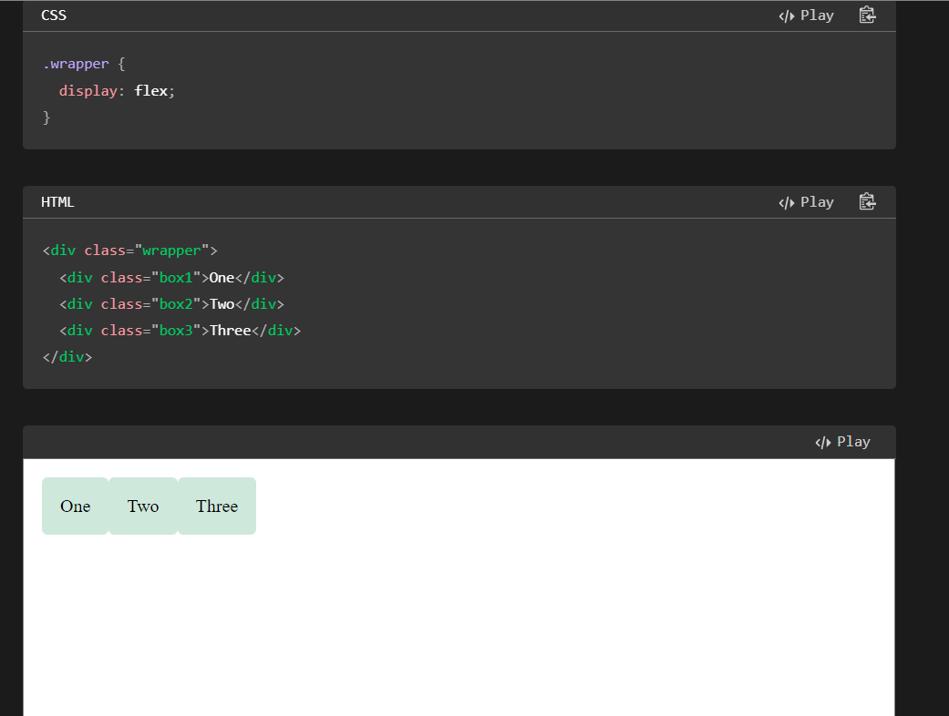

Slide 29
Nested Flexbox
It's possible to create some pretty complex layouts with flexbox. It's perfectly OK to set a flex item to also be a flex container, so that its children are also laid out like flexible boxes.

Slide 30
CSS Grid
It's possible to create some pretty complex layouts with flexbox. It's perfectly OK to set a flex item to also be a flex container, so that its children are also laid out like flexible boxes.
Similar to flexbox, we enable Grid Layout with its specific display value — display: grid. The below example uses similar markup to the flex example, with a container and some child elements. In addition to using display: grid, we also define some row and column tracks for the parent using the grid-template-rows and grid-template-columns properties respectively.

Slide 31
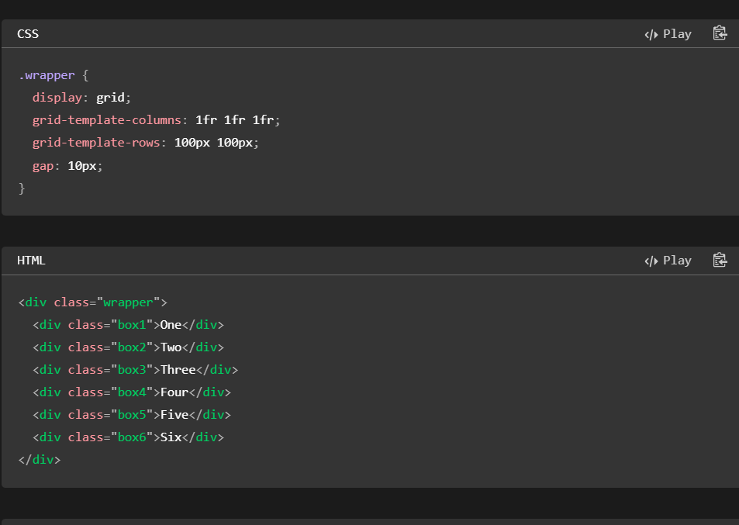

Slide 32
Responsive Web Design
Responsive web design is an approach to web development aimed at creating websites that adapt and respond to different screen sizes and devices.
The primary goal of responsive design is to provide an optimal and consistent user experience across a wide range of platforms, including desktop computers, laptops, tablets, and smartphones.

Slide 33


