Slide 1

TEXT GENERATION

Slide 2
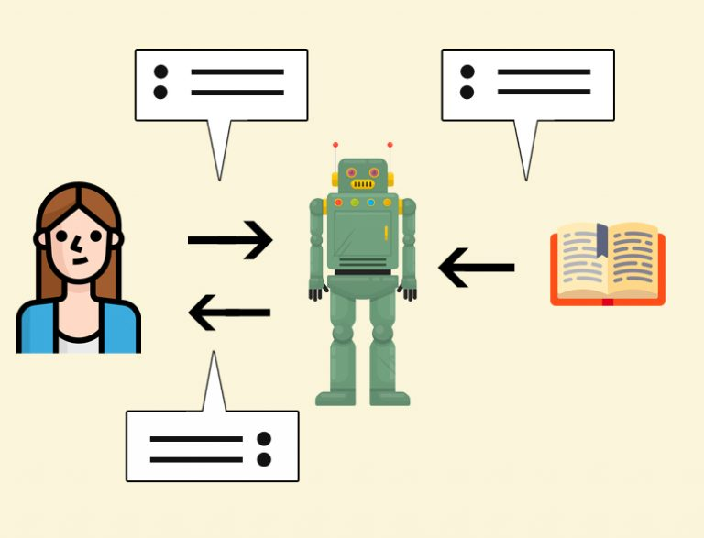
WHAT IS TEXT GENERATION?
The process of creating new pieces of text, such as sentences, paragraphs, or even entire documents, using algorithms and models trained on a corpus of existing text data.
Relies on predefined rules and templates to generate text.

Slide 3
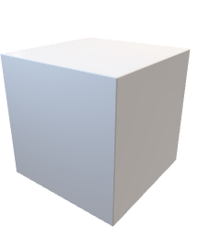
How does it work?
Input
Output
Once upon a time
Once upon a time, we know that our ancestors were on the verge of extinction. The great explorers and poets of the Old World.
Text
Generation
Model
It takes the text based input or prompt from the user.
The text generation model which is already trained on various data sets will process the text input given by the user.
The generated text will be displayed as the output to the user as per the requirement.

Slide 4
Text Generation Model
Data Collection and Preprocessing:
Gathering a large dataset of text relevant to the task.
Preprocessing the text data which involve tokenization.
2. Model Selection and Architecture Design:
The model architecture based on the specific requirements of the text generation task is
LSTM(LONG SHORT TERM MEMORY)
3. Training:
Training the selected model on the preprocessed text data.
4. Inference:
During inference, feeding input data (e.g., a seed text or prompt) into the model
Generating output text based on learned patterns and probabilities.

Slide 5
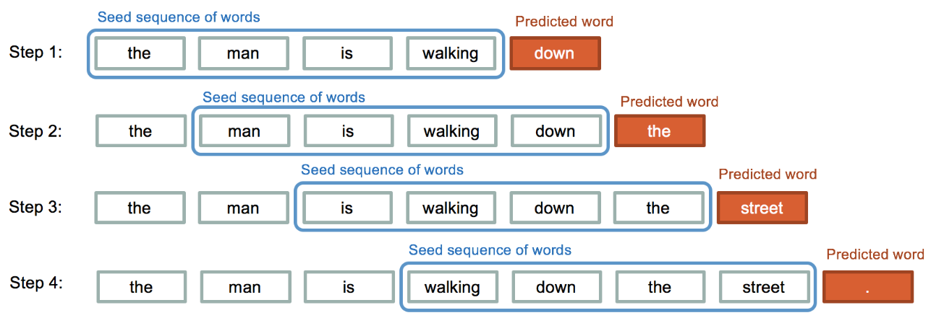
How Generation Is Done?
The next word is generated based on the previous word weights.
Deep learning models can capture intricate patterns and dependencies in language, allowing them to generate coherent and contextually relevant text.

Slide 6





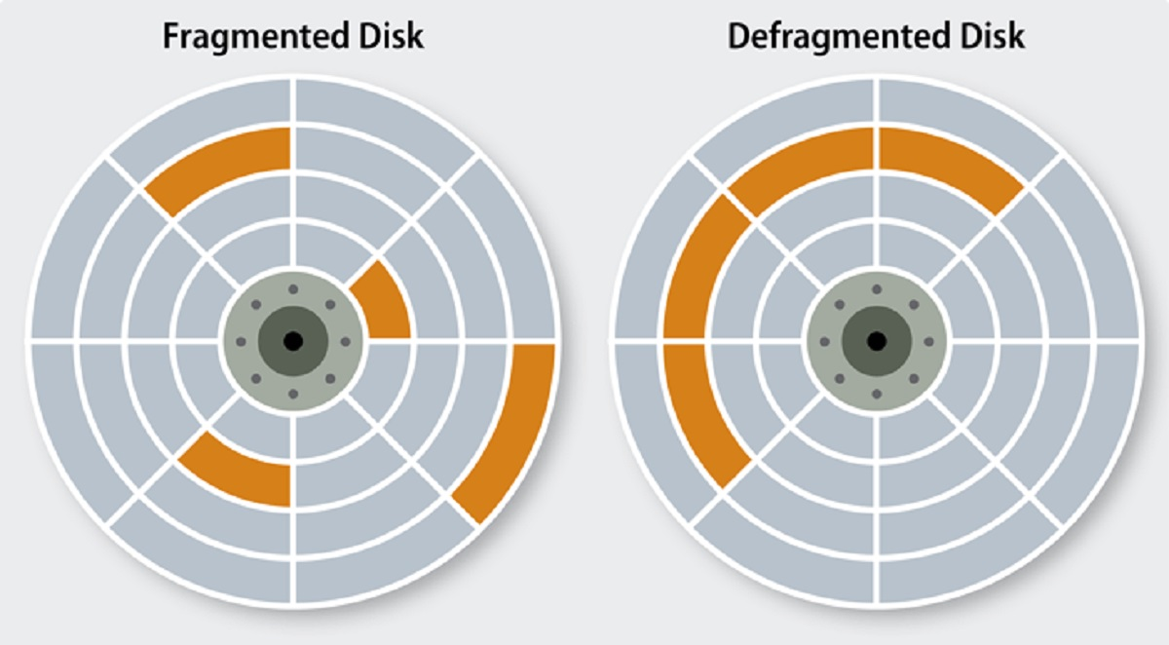
Real life Applications
1.Content creation
2.Conversational agents
3.Language Translation
4.Creative writing
5.Social media posts
6.Defragmentation

Slide 7
Thank you
Mentor: Rajesh Bolla
Team:
M. L. R. Tulasi
M. Swetha Bharathi
Y. Satya veni
P. Dharani
S. Abhinav Kumar
A. Samyuktha

