Slide 1
HOSPITAL MANAGEMENT SYSTEM
Rachit Srivastava-17BEC1018
Rohan Datta-17BEC1053
Tanmay Rai-17BEC

Slide 2
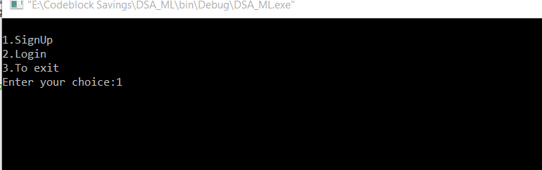
Account Details
The user will first create his account in the database
For that he needs to sign up using a name and the password
After his account details are stored he can log into the database.

Slide 3
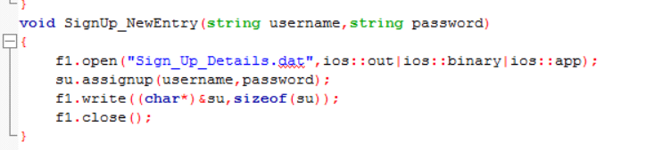
Binary file for Storing
All the account information will be stored in “Sign_Up_Details” binary file.
The information will be stored in the file in encrypted format

Slide 4
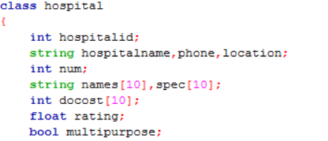
Variable Declaration
This snippet contains all the details about the hospitals in our database.
It includes hospital ID, name, location, number, and details about its doctors(their speciality and fees)

Slide 5
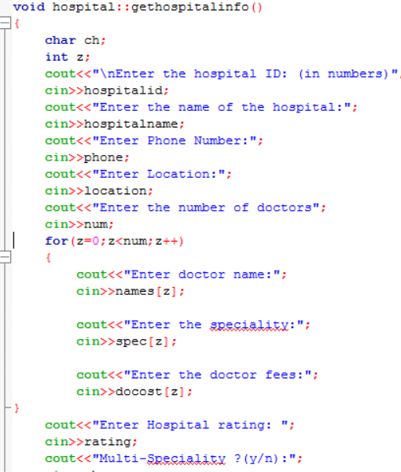
Hospital Details Entry
In the gethospitalinfo() function the user will be filling the necessary details of the hospital
Also the user will be entering the specifications of different types of doctors

Slide 6
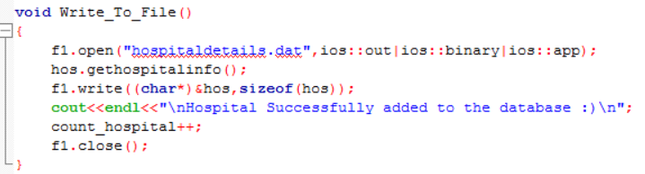
Storing Hospital Details
All the hospital details will be stored in a binary file named “hospitaldetails.dat”
The information will be stored in an encrypted format

Slide 7
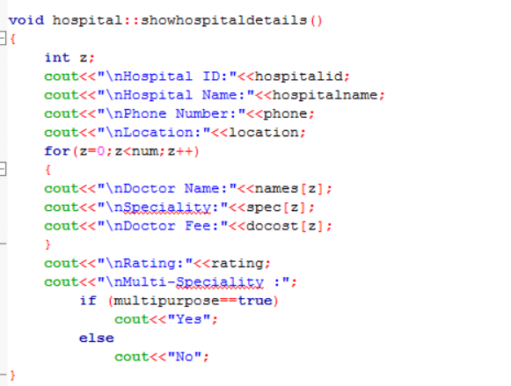
Give Hospital Details
We have a feature in our database which helps the user to get complete details about a particular hospital
He just need to give the name of the hospital and complete details will be shown as the output.

Slide 8
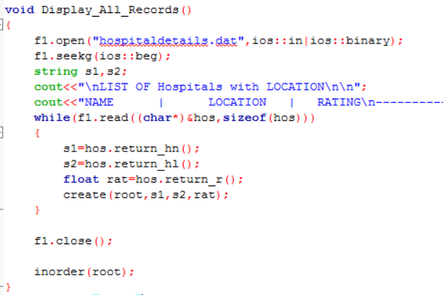
Display All Records
In this Display_All_Records() function we will all the hospitals stored in our binary file in alphabetical order
For this we have inorder traversal technique of trees

Slide 9
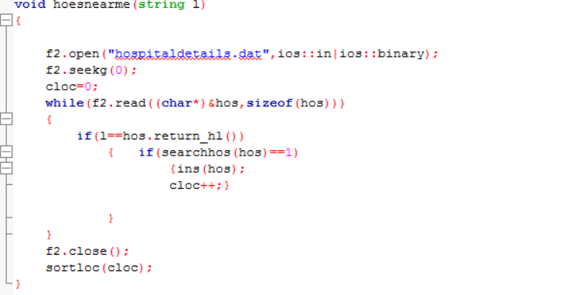
Available Hospitals at Location
In this function the user will enter the location and our system will show all the hospitals available in that location
Also the hospitals will be printed in alphabetical order

Slide 10
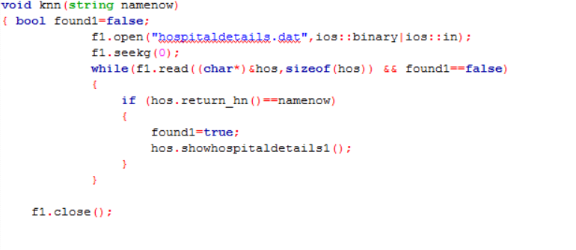
KNN Algorithm
We have also used knn algorithm to predict the doctor which is most suitable for the patient
The patient needs to enter his budget and based on this knn algorithm the most efficient doctor will be suggested.

