Slide 1
Aim: Load Balancing in Server
RACHIT SRIVASTAVA(17BEC1018)
ROHAN DATTA(17BEC1053)
AASHISH KIRTI SINGH(17BEC1114)

Slide 2
Aim of our Project
Suppose multiple clients simultaneously make a request for a file(same or different) from a server, then server has to prioritize their request using process scheduling algorithm.
Now if the number of clients are below the threshold value, then one server can easily fulfill all their requests based on some priority(burst time , throughput etc.).
But if clients count increases we have to make copies of the server, store all of their request in a queue and based on a process scheduling algorithm , print a Gant Chart which shows the sequence in which process will be executed.

Slide 3
Techniques to be used :
Multithreading (multiple clients can place their request to the server at the same time ).
Process Scheduling (There will be many requests/processes placed by different clients at the same time, so using Dynamic Round Robin Algorithm we have to prioritize their requests.)
MySql Database( to store the content in a organized and easily retrievable manner)

Slide 4
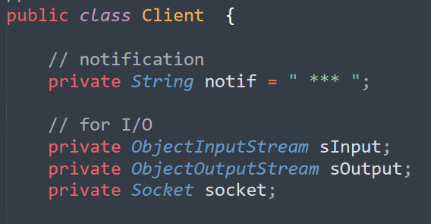
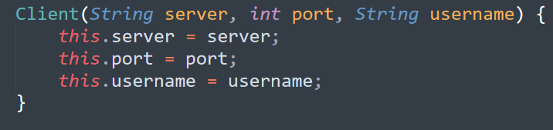
CLIENT PROGRAM (USED MULTI THREADING)
While creating the client program we have to make InputStream(to accept data from server) and OutputStream (to send data to server) object.
3 parameters are a must. You must define the server, port on which client program runs on and the username of the client.

Slide 5
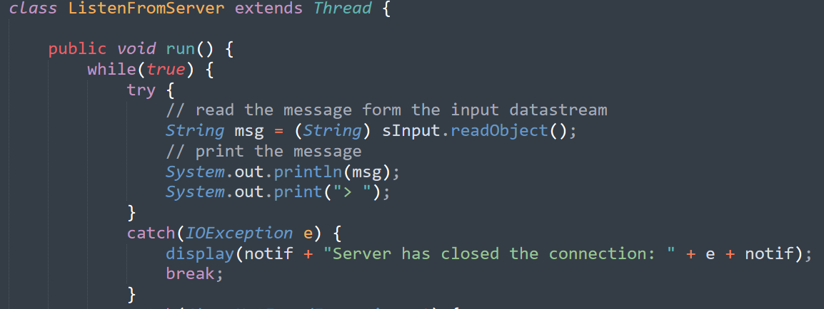
CLIENT PROGRAM (USED MULTI THREADING)
Thread class has been extended to make sure that the program runs not only for a single client but even for multiple clients who request for data at the same time

Slide 6
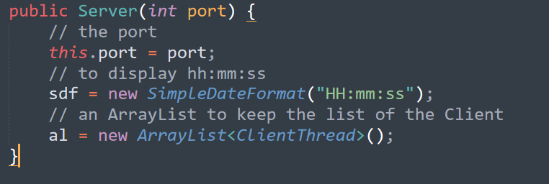
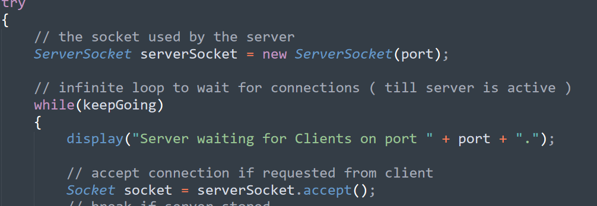
SERVER PROGRAM(USED MULTI THREADING)
For the Server side ,we have to assign the required port to server, and also keep an array of all clients currently active.
Server side need two types of socket, the serverSocket and normal socket.

Slide 7
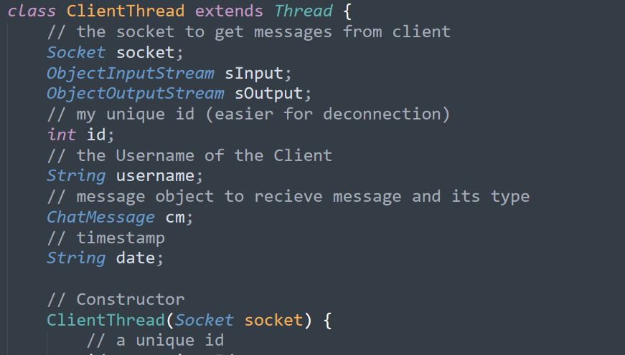
SERVER PROGRAM(USED MULTI THREADING)
Here also we create ClientThead class which extends Thread which provides unique id to each client and creates unique object for each client. So for multiple clients each will have unique set of parameters

Slide 8
MySQL database section will be handled by Rohan Datta.The next 3 slides includes ur stuff !!!!!

Slide 9
WHY MYSQL DATABSE?
The MySQL database server provides the ultimate in scalability to run massive data warehouses holding terabytes of information.
MySQL offers a variety of high-availability options from high-speed master/slave replication configurations, to specialized Cluster servers offering instant failover, to third party vendors offering unique high-availability solutions.
MySQL is the de-facto standard for high-traffic web sites because of its high-performance query engine, tremendously fast data insert capability, and strong support for specialized web functions like fast full text searches

Slide 10
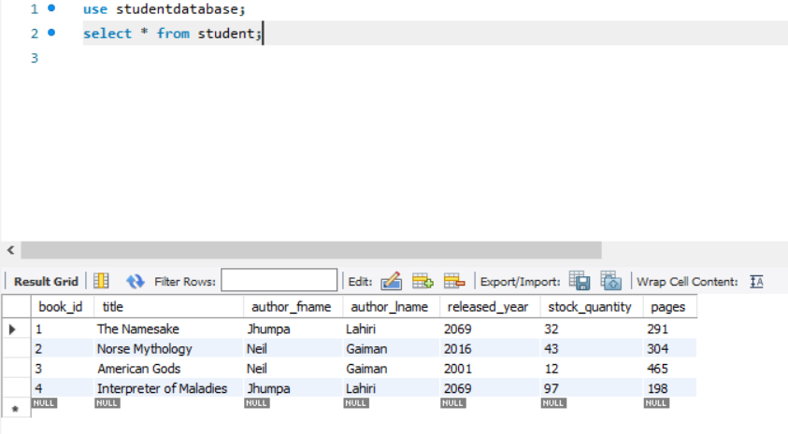
Here we have created just a sample MySQL database i.e. that contains books of some famous authors and other attributes like number of pages, author first name, author last name etc.

Slide 11
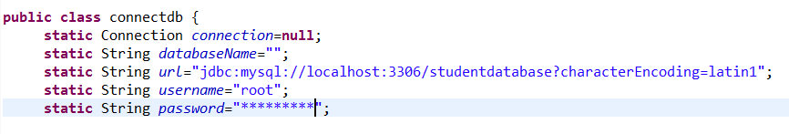
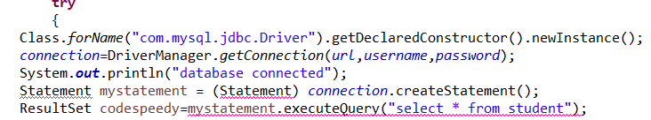
Using JDBC to Connect MySQL to Java Eclipse
We need to provide the localhost port number, username and password of our MySQL Workbench
Class.forName() is using JDBC driver to make connection to database.
The command connection.createStatement() provides the data in the form of Statement object.

