Slide 1

MEDICAL INVENTORY OPTIMIZATION

Slide 2
Contents:
Business Objectives
Business Constraints
Project Architecture - Data Flow Diagram
Data Collection
Exploratory Data Analysis
Data Visualization

Slide 3
Business Problem
NAME – Medical Inventory Optimization
PROBLEM :Bounce rate is increasing significantly leading to patient dissatisfaction

Slide 4
Project Overview and Scope
Overview : By leveraging accurate data and predictive analytics, the project seeks to optimize inventory levels, ensuring the availability of essential medical supplies while minimizing costs. The ultimate goal is to reduce bounce rates by at least 30% and increase revenue by 20 lakhs INR, all within the constraints of maintaining efficient and cost-effective inventory management practices
Scope : Inventory stockouts and high bounce rates are leading to patient dissatisfaction and financial losses. Optimize inventory levels to minimize bounce rates and ensure the availability of essential medical supplies. Minimize inventory costs while maintaining sufficient stock levels to meet patient demands.

Slide 5
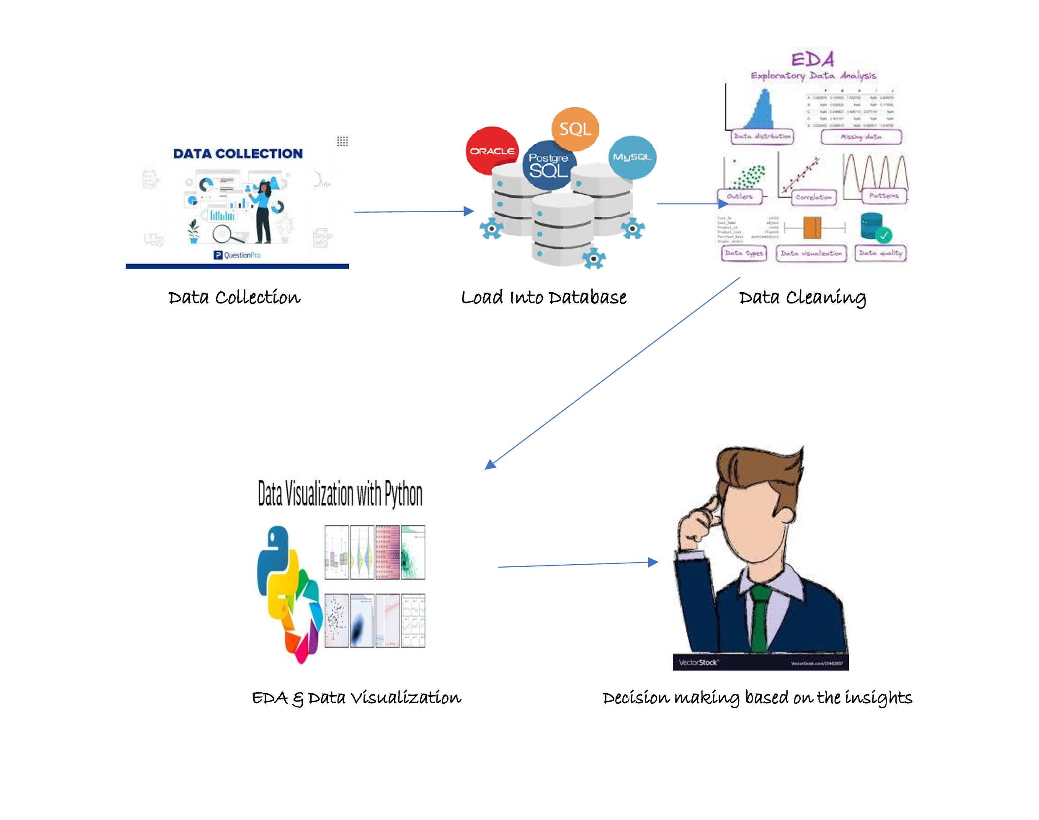
Project Architecture

Slide 6
Data Dictionary:
VARIABLE NAME | VARIABLE DESCRIPTION
Typeofsales | Type of sale of the drug. Either the drug is sold or returned.
Patient_ID | ID of a patient
Specialisation | Name of Specialisation (eg. Cardiology)
Dept | Pharmacy, the formulation is related with.
Dateofbill | Date of purchase of medicine
Quantity | Quantity of the drug
ReturnQuantity | Quantity of drug returned by patient to the pharmacy
Final_Cost | Final Cost of the drug (Quantity included)
Final_Sales | Final sales of drug
RtnMRP | MRP of returned drug (Quantity included)
Formulation | Type of formulation
DrugName | Generic name of the drug
SubCat | Subcategory (Type) to the category of drugs.
SubCat1 | Subcategory (condition) to the category of drugs

Slide 7
Exploratory Data Analysis [EDA]
Statistical Insights
Descriptive Statistics
Correlation Analysis
Regression Analysis
Residual Analysis
Business Insights
Significance of Quantity on Returns
Correlation Analysis
Model Performance
Optimal Inventory Levels

Slide 8
Data Preprocessing
Missing Value Handling: Identify and impute or remove rows with missing values to ensure complete data for analysis.
Date Conversion: Convert the 'Date' column from object to datetime format for time-based analysis.
Outlier Detection: Identify and handle outliers in numerical columns to prevent skewed results.
Normalization: Normalize continuous variables like pressures, temperatures, and speeds for uniform scaling.
Data Consistency: Ensure consistency in units and formats across all measurements.
Feature Engineering: Create new features like 'Day of Week' or 'Month' from the 'Date' column for additional insights.
Correlation Analysis: Analyze correlations between variables to identify potential multicollinearity.
Splitting Data: Split the dataset into training and testing sets for model validation.
Data Quality Check: Perform a final check to ensure data quality and readiness for analysis and modeling.

Slide 9
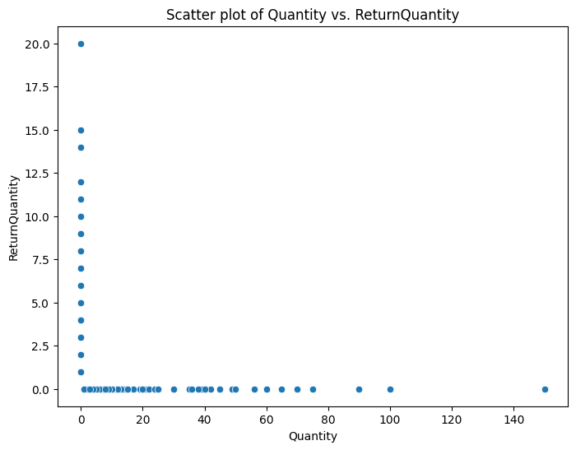
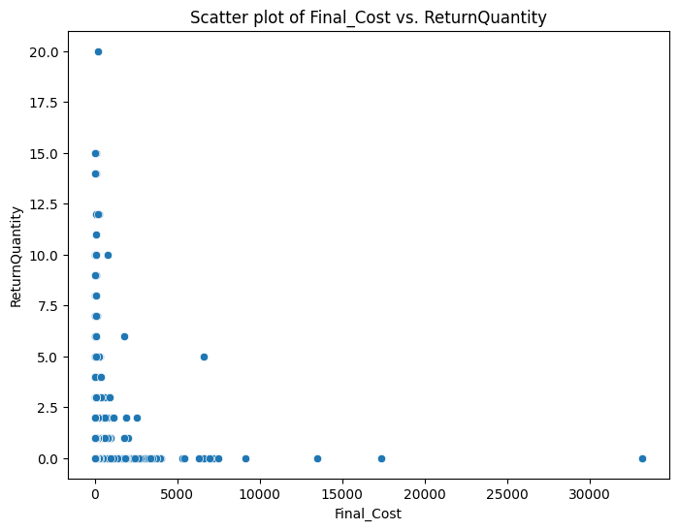
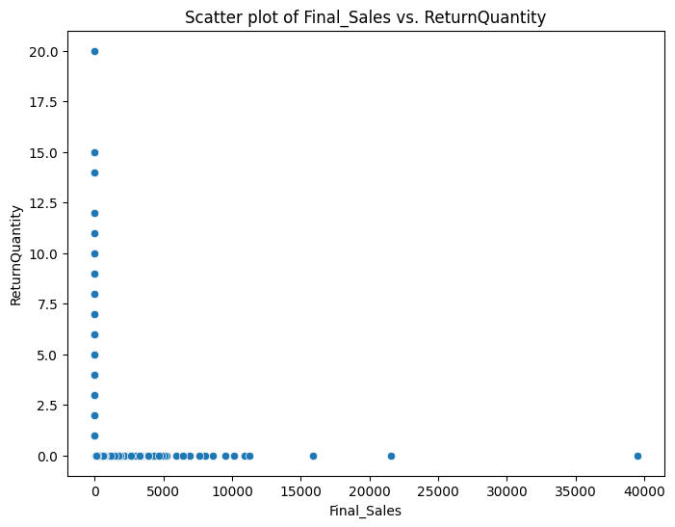
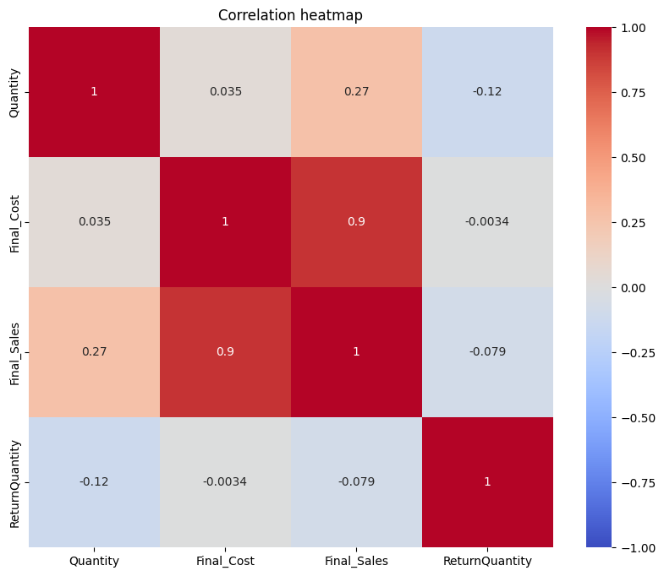
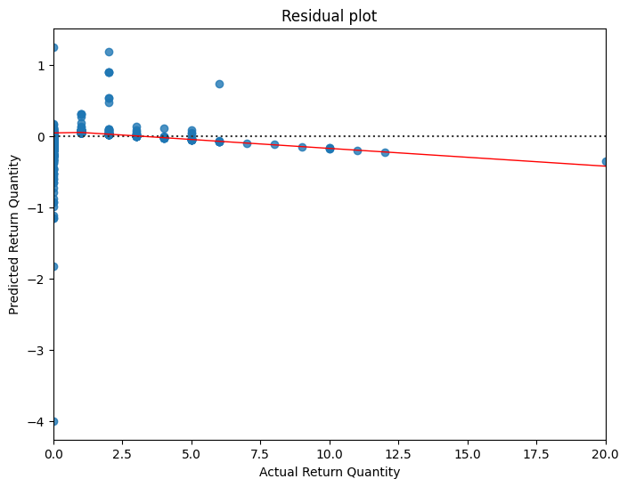
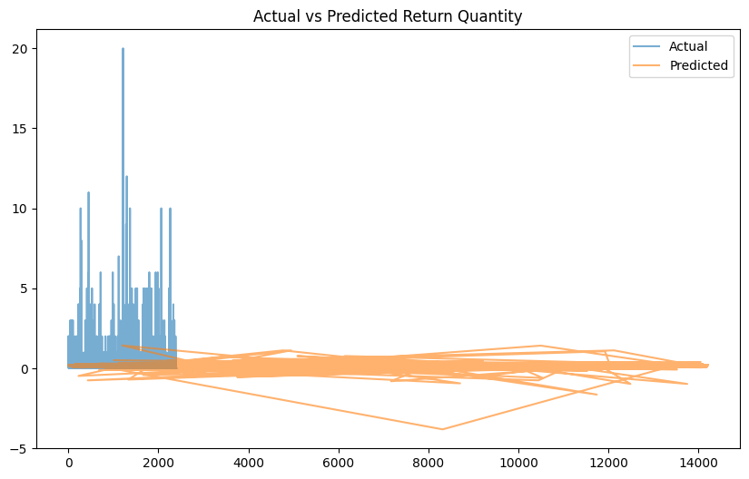
Data Visualization

Slide 10


