Slide 1

Cars24 Used Cars Data Analysis
Web Scraping, Data Cleaning, EDA & Business Insights

Slide 2
ABOUT ME
Vasavi Karraiah
MCA Graduate | 2026
Interested in Data Analytics & Data Science
Skills: Python • Web Scraping • Regex • Pandas • Excel
Project: Cars24 Used Cars Data Analysis— Web Scraping & Data Analytics
Linked in : www.linkedin.com/in/vasavi-karraiah-477800377
Github : https://github.com/21Vasavik

Slide 3
TABLE OF CONTENTS
• Project Overview.
• Business Scenario.
• Business Objectives.
• Dataset & Data Structure.
• Data Cleaning & Validation.
• Exploratory Data Analysis.
• Dashboard & Visualizations.
• Key Findings.
• Business Recommendations.
• Conclusion.

Slide 4
PROJECT OVERVIEW
• Collected used-car listing data from Cars24 using Playwright.
• Extracted vehicle details such as brand, model, price, year, fuel type, transmission and KM driven.
• Cleaned and structured the scraped data using Python and Pandas.
• Analysed used-car listings city-wise and brand-wise.
• Performed Exploratory Data Analysis (EDA) to identify pricing and vehicle trends.
• Built interactive visualizations and a Power BI dashboard for business-focused insights.

Slide 5
BUSINESS SCENARIO
• Used-car prices and availability vary across different cities and brands.
• Customers have different preferences for brands, fuel types and transmissions.
• Businesses need to understand market availability and pricing patterns.
• City-wise analysis can help identify differences in local used-car markets.
• Brand-wise analysis helps understand popular brands and their price positioning.
• Data-driven insights can support better inventory and pricing decisions.

Slide 6
BUSINESS OBJECTIVES
• Analyze used-car listings city-wise across the dataset.
• Identify popular brands and models based on listing volume.
• Compare average and median prices across cities and brands.
• Analyze fuel type and transmission distribution.
• Understand the impact of KM driven and car age on price.
• Generate data-driven insights to support inventory and pricing decisions.

Slide 7
DATASET & DATA STRUCTURE
2,004
Car Listings
14
Data Attributes
30
Cities Covered
2
Analysis Areas
Core Fields
VEHICLE DETAILS USAGE & SPECS PRICING & LOCATION
• Brand
• Model
• Manufacturing Year
• Body Type
• Fuel Type
• Transmission
• KM Driven
• Price
• City
• Listing URL
• Scraped Date
Data Flow
Web Pages → Raw Data → Clean Dataset → Analysis → Dashboard

Slide 8
DATA CLEANING & VALIDATION
• 2,004 used-car records were cleaned and prepared for analysis.
• Missing values were checked across all dataset columns.
• Price and KM Driven values were converted into appropriate numeric formats.
• City names extracted from listing URLs were standardized.
• Brand, Fuel Type and Transmission values were checked for consistency.
• The final dataset was validated for data types, duplicates and data consistency before EDA.
Clean → Validate→ Analyze

Slide 9
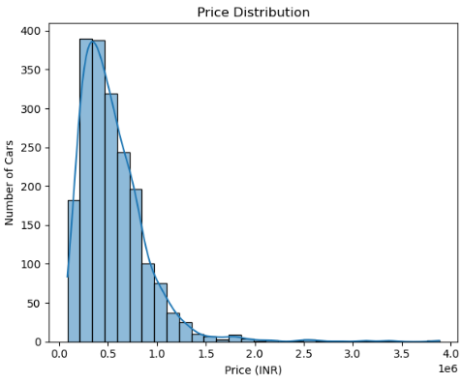
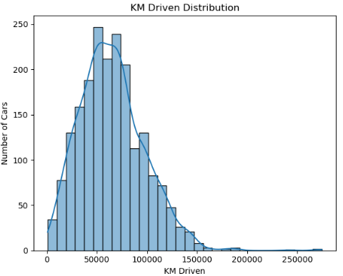
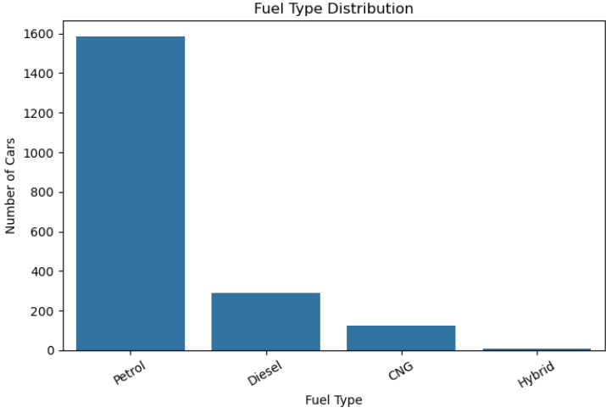
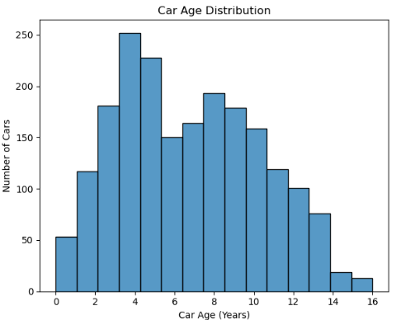
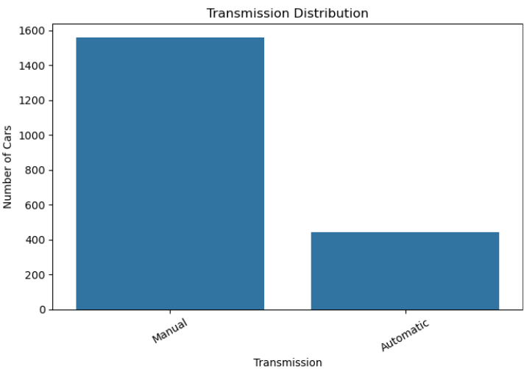
EXPLORATORY DATA ANALYSIS
UNIVARIATE ANALYSIS

Slide 10
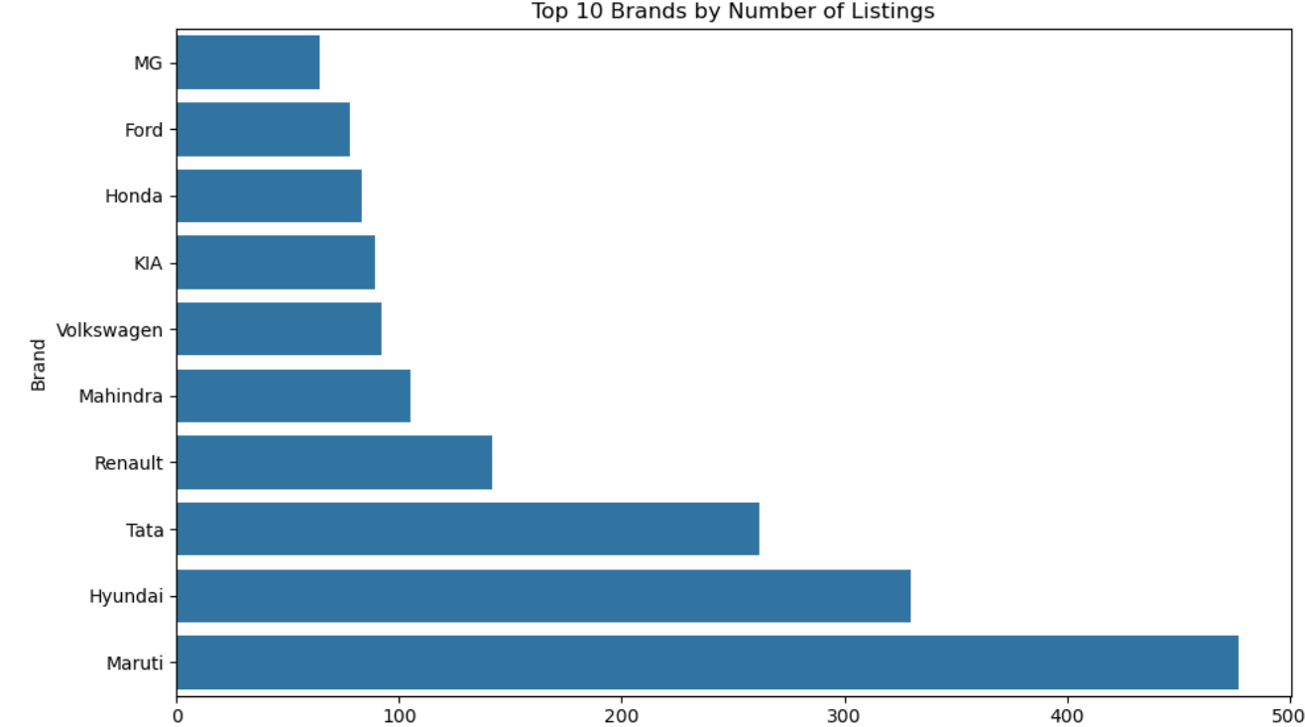
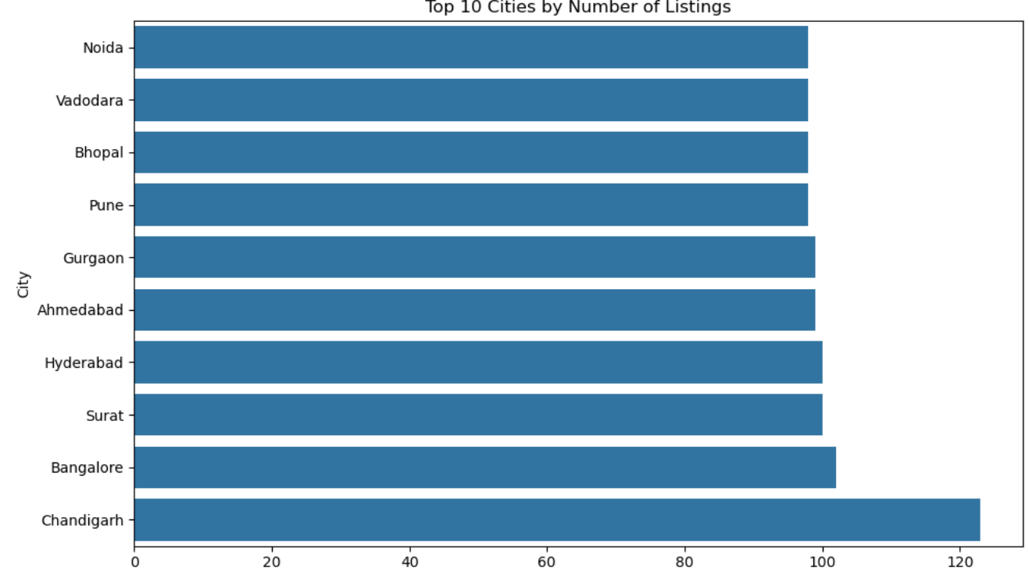
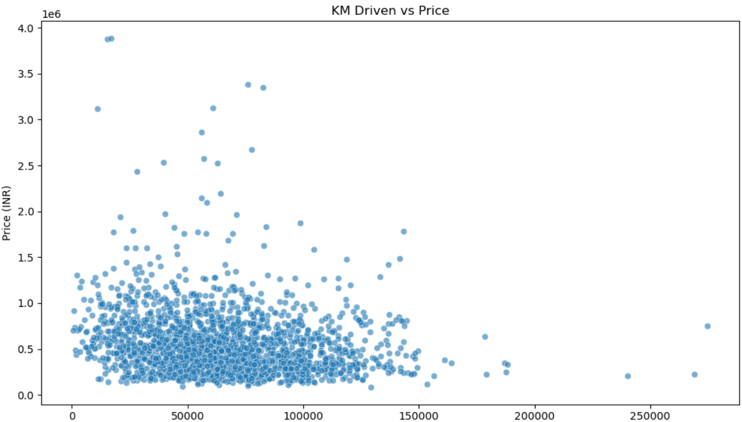
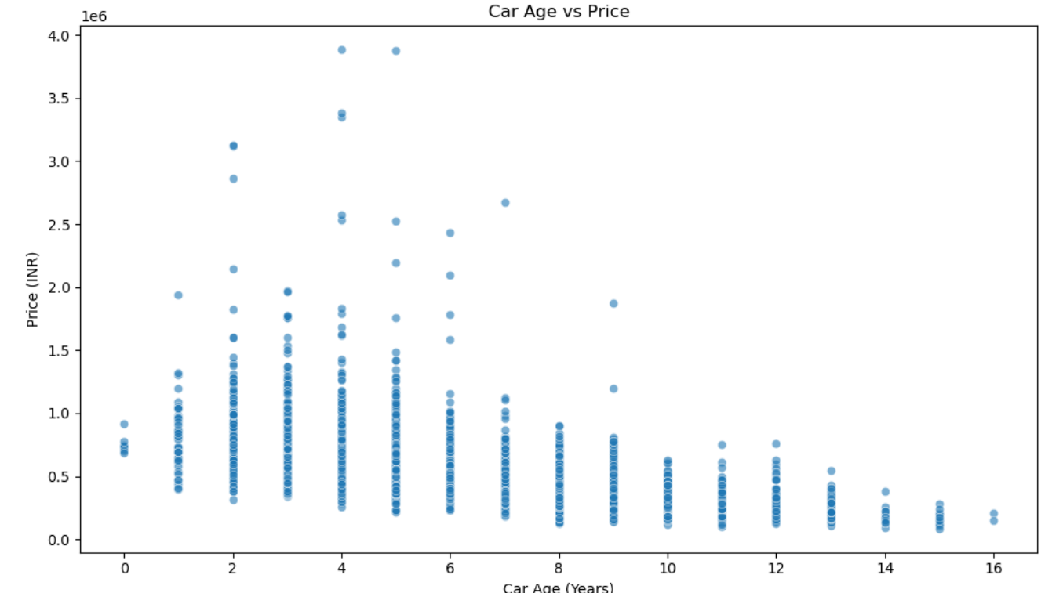
BI-VARIATE ANALYSIS

Slide 11
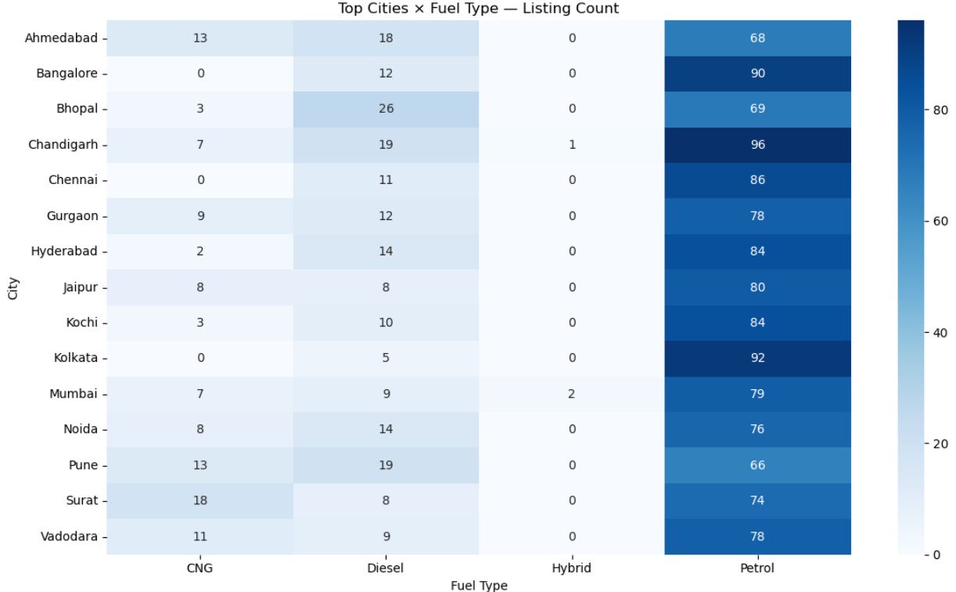
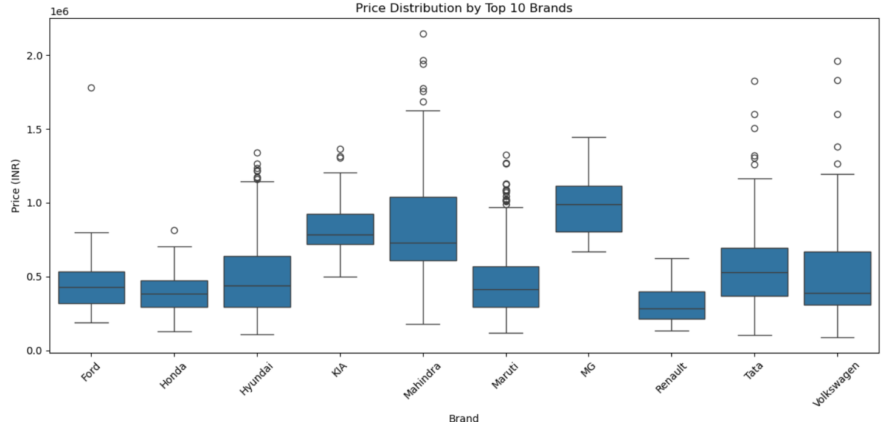
MULTI-VARIATE ANALYSIS

Slide 12
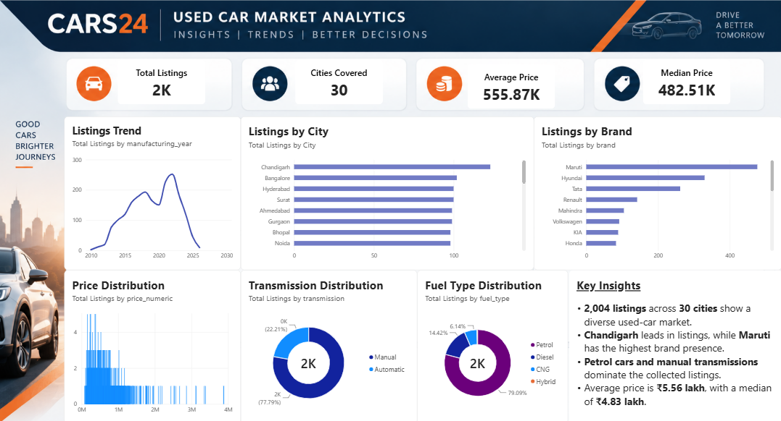
POWER BI DASHBOARD

Slide 13
OVERALL KEY FINDINGS
• 2,004 used-car listings across 30 cities reveal significant variation in market availability across locations and brands.
• Chandigarh records the highest listing volume, while Maruti has the strongest representation among the analysed brands.
• Petrol vehicles dominate the dataset (79.09%), and manual transmission accounts for 77.79% of listings.
• The average listed price is ₹5.56 lakh, compared with a median price of ₹4.83 lakh, indicating variation in vehicle pricing.
• Vehicle age, KM driven, brand and location are important factors associated with differences in used-car prices.

Slide 14
BUSINESS RECOMMENDATIONS
• Optimize inventory by city — prioritize vehicle sourcing and stock planning based on listing demand across cities.
• Focus on high-demand brands and models — maintain adequate inventory of frequently listed/popular vehicles.
• Adopt data-driven pricing — consider brand, city, vehicle age and KM driven when setting or reviewing prices.
• Segment vehicles by customer preference — tailor inventory and promotions around dominant fuel and transmission categories.
• Use regular dashboard monitoring — track listing volume, pricing trends and vehicle characteristics to identify changing market patterns.

Slide 15
CONCLUSION
• The project successfully analysed 2,004 used-car listings across 30 cities using structured data analysis.
• The analysis provided insights into city-wise demand, brand presence, pricing, fuel type and transmission preferences.
• EDA and Power BI visualizations helped identify key patterns in vehicle availability and pricing.
• The findings can support inventory planning, pricing decisions and market-focused strategies for used-car businesses.
• Overall, the project demonstrates how web-scraped data can be transformed into meaningful business insights through data analytics.
Web Data → Structured Data → Business Insights

Slide 16

THANK YOU

