Slide 1

Last-Mile Delivery Operations Analytics

Slide 2
Meet Team
Vasavi
Nandu Sree
Yamini
Background: MCA
Background: B. Tech
Background: B. Tech
Experience: Fresher
Experience: Fresher
Experience: Fresher
LinkedIn:
www.linkedin.com/in/vasavi
-karraiah-477800377
LinkedIn:
https://www.linkedin.com/in/nandu-kunchapu-b02210321/
LinkedIn:
www.linkedin.com/in/yamini
-jakkireddy-9382113a1
GitHub:
https://github.com/21Vasavik
GitHub:
https://github.com/kunchapunandu18-dev
GitHub:
https://github.com/Yamini174

Slide 3
Table of contents
Project Overview
Business Scenario
Business Objectives
Dataset & Database Overview
ER Diagram & Database Structure
Analysis of the Objectives
Overall Key Findings
Business Recommendations
Conclusion
Q&A

Slide 4
Project Overview
• Quick Route Logistics is a last-mile delivery company.
• It manages customers, orders, deliveries, drivers and vehicles.
• MySQL is used to analyze the delivery operations.
• The analysis looks at demand, customers, delivery performance, resources and delivery problems.
• The project aims to provide data-driven insights for improving delivery planning and operational efficiency.

Slide 5
Business Scenario
• Quick Route Logistics aims to improve its last-mile delivery operations.
• The Operations team needs insights into demand, delivery performance,
and resource utilization
• The analysis helps identify operational gaps and improvement areas.
• The goal is to support efficient planning and better customer service.
Drivers
↘ ↗
Customers
→
Orders
→
Deliveries
Vehicles
3

Slide 6
Business Objectives
1
Understand Delivery Demand
Compare order volume and identify demand trends.
2
Analyse Customer Order Behaviour
Look at repeat activity and higher-value customers.
3
Evaluate Delivery Performance
Compare outcomes across zones and service types.
4
Understand Driver & Vehicle Performance
Review the role of drivers and vehicles in delivery work.
5
Identify Delivery Problems
Look at failed, pending, rescheduled and repeated attempts.

Slide 7
Dataset & Database Overview
Table | Purpose | Records
Customers | Customer details and customer type | 400
Orders | Order info, service type, priority, value | 3,000
Deliveries | Delivery status, attempts, distance, duration | 3,500
Drivers | Driver details, rating and active status | 80
Vehicles | Vehicle type, fuel type, capacity | 50
Observation
3,500 deliveries are recorded for 3,000 orders, so some orders have more than one delivery record.
Finding
The five tables are connected through IDs (keys).
5

Slide 8
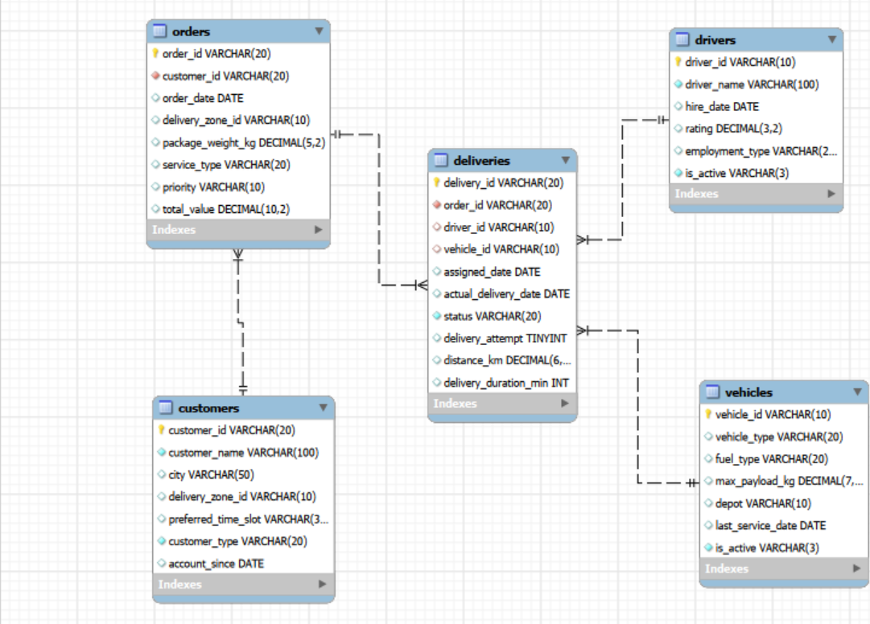
ER Diagram & Database Structure
Main Relationships
• Customers → Orders
• Orders → Deliveries
• Drivers → Deliveries
• Vehicles → Deliveries
Primary Keys
• customer_id, order_id
• delivery_id, driver_id, vehicle_id

Slide 9

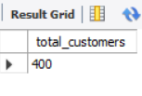




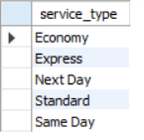


Basic Analysis: SQL Check
Key Findings:
400 customers and 3,000 orders
3,500 delivery records
5 service types available
75 active drivers
Key Insights:
High repeat customer activity
Delivery volume exceeds order volume
Multiple service options support varied customer needs
Driver capacity is crucial for operations

Slide 10
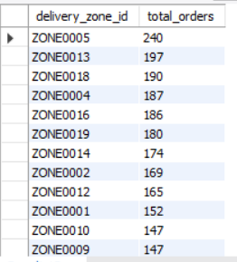
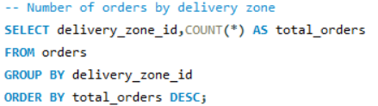
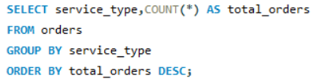
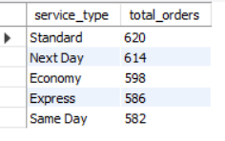


Analysis of the Objectives: Delivery demand
Orders By Zone:
Key Findings:
ZONE0005 generated the highest demand — 240 orders
Standard service recorded the highest volume — 620 orders
High-priority orders led demand — 1,035 orders
Orders by Service Type:
Key Insights:
Demand is concentrated in specific zones, while Standard service and High priority dominate order volume.
Orders by Priority:

Slide 11
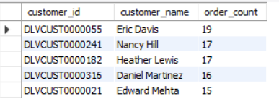
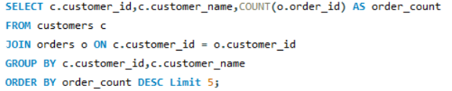
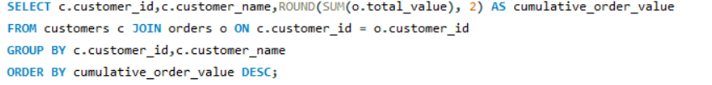
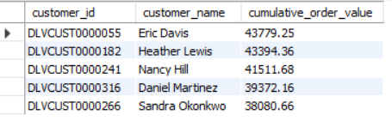
Customer Order Behaviour
Top Customers by Orders:
Top Customers by Order Value:
Key Findings:
Eric Davis placed the most orders — 19
Eric Davis generated the highest order value — $43,779.25
Key Insight:
Individual customers drive order volume, while Business customers generate higher average order value.

Slide 12
Delivery Performance
Key Findings:
3,500 total deliveries were recorded.
73.7% of deliveries were successfully completed.
26.3% were Pending, Rescheduled, or Failed.
Average delivery duration was 47.2 minutes.
ZONE0020 recorded the highest problem rate at 31.7%.
Key Insights:
Overall delivery performance is strong, but improvement is needed for the remaining 26.3%.
Pending and Rescheduled deliveries represent additional operational workload.
Delivery problems are concentrated in specific zones, rather than evenly distributed.
Reducing delays and failures in high-problem zones can improve overall operational efficiency.

Slide 13
Driver & Vehicle Performance
DRIVER WORKLOAD
DRIVER SUCCESS
VEHICLE USAGE
VEHICLE SUCCESS
68
86.5%
717
75.0%
DRV00073
DRV00027*
Cargo Bike
Electric Van
KEY FINDINGS
KEY INSIGHT
• Driver workload varies across the fleet. • The busiest driver is not necessarily the best performer. • Vehicle type affects usage and outcomes.
Balance workload, success rate and delivery duration when allocating drivers and vehicles.

Slide 14
Delivery Problems
Operational Problems
165 delivery records required more than one attempt — approximately 4.71% of delivery records.
Problem Areas
Failed deliveries, Pending deliveries, Rescheduled deliveries, Multiple delivery attempts.
Zone Findings
ZONE0019 has the highest multiple-attempt rate; ZONE0020 also shows relatively high repeated-attempt activity.
Key Insight
Reducing repeated delivery attempts can reduce operational effort and improve delivery efficiency. Package weight does not show a strong relationship with delivery duration.

Slide 15
Overall Key Findings
DEMAND
ZONE0005 has the highest demand (240 orders).
GROWTH
Order demand increased from 608 in 2022 to 1,229 in 2024.
CUSTOMERS
Individual customers generate the most demand; Eric Davis has 19 orders.
DELIVERY
2,581 of 3,500 delivery records were delivered; ZONE0020 is weakest.
RESOURCES
75 of 80 drivers are active; Cargo Bikes and Trucks handle high volume.
PROBLEMS
165 deliveries (4.71%) needed multiple attempts; ZONE0019 is highest.
20

Slide 16
Business Recommendations
Allocate more resources to high-demand zones, especially ZONE0005.
Investigate ZONE0020 to improve its low delivery success rate.
Review Economy service to reduce its higher failure rate.
Reduce multiple delivery attempts to improve delivery efficiency.
Optimize driver and vehicle allocation based on workload and performance.
Track high-frequency customers to support customer retention.
Plan future capacity based on the growing order demand.

Slide 17
Conclusion
The Last-Mile Delivery Operations Analytics project successfully used MySQL to analyse Quick Route Logistics' delivery operations. The analysis identified important patterns in delivery demand, customer behaviour, delivery performance, driver and vehicle utilization, and operational issues
The analysis revealed growing demand, variations across delivery zones and service types, differences in resource utilization, and recurring delivery issues. These findings provide a clear understanding of the operational areas that require attention.
Overall, these insights can help Quick Route make better decisions in resource allocation, capacity planning, delivery performance, and customer service, leading to more efficient last-mile operations.

Slide 18
Q&A
Questions & Discussion

Slide 19

THANK YOU

