Slide 1
Travelling Salesperson Problem
Graph Theory + Operations Research + Computer Science + Optimization
Presented By: P. Bhaavya Ramita, 25MCB1010

Slide 2
Given a list of cities and the distances between each pair of cities, what is the shortest possible route that visits each city exactly once and returns to the origin city?
Notes:
To verify, that a single solution is optimized requires both computing all the possible solutions and then comparing your solution to each of them ~ EXACT SOLUTION
The physical limitations of finding an exact solution lead us towards a very important concept – approximation algorithms. In an approximation algorithm, we cannot guarantee that the solution is the optimal one, but we can guarantee that it falls within a certain proportion of the optimal solution.

Slide 3
The difficulty in solving a combinatorial optimization problem such as the TSP lies not in discovering a single solution, but rather quickly verifying that a given solution is the optimal solution.
The TSP naturally arises as a subproblem in many transportation and logistics applications, for example the problem of arranging school bus routes to pick up the children in a school district (Vehicle Routine Problem).

Slide 4
Approaches to solving TSP
Exact Algorithm
Approximation Algorithm
It finds the absolute shortest possible tour that visits all cities exactly once and returns to the start.
Brute Force search: [(n-1)!]/2 possibilities
Dynamic Programming (Held-Karp algorithms): O(n^2 * 2^n)
Correct solutions but very slow, impractical for larger inputs.
7 cities is just over 5,000
10 cities it is over 3.6 million
13 cities it is over 6 billion.
It gives a solution that is close enough to optimal but computes quickly (in polynomial time) – gives NEAR OPTIMAL solution with a provable bound.
Nearest Neighbour Algorithm: O(n^2)
MST-based (Double Tree) Algorithm: O(n^2 * logn)
Christofides Algorithm: O(n^3)
Fast solution but not perfect. (depends on approximation ratio)
Notes:
If the optimal tour has cost 22, an exact algorithm must output exactly 22, not 23 or 30.

Slide 5
Exact Algorithm: Brute-Force
B
A B C D
5
10
A B C D
0 | 10 | 15 | 20
5 | 0 | 9 | 10
6 | 13 | 0 | 12
8 | 8 | 9 | 0
9
10
8
A
D
20
8
15
9
13
6
12
C

Slide 6
Exact Algorithm: Brute-Force (n−1)!
function NAIVE_TSP(cost_matrix, n):
best_cost = infinity
best_path = none
cities = [1, 2, ..., n-1] # all other cities
for each possible ordering (permutation) of these cities:
current_cost = 0
current_city = 0 #start from 0
for next_city in permutation:
current_cost += cost_matrix[current_city][next_city]
current_city = next_city
current_cost += cost_matrix[current_city][0] #cost to return back to starting city
if current_cost < best_cost:
best_cost = current_cost
best_path = [0] + permutation + [0]
print("Best path:", best_path)
print("Minimum cost:", best_cost)

Slide 7
Exact Algorithm: Dynamic programming
The brute force re-computes the same paths again and again. DP avoids this repetition by remembering the cost of subproblems.
A B C D
B
A B C D
0 | 10 | 15 | 20
5 | 0 | 9 | 10
6 | 13 | 0 | 12
8 | 8 | 9 | 0
5
10
9
10
8
A
D
20
8
15
9
13
6
12
C
G{I, S} = min({Ik + g(K, S – {K})})

Slide 8
Exact Algorithm: Dynamic programming O(n² × 2ⁿ)
function DP_TSP(cost, n):
for mask in range(0, 2^n):
for i in range(n):
dp[mask][i] = infinity
dp[1][0] = 0 # start at city 0 (A), mask=0001
for mask in range(1, 2^n):
for current in range(n):
if current is in mask:
for next_city in range(n):
if next_city not in mask:
new_mask = mask | (1 << next_city)
dp[new_mask][next_city] = min(
dp[new_mask][next_city],
dp[mask][current] + cost[current][next_city])
answer = infinity # finally, return to starting city (A)
for i in range(1, n):
answer = min(answer, dp[(1<<n)-1][i] + cost[i][0])
Notes:
# cost[i][j] = distance from city i to city j
# dp[mask][i] = minimum cost to reach city i having visited
# the set of cities represented by 'mask'

Slide 9
Understanding Polynomial Time (P)
There exists an algorithm that finds the correct answer in polynomial time (n^2, n^3, etc.)

Slide 10
Understanding Non-Deterministic Polynomial Time (NP)
If someone gives you a solution, you can verify if it’s correct in polynomial time.
One candidate Tour: A -> B -> D -> C -> A
A -> B = 10 B -> D = 10 D -> C = 9
C -> A = 6
Total cost = 10 + 10 + 9 + 6 = 35
Verification:
Each vertex A, B, C, D appears exactly once and you return to the start. = O(n)
Look up costs requires you to sum of the traversed nodes’ costs = O(n)
Verification is polynomial time.
B
5
10
9
10
8
A
D
20
8
15
9
13
6
12
C
Notes:
In TSP — if someone hands you a tour, you can easily check:
Does it visit all cities once?
What’s its total cost? Verification = O(n²), so it’s in NP.

Slide 11
Understanding Non-Deterministic Polynomial Time (NP)
If someone gives you a solution, you can verify if it’s correct in polynomial time.
NP-Complete
Is there a route with total distance ≤ K?
NP-Hard
What is the shortest possible route that visits all cities exactly once?
They must satisfy 2 properties:
They are in NP (easy to verify a given solution), i.e verification = polynomial
Every other NP problem can be reduced to it. Finding the correct path = exponential.
Decision version of TSP. You only need to decide whether such a route exists, not find the best one.
These are at least as hard as NP-complete problems, but they might not even by NP
The optimization version of the TSP (finding the shortest possible route) is NP-hard.
You must find the optimal (best) solution itself, not just check if one exists.
Finding or even verifying optimality isn’t polynomial-time feasible.
Notes:
they’re at least as hard as all other NP problems

Slide 12
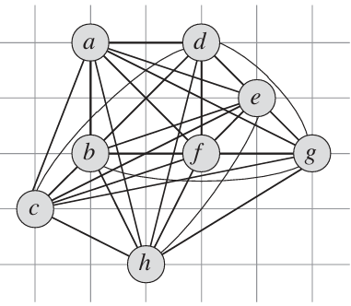
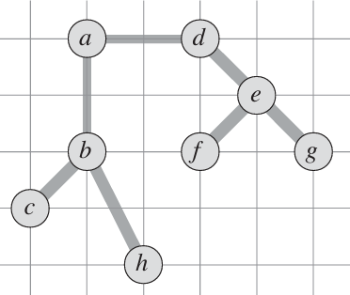
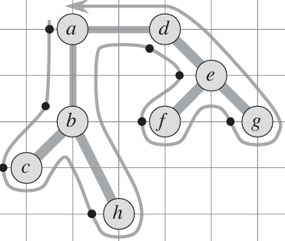
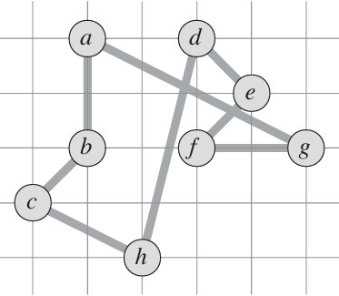
The 2-Approximation Algorithm (APPROX-TSP-TOUR)
Complete undirected graph
O(V^2)
MST-Prim
Preorder walk
Corresponding Tour

Slide 13
The 2-Approximation Algorithm (APPROX-TSP-TOUR)
The cost of this full walk is twice the cost of MST or the optimal tour
a -> b -> c -> b-> h -> b -> a -> d -> e -> f -> e -> g -> e -> d -> a
c(full walk) ≤ 2 × c(optimal tour)
Hamiltonian cycle H is obtained by deleting vertices from the full walk W
a -> b -> c -> h -> d -> e -> f -> g
(Triangle Inequality)
c(H) <= c(W)
MST-Prim
Preorder walk
Corresponding Tour

Slide 14
If the triangle inequality holds, we can find a 2-approximation tour.
c(u,v) ≤ c(u,w) + c(w,v)
4
A
B
A
C
B
3
3

Slide 15
The indirect route can suddenly become cheaper than the direct route.
This breaks the logic behind all approximation algorithms
(since they rely on shortcutting)
10
A
B
A
C
B
3
3
What if the triangle inequality does not hold?
When the triangle inequality does not hold, there is no polynomial-time approximation algorithm unless P = NP
without triangle inequality, you could unknowingly skip a “cheaper indirect path”, i.e meaning any polynomial-time algorithm might miss the optimal by an arbitrarily large factor.

Slide 16
APPROX-TSP-TOUR O(n² ) + 0(n) or O(n² log n) + O(n)
function APPROX_TSP_MST(cost, n):
# Step 1: Find MST of the graph
T = PRIM_MST(cost, n)
# Step 2: Perform preorder traversal of the MST
order = PREORDER(T, start=0)
# Step 3: Visit cities in this order, return to start
total_cost = 0
for i in range(len(order) - 1):
total_cost += cost[order[i]][order[i+1]]
total_cost += cost[order[-1]][order[0]]
print("Approximate tour:", order + [order[0]])
print("Approximate cost:", total_cost)
Notes:
Build an MST connecting all cities (minimum total edge weight).
Walk through that tree and list the order in which cities are visited (pre-order traversal).
Return to the starting city to complete the tour.
Use triangle inequality to “skip” repeated nodes.

Slide 17
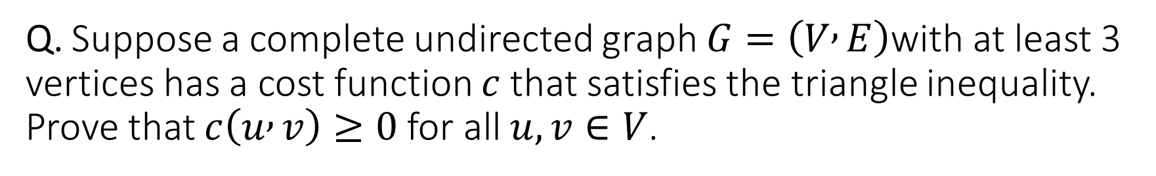
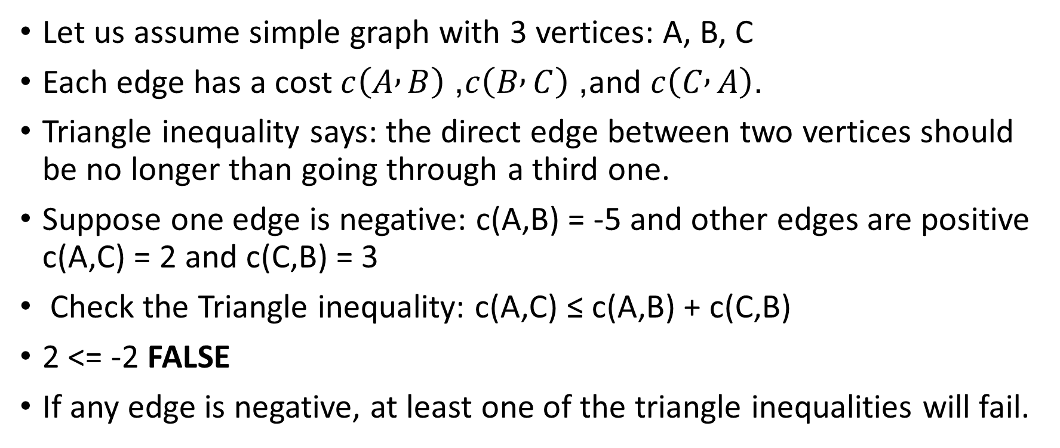
Q. Suppose a complete undirected graph $G=\left(V , E\right)$with at least 3 vertices has a cost function $c$that satisfies the triangle inequality. Prove that $c\left(u , v\right)≥0$for all $u,v∈V$.
Let us assume simple graph with 3 vertices: A, B, C
Each edge has a cost $c\left(A , B\right)$, $c\left(B , C\right)$, and $c\left(C , A\right)$.
Triangle inequality says: the direct edge between two vertices should be no longer than going through a third one.
Suppose one edge is negative: c(A,B) = -5 and other edges are positive c(A,C) = 2 and c(C,B) = 3
Check the Triangle inequality: c(A,C) ≤ c(A,B) + c(C,B)
2 <= -2 FALSE
If any edge is negative, at least one of the triangle inequalities will fail.
Notes:
Negative costs when looped make total cost infinetly smaller, violating the whole idea of triangle inequality and distance consistency.

Slide 18
References
Introduction to Algorithms by Cormen, Leiserson, Rivest, and Stein
Traveling Salesman Algorithms
Travelling Salesman Problem (TSP): Algorithm, Examples, Complexity

