Slide 1


Student Details
MUDAPAKA NAGA PRASANNA HARIKA
mnpharika@gmail.com
ADITYA ENGINEERING COLLEGE
Andhra Pradesh
artificial intelligence and machine learning/03-06-2024 to 15-07-2024

Slide 2
PROJECT TITLE/Problem Statement
PROJECT TITLE : EMPLOYEE BURNOUT PREDICTION
PROBLEM STATEMENT : ”In the fast-paced work environments of today, employee burnout has become a significant challenge for organizations. This issue leads to decreased productivity, increased absenteeism, and higher turnover rates. Despite various efforts to address workplace stress, there remains a critical need for proactive measures to predict and prevent burnout before it negatively impacts employee well-being and organizational performance. The need for a proactive and systematic approach to identifying burnout risk factors has never been more pressing. A robust predictive model leveraging machine learning techniques can offer a powerful solution. the adoption of a machine learning-based predictive model for burnout analysis represents a significant advancement in workplace management. It empowers organizations to foresee burnout risks and take preventative measures, ultimately fostering a supportive and resilient organizational culture.”

Slide 3
AGENDA
Project Overview
End Users
Solution and its Value Proposition
Customization of Project
Modelling
Results
Links

Slide 4
PROJECT OVERVIEW
The project on employee burnout prediction employs advanced machine learning techniques, including Support Vector Machines with Radial Basis Function kernels, Random Forest models, and Linear Regression. By collecting and analyzing diverse datasets encompassing work hours, task assignments, performance metrics, and employee surveys, the project aims to develop accurate predictive models. These models will identify early signs of burnout, allowing for proactive interventions such as workload adjustments, wellness programs, and targeted support to mitigate burnout risks.
objective
Identify key factors: workload, culture, satisfaction.
Implement data-driven interventions.
Evaluate intervention effectiveness
Provide actionable insights for stakeholders.

Slide 5
PROJECT OVERVIEW
Purpose
The purpose of your project on employee burnout prediction is multifaceted, aiming to address critical challenges in modern workplaces related to employee well-being and organizational effectiveness. This predictive capability is essential for identifying at-risk individuals before burnout reaches critical levels, allowing for timely intervention and support..
Scope
Collect and analyze data on employee behaviors and job satisfaction.
Create a model to predict early signs of burnout.
Identify main factors contributing to burnout.
Implement interventions based on predictions.

Slide 6
END USERS of this project
END USERS:
Organizational Leaders and Managers
Human Resources (HR) Department
Employees
Stakeholders
Investors
Benefits
Early Intervention and Prevention: Predictive models can help identify early warning signs of burnout, such as increased stress levels, decreased job satisfaction, or changes in behavior.
Enhanced Organizational Performance: Addressing burnout can lead to improved organizational performance in several ways. Engaged and healthy employees tend to be more productive, creative, and committed to their work.

Slide 7
NEEds
END USERS of this project
Early Detection: There is a need to identify signs of burnout in employees early on to prevent negative impacts on performance, well-being, and organizational outcomes.
Understanding Causes: Understanding the complex factors contributing to burnout, such as workload, organizational culture, and job satisfaction, is crucial for developing effective prevention strategies.
Effective Interventions: Developing and implementing targeted interventions based on predictive insights to mitigate burnout risks and support employee well-being.
Characteristics
Data-Driven: Relies on collecting and analyzing data on employee behaviors, satisfaction levels, and organizational factors.
Predictive: Uses statistical models and machine learning techniques to forecast and detect early signs of burnout.
Intervention-Focused: Implements targeted strategies and interventions based on predictive insights to mitigate burnout risks.

Slide 8
SOLUTION AND ITS VALUE PROPOSITION
Predictive Analytics for Early Detection:Implementing predictive analytics models to identify early indicators of burnout using employee data and machine learning algorithms.
Early detection and intervention reduce the likelihood of severe burnout, minimizing its impact on employee health and organizational performance
Comprehensive Well-being Programs:Implement holistic wellness initiatives including stress management, fitness, counseling, and flexible work arrangements.
Employees who feel supported and valued are more likely to be engaged, satisfied, and productive, leading to better performance and retention.
Effective Workload Management:Optimize task distribution and conduct workload assessments to ensure manageable workloads and prevent employee overwhelm.
Targeted interventions ensure efficient use of resources, focusing efforts where they are most needed and effective.
Supportive Organizational Culture and Leadership:Foster a culture of open communication and empathy, with trained leaders who prioritize and address employee well-being.
Promoting a culture of care and support enhances the organization's reputation, attracting and retaining top talent.

Slide 9
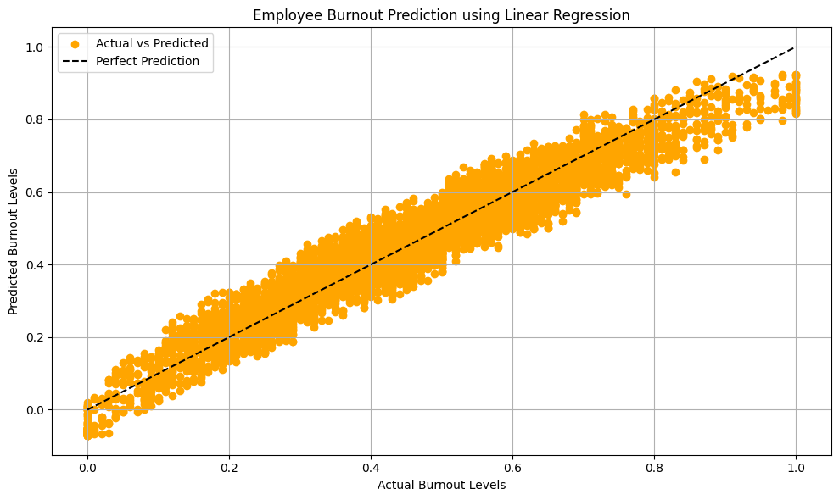
customization of project
Customizing an employee burnout prediction model using linear regression involves several steps, from data preparation to model evaluation. Here’s a high-level outline to get you started:
Data Collection: Gather data on various factors that could contribute to employee burnout
Data Preprocessing:Handle missing values, remove duplicates, and address any outliers.
Feature Selection:Select the most relevant features for predicting burnout. This can be done using techniques like Correlation analysis,Mutual information,Feature importance
Model Building:Split the dataset into training and test sets, train the linear regression model on the training data, and validate it using the test set to ensure it generalizes well without overfitting.

Slide 10
MODELLING
Modelling Techniques used:
Linear Regression : To predict employee burnout using linear regression, first gather relevant data such as work hours, task load, engagement scores, and job satisfaction. Clean and preprocess this data to handle missing values and normalize variables. Select key features that influence burnout through correlation analysis.
Support Vector Machine(RBF) : The RBF (Radial Basis Function) Support Vector Machine (SVM) is a variant of SVM that uses To predict employee burnout using a Support Vector Machine with a Radial Basis Function (RBF) kernel, begin by collecting and preprocessing relevant data, including work hours, task load, engagement scores, and job satisfaction.
Support Vector Machine(Linear) : A linear Support Vector Machine (SVM) is a type of SVM that uses to collect and preprocess relevant data such as work hours, task load, engagement scores, and job satisfaction. Select key features through correlation analysis.
Random Forest Regression : Random Forest Regression is an ensemble learning technique that uses multiple decision trees to perform regression tasks. The ensemble of decision trees in the Random Forest will provide robust predictions of burnout risk.

Slide 11
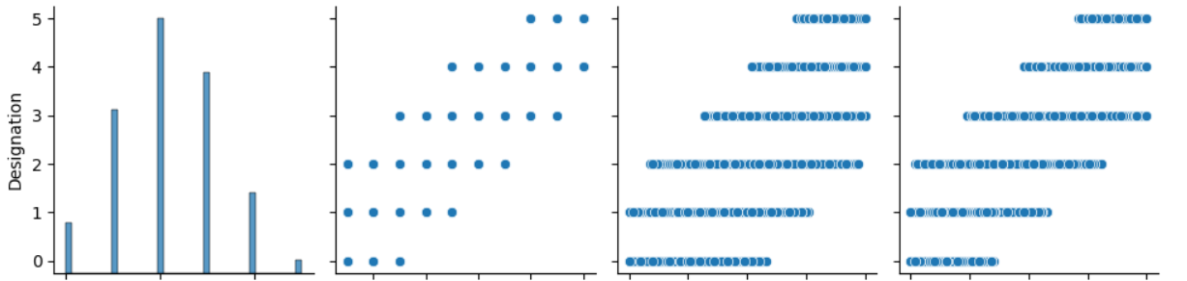
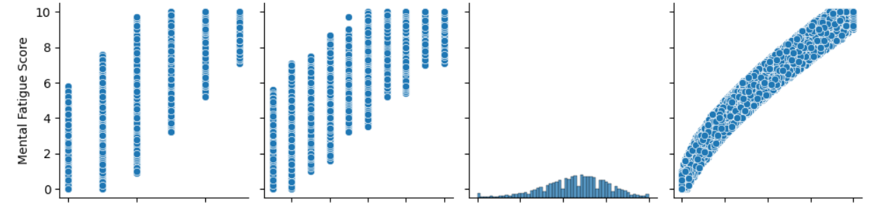
Exploratory data analysis

Slide 12
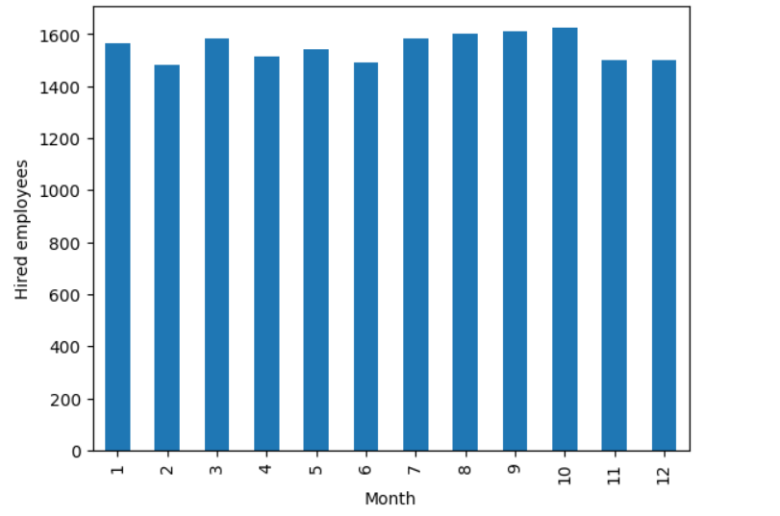
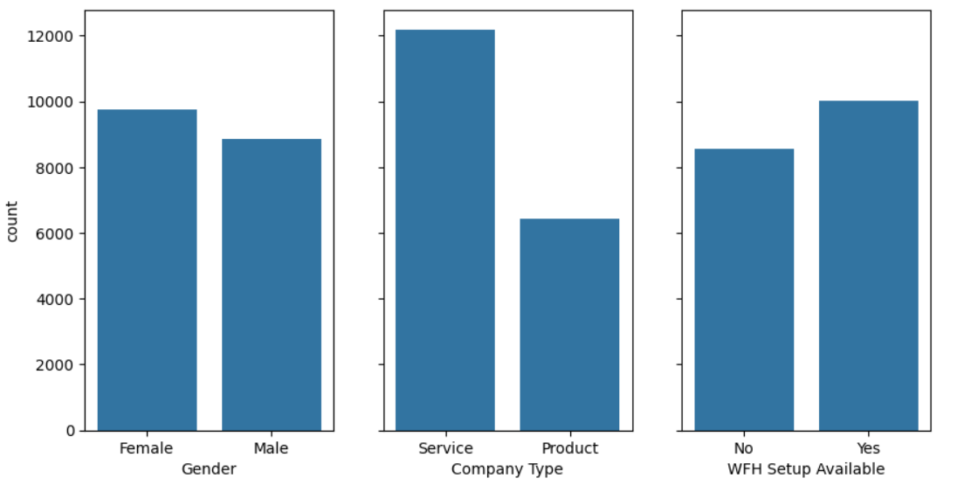
Exploratory data analysis

Slide 13
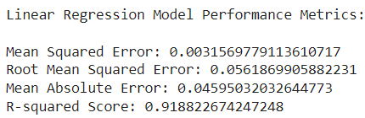
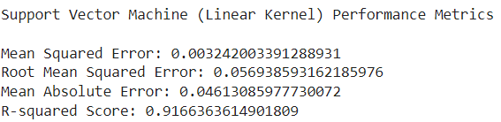
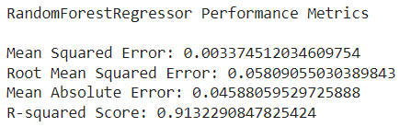
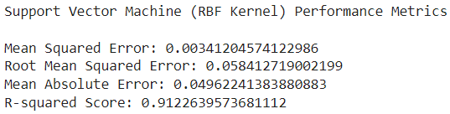
Results
Based on the evaluation metrics, the Linear Regression model has demonstrated superior performance in predicting employee burnout compared to other models we evaluated. So, the Linear Regression model is the best choice for predicting burnout, so we are deploying it.
It has shown the lowest values for Mean Squared Error (MSE), Root Mean Squared Error (RMSE), and Mean Absolute Error (MAE), indicating superior accuracy and precision in its predictions. Moreover, it achieved the highest R-squared score, suggesting a strong fit to the data and better explanation of the variance in the target variable compared to other models evaluated.

Slide 14
links
GitHub Link (Project Link):
https://github.com/21a91a05g2/project-aiml.git
Reference Link:
https://www.geeksforgeeks.org/ml-linear-regression/

