Slide 1

DESIGN OF MEMRISTOR BASED LOW POWER ENCODER USING PGL TECHNIQUE
ADITYA ENGINEERING COLLEGE (A)
BATCH NUMBER: C15
Under the guidance of : | Presented by:
MR.P.BUJJIBABU | 1. M.GANESH (20A91A04F4)
Professor | 2. M.KOMAL (21A95A0420)
Department of Electronics and Communication Engineering | 3. SK.A.RAZAK(20A91A04H5)
Aditya Engineering College (A) | 4. K.SAIRAM(20A91A04F1)

Slide 2
Contents
Abstract
Introduction
Existing system
Proposed system
Results
Conclusion
References

Slide 3
Abstract
Combinational logic circuits are the fundamental building blocks for almost all digital electronic systems. The design of digital logic gates using a Memristor gives an alternative to the present IC design because of its lower power consumption as compared to CMOS logic. Data converters are even crucial for signal processing modules. In such case, encoders and decoders are playing key role. Another interesting application for Memristor devices is logic circuits. Here, a Memristor-based Encoder using Power Gating Logic(PGL) is superior in performance. Memristive devices are novel structures, developed primarily as memory. Here, a Memristor-based encoder using Power Gating Logic(PGL) can be used to reduce the power consumption, delay of overall logic circuit. The encoder will be design using various logic styles such as CMOS logic, Pseudo NMOS logic, and Memristor (MRL) logic for comparative analysis. This project mainly aims to design power efficient encoder, and at potential delay besides the area in different combinational circuits. By virtually designing these circuits in Cadence Tools we can select the circuit that is most effective which can be used in various applications such as sample and hold, or other type of communication channels.
.
.

Slide 4
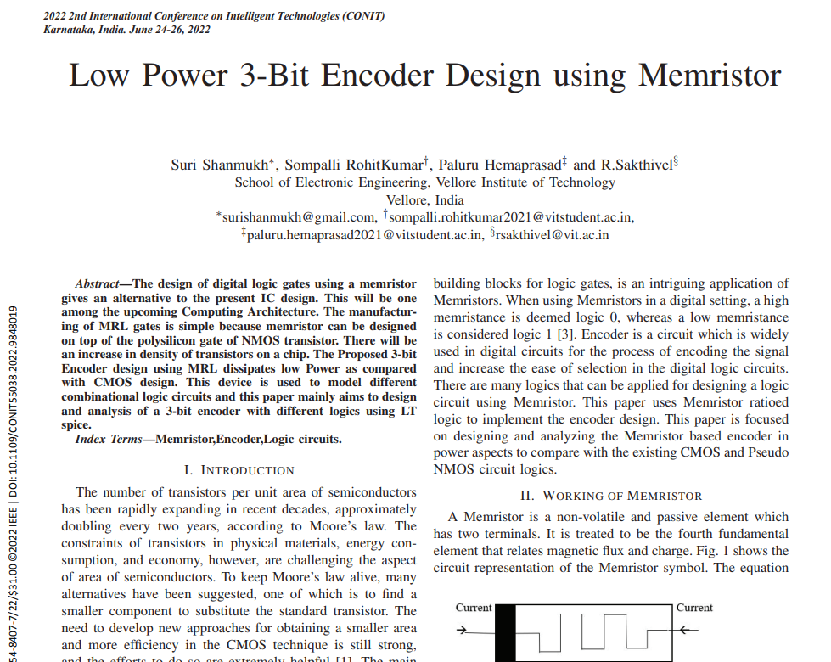
Base Paper

Slide 5
Introduction
A memristor is an electrical component that regulates flow of electrical current in a circuit and remembers the amount of charge that has previously flowed through it.
Memristor is a non-volatile and passive element which has two terminals.
Memristance is related to the magnetic flux and charge i.e,
M = dφ/dq
Memristance is simply charge-dependent resistance and the unit of the memristance is ohm.

Slide 6
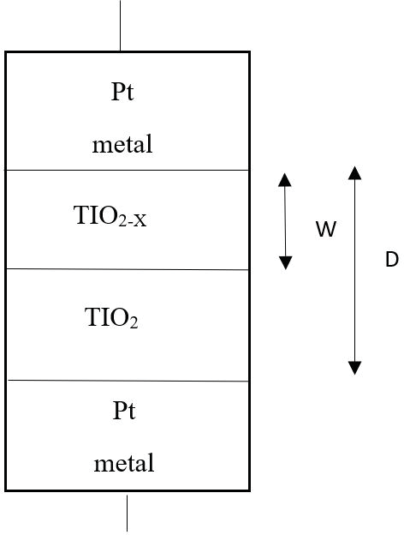
Memristor is usually an MIM structure i.e. an insulating layer/resistive layer is sandwiched between two metal layers.
pure(undoped) titanium dioxide (TiO2) acts as a dielectric.
On top of the dielectric, a doped titanium dioxide (TiO2−x) acts as a semiconductor. The current through the memristor makes the resistance of the device to vary.

Slide 7
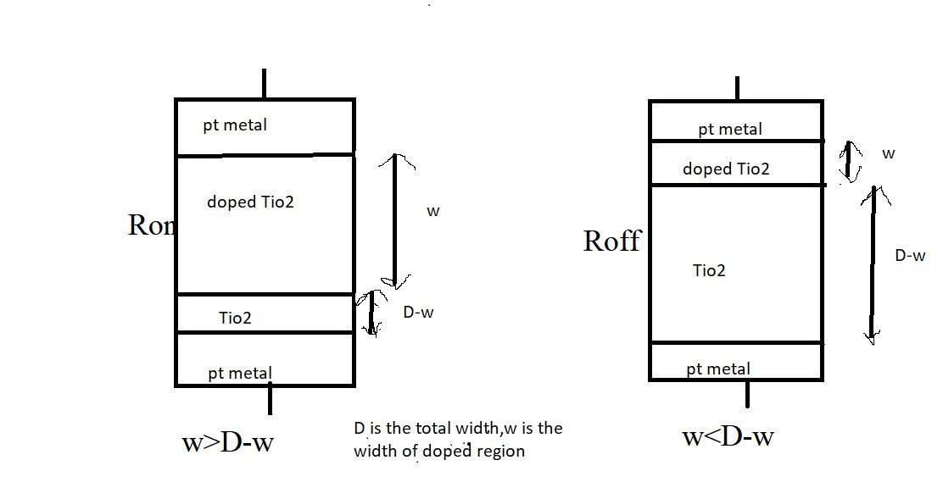
Resistance offered by the memristor when the width of the doped region(w) is higher than the undoped region width(D-w) of TiO2 is Low and is known as Ron.
Resistance offered by the memristor where the width of the undoped region(D-w) is higher than the width of the doped region(w) is High and is know as Roff .
Fig 2 : Resistances in memristor

Slide 8
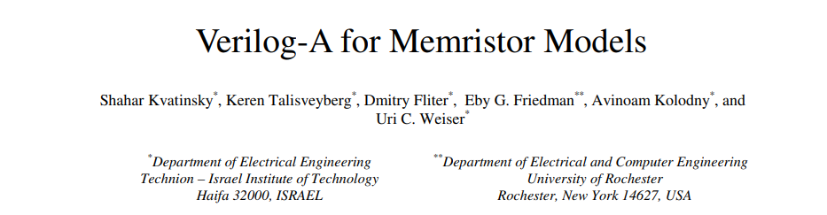
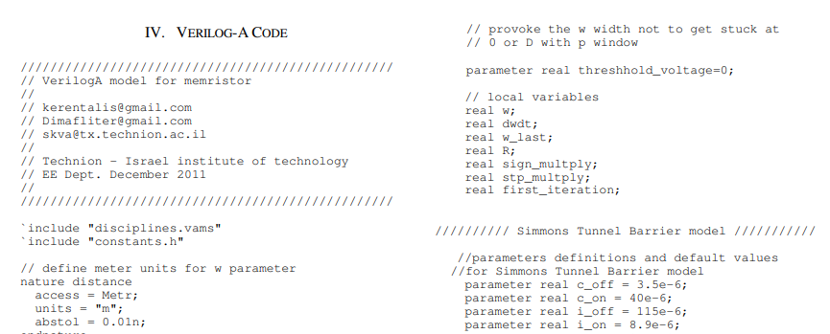
In general the memristor device in not available in the modules of cadence.
In order to get the memristor device into cadence we used the Verilog A code from the external source.
And implemented into our encoder design.

Slide 9
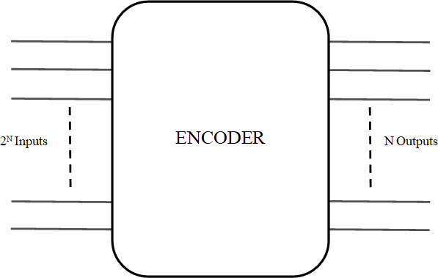
Encoder
Encoder is a combinational circuit which does the encoding function. The encoder function is to encode when one of the input bits is of effective level, and the encoder output changes in accordance with its input bits. The circuit has‘2^{N}’ inputs. ‘N’ outputs.
Fig 4 : Block Diagram of Encoder

Slide 10
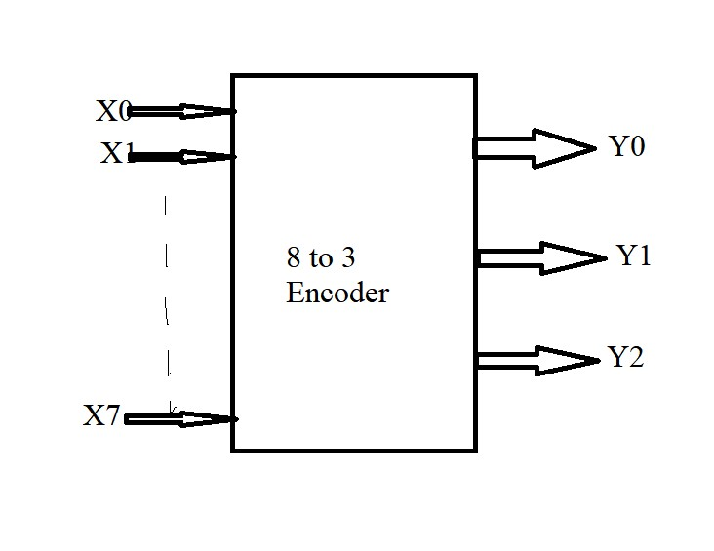
Design of 8 to 3 Encoder:
Fig 5 : Block diagram

Slide 11
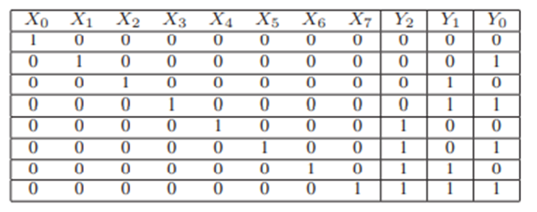
Truth Table of encoder
From the Encoder truth table, the outputs and inputs are related by
Y0 = X1 + X3 + X5 + X7
Y1 = X2 + X3 + X6 + X7
Y2 = X4 + X5 + X6 + X7

Slide 12
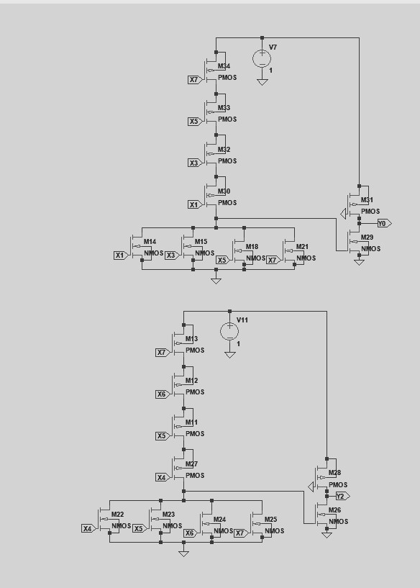
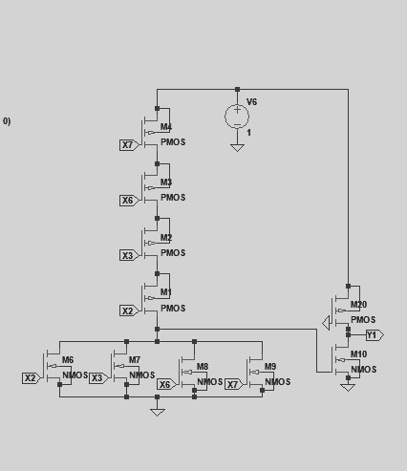
Encoder using CMOS logic

Slide 13
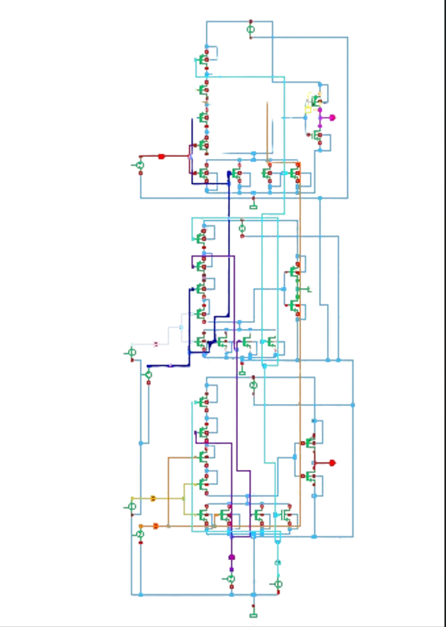
Encoder using CMOS logic

Slide 14
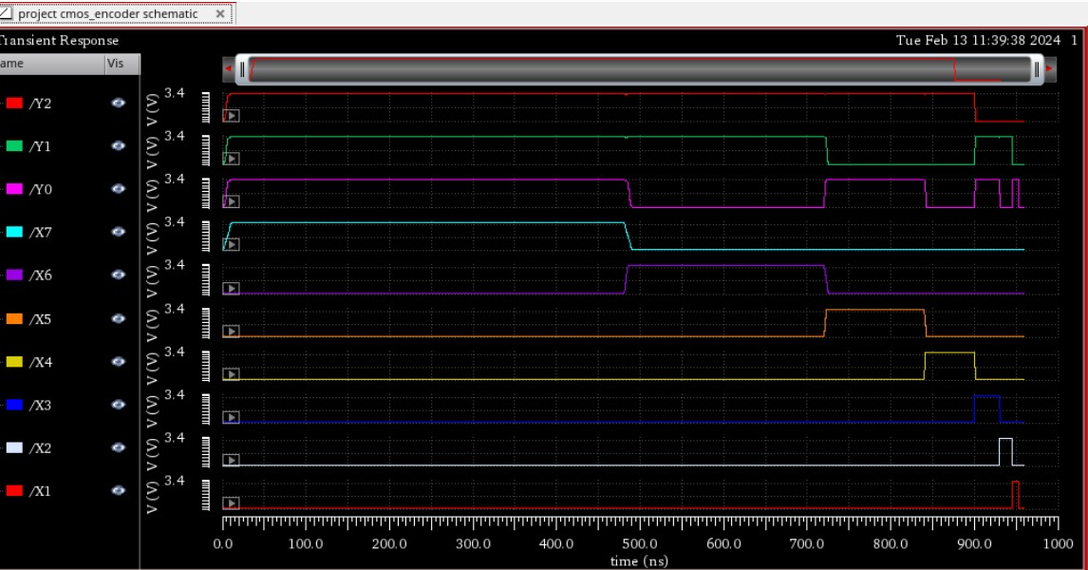
Resulting waveform

Slide 15
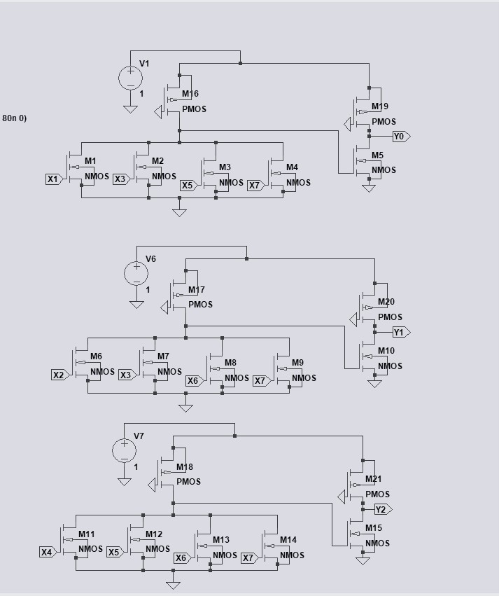
Encoder using Pseudo NMOS logic

Slide 16
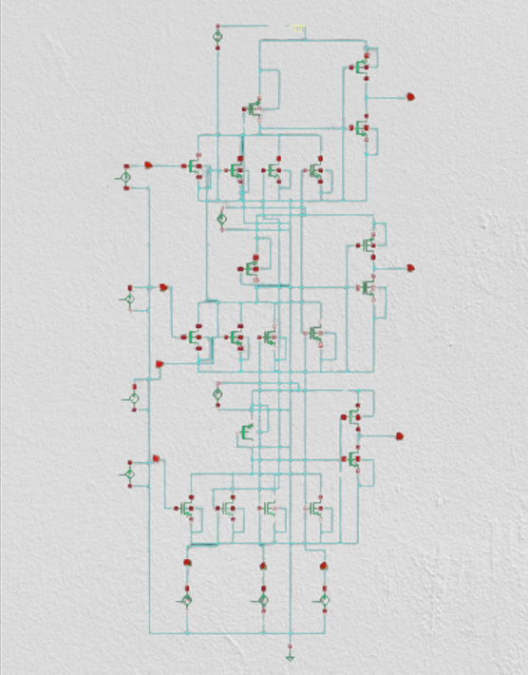
Encoder using Pseudo NMOS logic

Slide 17
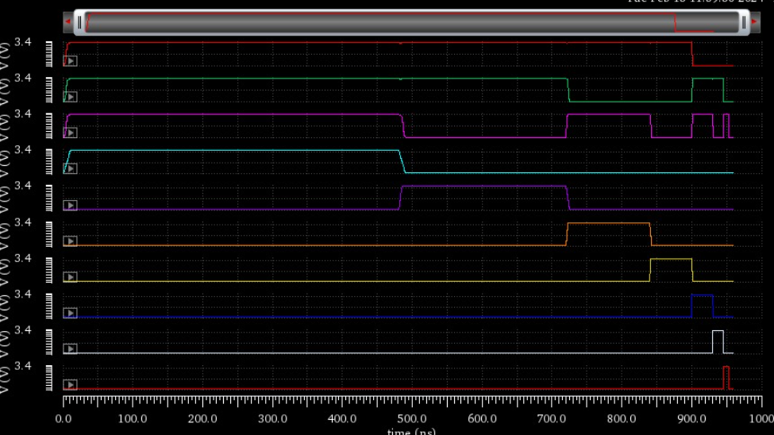
Resulting waveform

Slide 18
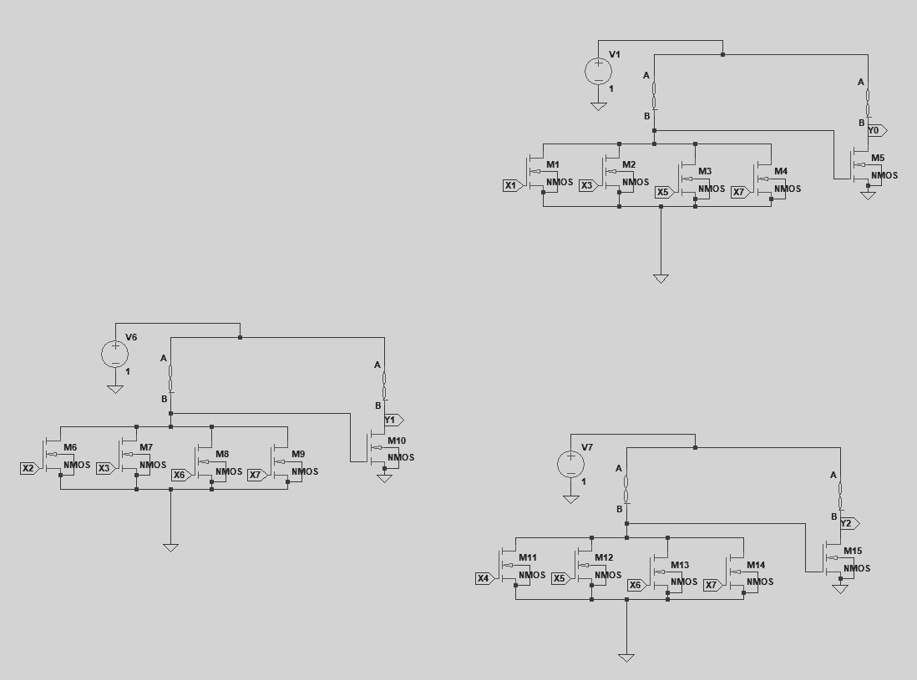
Encoder using memristor

Slide 19
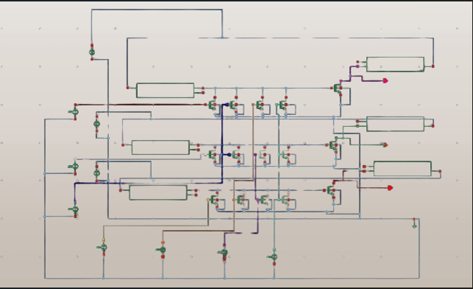
Encoder using memristor

Slide 20
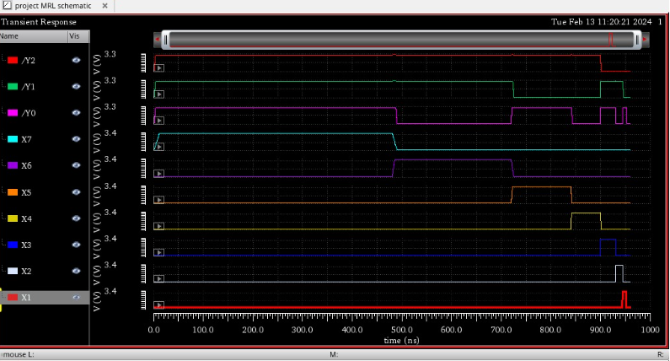
Resulting waveform

Slide 21
Performance evaluation
 | Average Power (uW) | Delay (ps) | Average power * Delay
CMOS Based Encoder | 176.1 | 214.8 | 37.826
Pseudo NMOS encoder | 226.6 | 198.2 | 44.838
MRL Based encoder | 148.7 | 193.92 | 28.835

Slide 22
References
[1] S. Smaili and Y. Massoud, “Analytic modeling of memristor variability for robust memristor systems designs,” in 2014 IEEE International Symposium on Circuits and Systems (ISCAS). IEEE, 2014, pp. 794–797
[2]. S. Mandal, J. Sinha, and A. Chakraborty, “Design of memristor– cmos based logic gates and logic circuits,” in 2019 2nd International Conference on Innovations in Electronics, Signal Processing and Com- munication (IESC). IEEE, 2019, pp. 215–220.
[3] G. Liu, S. Shen, P. Jin, G. Wang, and Y. Liang, “Design of memristor based combinational logic circuits,” Circuits, Systems, and Signal Processing, vol. 40, no. 12, pp. 5825–5846, 2021.
[4] G. Liu, S. Shen, P. Jin, G. Wang, and Y. Liang, “Design of memristor based combinational logic circuits,” Circuits, Systems, and Signal Processing, vol. 40, no. 12, pp. 5825–5846, 2021.
[5]Suri Shanmukh, Sompalli RohitKumar, Paluru Hemaprasad‡ and R.Sakthivel Low Power 3-Bit Encoder Design using Memristor2nd International Conference on Intelligent Technologies (CONIT) Karnataka, India. June 24-26, 2022

Slide 23
Thank You…

