Slide 1

DESIGN OF MEMRISTOR BASED LOW POWER ENCODER USING PGL TECHNIQUE
ADITYA ENGINEERING COLLEGE (A)
BATCH NUMBER: C15
Under the guidance of : | Presented by:
MR.P.BUJJIBABU | 1. M.GANESH (20A91A04F4)
Associate Professor | 2. M.KOMAL (21A95A0420)
Department of Electronics and Communication Engineering | 3. SK.A.RAZAK(20A91A04H5)
Aditya Engineering College (A) | 4. K.SAIRAM(20A91A04F1)

Slide 2
Contents
Abstract
Introduction
Existing system
Proposed system
Results
Conclusion
References

Slide 3
Abstract
This project delves into the design and implementation of an innovative encoder architecture leveraging memristors integrated with Power Gating Logic (PGL), aiming to present a compelling alternative to traditional CMOS logic circuits that consumes less power. The study not only introduces a novel encoder architecture incorporating PGL based on memristors but also conducts comprehensive comparative analyses with established logic styles such as Memristor Logic (MRL), CMOS, and pseudo-NMOS encoder designs. Through rigorous experimentation and evaluation, significant enhancements are demonstrated, including a noteworthy reduction in the power-delay product (PDP) from 10816x10^-12 to 10666x10^-12 and a substantial decrease in average power consumption from 80.7 milliwatts to 61.4 milliwatts. The utilization of Cadence Tools facilitates thorough evaluation of a 3-bit memristor encoder, employing the PGL methodology. This project not only showcases the feasibility and effectiveness of memristor-based logic circuits but also contributes valuable insights into optimizing power efficiency and performance in digital circuit design.
.
.

Slide 4
Introduction
A memristor is an electrical component that regulates flow of electrical current in a circuit and remembers the amount of charge that has previously flowed through it.
Memristor is a non-volatile and passive element which has two terminals.
Memristance is related to the magnetic flux and charge i.e,
M = dφ/dq
Memristance is simply charge-dependent resistance and the unit of the memristance is ohm.

Slide 5
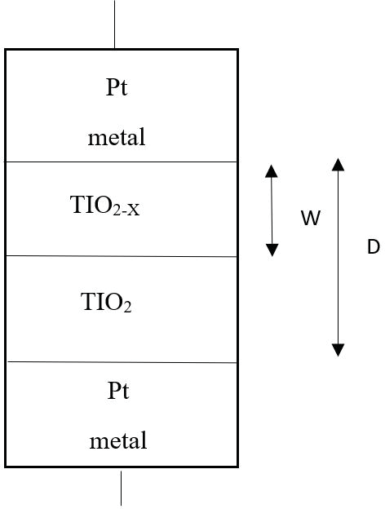
Memristor is usually an MIM structure i.e. an insulating layer/resistive layer is sandwiched between two metal layers.
pure(undoped) titanium dioxide (TiO2) acts as a dielectric.
On top of the dielectric, a doped titanium dioxide (TiO2−x) acts as a semiconductor. The current through the memristor makes the resistance of the device to vary.

Slide 6
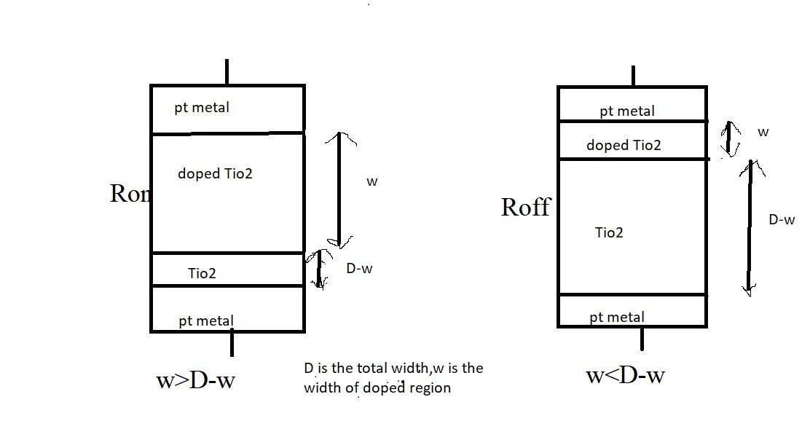
Resistance offered by the memristor when the width of the doped region(w) is higher than the undoped region width(D-w) of TiO2 is Low and is known as Ron.
Resistance offered by the memristor where the width of the undoped region(D-w) is higher than the width of the doped region(w) is High and is know as Roff .
Fig 2 : Resistances in memristor

Slide 7
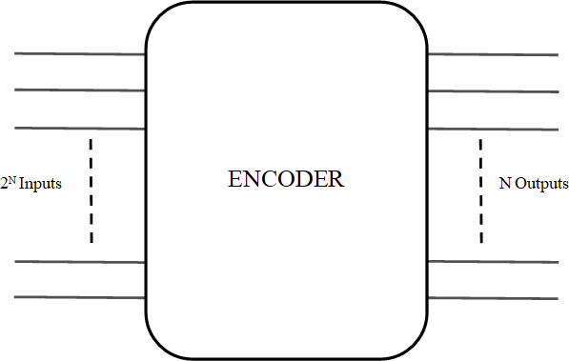
Encoder
Encoder is a combinational circuit which does the encoding function. The encoder function is to encode when one of the input bits is of effective level, and the encoder output changes in accordance with its input bits. The circuit has‘2^{N}’ inputs. ‘N’ outputs.
Fig 4 : Block Diagram of Encoder

Slide 8
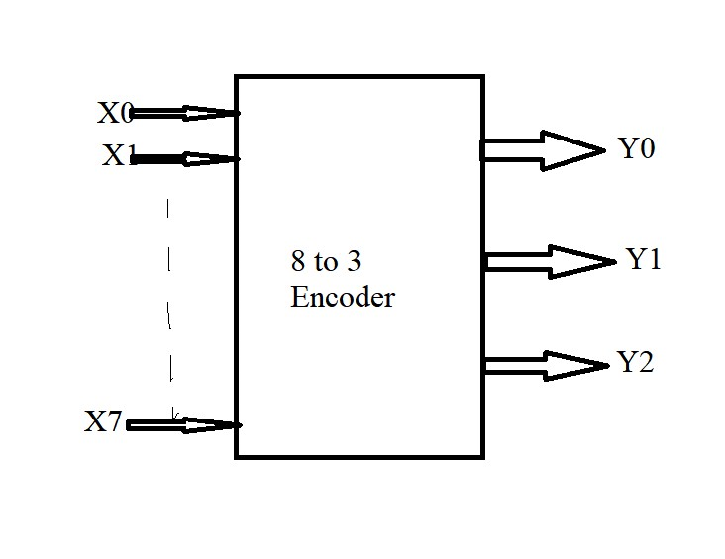
Design of 8 to 3 Encoder:
Fig 5 : Block diagram

Slide 9
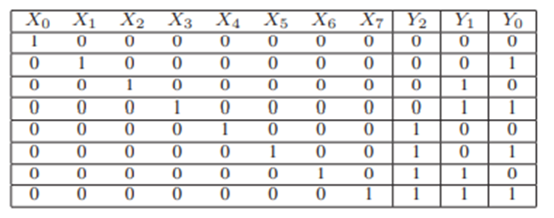
Truth Table of encoder
From the Encoder truth table, the outputs and inputs are related by
Y0 = X1 + X3 + X5 + X7
Y1 = X2 + X3 + X6 + X7
Y2 = X4 + X5 + X6 + X7

Slide 10
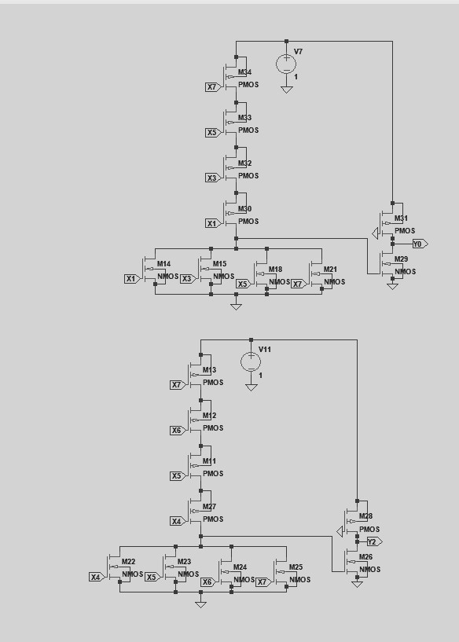
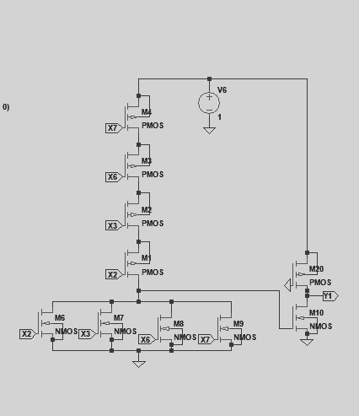
Encoder using CMOS logic

Slide 11
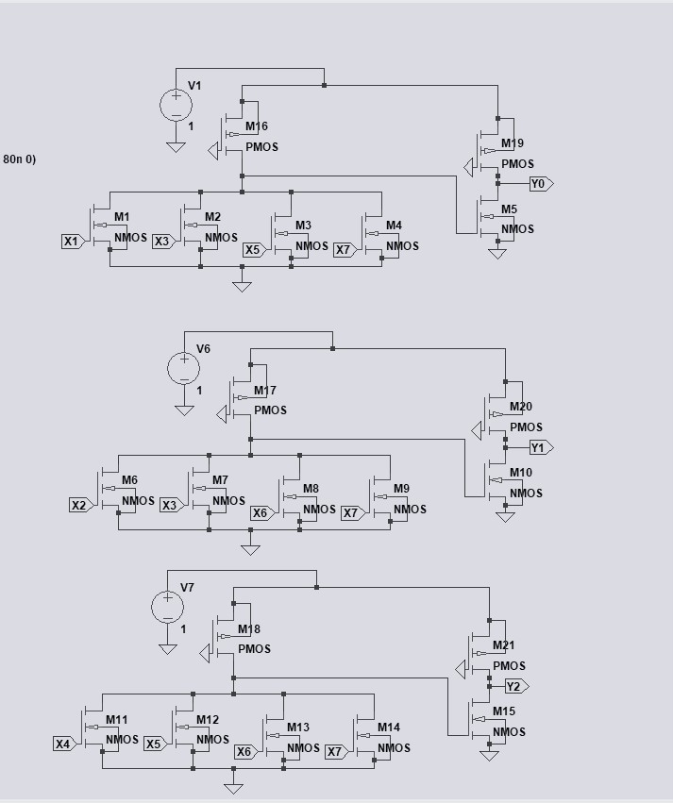
Encoder using Pseudo NMOS logic

Slide 12
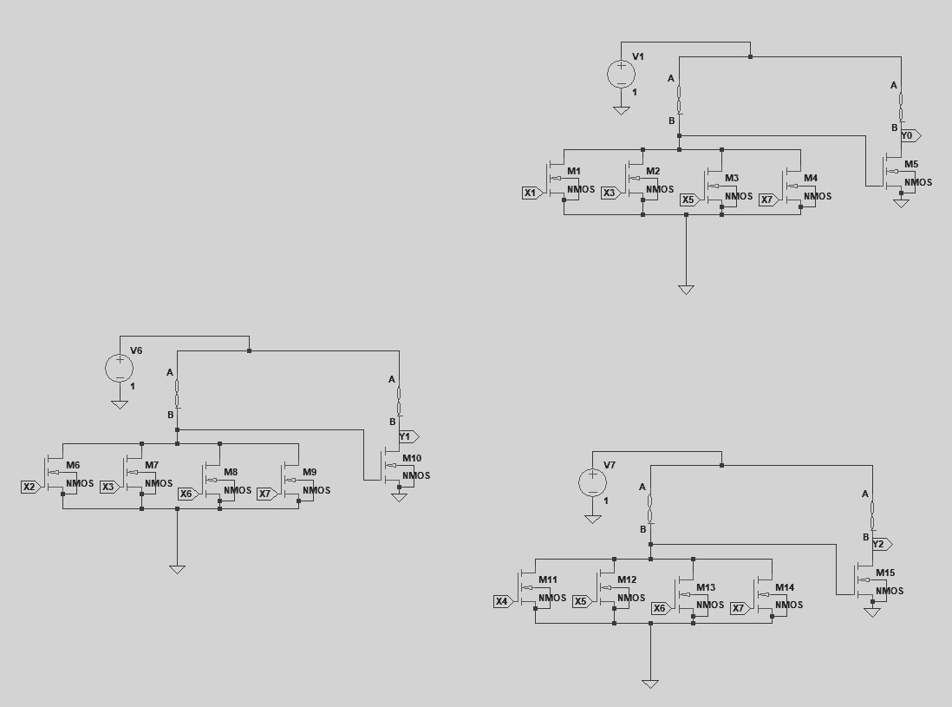
Encoder using memristor

Slide 13
Disadvantage:
More Power consumption
More Delay
Area is More
13

Slide 14
Problems Identified
Literature Review
Year of publishing | Type of publishing | Authors | Title | Description
2012 | International Journal of Technical Research and Applications | S. Kvatinsky, N. Wald, G. Satat | Mrl—memristor ratioed logic | It is about to reduce the design effort of an MRL circuit by using standard library cells composed of only NOR and NAND logic gates.
2013 | IEEE Transactions on Very Large Scale Integration (VLSI) SYSTEMS | S. Kvatinsky, G. Satat, N. Wald | Memristor-based material implication (imply) logic: Design principles and methodologies | It tells about device structure optimization, logic synthesis methods, array structures, and computing architectures
2020 | International Institute of Information Technology | K. Mbarek, F. O. Rziga | Design and properties of logic circuits based on memristor devices | In this context, we examined the model behavior under the configuration of the 1T1R OxRRAM.
2021 2022 | IEEE journal of solid state circuits International conference on intellignt technologies | Liu, Gongzhi & Shen, Shuhang SuriShanmukh,Sompalli Rohit kumar. | Memristor based XNOR for high speed area efficient 1-bit Full Adder Low power 3-bit encoder using Memristor | In this paper nano-device property of Memristor has been utilized to design an area efficient high speed full adder. In comparison to other design of logic gate and full adder, the novel full adder circuit has the advantage of simplified architecture, better speed and higher power efficiency. In this paper designing of encoder using memristor is designed and also compare with the other design with CMOS,Pseudo NMOS.
14

Slide 15
PGL Technique
In the power gating structure, a circuit operates in two different modes.
In the active mode, the sleep transistors are turned ON and can be treated as the functional redundant resistances.
In the sleep mode, the sleep transistors are turned OFF to reduce the leakage power.
When a sleep transistor is placed at VDD, it is called as the "Header switch" and while it is placed near the ground, it is called as "Footer switch"..

Slide 16
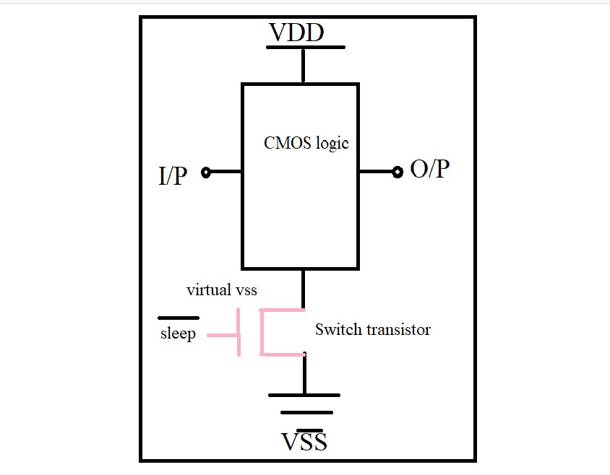
Sleep transistor (ST) are used as switches to shut off power supplies of the standby circuits, as shown in fig. A ST is referred to either a PMOS or NMOS.High Vth transistor that connects permanent power supply to circuit power supply which is commonly called “virtual power supply”.
Fig 6 : Block Diagram of PGL Aproach
16

Slide 17
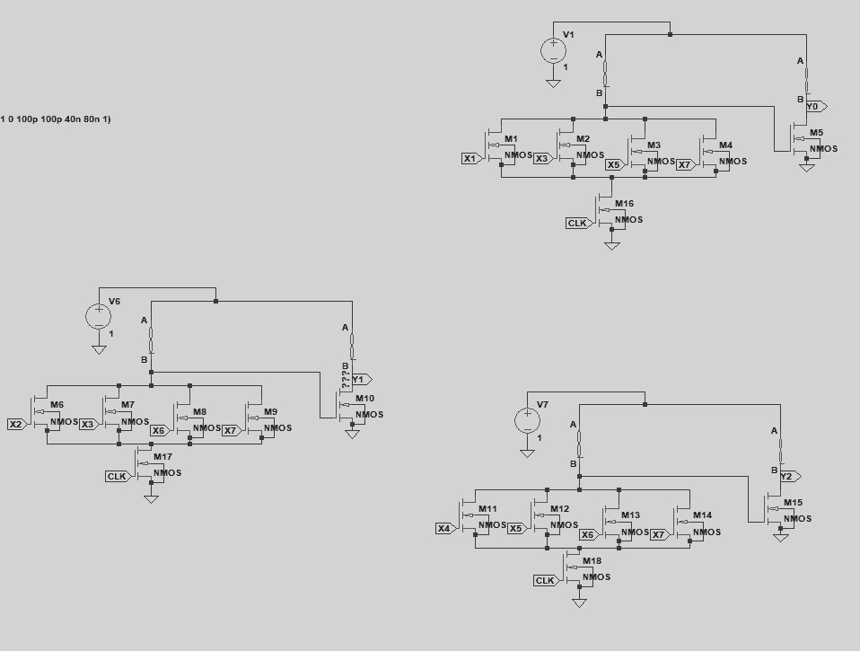
Block Diagram for Memristor Using PGL
*

Slide 18
Advantages
Less Power consumption
Less Delay
Less Number of Transistors used
Applications
Data Backup Technique
Digital circuit design
18

Slide 19
Performance evaluation
 | Average Power (mW) | Delay (ps) | Power-Delay Product (PDP)
CMOS Based Encoder | 719.5 | 129.57 | 93225 x 10^-12
Pseudo NMOS encoder | 104.7 | 177.94 | 18630 x 10^-12
MRL Based encoder | 80.7 | 134.031 | 10816 x 10^-12
MRL based encoder using PGL technique | 60.4 | 173.74 | 10667 x 10^-12

Slide 20
Conclusion
Memristor based encoder in Power Gating logic is much efficient in the aspects of power and area when compared with conventional CMOS logic and Pseudo NMOS logic. The trade-off between the power, area and speed of a circuit is persistent. It can be concluded that this design technique gives lesser number of transistor count required. Total power consumption is reduced to 60.4mW from 80.7mW which is 23.9% reduction from encoder using MRL Technique. the power-delay product(PDP) factor is reduced to 10667x10^-12 from 10816x10^-12. Due to this advantage it makes more efficient way of designing a digital circuit.
20

Slide 21
References
[1] S. Smaili and Y. Massoud, “Analytic modeling of memristor variability for robust memristor systems designs,” in 2014 IEEE International Symposium on Circuits and Systems (ISCAS). IEEE, 2014, pp. 794–797
[2]. S. Mandal, J. Sinha, and A. Chakraborty, “Design of memristor– cmos based logic gates and logic circuits,” in 2019 2nd International Conference on Innovations in Electronics, Signal Processing and Com- munication (IESC). IEEE, 2019, pp. 215–220.
[3] G. Liu, S. Shen, P. Jin, G. Wang, and Y. Liang, “Design of memristor based combinational logic circuits,” Circuits, Systems, and Signal Processing, vol. 40, no. 12, pp. 5825–5846, 2021.
[4] G. Liu, S. Shen, P. Jin, G. Wang, and Y. Liang, “Design of memristor based combinational logic circuits,” Circuits, Systems, and Signal Processing, vol. 40, no. 12, pp. 5825–5846, 2021.
[5]Suri Shanmukh, Sompalli RohitKumar, Paluru Hemaprasad‡ and R.Sakthivel Low Power 3-Bit Encoder Design using Memristor2nd International Conference on Intelligent Technologies (CONIT) Karnataka, India. June 24-26, 2022

Slide 22
Thank You…

