Slide 1

DESIGN OF MEMRISTOR BASED LOW POWER ENCODER USING PGL TECHNIQUE
ADITYA ENGINEERING COLLEGE (A)
BATCH NUMBER: C15
Under the guidance of : | Presented by:
MR.P.BUJJIBABU | 1. M.GANESH (20A91A04F4)
Associate Professor | 2. M.KOMAL (21A95A0420)
Department of Electronics and Communication Engineering | 3. SK.A.RAZAK(20A91A04H5)
Aditya Engineering College (A) | 4. K.SAIRAM(20A91A04F1)

Slide 2
Contents
Abstract
Introduction
Existing system
Proposed system
Results
Conclusion
References

Slide 3
Abstract
Combinational logic circuits are the fundamental building blocks for almost all digital electronic systems. The design of digital logic gates using a Memristor gives an alternative to the present IC design because of its lower power consumption as compared to CMOS logic. Data converters are even crucial for signal processing modules. In such case, encoders and decoders are playing key role. Another interesting application for Memristor devices is logic circuits. Here, a Memristor-based Encoder using Power Gating Logic(PGL) is superior in performance. Memristive devices are novel structures, developed primarily as memory. Here, a Memristor-based encoder using Power Gating Logic(PGL) can be used to reduce the power consumption, delay of overall logic circuit. The encoder will be design using various logic styles such as CMOS logic, Pseudo NMOS logic, and Memristor (MRL) logic for comparative analysis. This project mainly aims to design power efficient encoder, and at potential delay besides the area in different combinational circuits. By virtually designing these circuits in Cadence Tools we can select the circuit that is most effective which can be used in various applications such as sample and hold, or other type of communication channels.
.
.

Slide 4
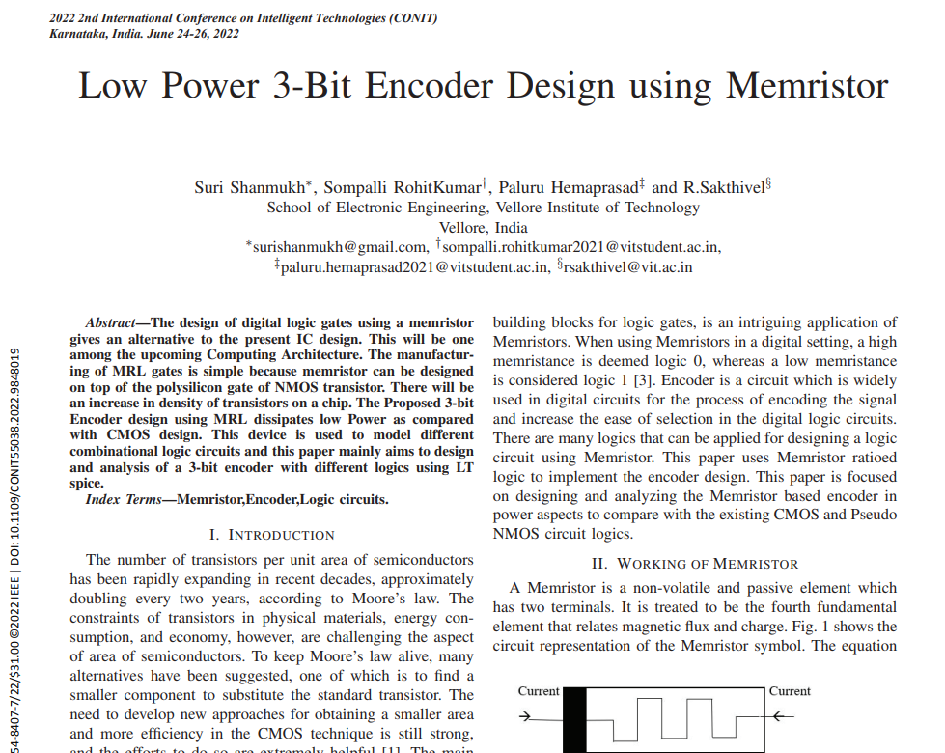
Base Paper

Slide 5
Introduction
A memristor is an electrical component that regulates flow of electrical current in a circuit and remembers the amount of charge that has previously flowed through it.
Memristor is a non-volatile and passive element which has two terminals.
Memristance is related to the magnetic flux and charge i.e,
M = dφ/dq
Memristance is simply charge-dependent resistance and the unit of the memristance is ohm.

Slide 6
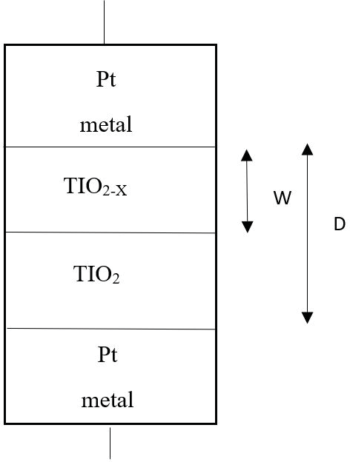
Memristor is usually an MIM structure i.e. an insulating layer/resistive layer is sandwiched between two metal layers.
pure(undoped) titanium dioxide (TiO2) acts as a dielectric.
On top of the dielectric, a doped titanium dioxide (TiO2−x) acts as a semiconductor. The current through the memristor makes the resistance of the device to vary.

Slide 7
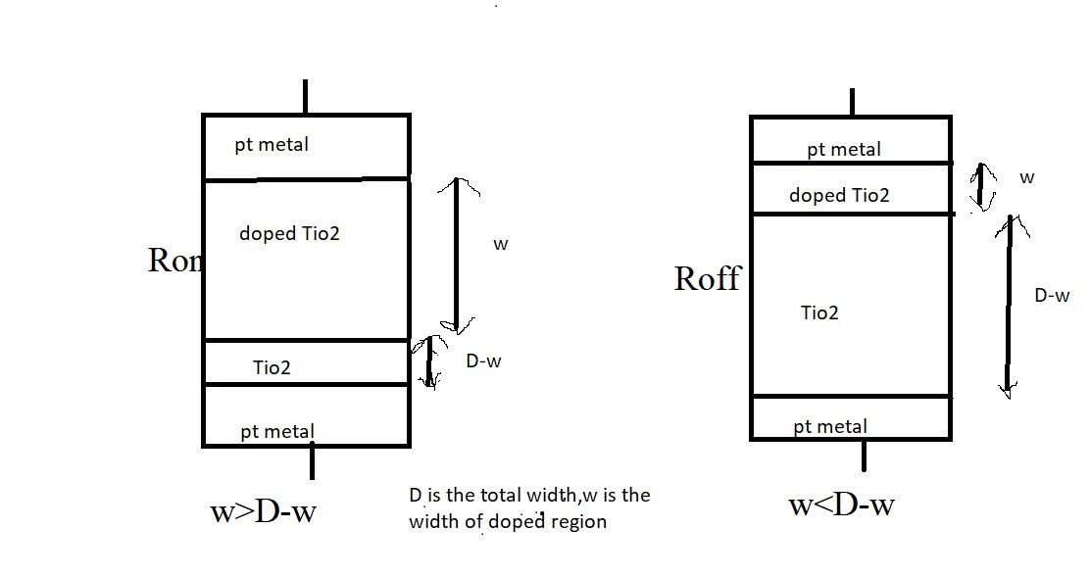
Resistance offered by the memristor when the width of the doped region(w) is higher than the undoped region width(D-w) of TiO2 is Low and is known as Ron.
Resistance offered by the memristor where the width of the undoped region(D-w) is higher than the width of the doped region(w) is High and is know as Roff .
Fig 2 : Resistances in memristor

Slide 8
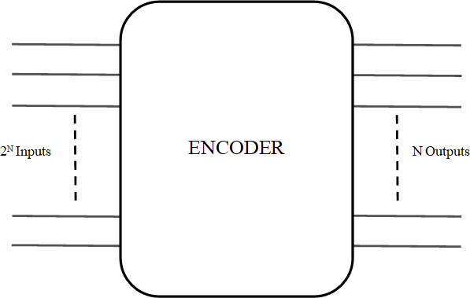
Encoder
Encoder is a combinational circuit which does the encoding function. The encoder function is to encode when one of the input bits is of effective level, and the encoder output changes in accordance with its input bits. The circuit has‘2^{N}’ inputs. ‘N’ outputs.
Fig 4 : Block Diagram of Encoder

Slide 9
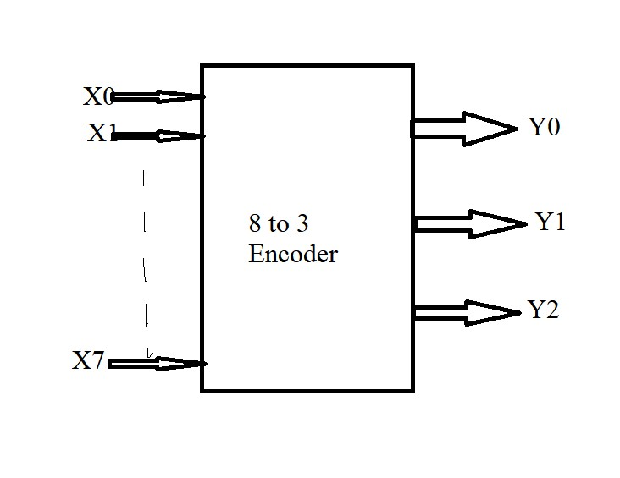
Design of 8 to 3 Encoder:
Fig 5 : Block diagram

Slide 10
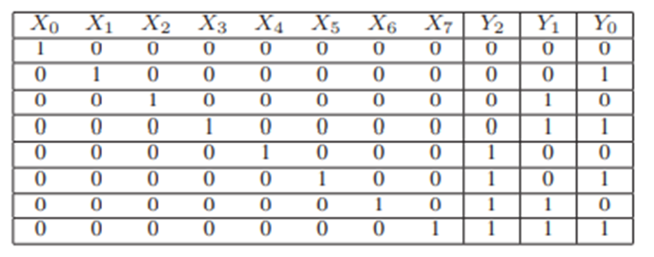
Truth Table of encoder
From the Encoder truth table, the outputs and inputs are related by
Y0 = X1 + X3 + X5 + X7
Y1 = X2 + X3 + X6 + X7
Y2 = X4 + X5 + X6 + X7

Slide 11
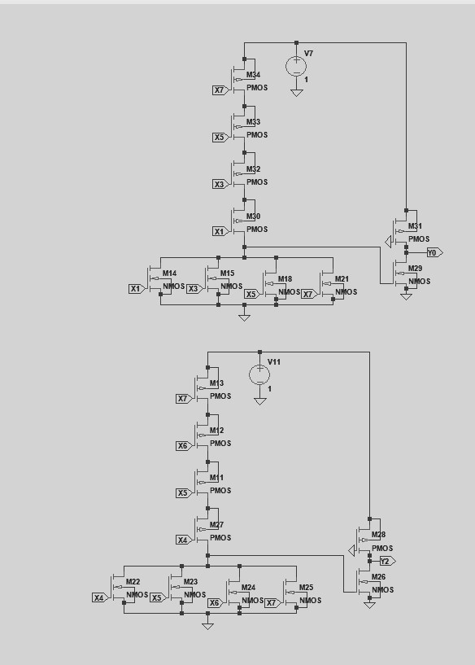
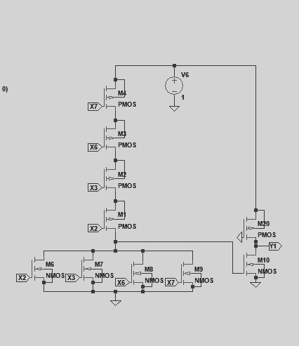
Encoder using CMOS logic

Slide 12
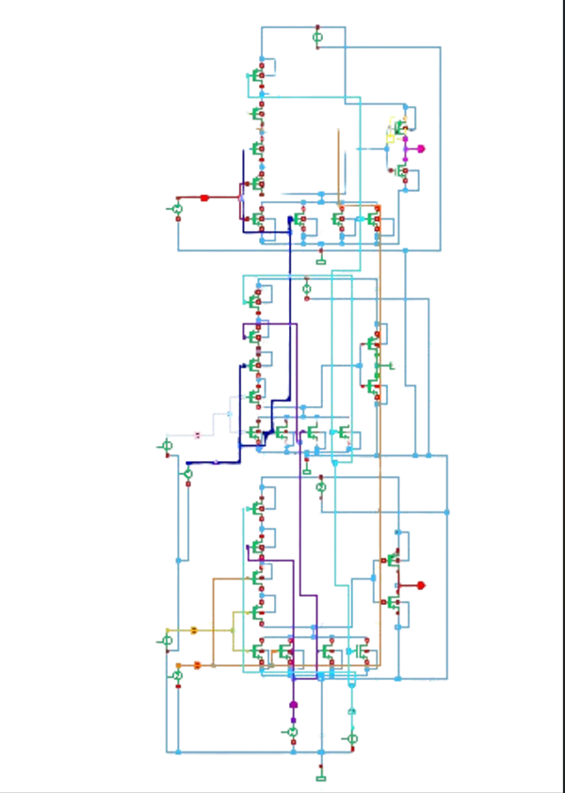
Encoder using CMOS logic

Slide 13
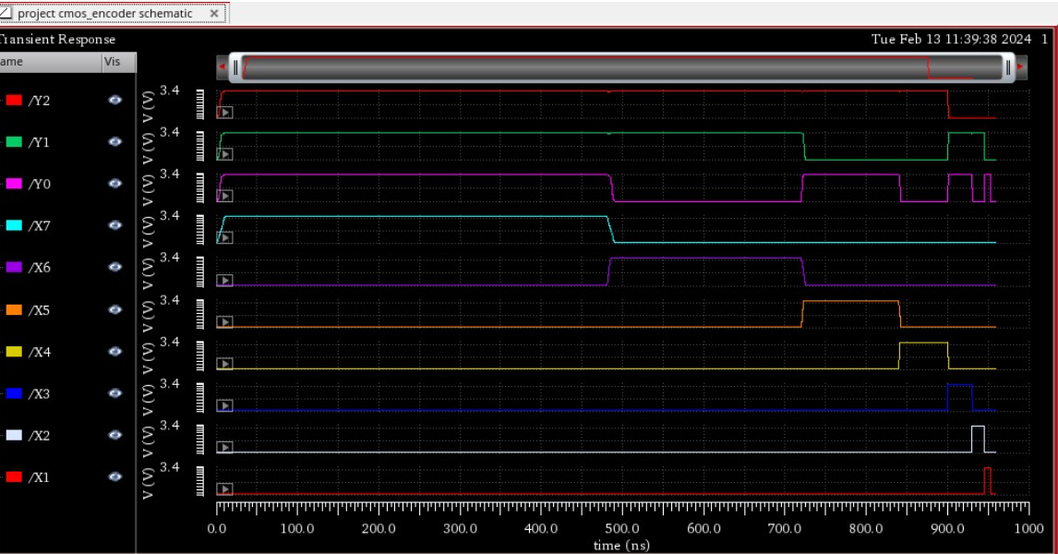
Resulting waveform

Slide 14
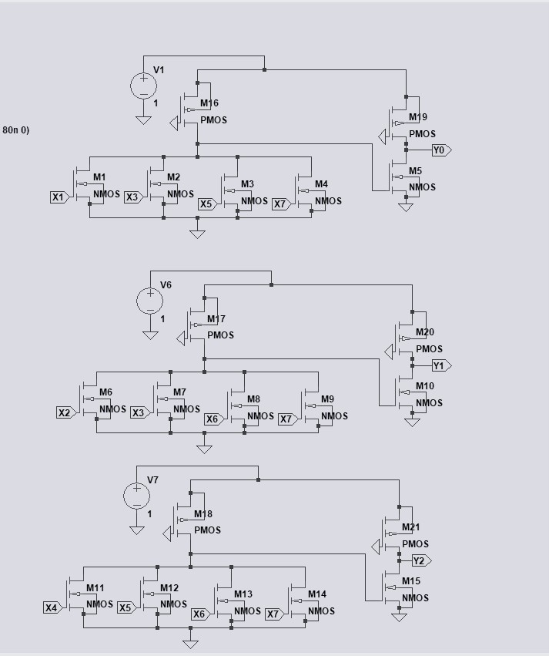
Encoder using Pseudo NMOS logic

Slide 15
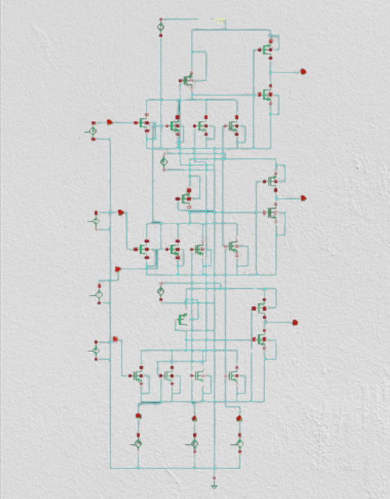
Encoder using Pseudo NMOS logic

Slide 16
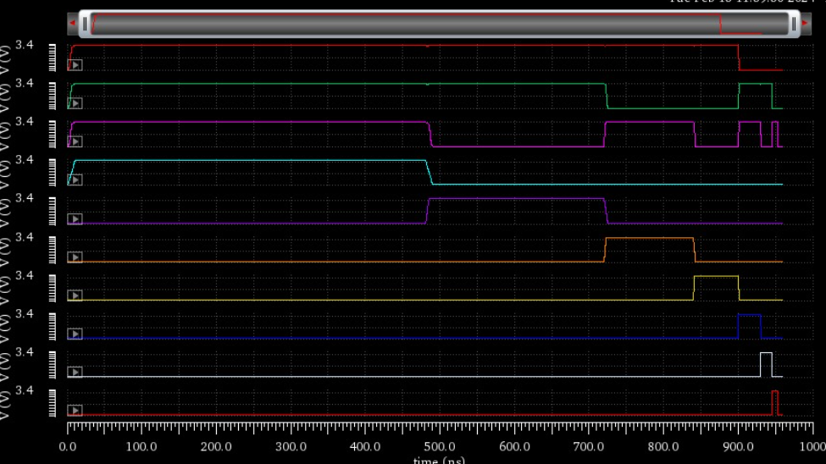
Resulting waveform

Slide 17
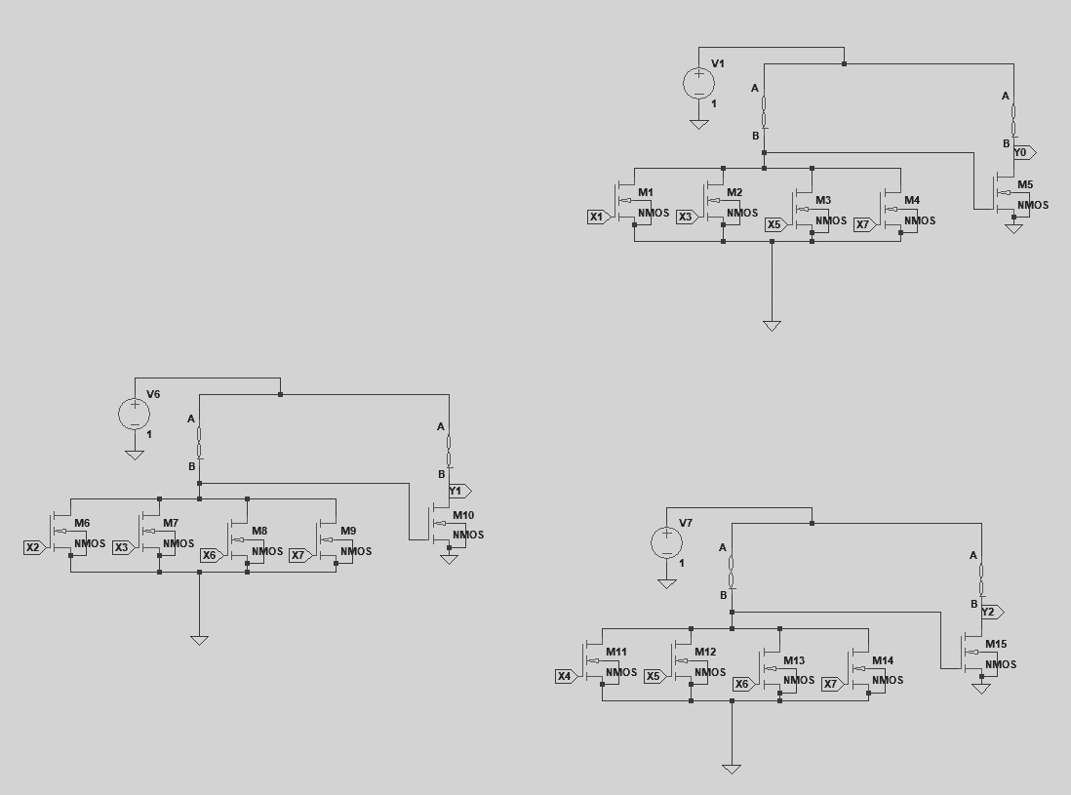
Encoder using memristor

Slide 18
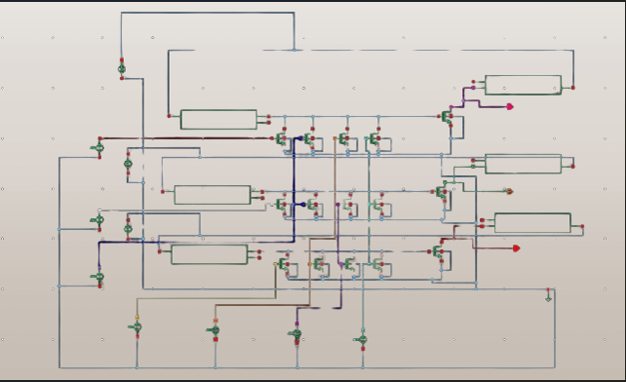
Encoder using memristor

Slide 19
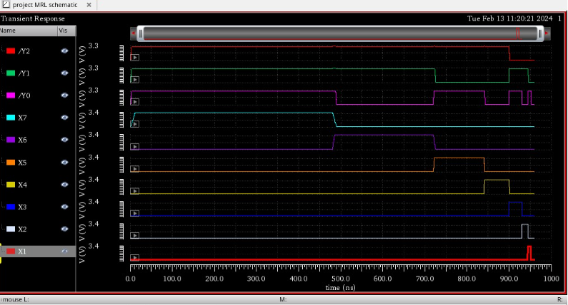
Resulting waveform

Slide 20
Problems Identified
More Power consumption
More Delay
Area is More
High power-delay factor

Slide 21
Problems Identified
Literature Review
Year of publishing | Type of publishing | Authors | Title | Description
2012 | International Journal of Technical Research and Applications | S. Kvatinsky, N. Wald, G. Satat | Mrl—memristor ratioed logic | It is about to reduce the design effort of an MRL circuit by using standard library cells composed of only NOR and NAND logic gates.
2013 | IEEE Transactions on Very Large Scale Integration (VLSI) SYSTEMS | S. Kvatinsky, G. Satat, N. Wald | Memristor-based material implication (imply) logic: Design principles and methodologies | It tells about device structure optimization, logic synthesis methods, array structures, and computing architectures
2020 | International Institute of Information Technology | K. Mbarek, F. O. Rziga | Design and properties of logic circuits based on memristor devices | In this context, we examined the model behavior under the configuration of the 1T1R OxRRAM.
2021 2022 | IEEE journal of solid state circuits International conference on intellignt technologies | Liu, Gongzhi & Shen, Shuhang SuriShanmukh,Sompalli Rohit kumar. | Memristor based XNOR for high speed area efficient 1-bit Full Adder Low power 3-bit encoder using Memristor | In this paper nano-device property of Memristor has been utilized to design an area efficient high speed full adder. In comparison to other design of logic gate and full adder, the novel full adder circuit has the advantage of simplified architecture, better speed and higher power efficiency. In this paper designing of encoder using memristor is designed and also compare with the other design with CMOS,Pseudo NMOS.
21

Slide 22
PGL Technique
In the power gating structure, a circuit operates in two different modes.
In the active mode, the sleep transistors are turned ON and can be treated as the functional redundant resistances.
In the sleep mode, the sleep transistors are turned OFF to reduce the leakage power.
When a sleep transistor is placed at VDD, it is called as the "Header switch" and while it is placed near the ground, it is called as "Footer switch"..

Slide 23
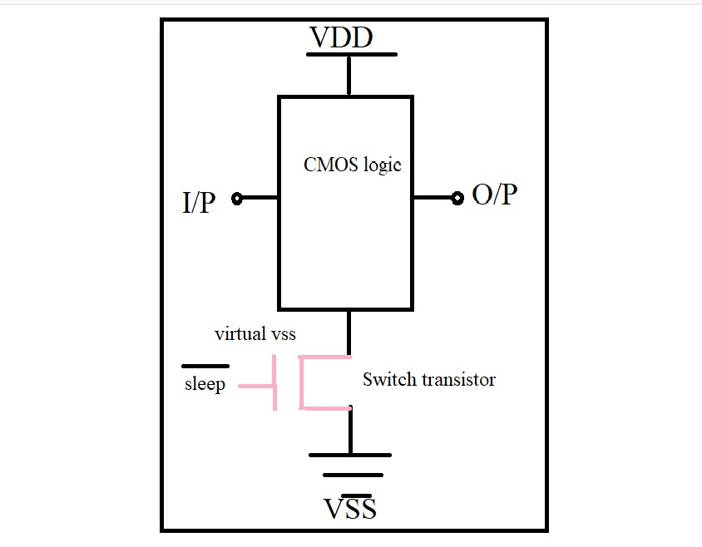
Sleep transistor (ST) are used as switches to shut off power supplies of the standby circuits, as shown in fig. A ST is referred to either a PMOS or NMOS.High Vth transistor that connects permanent power supply to circuit power supply which is commonly called “virtual power supply”.
Fig 6 : Block Diagram of PGL Aproach
23

Slide 24
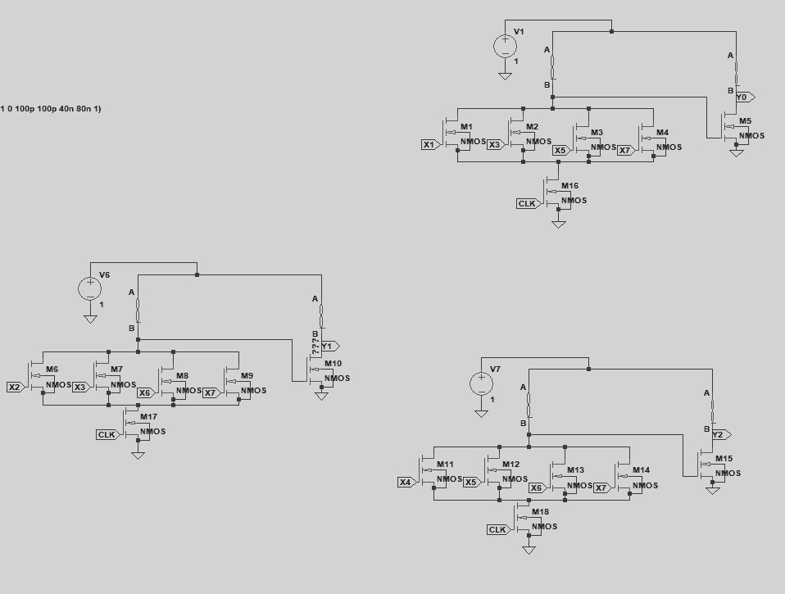
Block Diagram for Memristor Using PGL
*

Slide 25
Advantages
Less Power consumption
Less Delay
Less Number of Transistors used
Applications
Data Backup Technique
Digital circuit design
25

Slide 26
Performance evaluation
 | Average Power (mW) | Delay (ps) | Power-Delay Product (PDP)
CMOS Based Encoder | 719.5 | 129.57 | 93225 x 10^-12
Pseudo NMOS encoder | 104.7 | 177.94 | 18630 x 10^-12
MRL Based encoder | 80.7 | 134.031 | 10816 x 10^-12
MRL based encoder using PGL technique | 60.4 | 173.74 | 10667 x 10^-12

Slide 27
SWOT Analysis
STRENGTHS
Memristor logic offers enhanced performance compared to CMOS encoders. Resulting in
Low power Consumption
Faster Operation
WEAKNESS
The design and function of memristor is somewhat complex to understand compared to resistor, capacitor and inductor
High power consumption
Limited scalability
27
27

Slide 28
SWOT Analysis
OPPORTUNITY
Implementing memristor logic opens up new opportunities in digital electronics
Enhanced performance
Expanded functionality
THREATS
There might be a resistance to change from traditional CMOS technology.
28
28

Slide 29
References
[1] S. Smaili and Y. Massoud, “Analytic modeling of memristor variability for robust memristor systems designs,” in 2014 IEEE International Symposium on Circuits and Systems (ISCAS). IEEE, 2014, pp. 794–797
[2]. S. Mandal, J. Sinha, and A. Chakraborty, “Design of memristor– cmos based logic gates and logic circuits,” in 2019 2nd International Conference on Innovations in Electronics, Signal Processing and Com- munication (IESC). IEEE, 2019, pp. 215–220.
[3] G. Liu, S. Shen, P. Jin, G. Wang, and Y. Liang, “Design of memristor based combinational logic circuits,” Circuits, Systems, and Signal Processing, vol. 40, no. 12, pp. 5825–5846, 2021.
[4] G. Liu, S. Shen, P. Jin, G. Wang, and Y. Liang, “Design of memristor based combinational logic circuits,” Circuits, Systems, and Signal Processing, vol. 40, no. 12, pp. 5825–5846, 2021.
[5]Suri Shanmukh, Sompalli RohitKumar, Paluru Hemaprasad‡ and R.Sakthivel Low Power 3-Bit Encoder Design using Memristor2nd International Conference on Intelligent Technologies (CONIT) Karnataka, India. June 24-26, 2022

Slide 30
Thank You…

