Slide 1
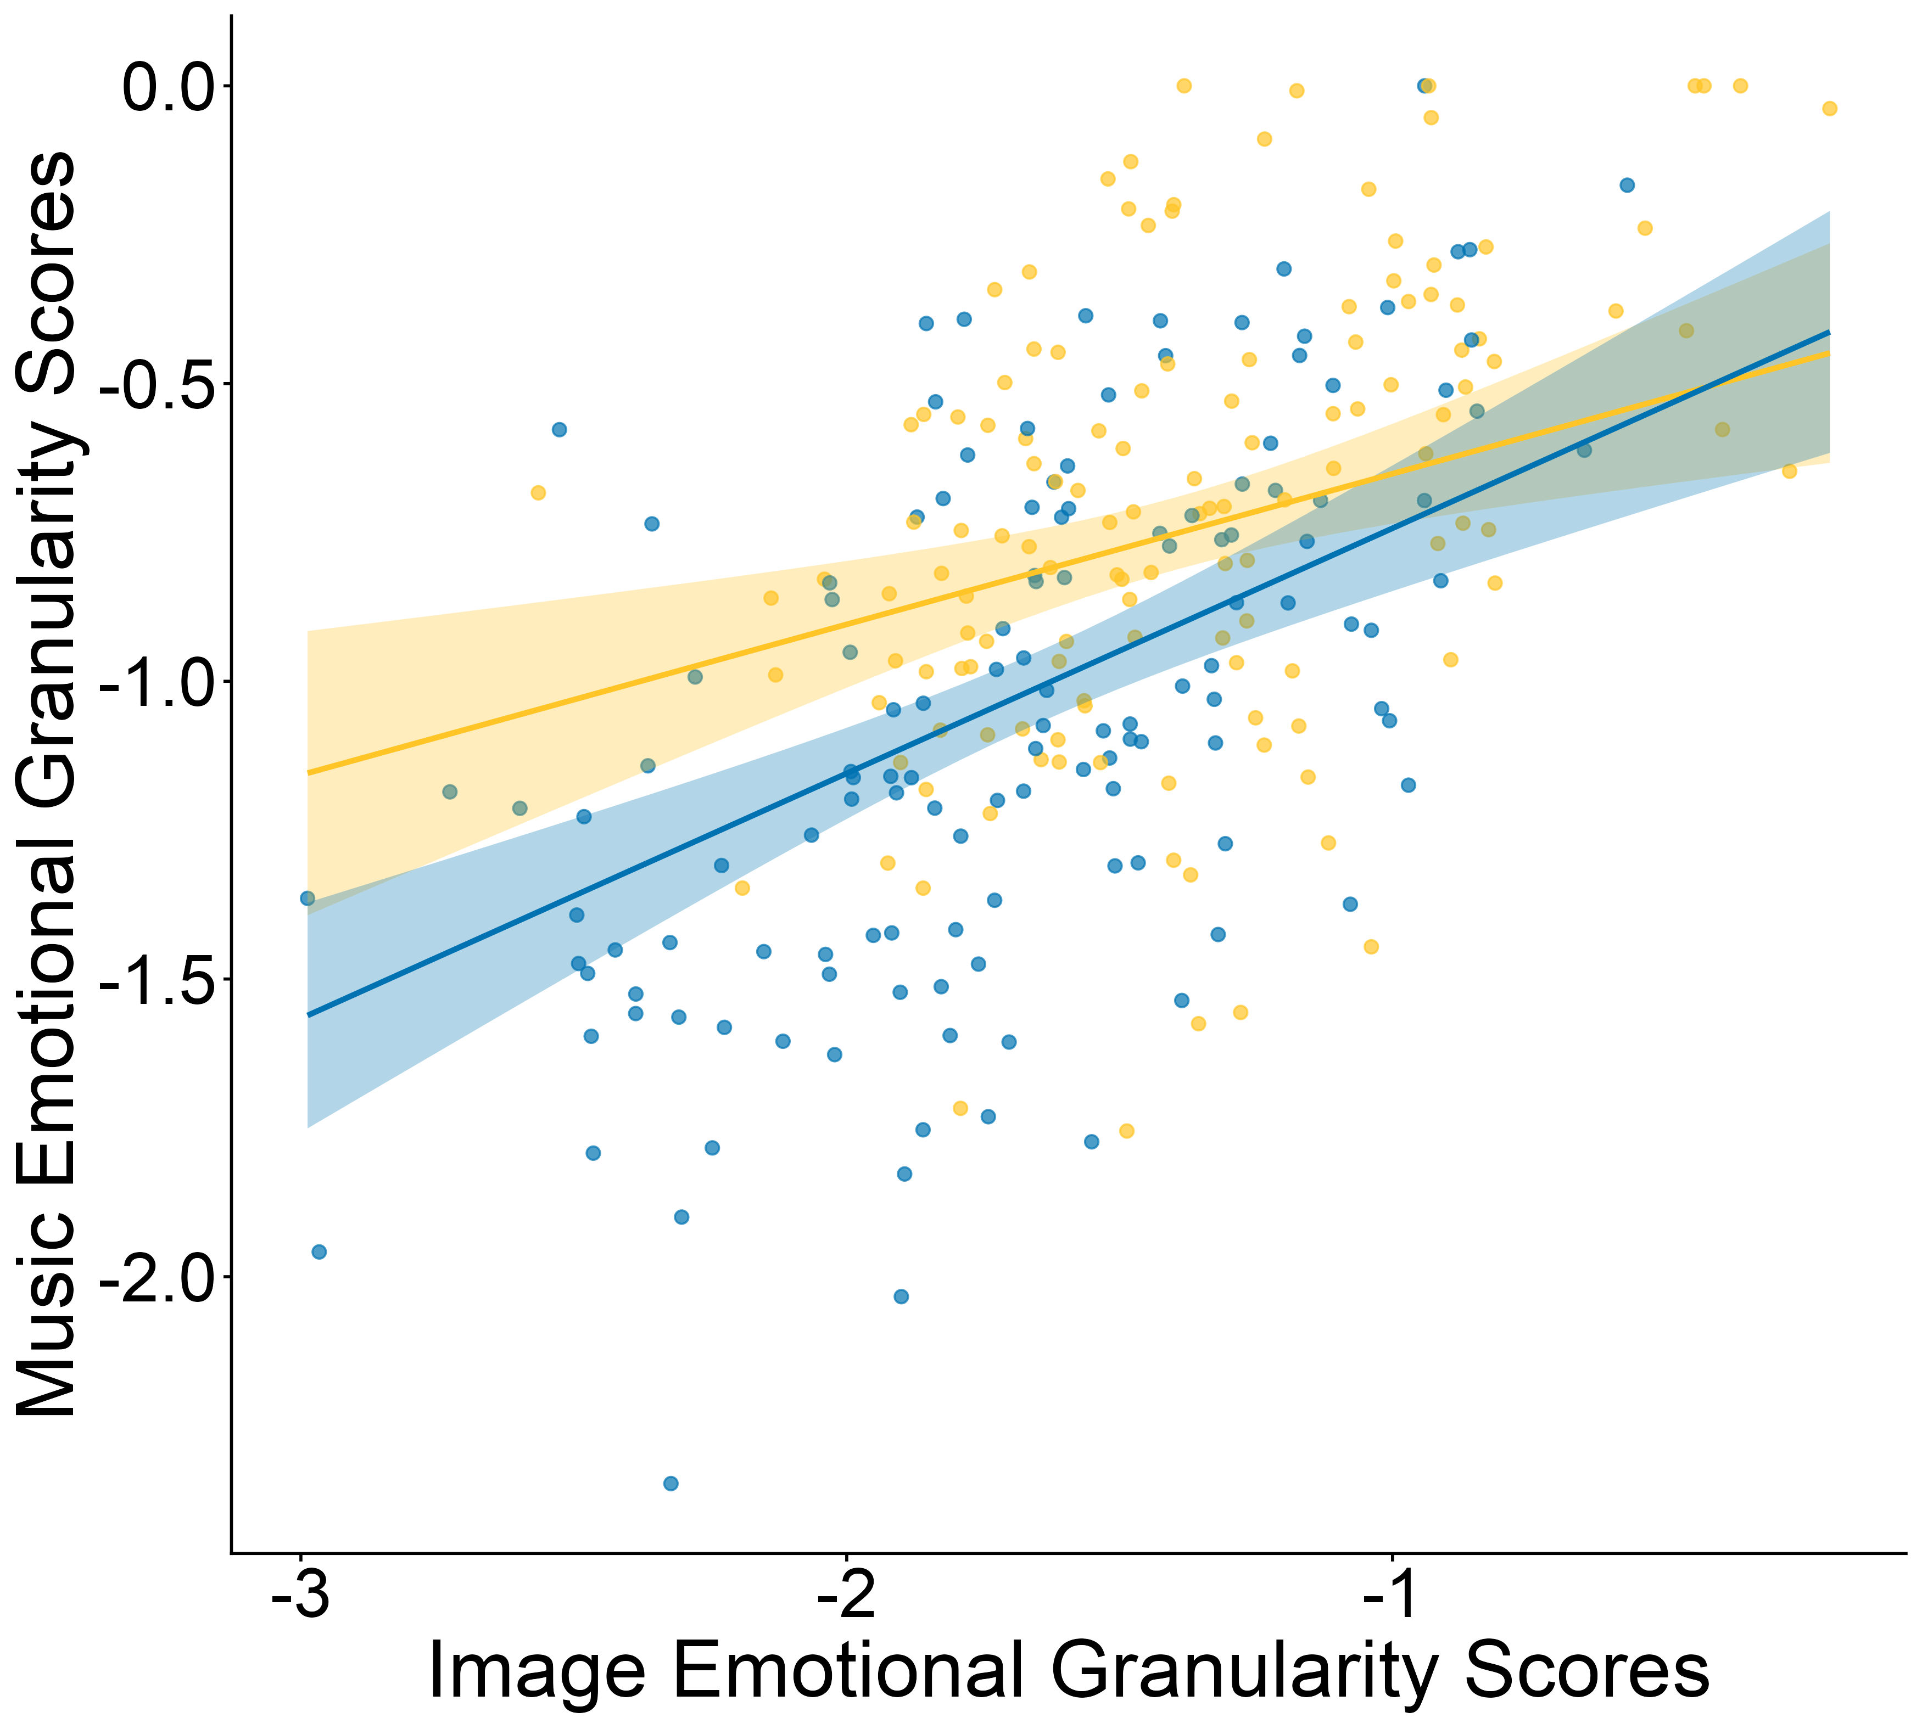
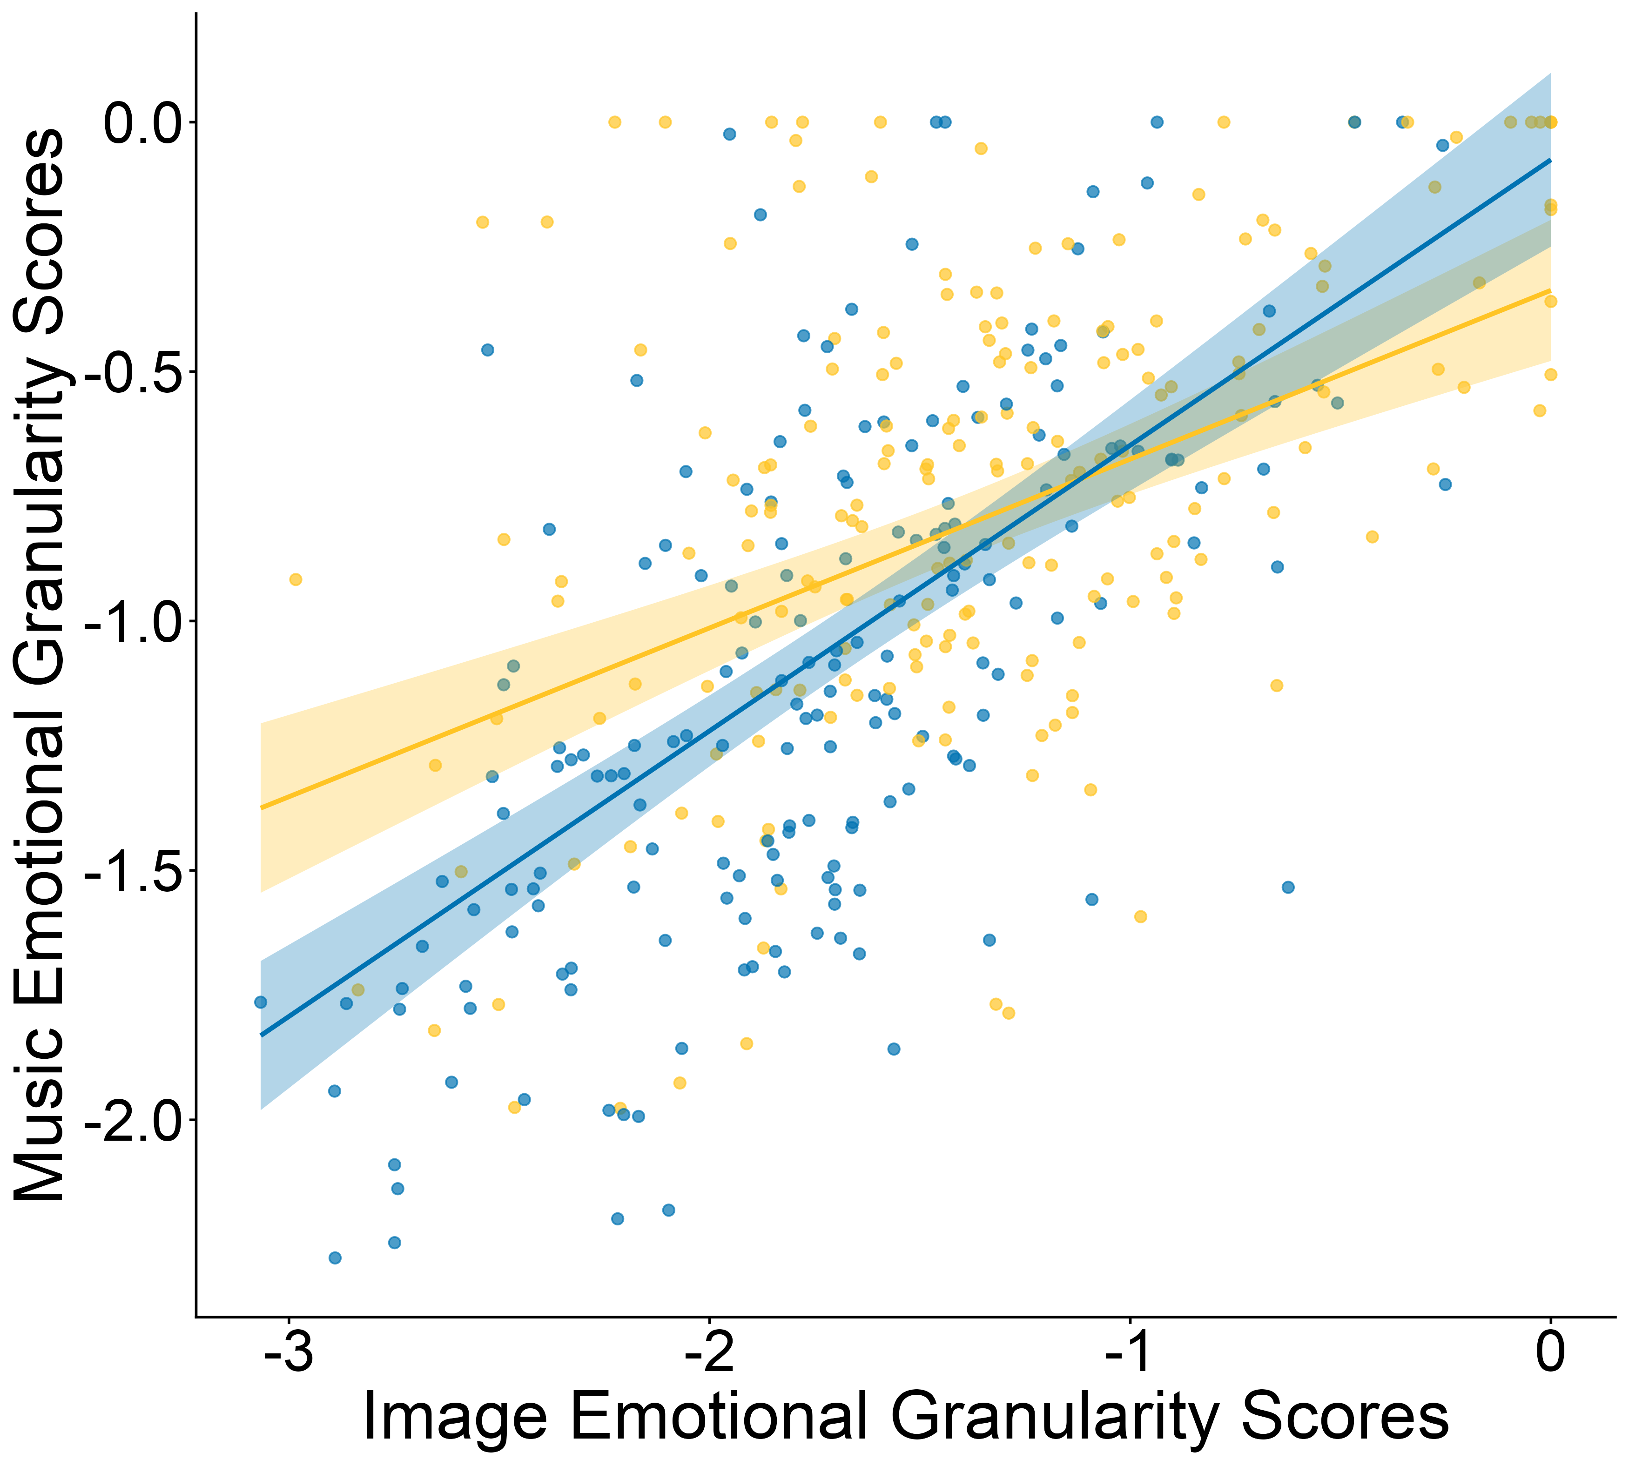
A)
B)
Study 1
Positive
Negative
C)
D)
Study 2

Slide 2
A)
B)
Study 1
Music
Images
C)
D)
Study 2

