Slide 1
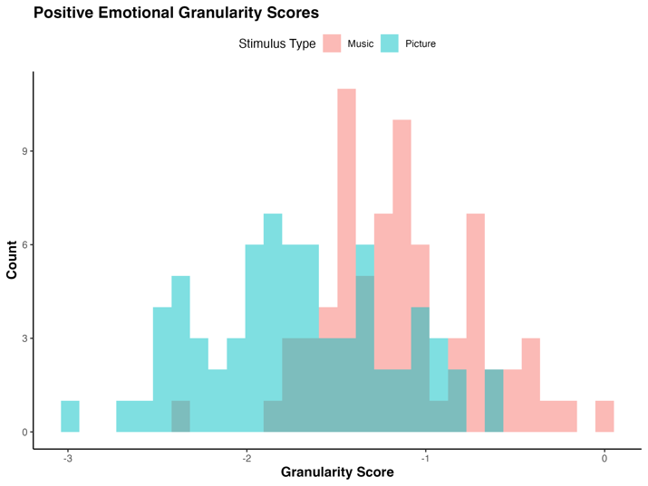
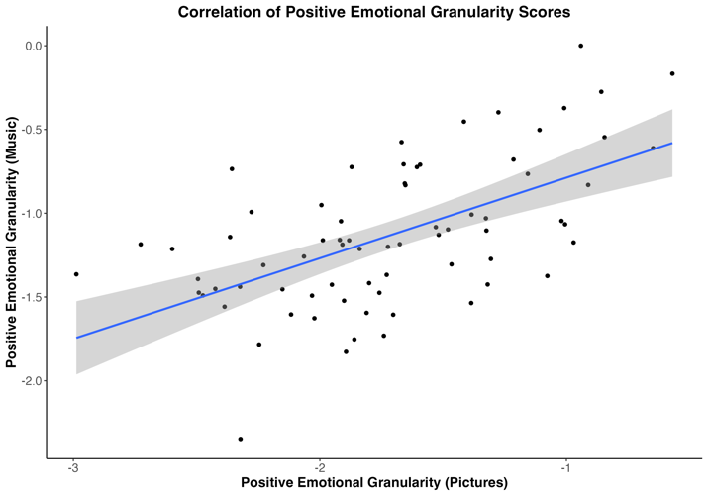
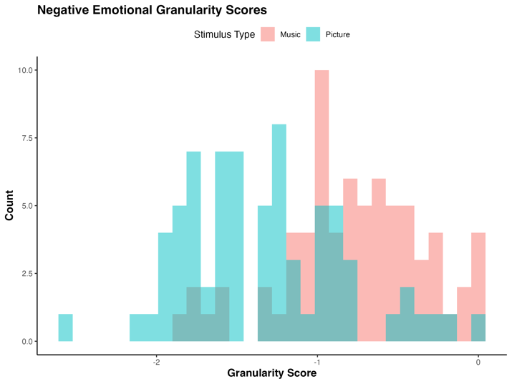
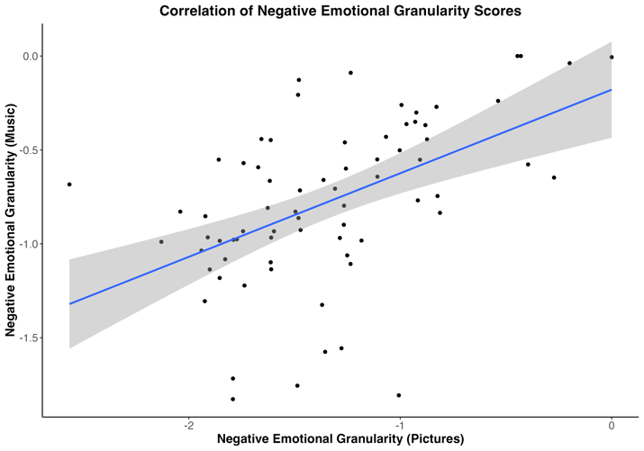
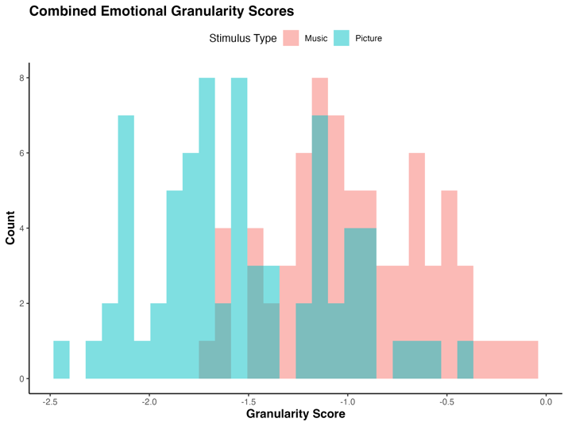
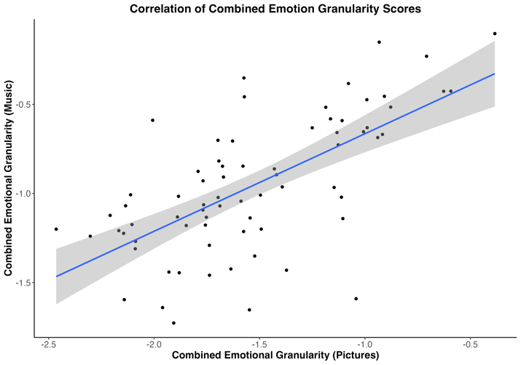
A
D
B
E
C
F
Figure 1. Study 1 histograms of emotional granularity scores and scatter plots of correlations between granularity scores for positive emotions (A, D) and negative emotions (B, E), and combined emotional granularity (C, F). Histogram bars are labeled by stimulus type (red for music, blue for pictures).

Slide 2
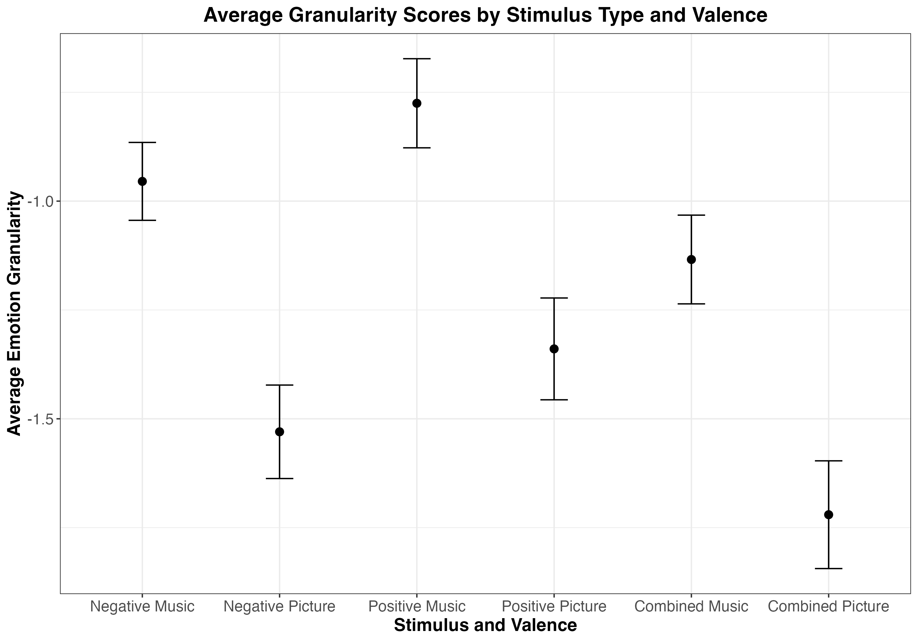
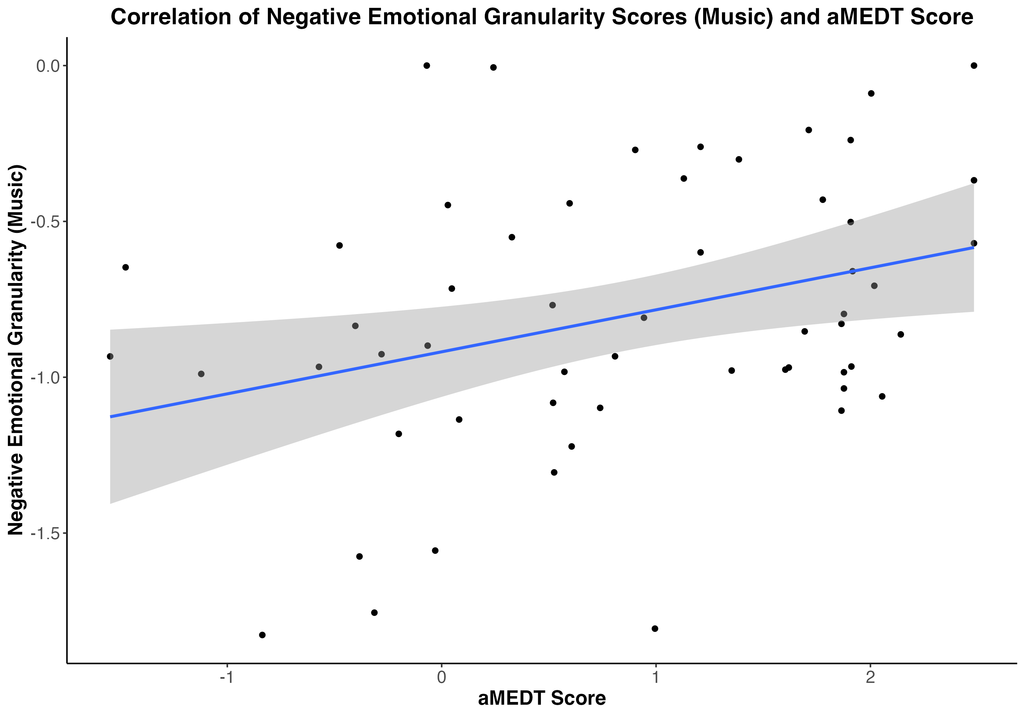
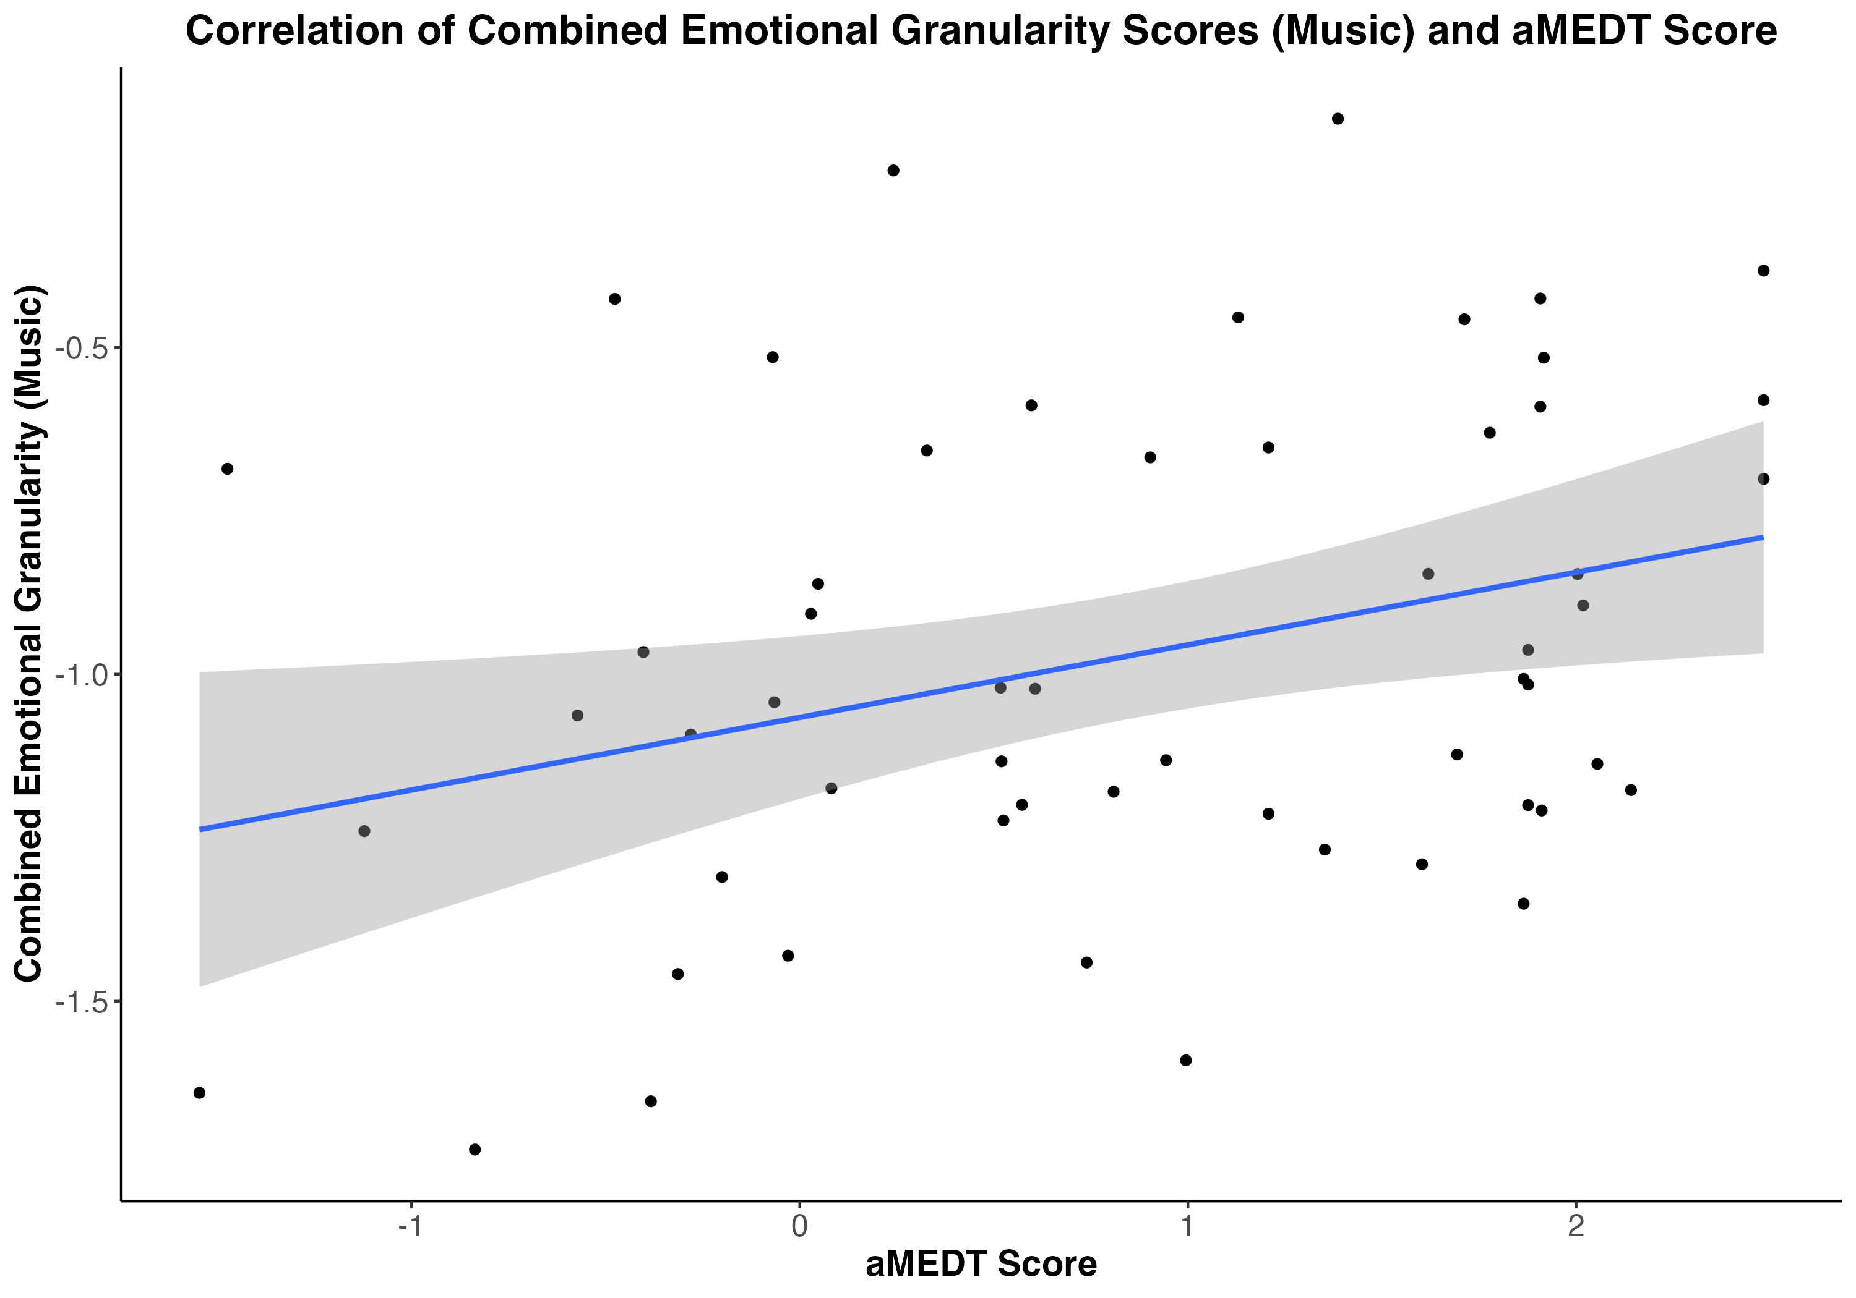
Figure 2. Study 1 average emotional granularity scores split by emotion valence (negative vs. positive) and stimulus type (picture vs. music). Error bars show 95% confidence intervals.
Figure 3. Study 1 scatter plot of significant positive correlations between negative (A) / combined (B) emotional granularity in response to music and musical emotion discrimination task score. A. r(58) = .33, p = .014
B. r(58) = .31, p = .019
A
B

Slide 3
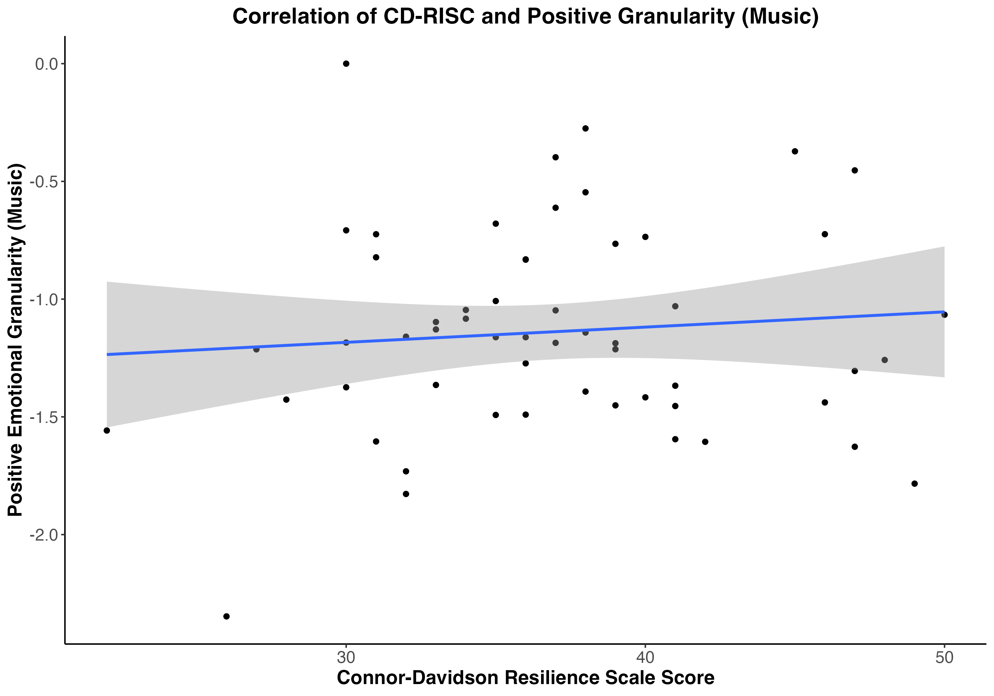
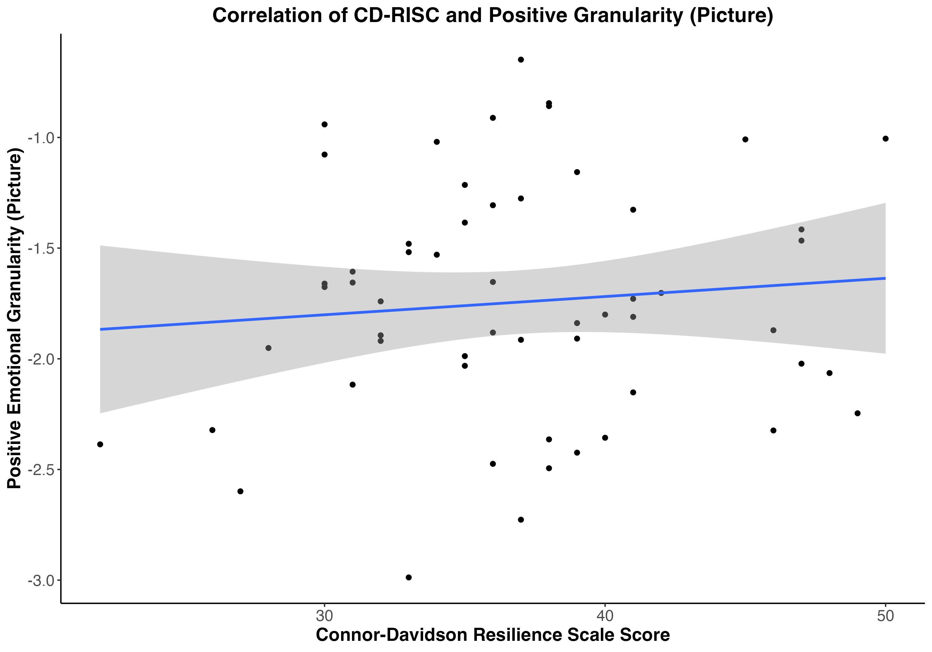
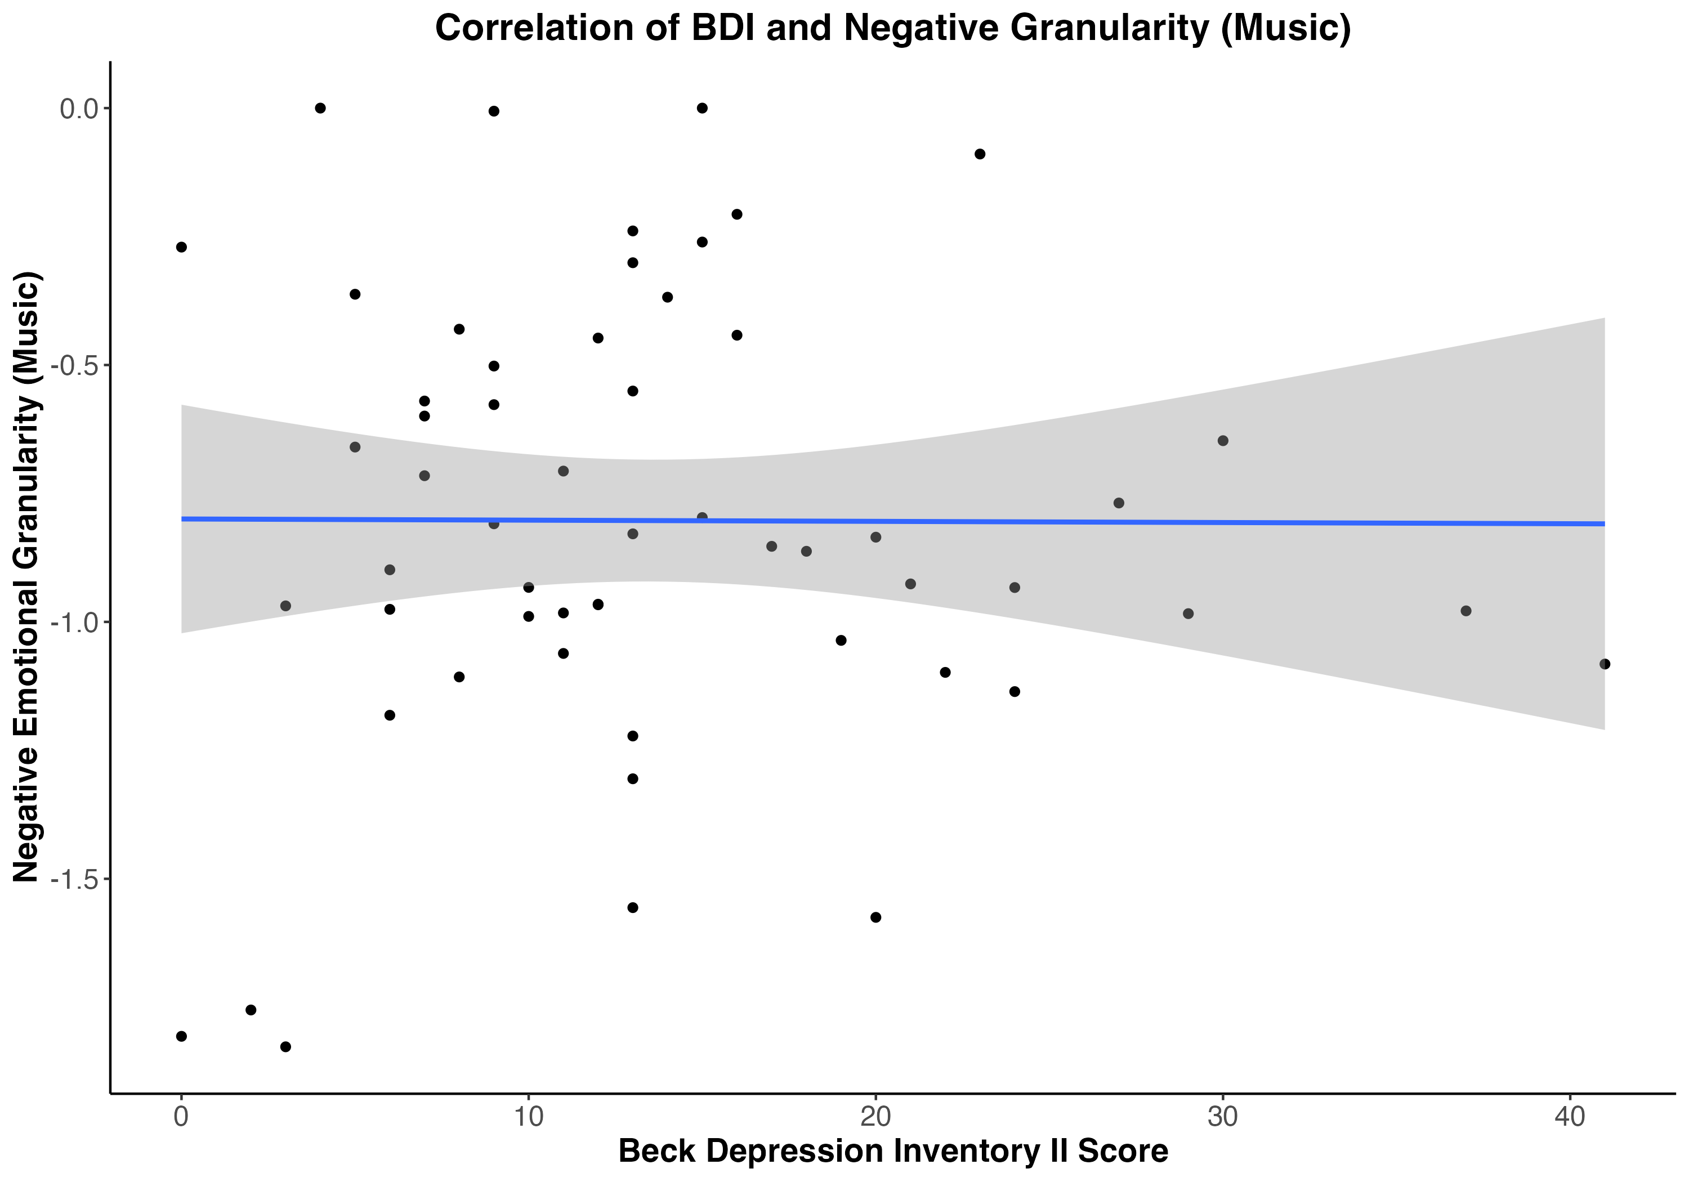
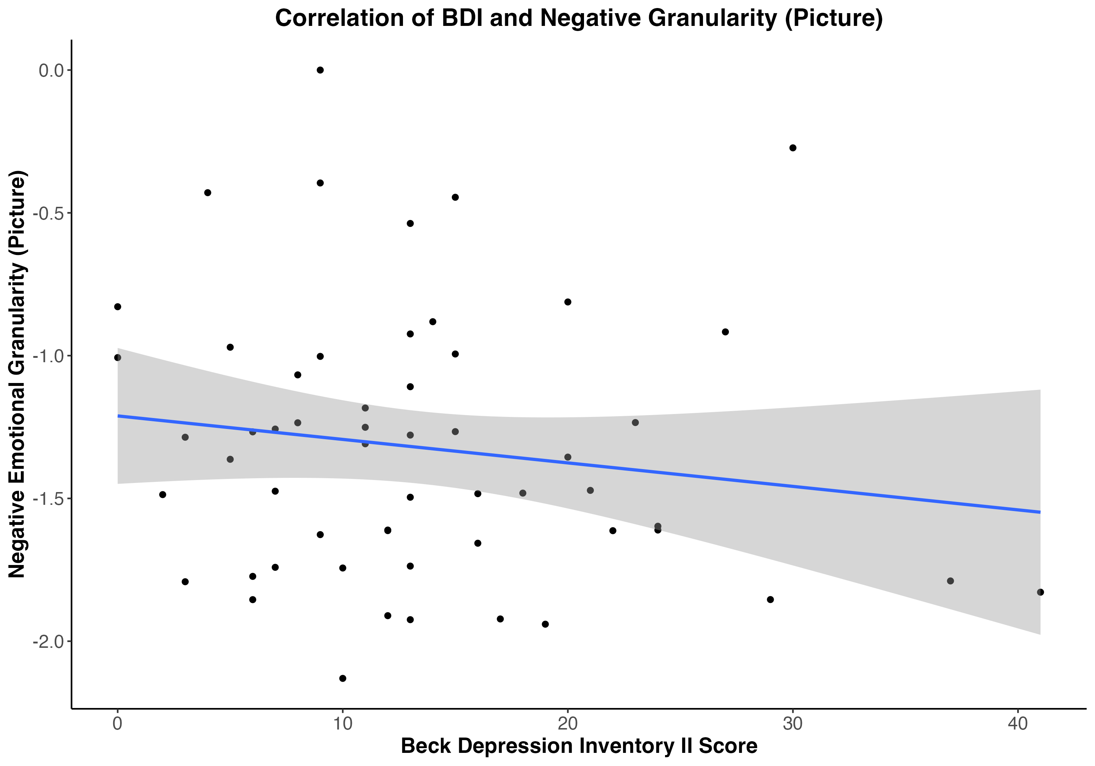
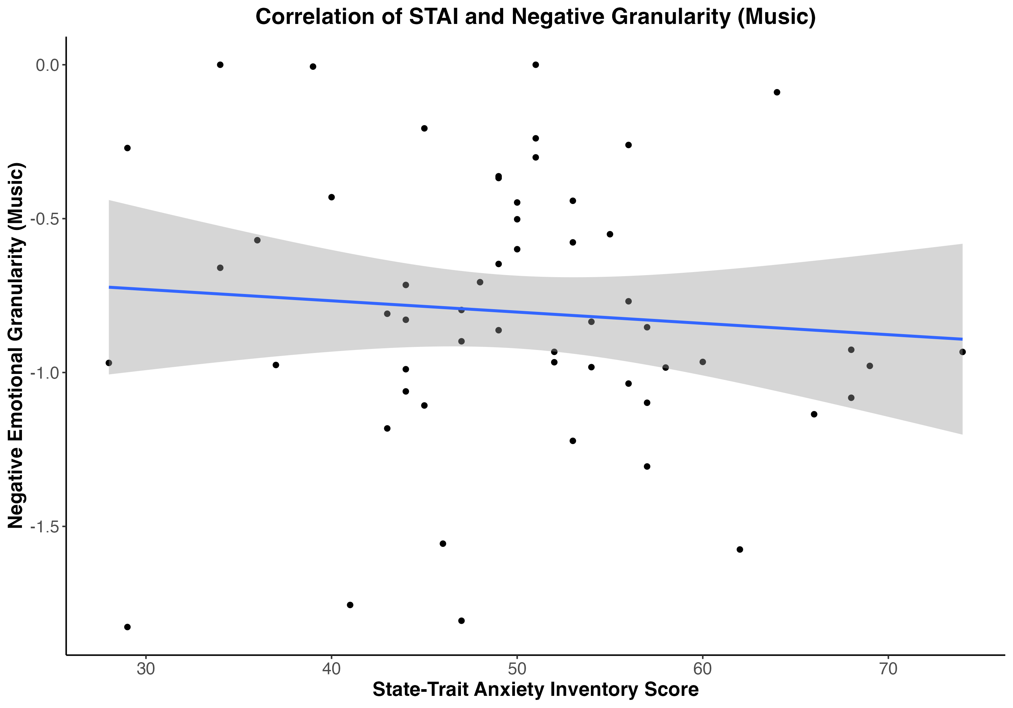
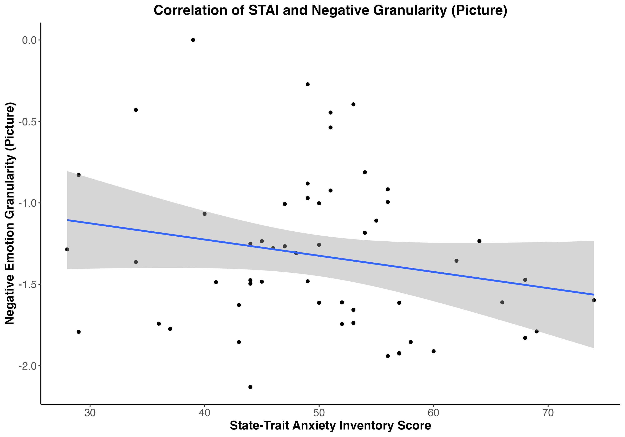
A
B
C
D
E
F
Figure 4. Study 1 scatter plots of correlations between mental health measures and emotional granularity in response to music (A, B, C) and granularity in response to pictures (D, E, F).
(A) Positive emotional granularity (music) and resilience (CD-RISC) – r(62) = .09, p = .50
(B) Positive emotional granularity (picture) and resilience (CD-RISC) – r(62) = .09, p = .49
(C) Negative emotional granularity (music) and depression (BDI-II) – r(62) = 0, p = .97
(D) Negative emotional granularity (picture) and depression (BDI-II) – r(62) = –.15, p = .27
(E) Negative emotional granularity (music) and anxiety (STAI) – r(62) = –.08, p = .54
(F) Negative emotional granularity (picture) and anxiety (STAI) – r(62) = –.21, p = .12

Slide 4
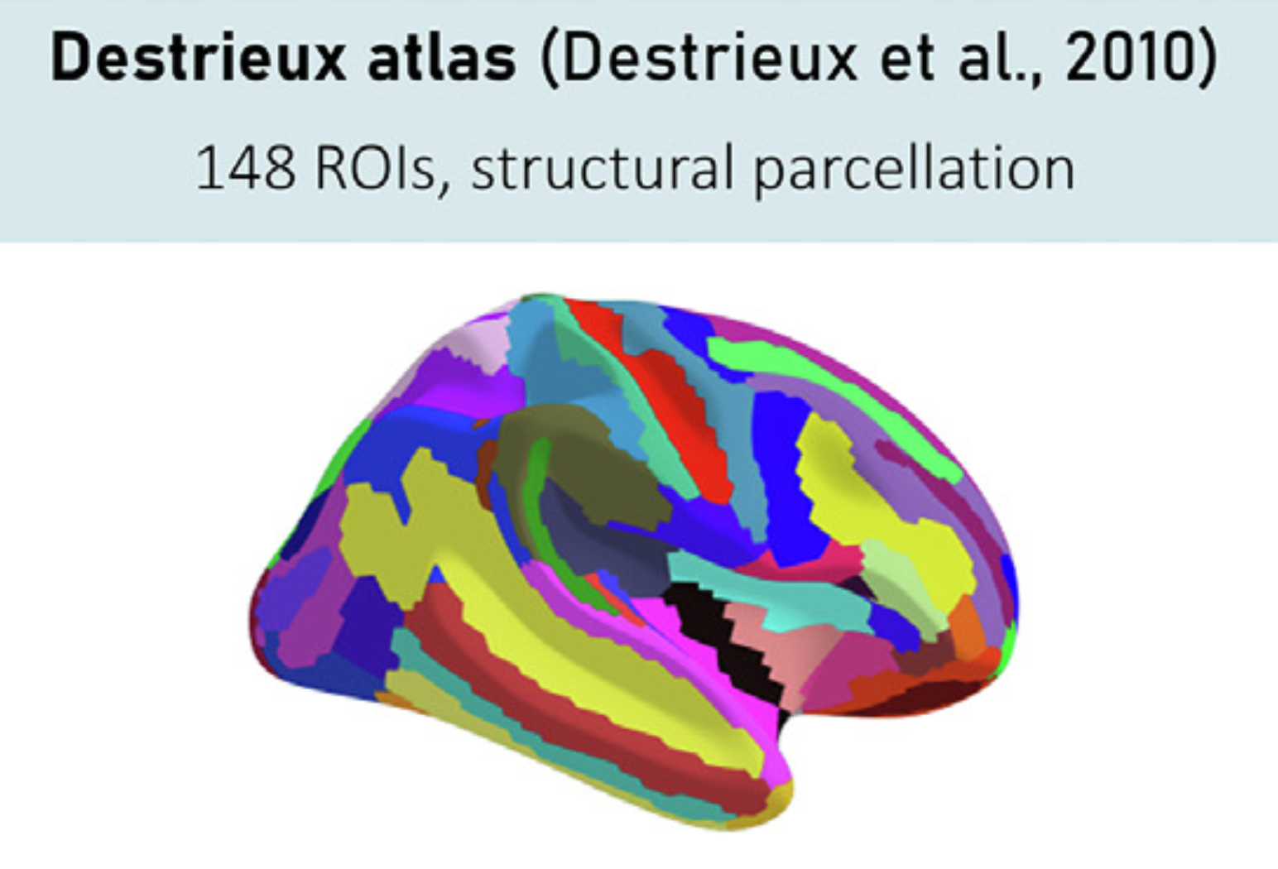
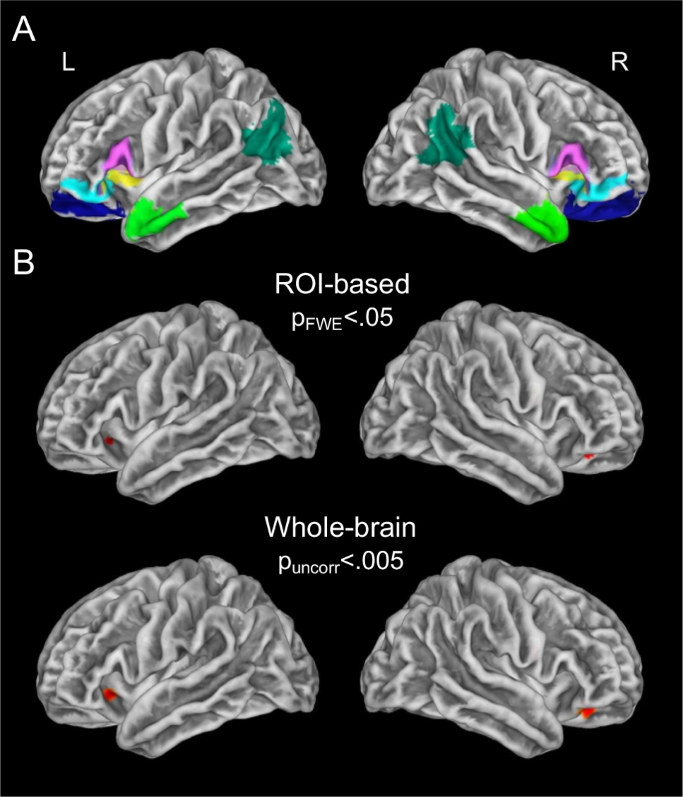
Figure 5. (A) Visualization of Destrieux atlas structural parcellation with 148 ROIs (Fürtjes et al., 2023)
(B) Inferior frontal cortex ROIs: (1) posterior inferior frontal gyrus, including pars opercularis and pars triangularis (BA44/45, in pink); (2) lateral orbitofrontal cortex, including pars orbitalis (BA47) and BA12 (cyan), and (3) BA11 (blue); and (4) dorsal anterior insula (yellow). Anterior temporal lobes (light green) and angular gyri (dark green) are also highlighted, as they were used in control analyses in the paper this figure is derived from (Lukic et al., 2023). (This will be replaced by my own ROI visualization, this is a placeholder)
A
B

Slide 5
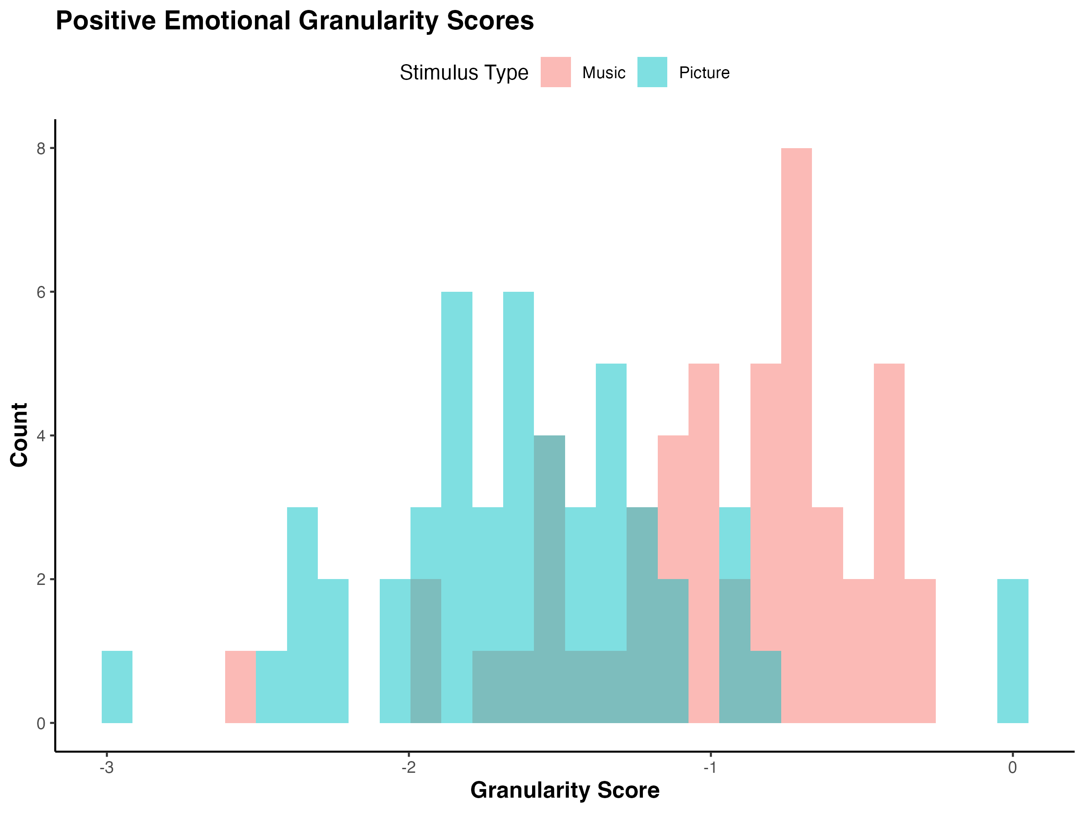
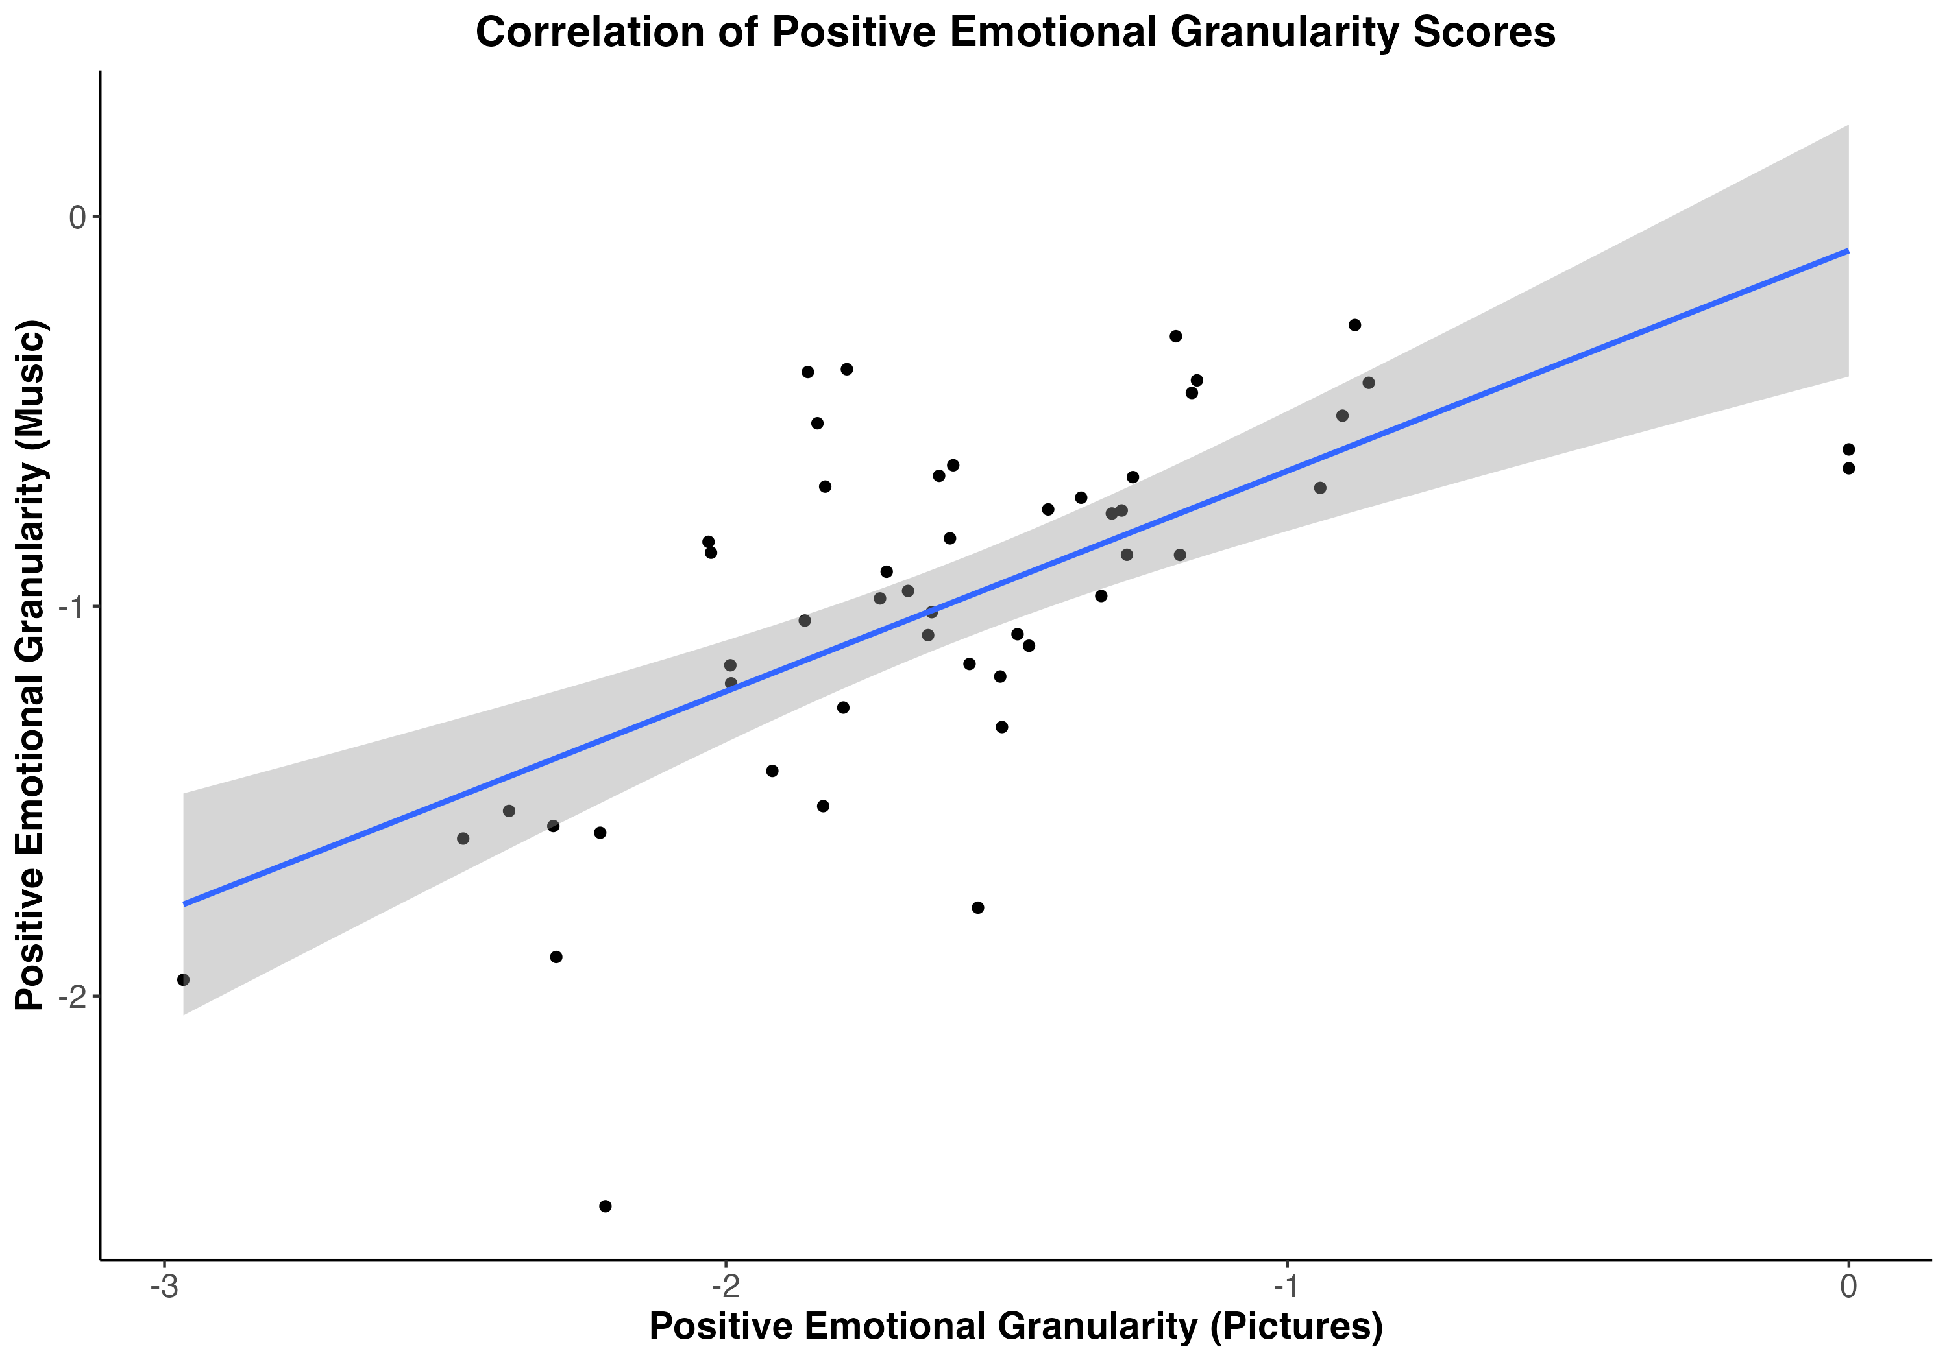
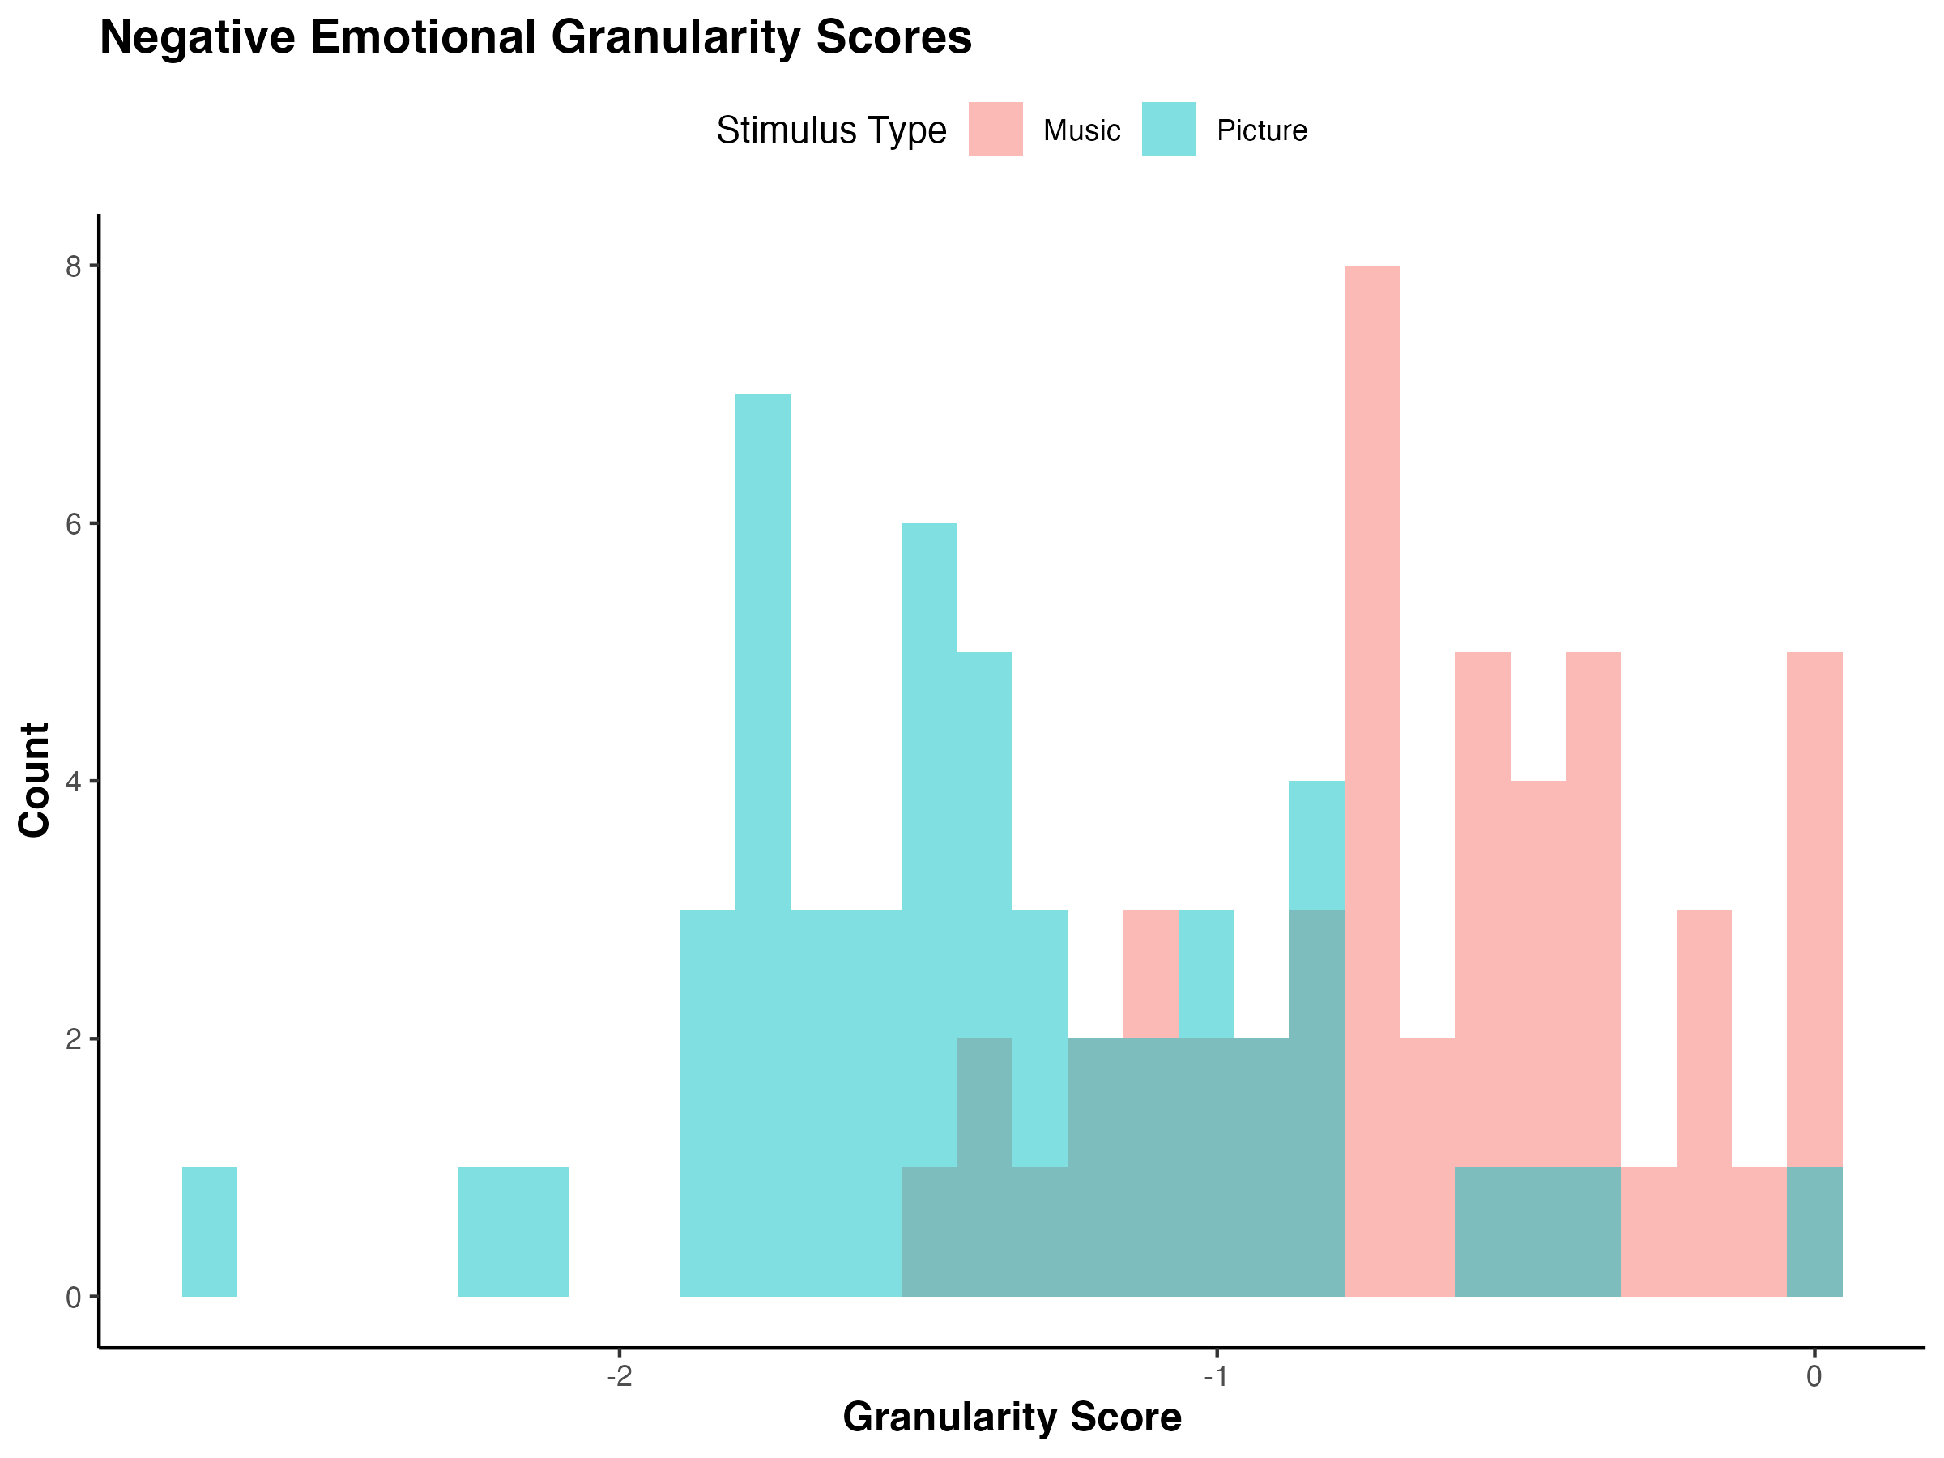
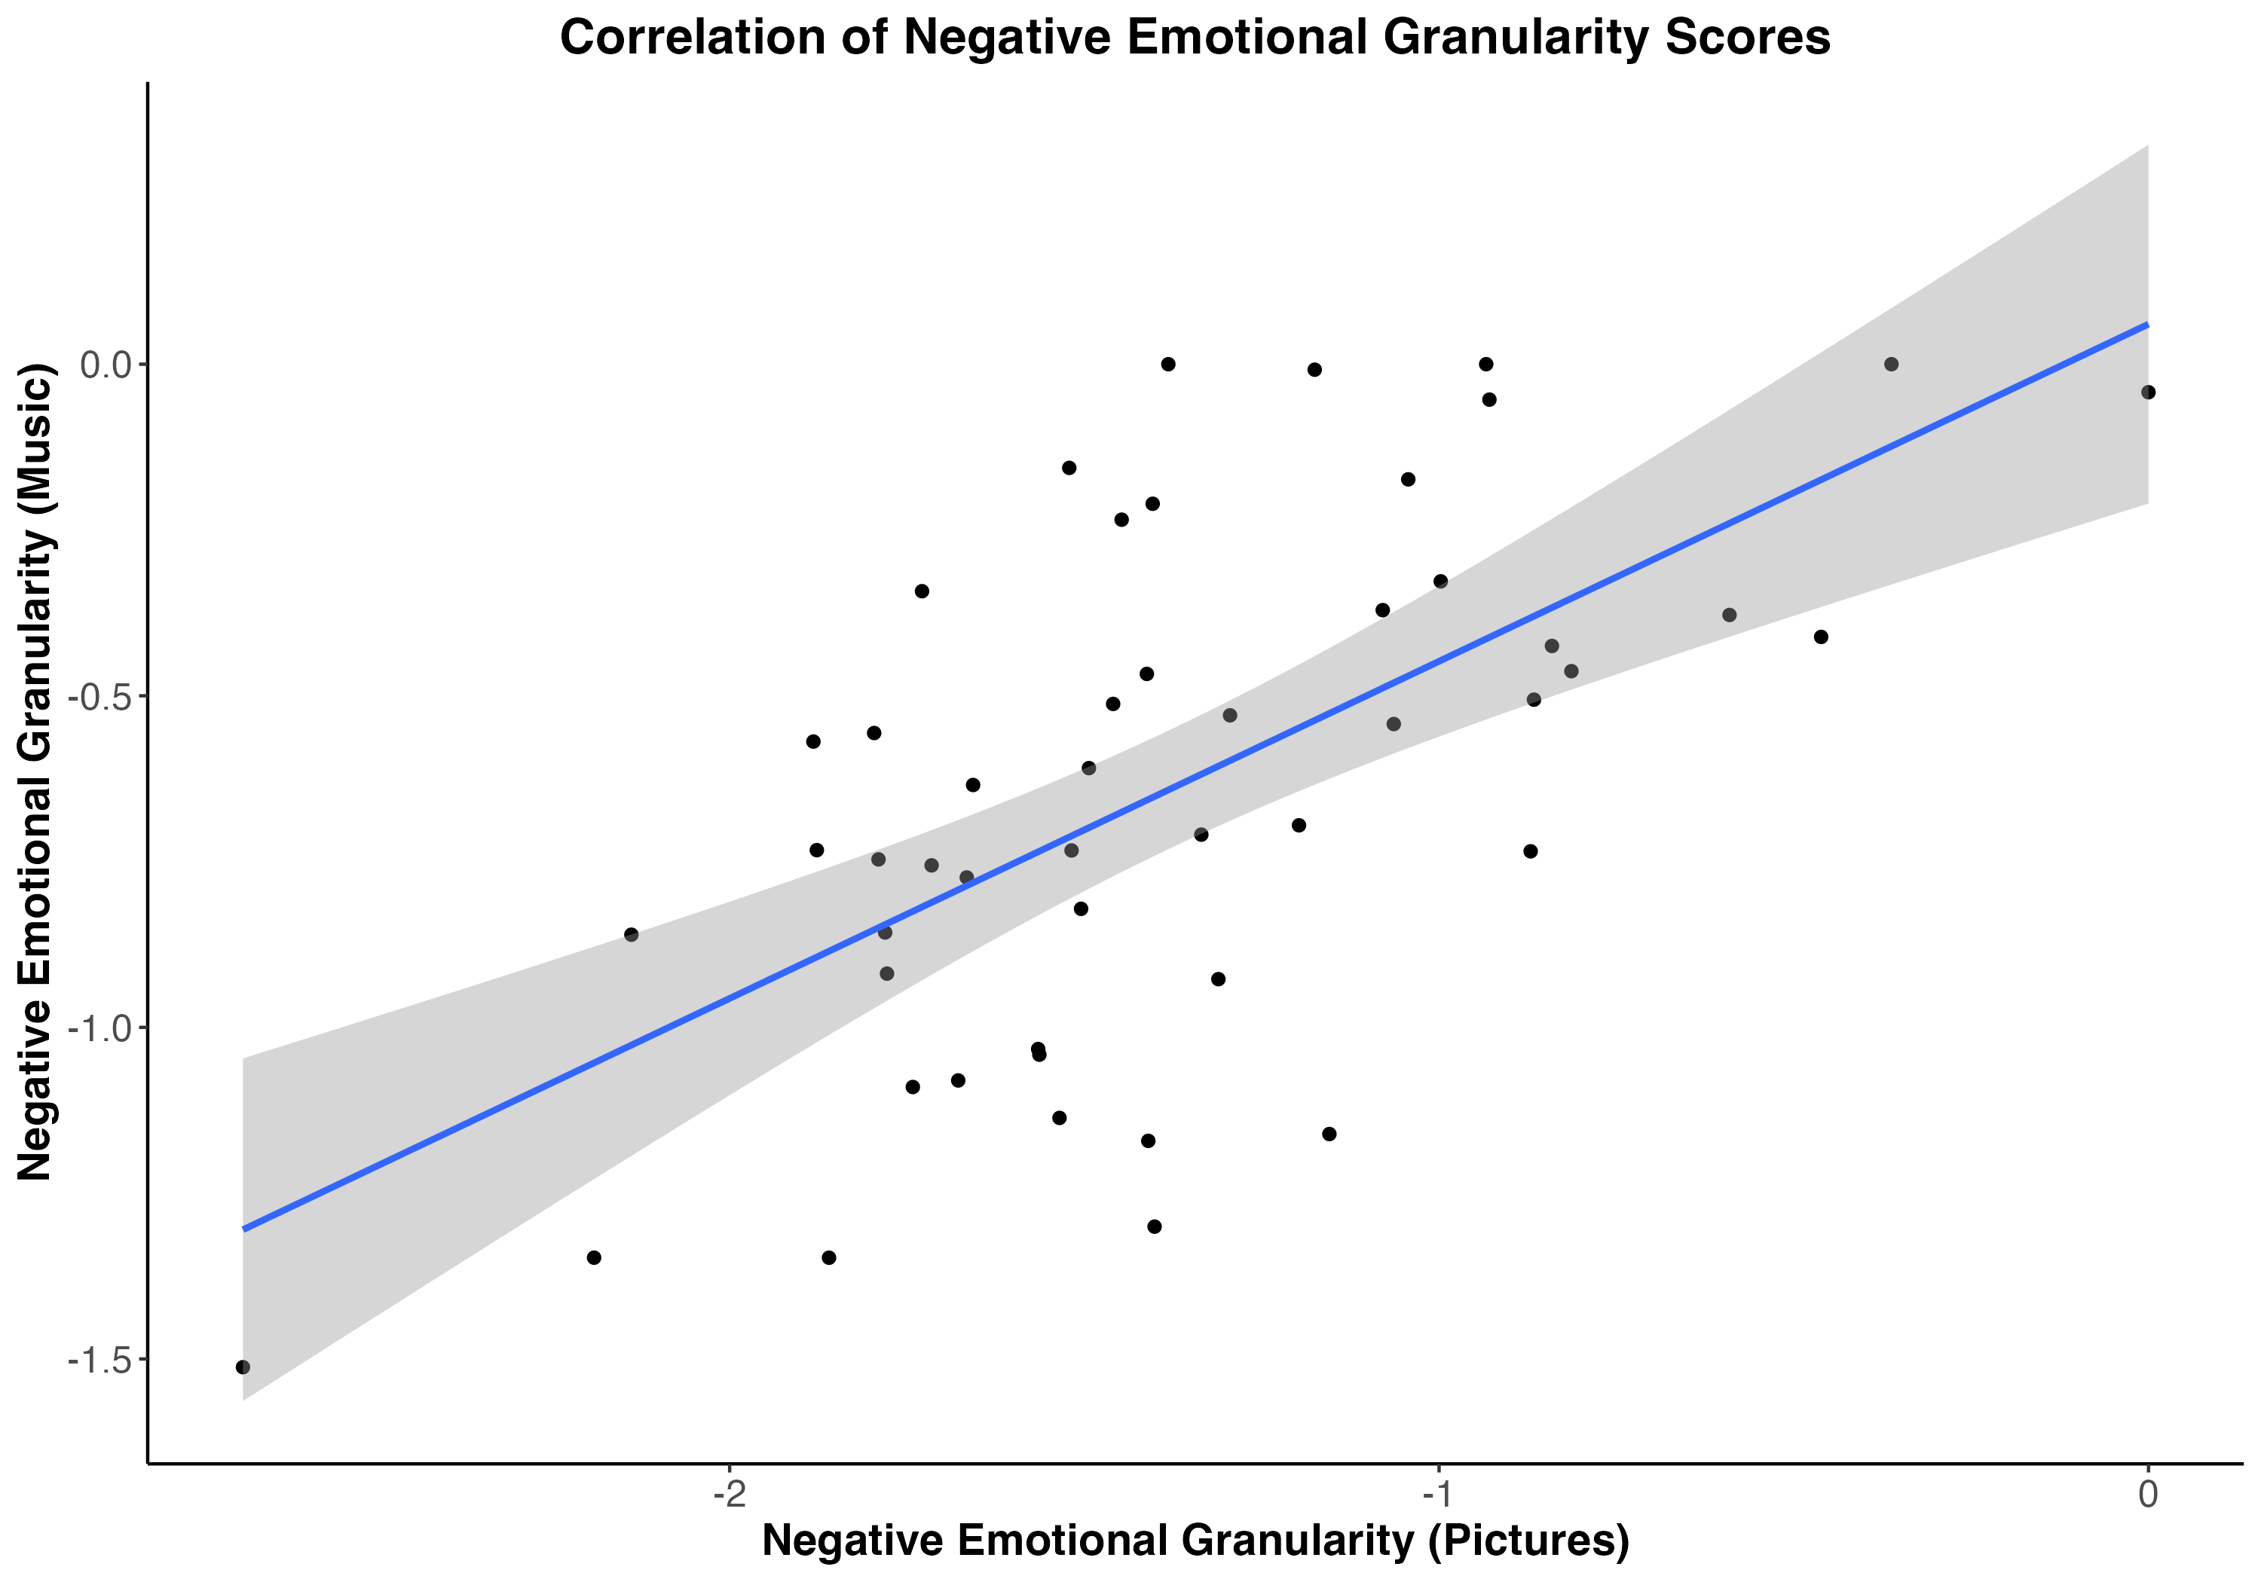
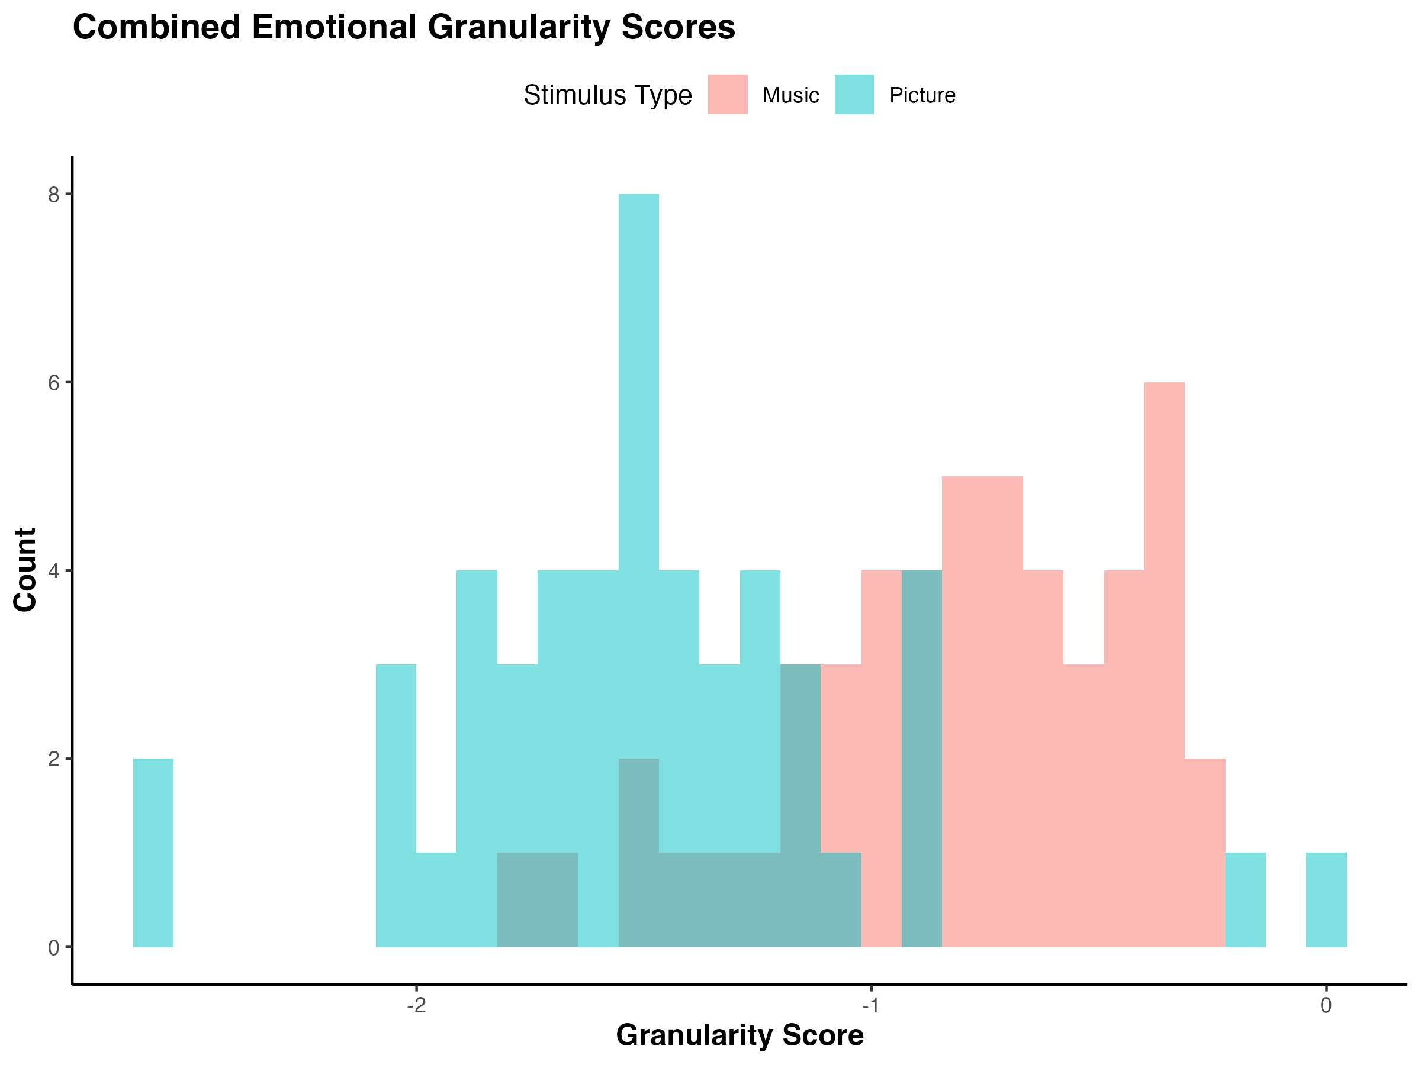
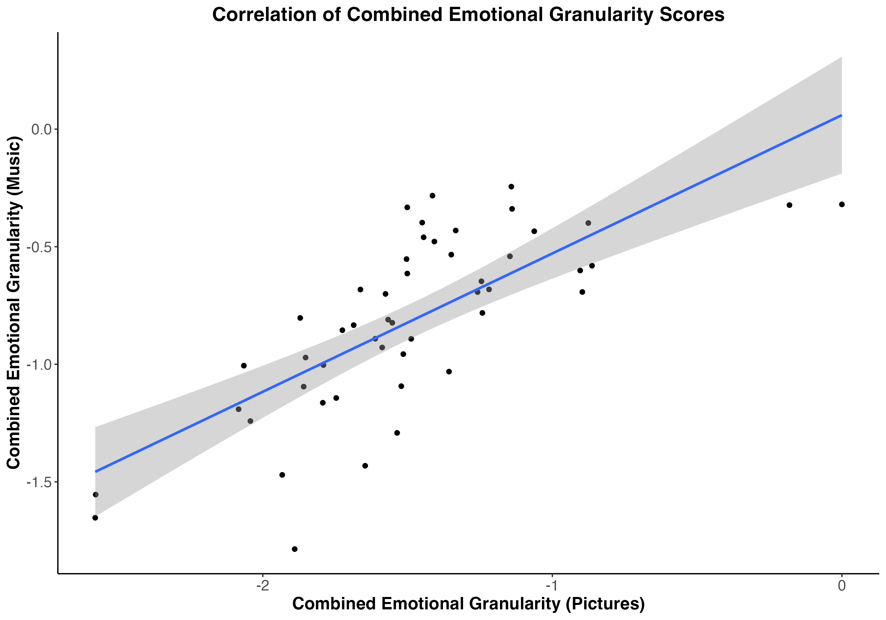
A
D
B
E
C
F
Figure 6. Study 2 histograms of emotional granularity scores and scatter plots of correlations between granularity scores for positive emotions (A, D) and negative emotions (B, E), and combined emotional granularity (C, F). Histogram bars are labeled by stimulus type (red for music, blue for pictures).

Slide 6
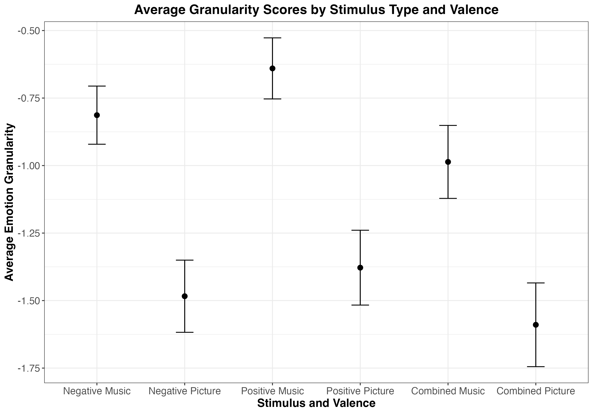
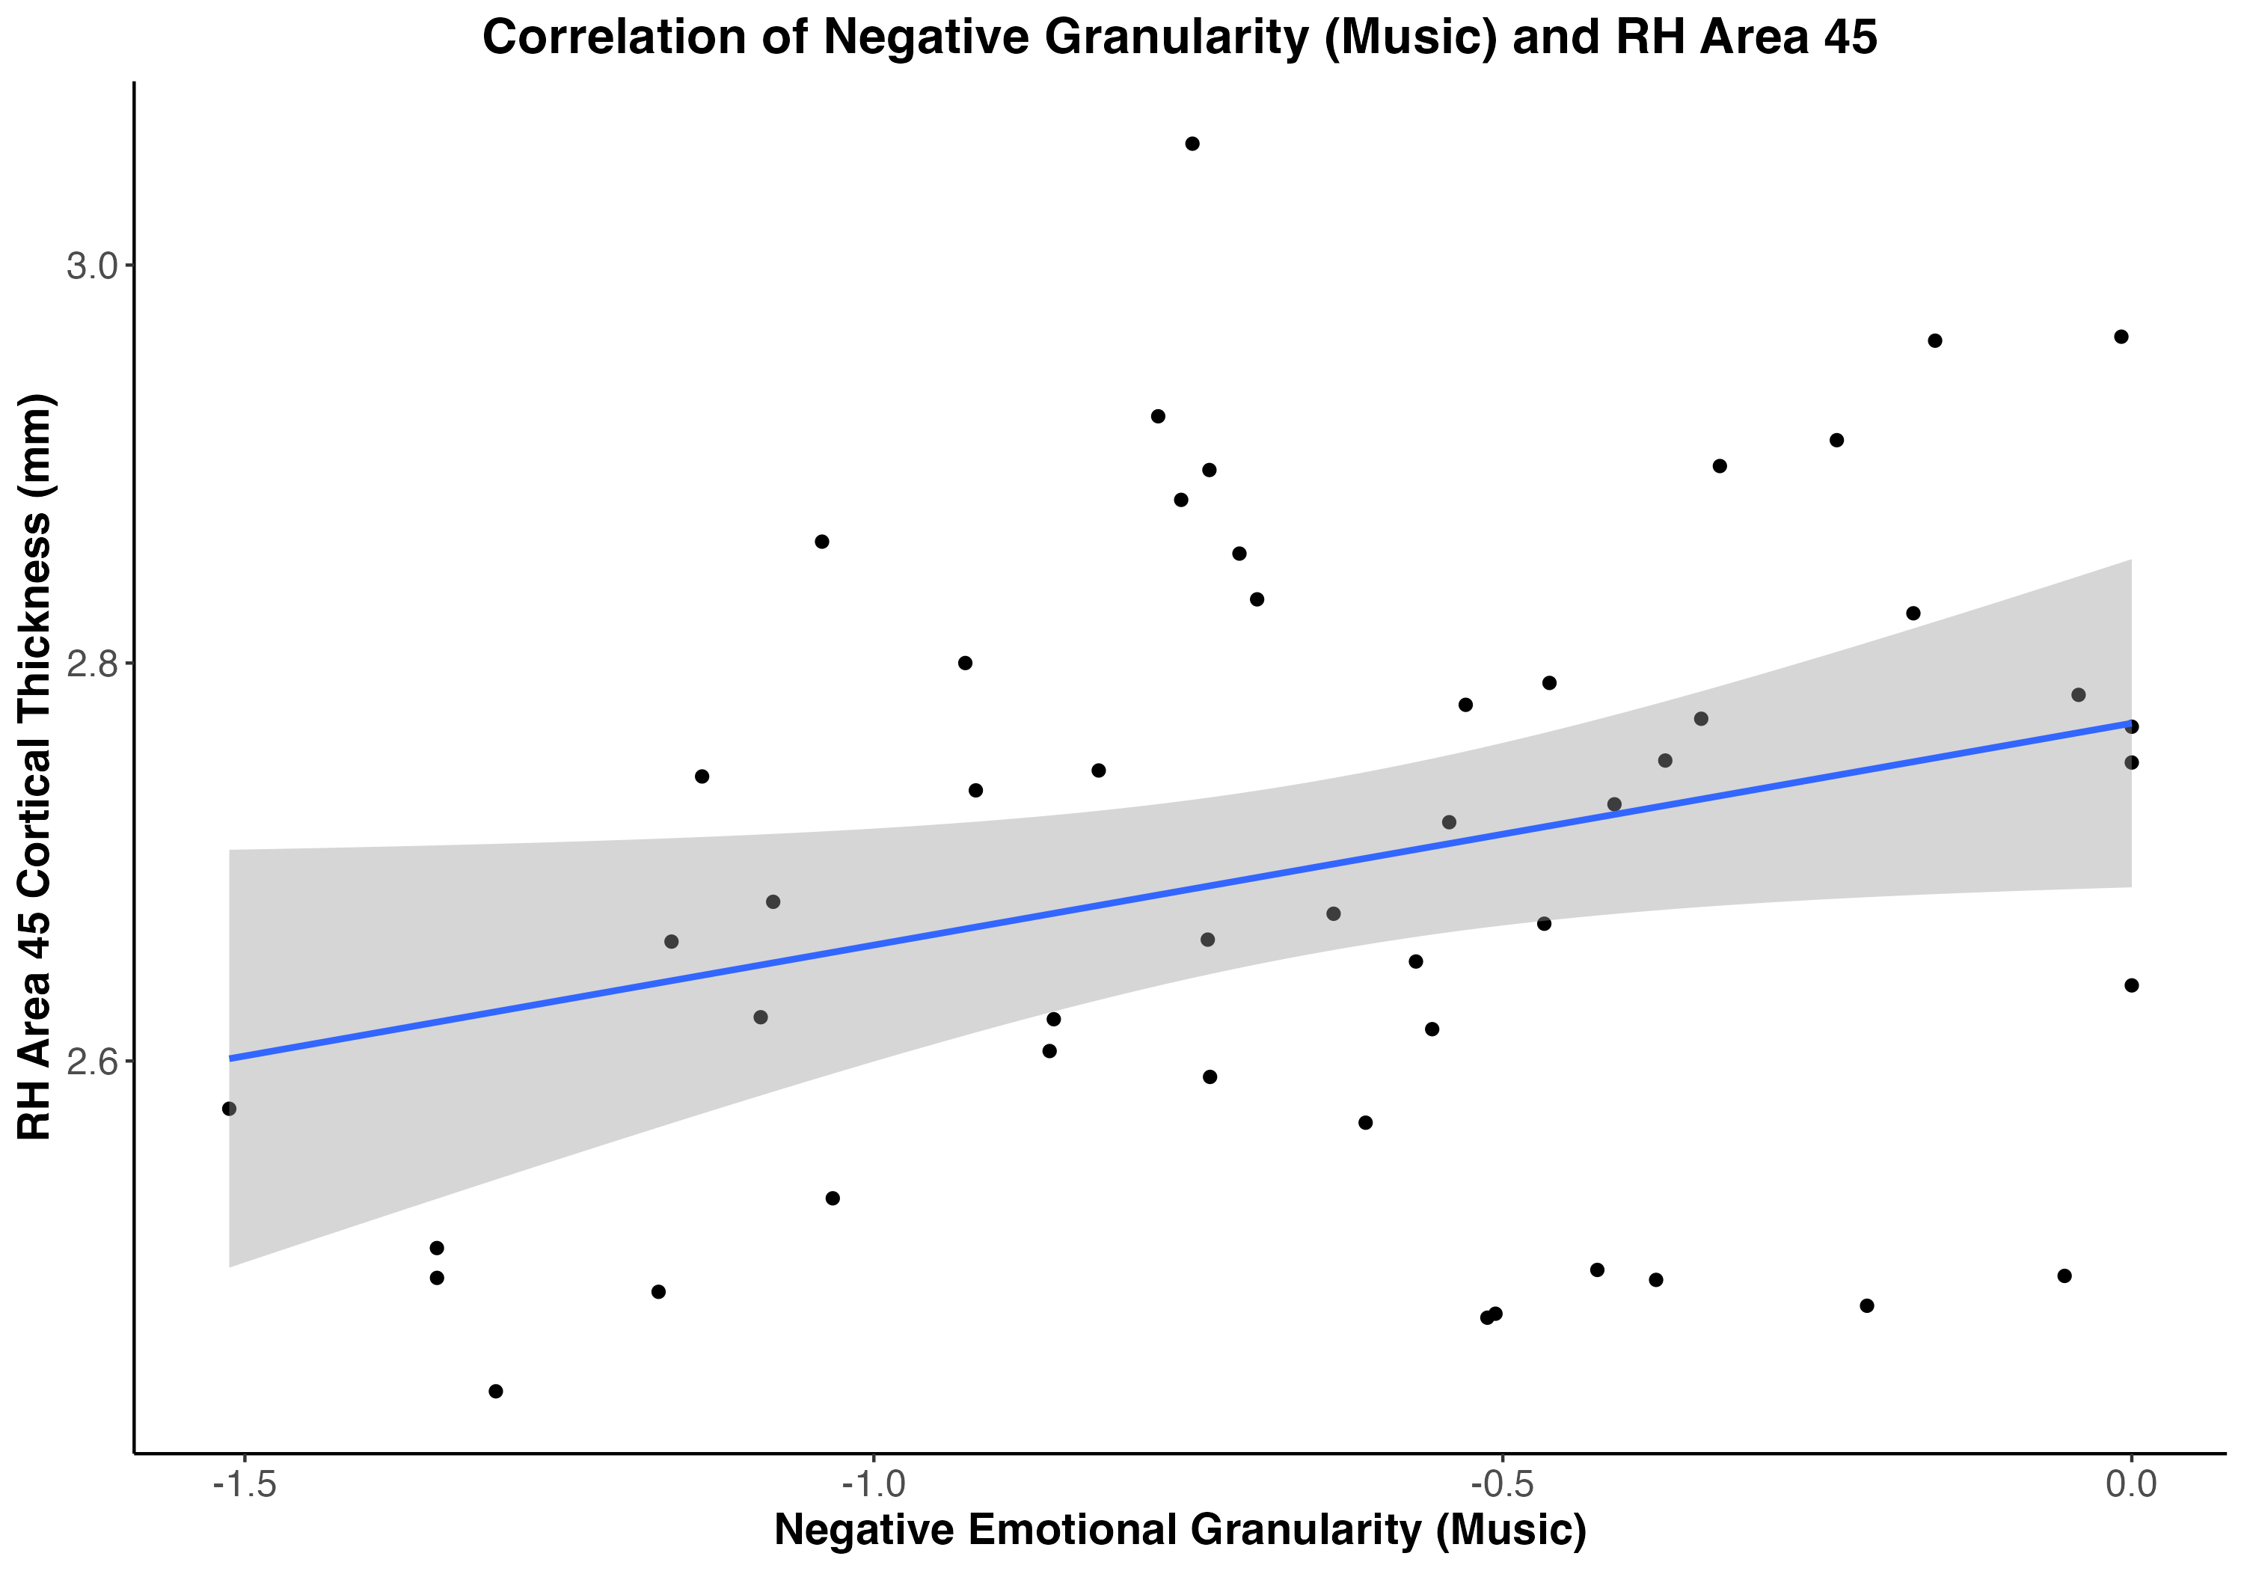
Figure 7. Study 2 average emotional granularity scores split by emotion valence (negative vs. positive) and stimulus type (picture vs. music). Error bars show 95% confidence intervals.
Figure 8. Study 2 scatter plot showing positive correlation between right hemisphere Area 45 (pars triangularis) cortical thickness and negative emotional granularity in response to music,
r(48) = .28, p = .047.
Figure 9. Right hemisphere ROI visualization from Lukic et al. (2023). Areas 44 and 45 are shown in pink. (This will be replaced by my own ROI visualization, this is a stand-in for now)

