Slide 1

Batch – 14 COLLISION GUARD
SHRI VISHNU ENGINEERING COLLEGE FOR WOMEN(AUTONOMOUS)
DEPARTMENT OF CSE
Presented By
Bandi Geetha Priyanka
Bendapudi Gnana Vyshnavi
Boorlagadda V N S Asritha
Chakrala Rakshitha
Dayana Devisree
Jujjuru Rama Mydhili
Guided By
Mrs K Ratna Kumari

Slide 2

Agenda
Introduction
ABSTRACT
OBJECTIVES
Modules
REQUIREMENT ANALYSIS
Design
Implementation
conclusion

Slide 3

INTRODUCTION
Currently we are in educational system where students work on projects. While selecting the projects, there are high chances for collision. In order to avoid such collisions we came up with this project Collision Guard.

Slide 4

ABSTRACT
COLLSION GUARD is a web-based application that enables students to select projects from a list or propose their own projects. The system allows students to request project approval from faculty members who can either accept or reject the requests. Accepted projects are allocated to students. The system streamlines the project allocation process, giving students choice and faculty control.

Slide 5
MODULES
User Management
User Registration
User Authentication
Project Management
Available Projects
Custom Project Proposal
Project Allocation
Project Selection
Project Approval
Project Status and Updates
Allocated Projects
Project Status:

Slide 6

OBJECTIVES
Provides a centralized platform for faculty and students to manage project allocations.
Allows students to select available projects that match their interests.
Provides a platform for students to propose their own projects.
Avoids collision of selecting the projects.

Slide 7

REQUIREMENT ANALYSIS
Software Requirements:
Languages : HTML, CSS, JavaScript.
Framework : Bootstrap.
Database : MYSQL.
Backend : Java.
Hardware Requirements:
Operating System : Windows 10 or 11
Processor : Intel i3 or above
RAM : 4GB or above
Space on Hard disk : 256GB

Slide 8
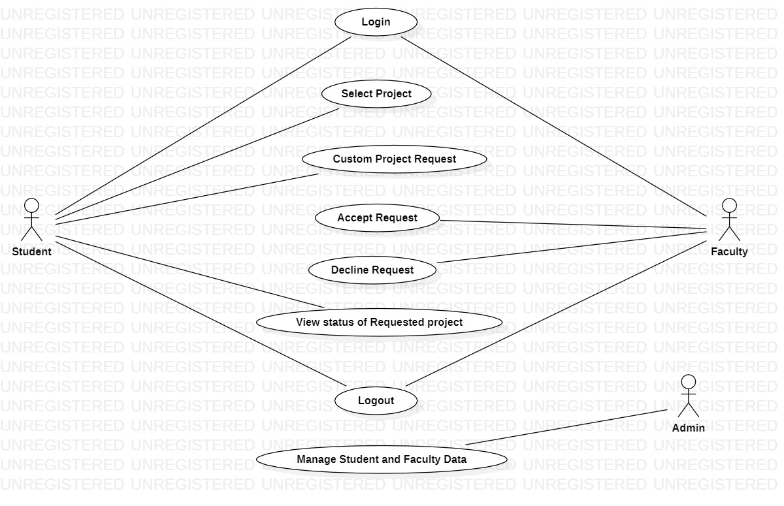
USECASE DIAGram

Slide 9
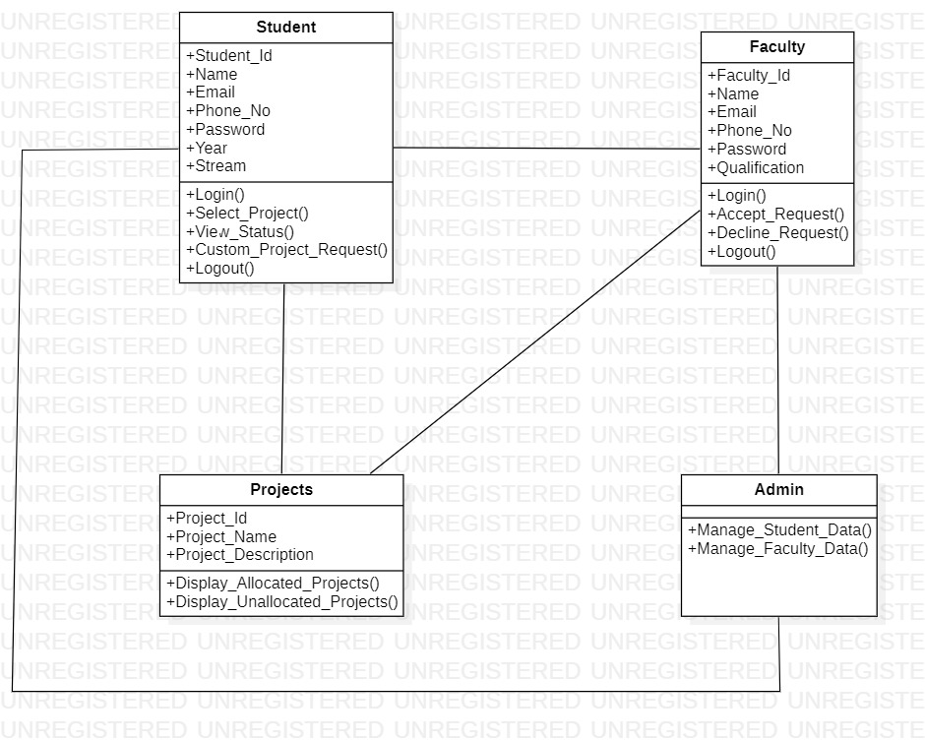
CLASS DIAGram

Slide 10
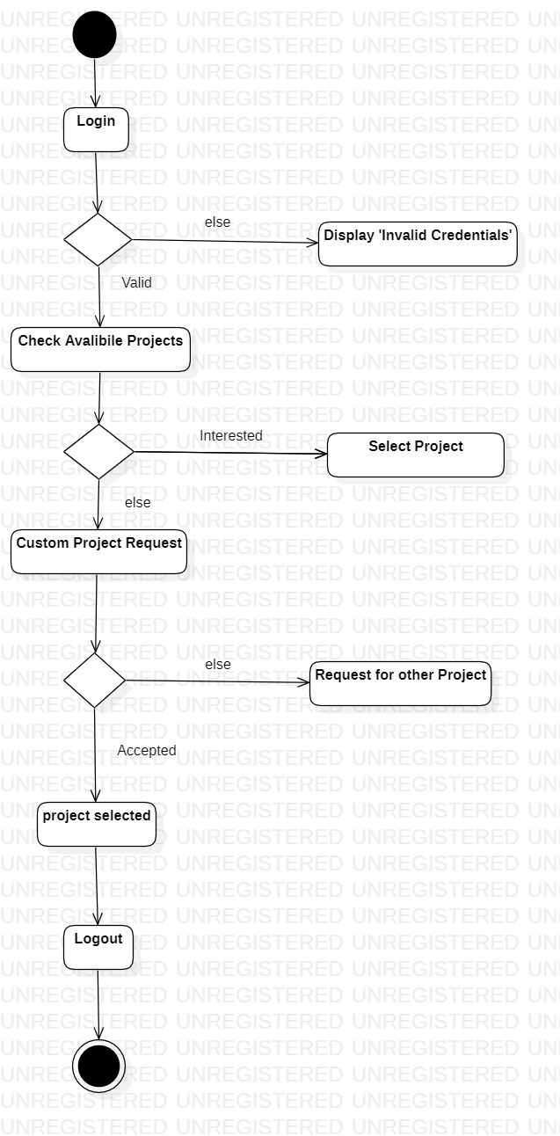
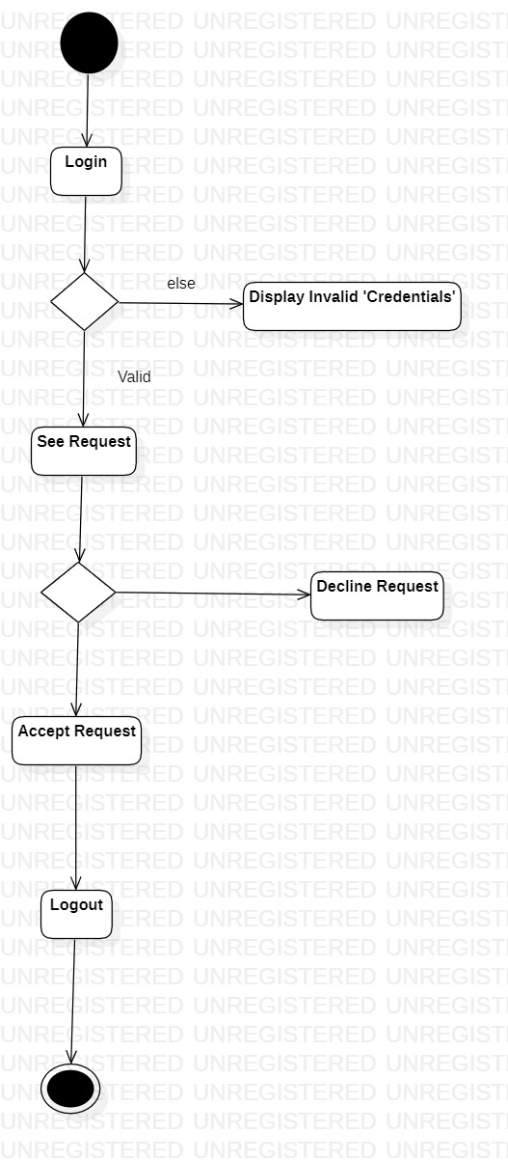
ACTIVITY Diagrams
Student
Faculty

Slide 11
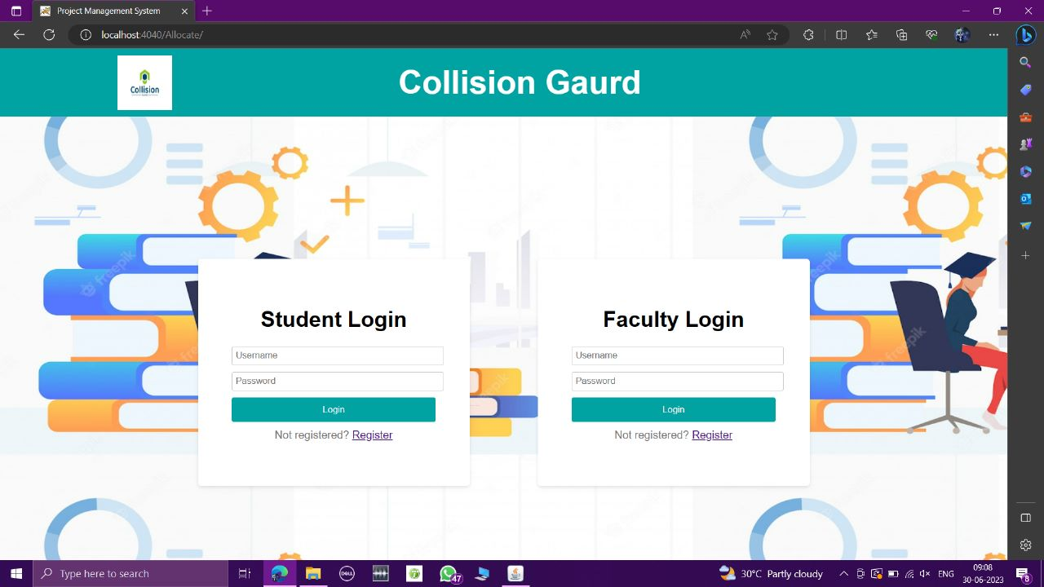
implementation-1

Slide 12
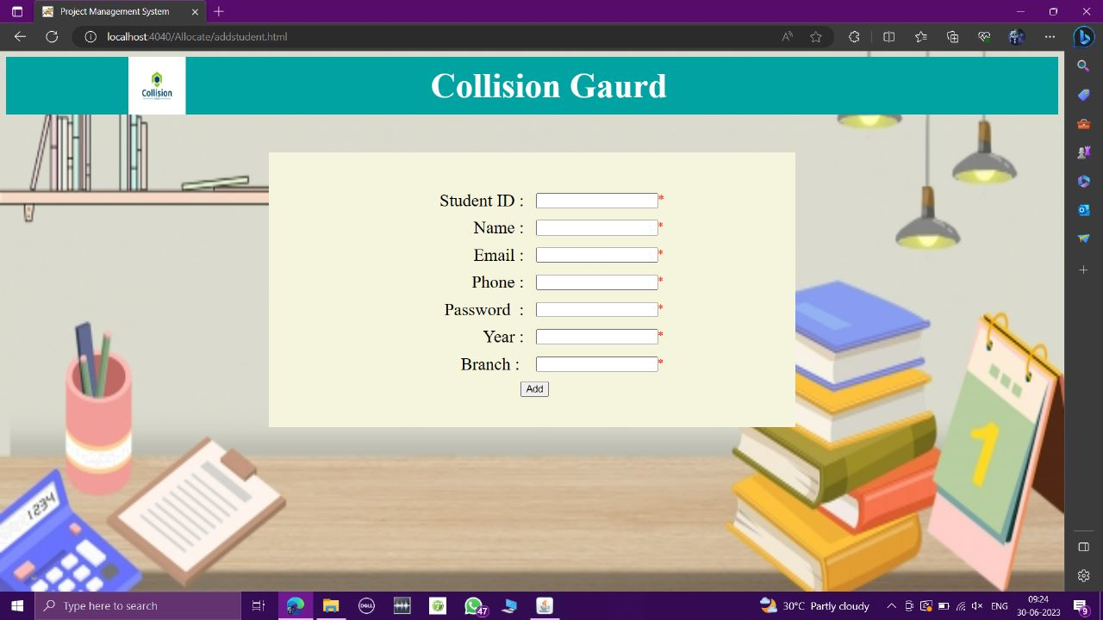
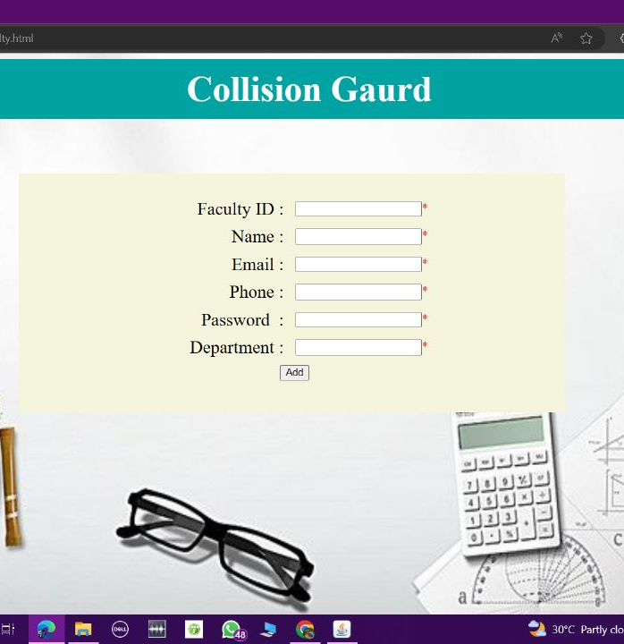
IMPLEMENTATION-2

Slide 13
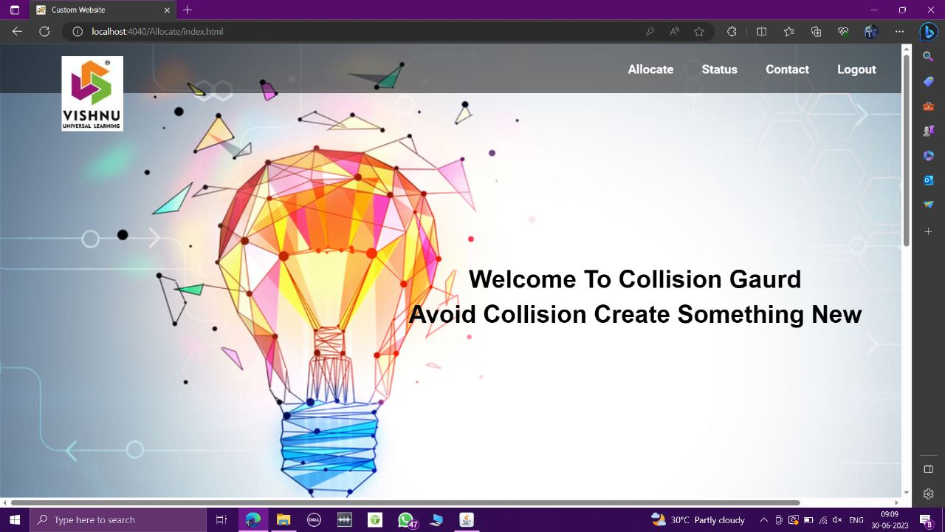
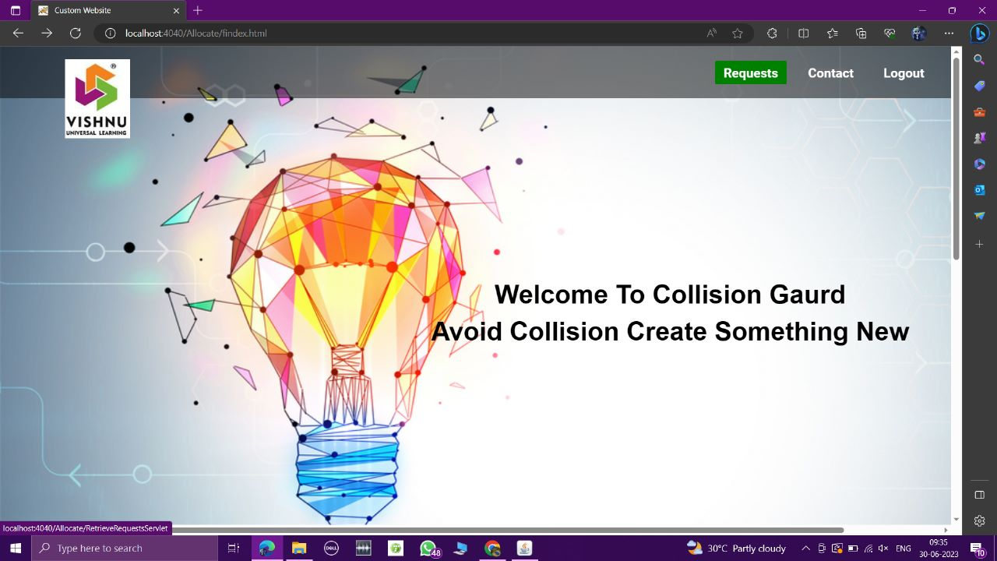
Implementation-3

Slide 14
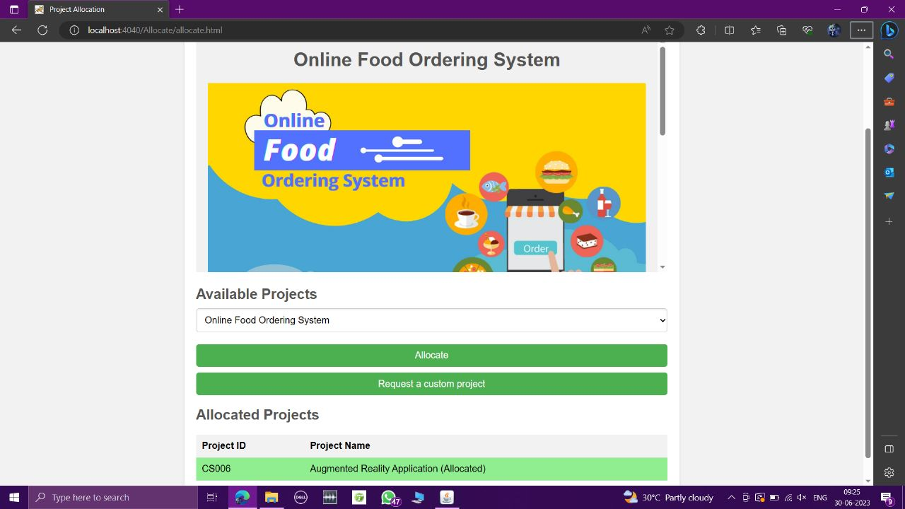
Implementation-4

Slide 15
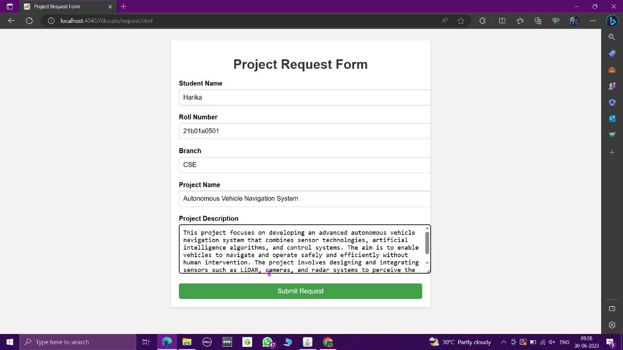
Implementation-5

Slide 16
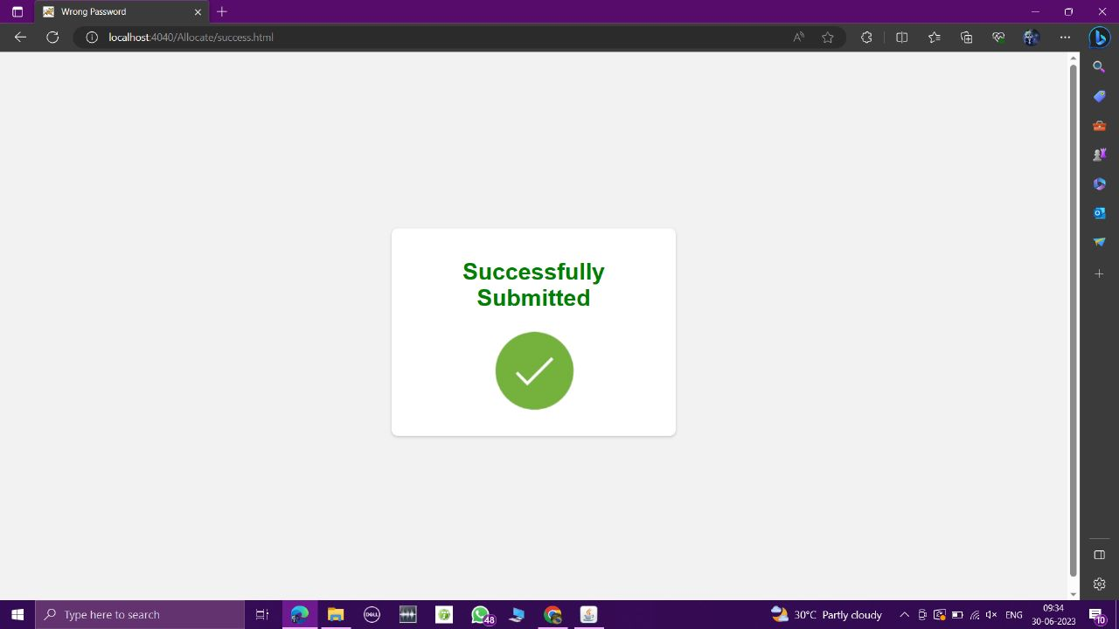
Implementation-6

Slide 17
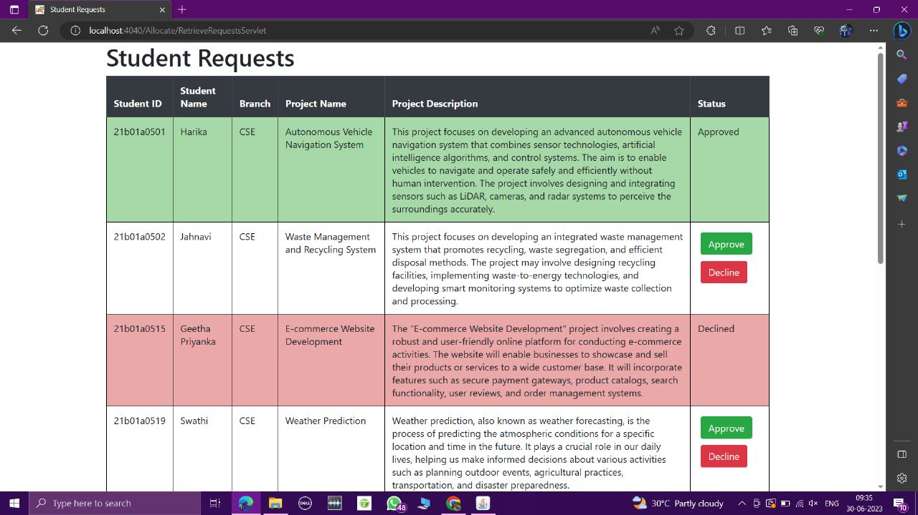
Implementation-7

Slide 18
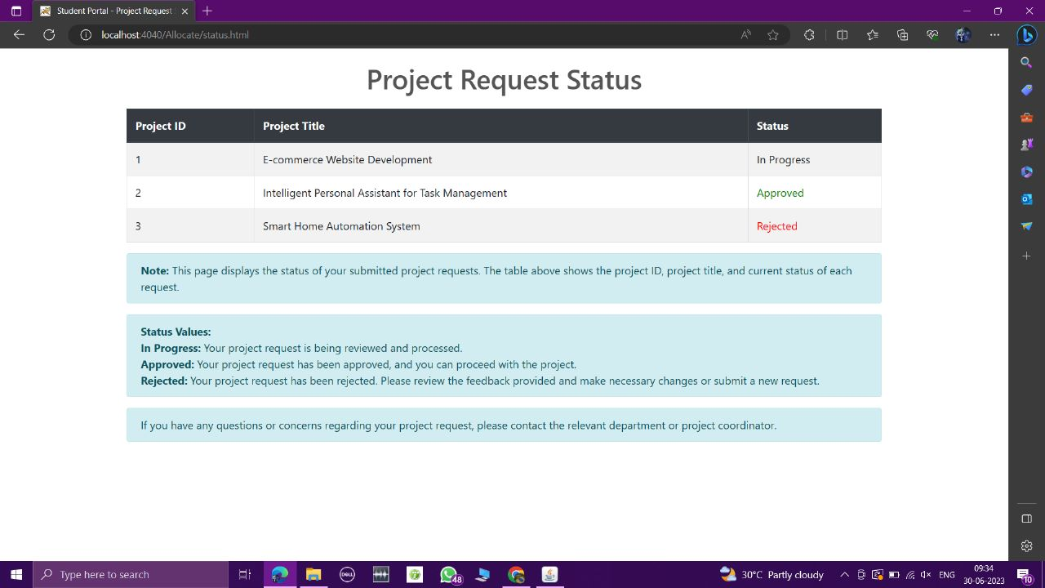
Implementation-8

Slide 19
Conclusion
By this, the challenges associated with traditional project allocation systems are addressed.
Overall, Collision Guard revolutionizes the way projects are allocated within the academic setting, providing a centralized and collaborative platform for student and faculty information.
Collision Guard will greatly enhance the project management experience, leading to improved student satisfaction, increased productivity, and better outcomes for academic projects.

Slide 20

Thank you

