Slide 1



Shri Vishnu Engineering College for Women
Department : Information Technology
Title: Optimized Road Route Prediction
Domain : Logistics
Project Guide: P. Venkata Rama Raju Sir
Team Members:
22B05A1211 - K. Varshini
21B01A1276 – K. Manasa
21B01A1296 – K. Harshini
21B01A1297 – K. Prasanna
21B01A1298 – L. Eswari

Slide 2

Abstract
This project aims to develop comprehensive route optimization solutions for the logistics industry. It utilizes machine learning, to check if a particular route can be taken or not. The solution takes into account various factors like traffic , safety ,mobile network, type of road and vehicle and other delivery constraints to ensure if the route is feasible to travel. This model helps achieve safety, cost savings, minimize resource.
The inputs required for the model include the start location, destination via a place and other information about the route. The output of the system provides a decision if a particular road can be taken or not based on the details provided, enabling users to navigate efficiently and make informed decisions during their logistics operations.

Slide 3
Objectives:
The objectives of road route optimization project typically revolve around improving transportation efficiency and reducing travel times, with increased safety.
Consider Traffic Conditions: The optimization model can take traffic condition into account, enabling dynamic route adjustments based on current road conditions and unexpected events like accidents or road closures.
Improved Safety measures: The model can take into account the accident rate of each route, and provide the best route with more safety rating.
Optimize Fuel Consumption: By identifying more efficient route, the project aims to provide route taking into account the type of road and type of vehicle used for travel, which in short minimizes the fuel consumption for vehicles, leading to cost savings and reduced environmental impact.

Slide 4
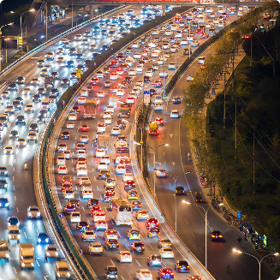
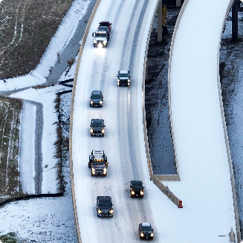

Advantages
Save Time ⏰
Reduce Costs 🛢️
Improve Safety 🚀
Improper roads and low network areas means more time spent to travel. So better to choose a proper route while starting
Efficient routes require less fuel, and vehicle wear and tear - saving you money and helping the environment.
Better to travel by accident less roads, which means increased safety.
Factors to Consider
Traffic
Heavy traffic, congestion, and roadwork can add time to routes and delay drivers.
Safety
Accident prone areas and low network areas may effect the safety of travelers.
Vehicle and Road Constraints
Vehicle type and road type effect their routes and their efficiency.

Slide 5
Tech Stack
Supervised learning
HTML,CSS
JavaScript
Supervised learning Classification algorithms like Logistic Regression and Decision tree algorithms are used.
Model is created using supervised learning algorithms applied on labelled data containing columns like pickup and drop location, vehicle type ,road type, accident rate and other details.
Model then trained and tested to return if the road can be taken or not.

Slide 6
Existed work :
Google Maps:
It is one of the most widely used route optimization platforms.
It utilizes a combination of algorithms, including Dijkstra's algorithm to calculate the most efficient routes between two locations.
Google Maps also takes real-time traffic conditions into account, adjusting routes based on current traffic congestion.
Limitations:
Google Maps provides the optimized route but does not check if the provided route can be taken to travel or not.
Proposed work :
Our project predicts if a particular route can be taken or not, based on the input details provided like accident rate, no.of diversions of a road ,network availability, distance etc..

Slide 7
Project Flow Diagram
1
Signup/ Login
User name
Phone number
Mail I’d
Choose Language
2
Preferred Language
3
Input Data
Starting point
Destination
Via place
Vehicle Information
Accidents rate
Output Data
4
Results if the path provided can be taken or not.

Slide 8
Modularization:
Data Ingestion and Preprocessing:
Data Collection: Collect data from various sources, including traffic data providers, safety records, mobile network information, and road databases.
Data Preprocessing: Clean, validate, and preprocess the data. This includes handling missing values, outliers, and standardizing data formats.
Feature Engineering: Create relevant features from the collected data, such as calculating average traffic speed, identifying high-risk areas, and categorizing road types.
2. Machine Learning Model Development:
Create a model that can predict if the given route can be taken or not based on input features.

Slide 9
Train machine learning models on historical data to predict route feasibility. This involves using algorithms to learn from past data and make predictions based on new input.
3. User Interface Module:
Input : Create an interface for users to input details like the starting location, destination via a place, and other route-related information.
Output Presentation: Display the system's decision on whether a route can be taken or not to the user.
Route Planning: Generate optimized routes based on the predictions made by the machine learning models.
Deployment: Prepare the route optimization system for deployment, including selecting deployment platforms ,configuring server infrastructure, and deploying the system to production.

Slide 10
Project Plan:
Design and Planning
1Week
Data Ingestion and
Preprocessing
2 Weeks
Model Development
3 Weeks
Deployment
1 Week

Slide 11
Design and Methodology:
Road and vehicle Inputs
Processing Input
User
Dataset
Returns if the path provided is suitable or not
Checking for constraints

Slide 12
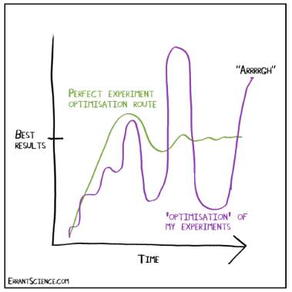


Conclusion
Increased Efficiency
Improved Safety
Global Relevance
Decide if a particular path is feasible to take or not. Which helps us decide an efficient route.
Checking for safety rate and accidents rates ensures a safety path to travel. Also the network constraints are involved.
Optimised route planning plays a crucial role in logistics, transportation and supply chains around the world.

Slide 13
Thank You

