Slide 1
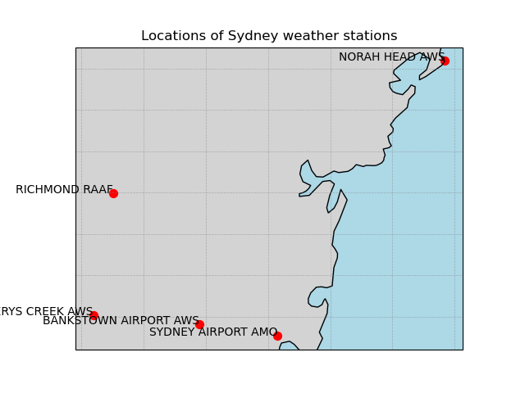
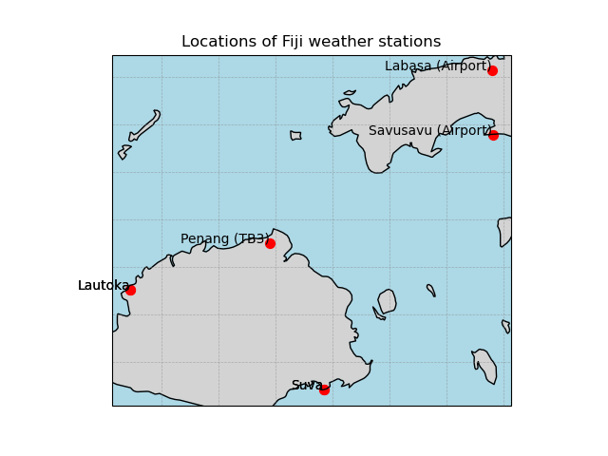
Rainfall evaluation: Insights using station data from Sydney, Australia Fiji

