Slide 1
Model intercomparison for extremes precipitation
Team
Skye, Loan, Xueying, Joel, Greta, Kathiana, Huyen, Ashneel, Sanna, Leena

Slide 2
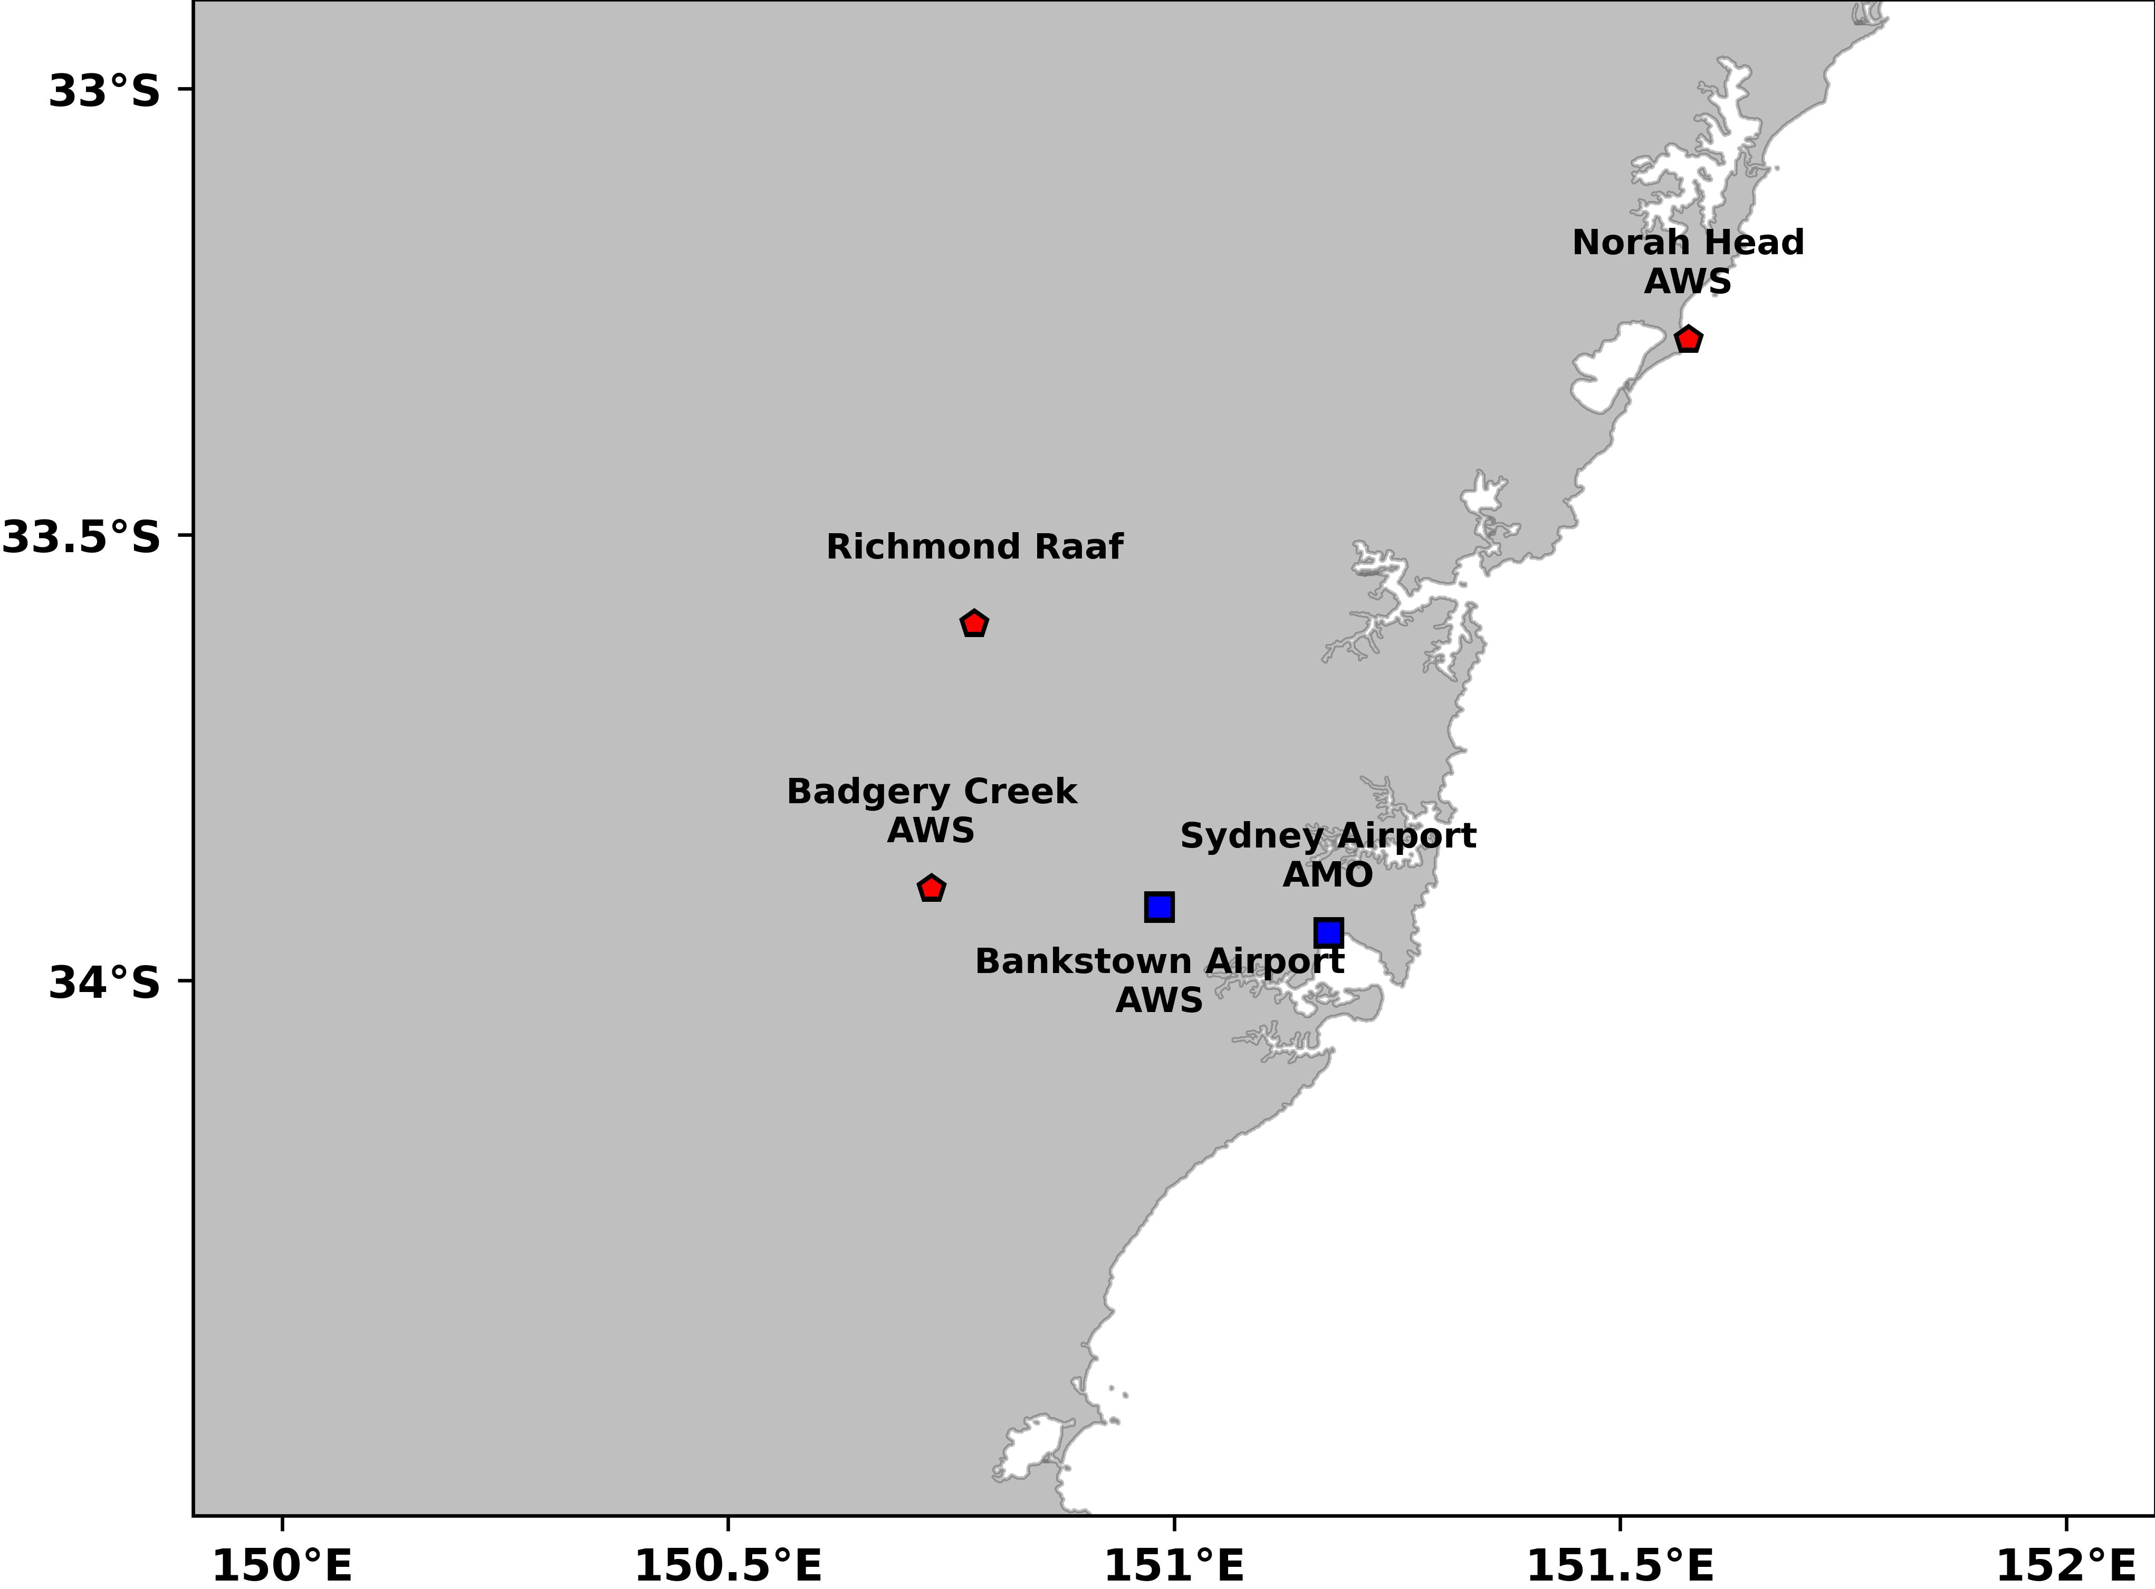
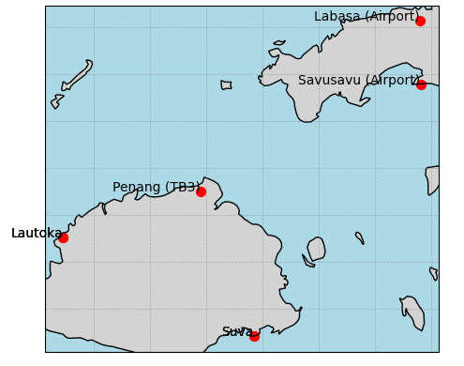
Objective: How well do convection-permitting models represent extreme precipitation events?
Sydney station locations
Fiji station locations

Slide 3
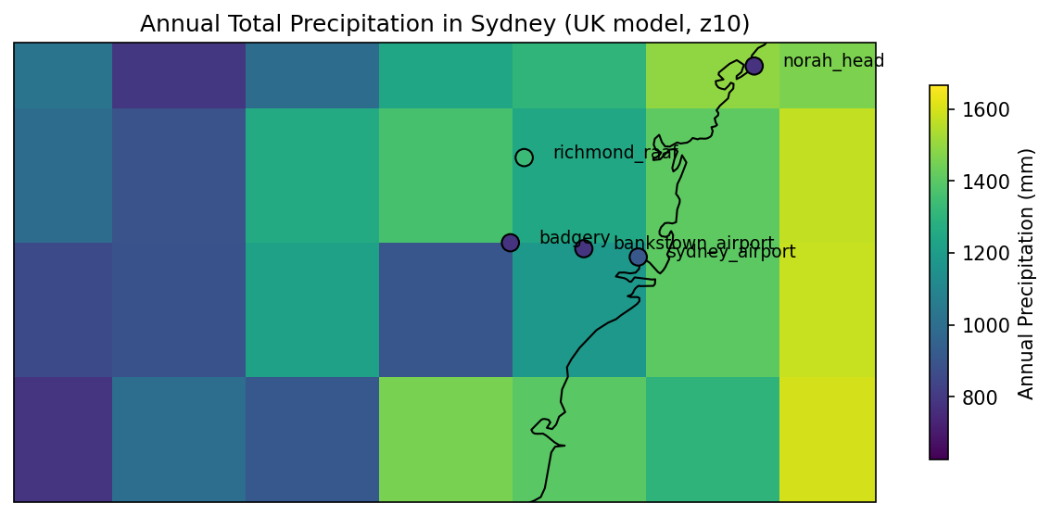
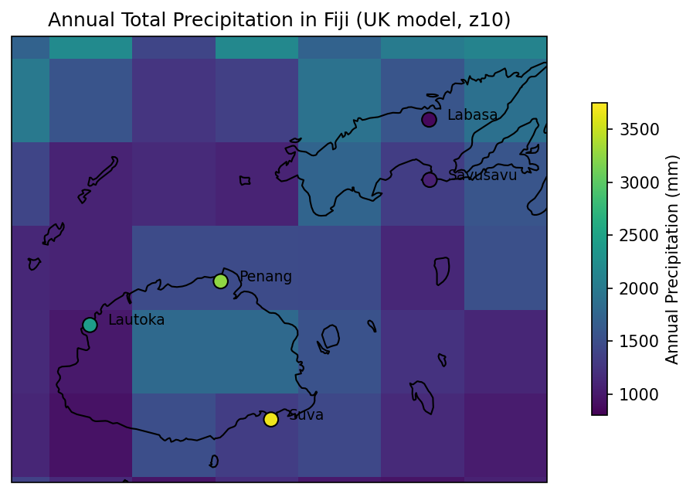
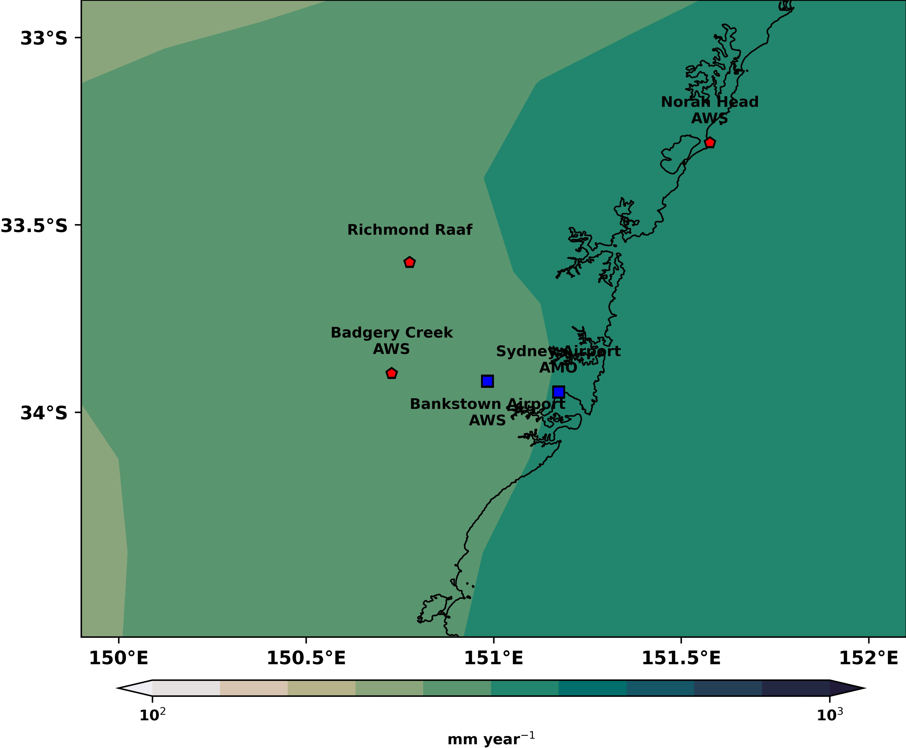
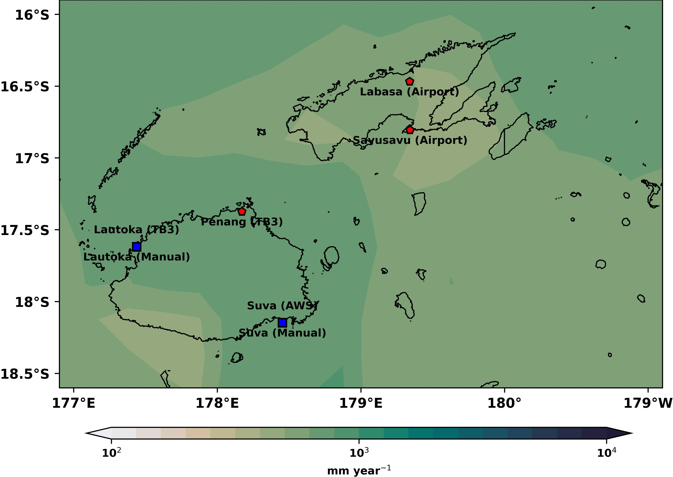
Annual precipitation
Sydney
Fiji
TRMM-
Annual precipitation

Slide 4
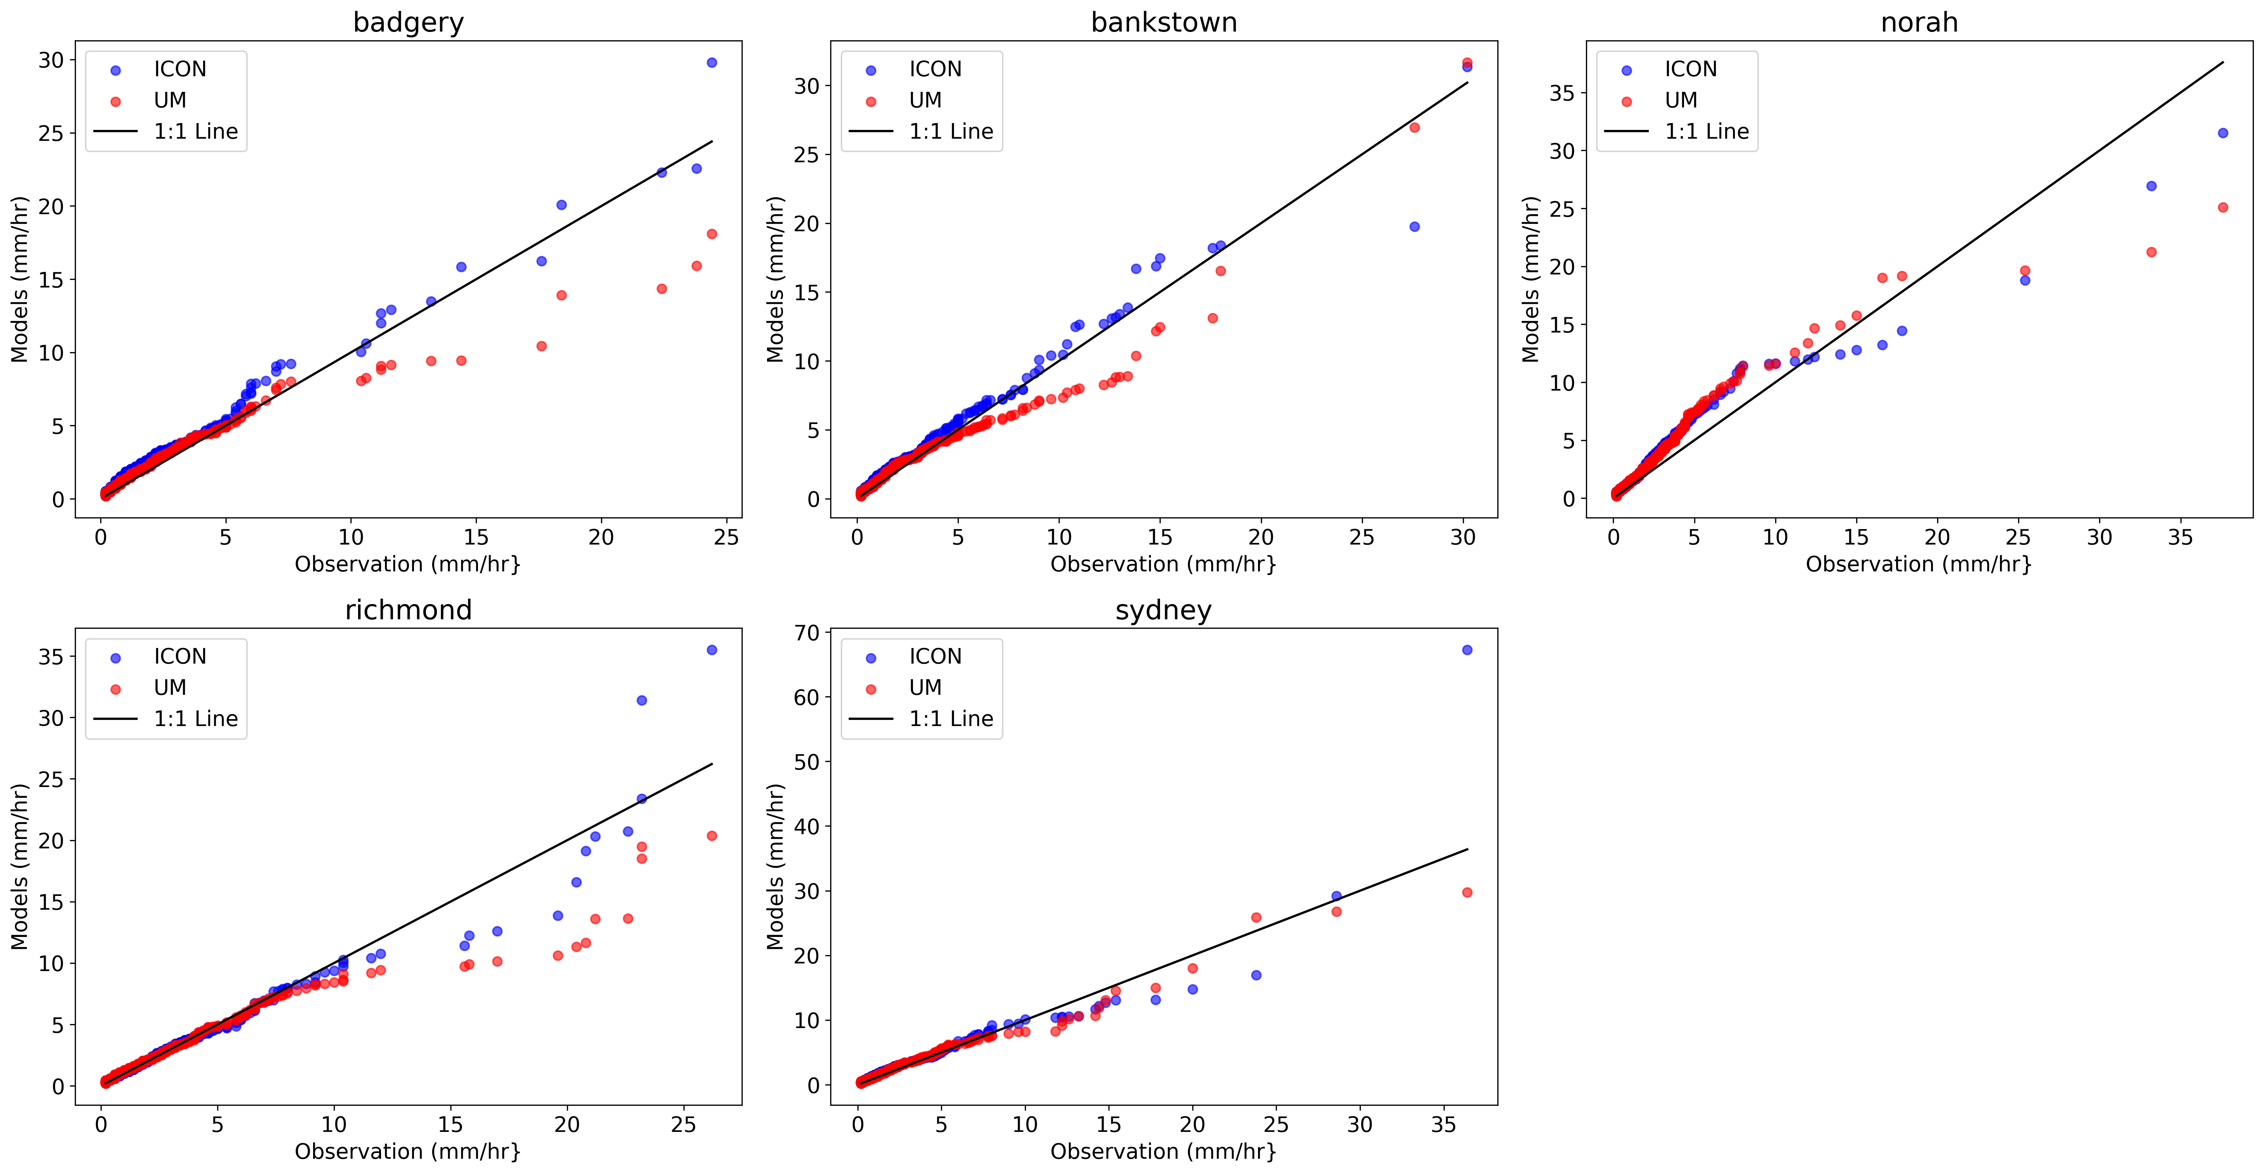
Quantile – Quantile mapping
- Sydney

Slide 5
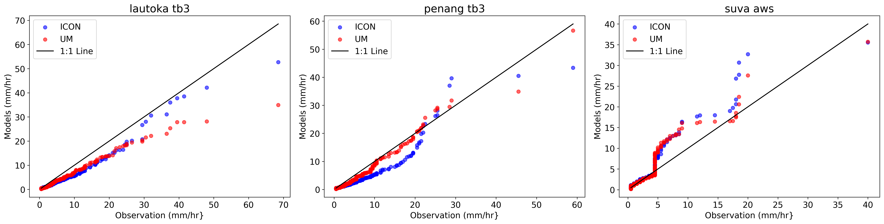
Quantile – Quantile mapping
- Fiji

Slide 6
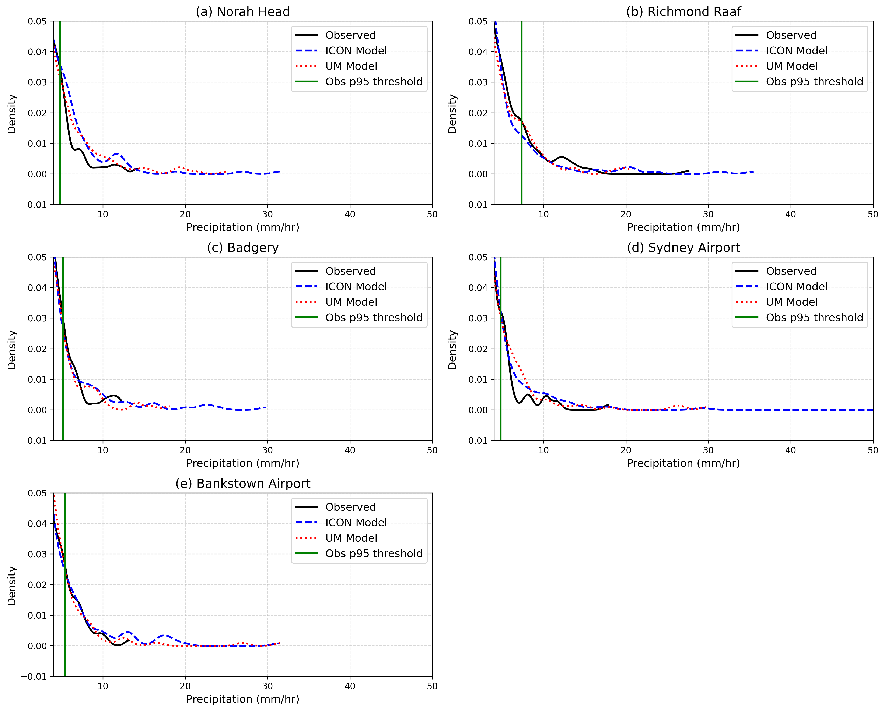
95 Percentile threshold
- Sydney

Slide 7
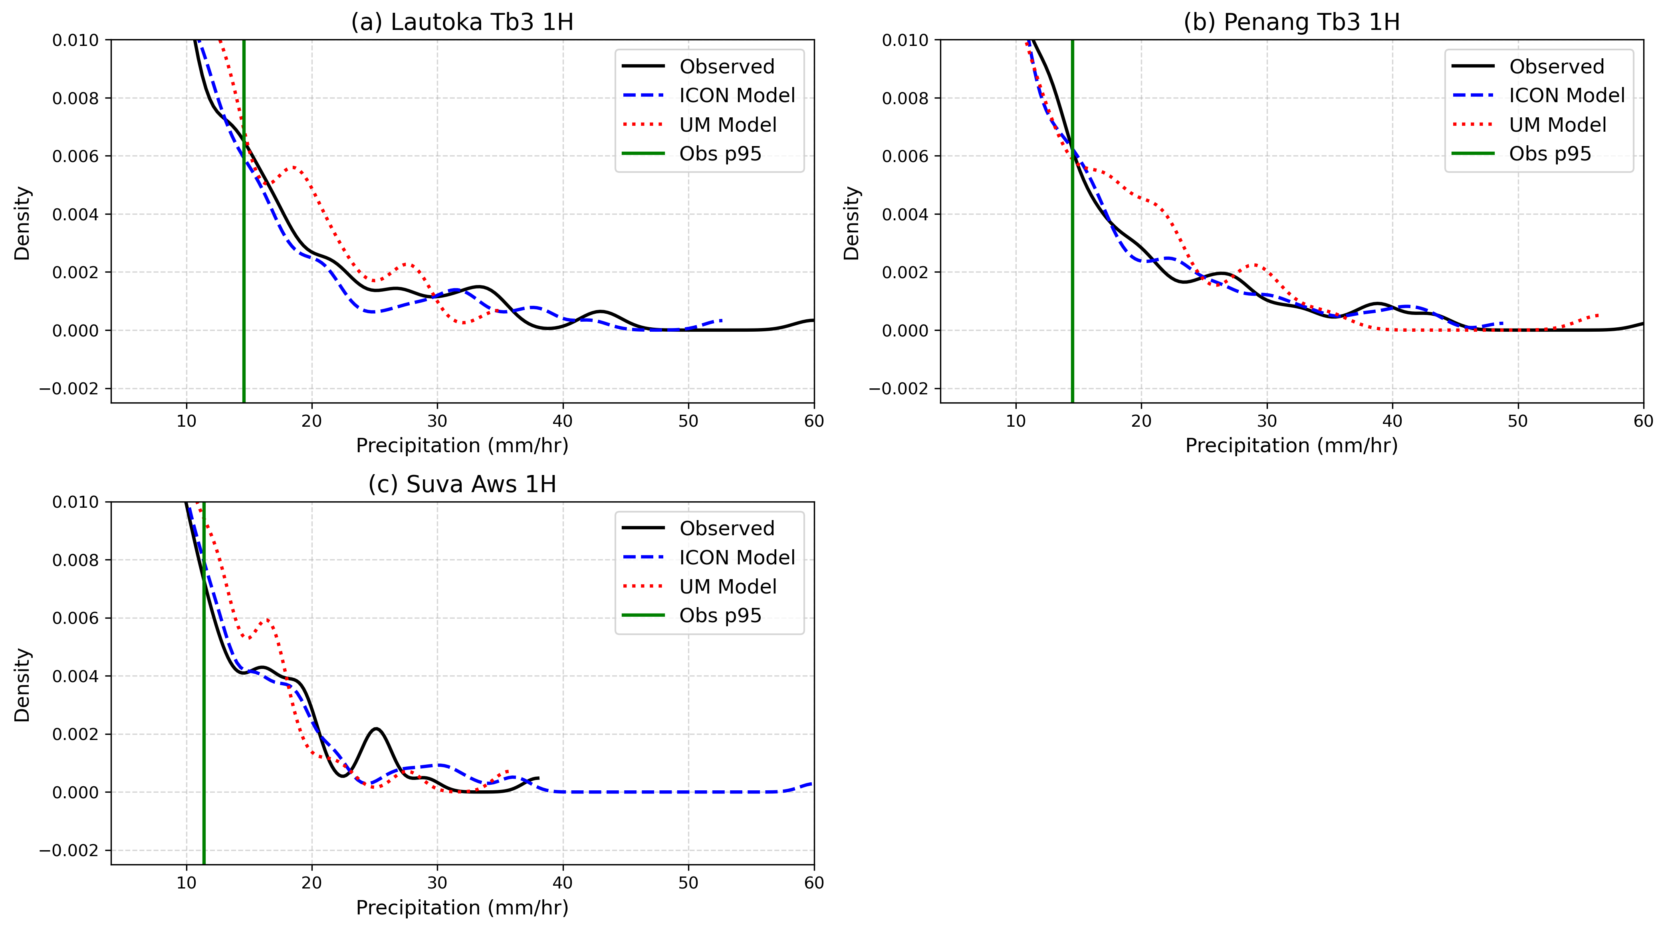
95 Percentile threshold
- Fiji

