Slide 1

EM-ALGORITHM &
APPLICATIONS
Presented By : Hemant Nishad
Indian Institute of Space Science and Technology | 2025

Slide 2
1
INTRODUCTION
The Expectation-Maximization (EM) algorithm is a widely used iterative method for finding maximum likelihood estimates of parameters in probabilistic models utilizing the observed data, especially when data has missing or latent variables.
IIST | 2025

Slide 3
Mathematical Framework
2
1. Observed Data (X)
Represented as X={x¹,x²,…,x^{n}}, where each x^{i} is a measurable quantity
e.g., features in a dataset.
2. Latent Variables (Z)
Unobserved variables Z={z¹,z²,…,z^{n}} that influence the distribution of X.
3. Parameters (θ)
Unknown quantities θ to be estimated.
The goal is to find θ that maximises the likelihood of X
IIST | 2025

Slide 4


Mathematical Framework
3
Likelihood Functions
Complete-Data Likelihood
The joint probability of X and Z given θ
$$p\left(X,\left.Z\right|θ\right)=\prod_{i⋅=1}^{n}{p\left(x_{\dot{i}},\left.z_{i}\right|θ\right)}$$
This incorporates both observed and latent variables but is intractable directly because Z is unobserved.
Observed-Data Likelihood
The marginal likelihood of X, obtained by integrating out Z:
$$p\left(\left.X\right|θ\right)=\int{p\left(X,\left.Z\right|θ\right)ⅆZ}$$
Maximizing log(⁡p(X∣θ)) directly is often difficult due to the integral.
IIST | 2025

Slide 5
4
HOW DOES EM ALGORITHM WORKS ?
Expectation Step (E – Step)
EM Algorithm has two main Steps, which are repeated iteratively until convergence (which is guaranteed!).
Estimate the missing/ hidden variables using current parameter values.
Computes the expected likelihood of the data.
IIST | 2025
Maximization Step (M-Step)
Optimize parameters to maximize the expected likelihood found in the E-step.

Slide 6
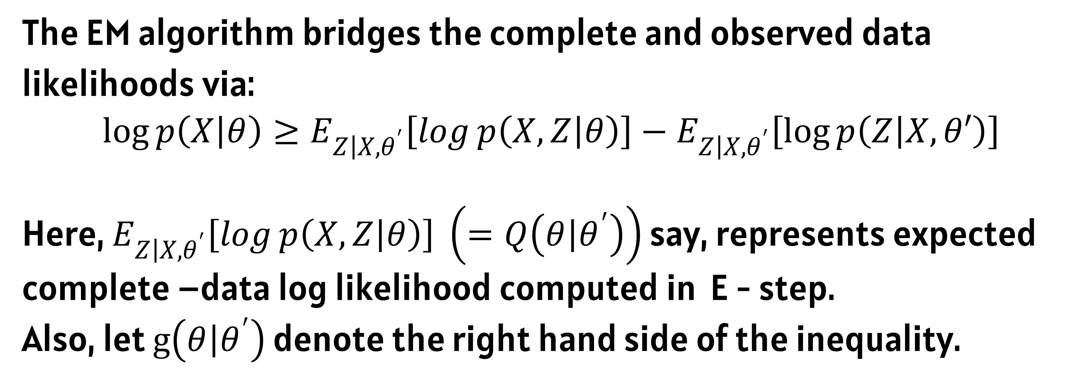
5
THE CONNECTION
The EM algorithm bridges the complete and observed data likelihoods via:
$$\log{p\left(\left.X\right|θ\right)}≥E_{\left.Z\right|X,θ^{′}}\left[\log{p\left(X,\left.Z\right|θ\right)}\right]−E_{\left.Z\right|X,θ^{′}}\left[\log{p\left(\left.Z\right|X,θ′\right)}\right]$$
Here, $E_{\left.Z\right|X,θ^{′}}\left[\log{p\left(X,\left.Z\right|θ\right)}\right] \left(=Q\left(\left.θ\right|θ^{′}\right)\right)$ say, represents expected complete –data log likelihood computed in E - step.
Also, let $g\left(\left.θ\right|θ^{′}\right)$ denote the right hand side of the inequality.
IIST| 2025

Slide 7
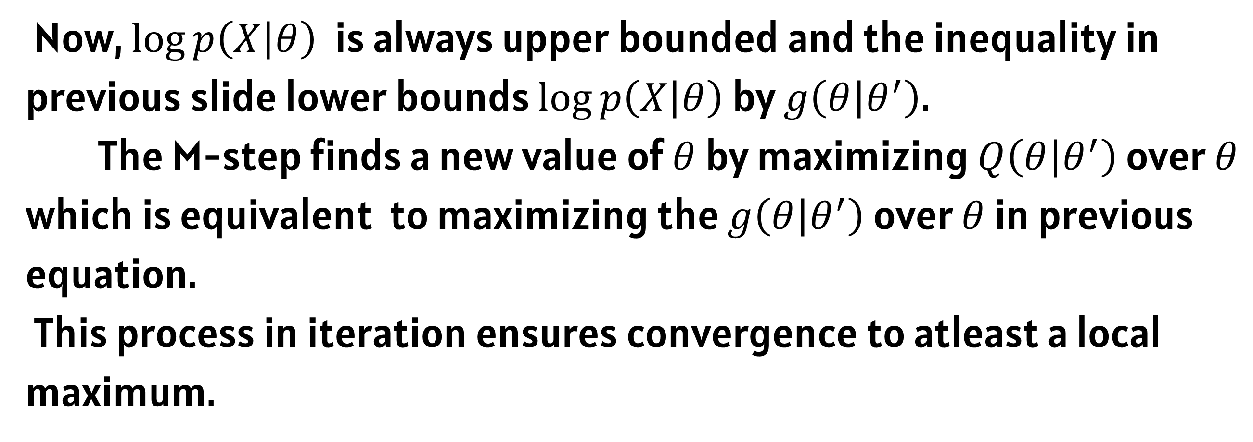
6
THE CONNECTION
Now, $\log{p\left(\left.X\right|θ\right)}$ is always upper bounded and the inequality in previous slide lower bounds $\log{p\left(\left.X\right|θ\right)}$ by $g\left(\left.θ\right|θ^{′}\right)$.
The M-step finds a new value of $θ$ by maximizing $Q\left(\left.θ\right|θ^{′}\right)$ over $θ$ which is equivalent to maximizing the $g\left(\left.θ\right|θ^{′}\right)$ over $θ$ in previous equation.
This process in iteration ensures convergence to atleast a local maximum.
IIST| 2025

Slide 8
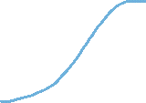
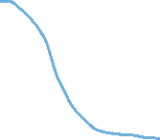
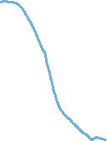
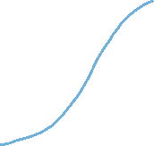

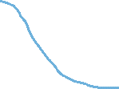
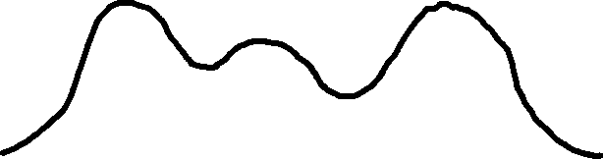
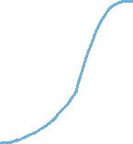
7
APPLICATIONS
Gaussian Mixture Models
The EM algorithm is a versatile tool that can be used in various problems. The feat of handling incomplete or missing data makes it a very sought-after algorithm in various ML applications.
Let us discuss some of them.
IIST | 2025
Latent Dirichlet Allocation

Slide 9
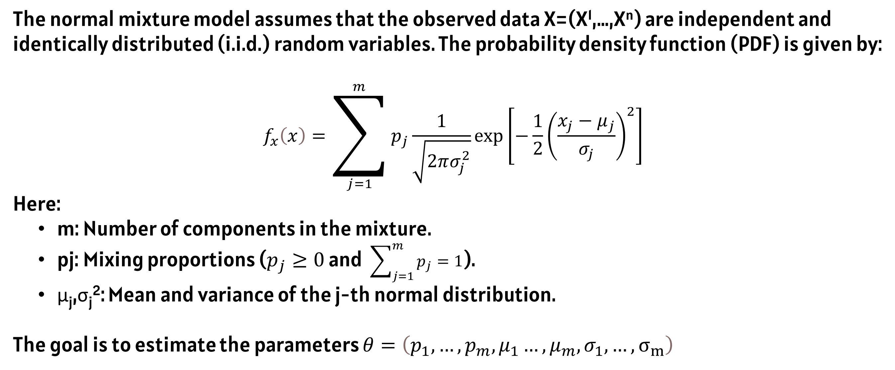
GAUSSIAN MIXTURE MODELS
8
The normal mixture model assumes that the observed data X=(X¹,…,X^{n}) are independent and identically distributed (i.i.d.) random variables. The probability density function (PDF) is given by:
$$f_{x}\left(x\right)=\sum_{j=1}^{m}{p_{j}\frac{1}{\sqrt{2πσ_{j}^{2}}}\exp\left[−\frac{1}{2}{\left(\frac{x_{j}−μ_{j}}{σ_{j}}\right)}^{2}\right]}$$
Here:
m: Number of components in the mixture.
pj: Mixing proportions ($p_{j}≥0$ and $\sum_{j=1}^{m}{p_{j}}=1$).
μ_{j},σ_{j}²: Mean and variance of the j-th normal distribution.
The goal is to estimate the parameters $θ=\left(p_{1},…,p_{m},μ_{1}…,μ_{m},σ_{1},…, σ_{m}\right)$
IIST | 2025

Slide 10
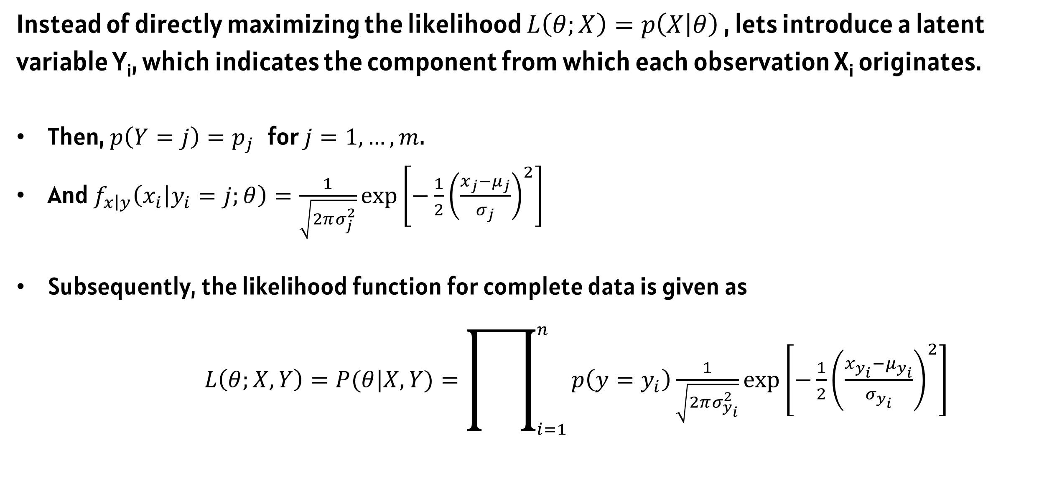
9
GAUSSIAN MIXTURE MODELS
Instead of directly maximizing the likelihood $L\left(θ;X\right)=p\left(X | θ\right)$ , lets introduce a latent variable Y_{i}, which indicates the component from which each observation X_{i} originates.
Then, $p\left(Y=j\right)=p_{j }$ for $j=1,…,m$.
And $f_{\left.x\right|y}\left(\left.x_{i}\right|y_{i}=j;θ\right)=\frac{1}{\sqrt{2πσ_{j}^{2}}}\exp\left[−\frac{1}{2}{\left(\frac{x_{j}−μ_{j}}{σ_{j}}\right)}^{2}\right]$
Subsequently, the likelihood function for complete data is given as
$L\left(θ;X,Y\right)=P(θ|X,Y)=\prod_{i=1}^{n}{p\left(y=y_{i}\right)\frac{1}{\sqrt{2πσ_{y_{i}}^{2}}}\exp\left[−\frac{1}{2}{\left(\frac{x_{y_{i}}−μ_{y_{i}}}{σ_{y_{i}}}\right)}^{2}\right]}$
IIST | 2025

Slide 11
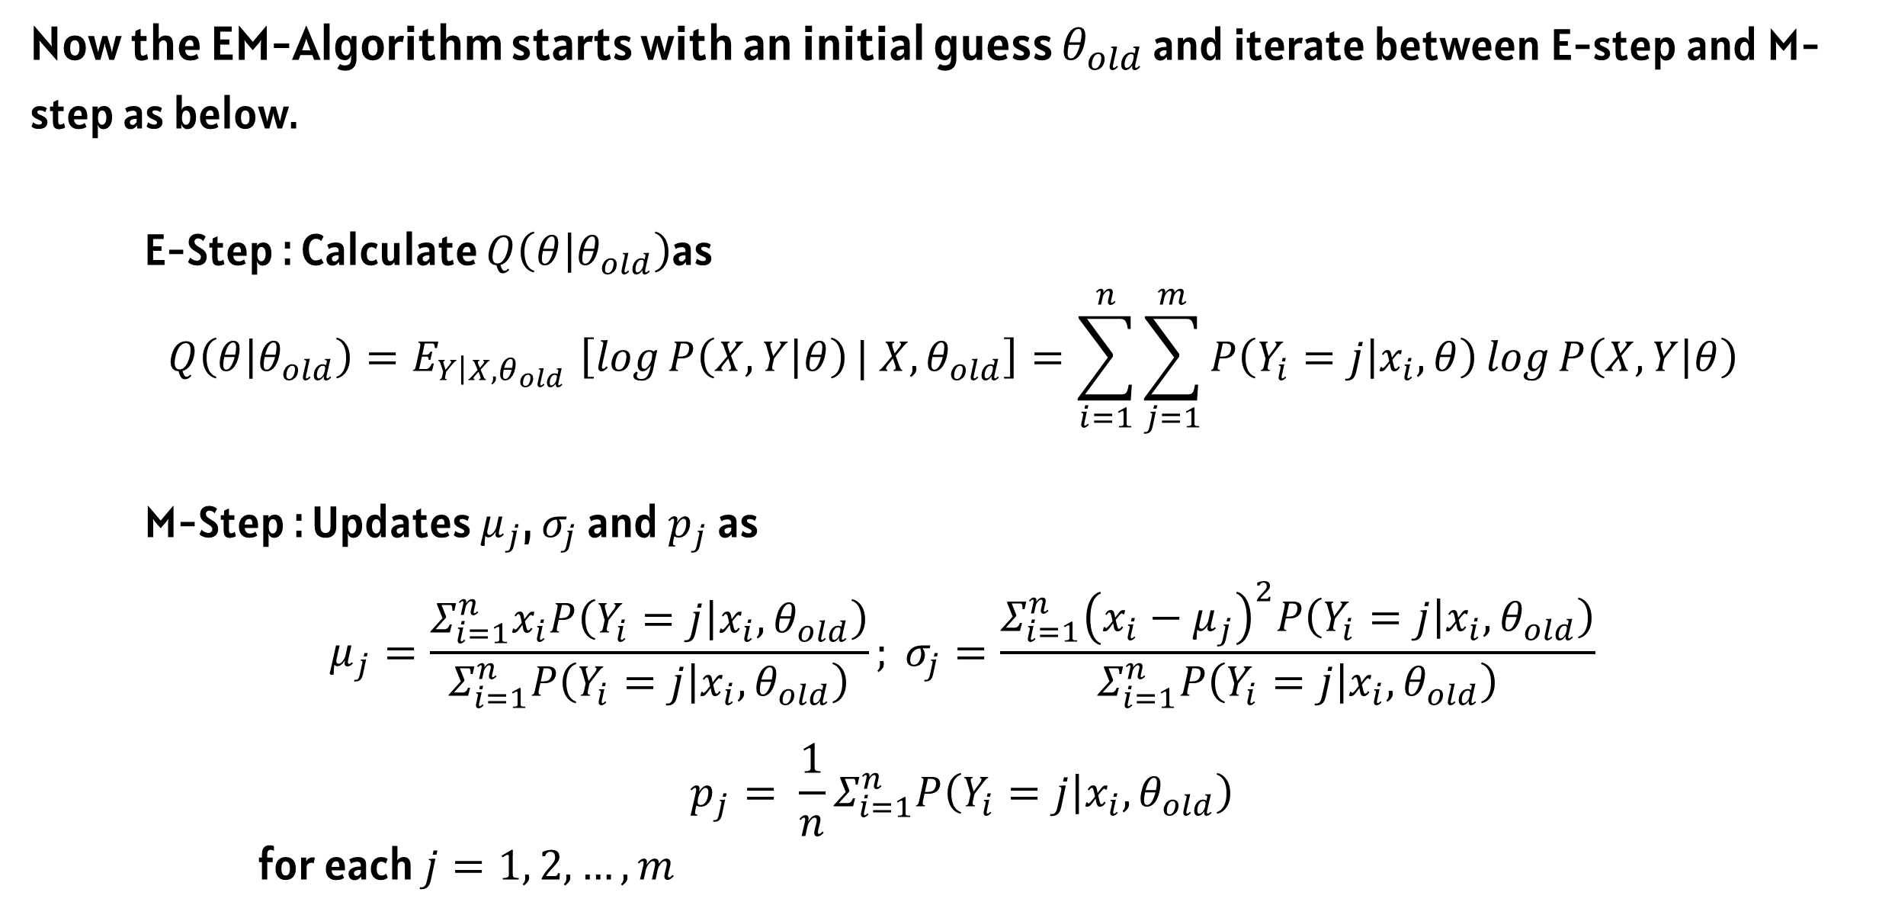
10
GAUSSIAN MIXTURE MODELS
Now the EM-Algorithm starts with an initial guess $θ_{old}$ and iterate between E-step and M-step as below.
E-Step : Calculate $Q\left(\left.θ\right|θ_{old}\right)$as
$${Q\left(\left.θ\right|θ_{old}\right){=E}_{\left.Y\right|X,θ_{old}}\left[\log{P\left(X,\left.Y\right|θ\right)}| X,θ_{old}\right]=\sum_{i=1}^{n}{\sum_{j=1}^{m}{P\left(Y_{i}=\left.j\right|x_{i},θ\right)\log{P\left(X,\left.Y\right|θ\right)} }}}_{ }$$
M-Step : Updates $μ_{j}$, $σ_{j}$ and $p_{j}$ as
$$μ_{j}=\frac{Σ_{i=1}^{n}x_{i}P\left(Y_{i}=\left.j\right|x_{i},θ_{old}\right)}{Σ_{ⅈ=1}^{n}P\left(Y_{i}=\left.j\right|x_{i},θ_{old}\right)}; σ_{j}=\frac{Σ_{i=1}^{n}{\left(x_{i}−μ_{j}\right)}^{2}P\left(Y_{i}=\left.j\right|x_{i},θ_{old}\right)}{Σ_{ⅈ=1}^{n}P\left(Y_{i}=\left.j\right|x_{i},θ_{old}\right)}$$
$$p_{j}= \frac{1}{n}Σ_{i=1}^{n}P\left(Y_{i}=\left.j\right|x_{i},θ_{old}\right)$$
for each $j=1, 2, …,m$
IIST | 2025

Slide 12
10
LATENT DIRICHLET ALLOCATION
In NLP, a topic model is a statistical model for discovering “topics” that occur in a collection of documents. The Latent Dirichlet Allocation (LDA) is the most common topic model currently being used.
Latent Dirichlet Allocation is a generative probabilistic model in which each item of a collection is modelled as a finite mixture over an underlying set of concepts. Also, each of these concepts is modelled as distributions over words.
IIST | 2025

Slide 13
11
LATENT DIRICHLET ALLOCATION
Topic Models, like LDA, work on the following assumptions :
Every document is a mix of topics.
Every topic is a mix of words.
Bag of Words: The order of words in a document, as well as the order of documents, has no importance.
IIST | 2025
Notes:
Suppose we have some documents written on topics {physics, chemistry, biology}
using a fixed set of vocabulary {gravity, space, pressure, atom, body, acid, ethanol, cell, digesion]

Slide 14
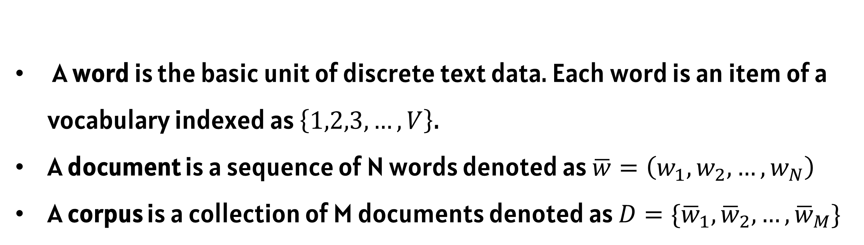
11
LATENT DIRICHLET ALLOCATION
A word is the basic unit of discrete text data. Each word is an item of a vocabulary indexed as $\left\{1,2,3,…,V\right\}$.
A document is a sequence of N words denoted as $\overline{w}=\left(w_{1},w_{2},…,w_{N}\right)$
A corpus is a collection of M documents denoted as $D=\{{\overline{w}}_{1},{\overline{w}}_{2},…,{\overline{w}}_{M}\}$
IIST | 2025

Slide 15
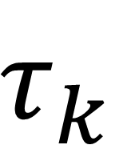
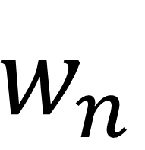
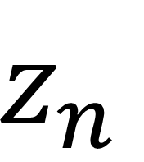
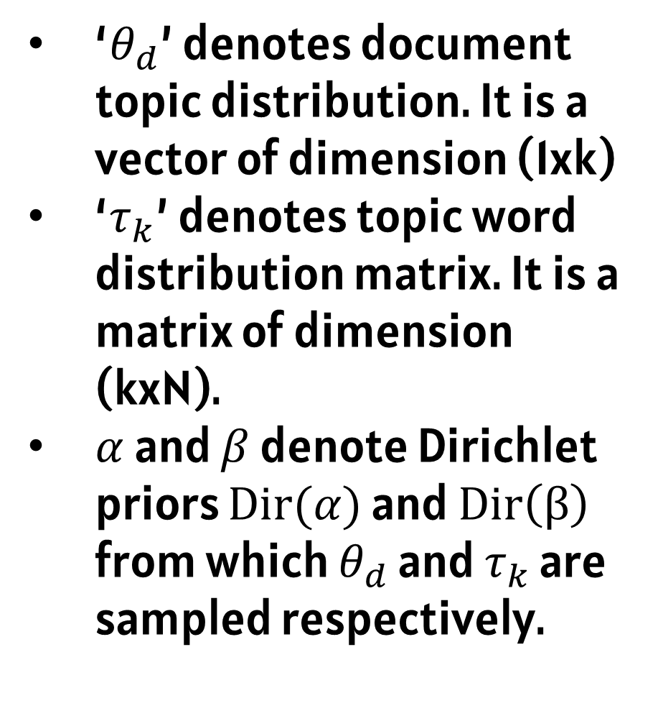
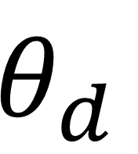


11
LATENT DIRICHLET ALLOCATION
‘$θ_{d}$’ denotes document topic distribution. It is a vector of dimension (1xk)
‘$τ_{k}$’ denotes topic word distribution matrix. It is a matrix of dimension (kxN).
$α$ and $β$ denote Dirichlet priors $Dir(α)$ and $Dir\left(β\right)$ from which $θ_{d}$ and $τ_{k}$ are sampled respectively.
$$β$$
$$τ_{k}$$
K
IIST | 2025
$$α$$
$$θ_{d}$$
$$z_{n}$$
$$w_{n}$$
M
N
Notes:
‘Theta d’ denotes document topic distribution. It is a vector of dimension (1 X k)
‘Tau k’ denotes topic word distribution matrix. It is a matrix of dimention (k x N).

Slide 16
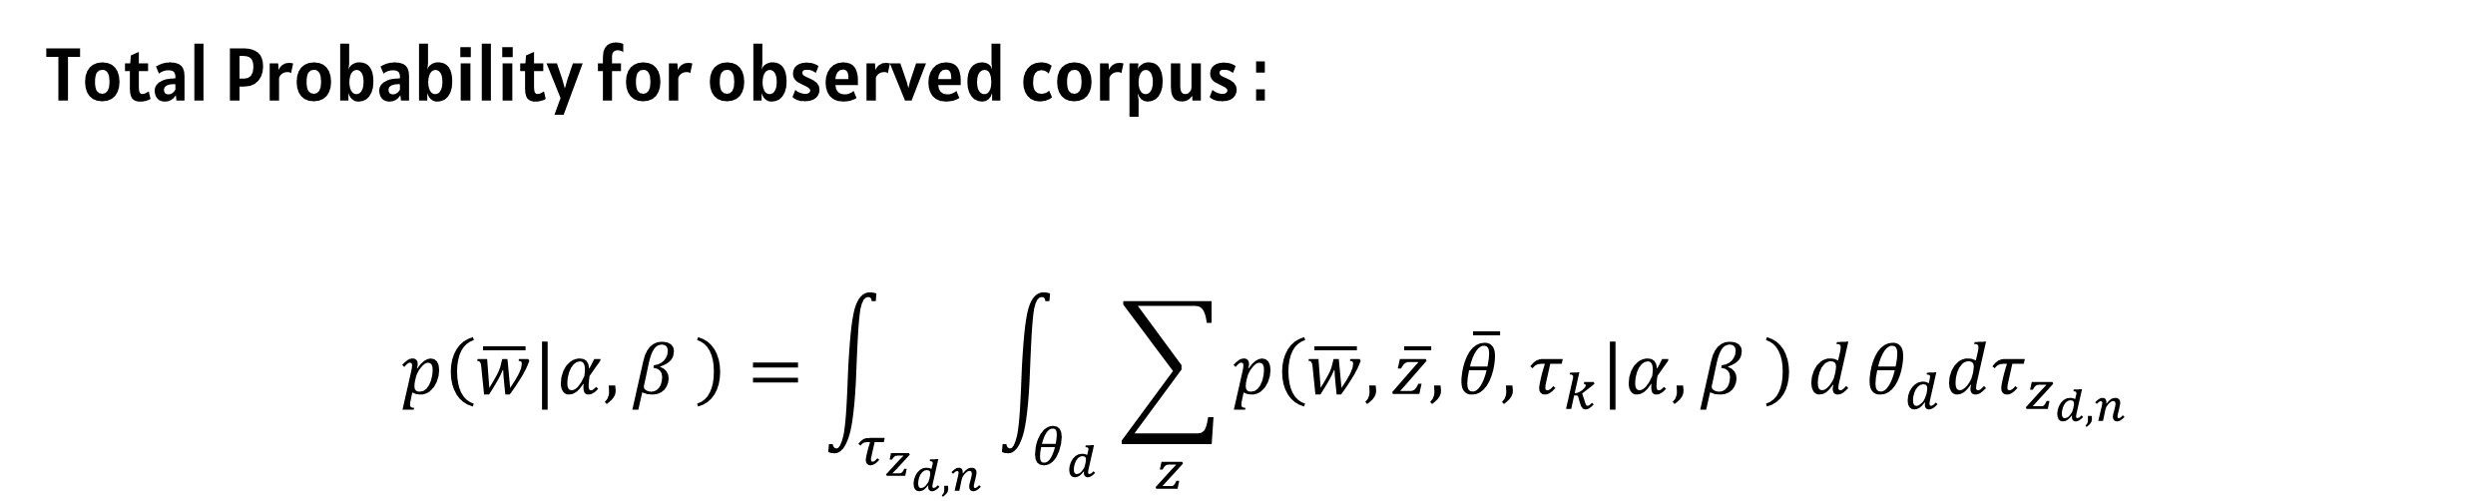
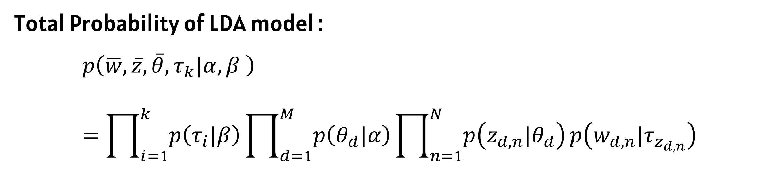
11
LATENT DIRICHLET ALLOCATION
Total Probability of LDA model :
$$p\left(\overline{w},\overline{z},\overline{θ},τ_{k}|α,β \right)=\prod_{i=1}^{k}{p\left(τ_{i}|β\right)}\prod_{d=1}^{M}{p\left(θ_{d}|α\right)}\prod_{n=1}^{N}{p\left(z_{d,n}|θ_{d}\right)}p\left(w_{d,n}|τ_{z_{d,n}}\right)$$
IIST | 2025
Total Probability for observed corpus :
$$p\left(\overline{w}|α,β \right)=\int_{τ_{z_{d,n}}}{\int_{θ_{d}}{\sum_{z}{p\left(\overline{w},\overline{z},\overline{θ},τ_{k}|α,β \right)}}d}θ_{d}dτ_{z_{d,n}}$$
Notes:
Suppose we have some documents written on topics {physics, chemistry, biology}
using a fixed set of vocabulary {gravity, space, pressure, atom, body, acid, ethanol, cell, digesion]

Slide 17
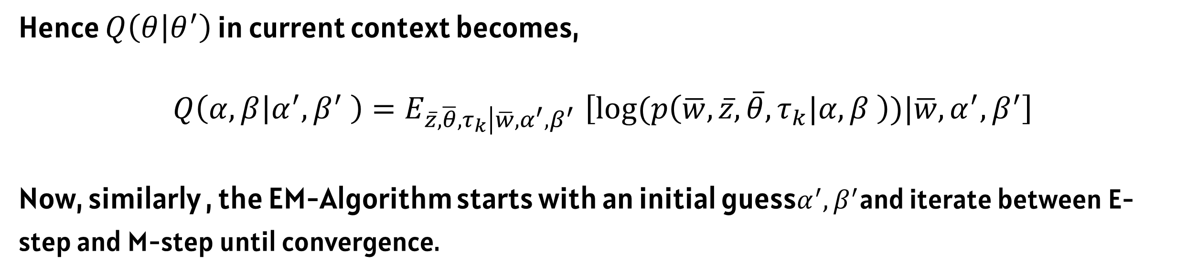
11
LATENT DIRICHLET ALLOCATION
Hence $Q\left(\left.θ\right|θ^{′}\right)$ in current context becomes,
$$Q\left(\left.α, β\right|α^{′},β^{′} \right){=E}_{\left.\overline{z},\overline{θ},τ_{k}\right|\overline{w},α^{′},β^{′}}\left[log⁡(p\left(\overline{w},\overline{z},\overline{θ},τ_{k}|α,β \right))|\overline{w},α^{′},β^{′}\right]$$
Now, similarly , the EM-Algorithm starts with an initial guess$α^{′},β^{′}$and iterate between E-step and M-step until convergence.
IIST | 2025
Notes:
E step Calculates : Q(theta|theta old)
M step Maximises Q(theta|theta_old) to obtain a new value

Slide 18
5
References
1
Haugh, M. (2015). Machine Learning for OR&FE [Lecture Notes] The EM Algorithm, Columbia University.
IIST | 2025
2
Blei, David M., Andrew Y. Ng, and Michael I. Jordan. "Latent Dirichlet Allocation." Journal of machine Learning research 3.Jan (2003): 993-1022.

Slide 19
IIST | 2025
THANK YOU
Presented By : Hemant Nishad

