Slide 1
Uncertainty-Guided Image Recapture for Mobile Chest X-Rays
Improving Abnormality Detection Reliability in Smartphone-Captured Chest Radiographs
DSAI Lab Project / Academic Research Committee Presentation
Evaluating active, region-specific image re-acquisition to overcome photographic glare and distortion on mobile chest X-ray digitizations.

Slide 2
Research Problem & Key Questions
Key Research Questions
1. Can a model remain reliable under real-world photographic distortions?
2. Can the system pinpoint which specific anatomical area is diagnostically inadequate?
3. Can spatial aleatoric uncertainty reliably identify obscured cases needing re-assessment?
4. Can a model choose a specific region where targeted close-up recapture improves prediction confidence?
5. Does combining active re-acquisition with macro context outperform standard passive baselines?
Problem Statement
"Can uncertainty-guided, region-specific image recapture improve the reliability of chest X-ray abnormality detection from smartphone photographs of physical X-ray films?"
Diagnostic Context & Challenges
Deep learning models trained on clean datasets (MIMIC-CXR-JPG, CheXphoto, VinDr-CXR) experience severe performance loss on photographed X-rays due to glare, perspective warp, and moiré patterns.
Low-confidence predictions require actionable re-acquisition rather than unverified claims.

Slide 3
Literature Benchmark Analysis
Current Model Performance
CheXphoto Benchmark: Standard CheXpert models show a 10–14% ROC AUC drop on smartphone photographs compared to pristine DICOMs (Leaderboard #1 scored 0.850 on film vs 0.890 on digital).
Model Recalibration (Nature 2021): Mean AUROC dropped from 0.75 (digital) to 0.67 (photograph). Recalibration with <200 photographs recovered AUROC to 0.75, outperforming transfer learning (0.71) and direct training (0.59).
RoMIA Framework: Implements noise-added training, input mixing, and DCT denoising to achieve a 3–5% accuracy improvement (22.6% reduction in misclassifications).
Mamba-YOLOvX & RA-CNN: Selective scanning (AP50 improved from 0.16 to 0.174) and recurrent attention localize discriminative regions, but rely purely on digital amplification rather than optical re-acquisition.
Methodological Gap
Core Literature Limitation
"Existing approaches attempt digital enhancement or model retraining on degraded inputs. None leverage physical re-acquisition to replace obscured optical signal."
Key Opportunity
Shift focus from purely algorithmic restoration on degraded data toward active physical optical re-acquisition frameworks.

Slide 4

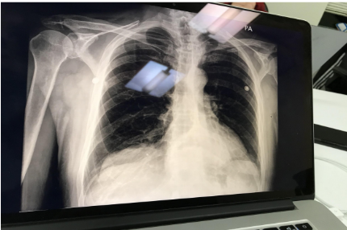
Baseline Architecture Breakdown
Baseline Classification Models
Baseline A (Performance Floor): Standard classification backbone (DenseNet-121 / ResNet-50) trained on clean DICOMs and tested directly on degraded photographs without pre-processing.
Baseline B (Synthetic Augmentation): Backbone trained with heavy synthetic geometric and photometric transformations on clean X-rays.
Baseline C (SOTA Passive Restoration): Algorithmic pre-processing pipeline involving glare removal and homography rectification before passing images to the classifier.
Limitations of Passive Restoration
Algorithmic Hallucination: Passive baselines mathematically guess pixel values beneath glare artifacts, failing to recover true underlying tissue structures.
High False Negative Rate (FNR): Obscured focal pathologies (e.g., small pneumothorax or nodules) remain unrectified, maintaining an unacceptably high FNR in clinical settings.
Figure 1: Sample Smartphone Glare Photograph
Degraded screen acquisition exhibiting severe specular reflection and geometric distortion, illustrating the clinical challenges encountered by standard baseline classifiers and passive restoration models.

Slide 5
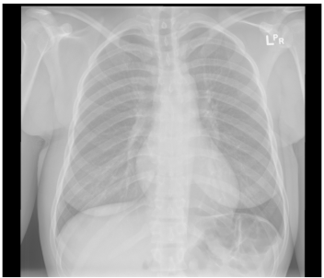
System Architecture & Mechanics
Methodological Paradigm Shift: Active, Uncertainty-Guided Optical Re-Acquisition
1
2
3
Reference DICOM X-Ray
Spatial Aleatoric Uncertainty
Measures pixel-wise sensor noise and specular glare.
Intersects uncertainty maps with diagnostic task saliency to determine if an obscured region (e.g., lung apex) is clinically critical.
Targeted User Prompting
If an obscured area is diagnostically critical, the system prompts the user for a targeted, close-up photograph of just that region.
Two-Branch CNN & Feature Fusion
Global Branch: Processes full-frame photo for macro-anatomical context.
Local Branch: Processes high-frequency close-up for fine optical detail.
Attention Mechanism: Dynamically fuses feature maps for accurate classification.
Diagnostic Scan Target
Saliency analysis identifies region-of-interest parameters before directing the local re-acquisition branch.

Slide 6
Expected Outcomes & Interactive Prototype
Expected Research Outcomes
Interactive Prototype Workflow
Recover AUROC: Close the performance gap between smartphone-photographed X-rays and pristine digital DICOM scans.
Reduce False Negative Rate: Drastically lower FNR for focal thoracic pathologies vulnerable to specular glare masking.
1
Primary Input
Mobile photo of chest X-ray film.
2
Initial Score & Uncertainty Assessment
Generates preliminary prediction + spatial uncertainty map.
Quality & Uncertainty Metrics
Expected Calibration Error (ECE)
Measures alignment between model prediction confidence and actual classification accuracy.
3
Actionable Prompt
Requests targeted secondary close-up photo if crucial region is obscured.
< 15% Target
Recapture Efficiency
Tracks percentage of images triggering recapture to ensure clinical practicality.
4
Final Output
Highly confident, fused diagnostic classification.

