Slide 1

Crop Prediction System On Environmental Factors Using Machine Learning, iot, python, goole sheets
© Templateswise.com

Slide 2
Contents
Abstract
Problem statement
Requirements
Proposed method
Features extracting in the proposed method
Results and Discussions
Conclusion

Slide 3
Abstract
India being an agricultural country, the most part of economy is depends on yield growth. Agriculture, is largely depends on rain water, and also depends on diverse soil parameters namely nitrogen, phosphorous, potassium and weather aspects like temperature, rainfall etc.
The technological growth in agriculture will increase the crop productivity. Remote sensing systems like IOT systems are being more widely used in smart farming systems, these systems produce generous amount of data.
Machine learning is an emerging research filed to predict the crop based on the patterns of the data.

Slide 4
Abstract
The proposed system will integrate the IOT sensors like Ph., Moisture, Rainfall, Temperature and Humidity sensors observe the data from those sensors and applying machine learning algorithms: Logistic Regression, Decision Trees.
A prediction of most suitable crops according the current environmental is made.
This work gives a better prediction for the farmers to plant which kind of crops to their farm field based on above mention parameters to improve the productivity of Smart Farming.

Slide 5
Problem Statement
In previous days we use IOT sensors to monitor the crop and we take actions according to the situations.
We don’t use the power of machine learning on those IOT sensors data and there is a high chance of getting less results on crop growth.
So now analyse the farm before we starting the crop environmental factors using machine learning algorithms and suggest the best suitable crop on particular field.
So the formers can get high growth of the crop and highest profits

Slide 6
Requirements
Software requirements:
Python
Machine Learning
IOT
Google Sheets
Visual Studio
HTML, CSS, JS.
Windows.

Slide 7
Requirements
Hardware requirements:
ESP8266 Microcontroller
NPK Sensor
Ph Sensor
Dht11 Sensor
Rainfall sensor
Oled Display
Bug Convertors

Slide 8
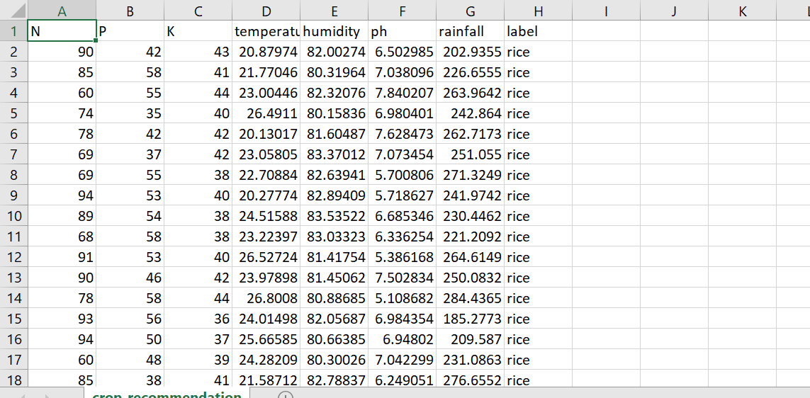
Dataset considered to build the model
Our project uses crop_recommendation dataset as a data source.

Slide 9
Proposed system
In our proposed system we collect the data about the farm before start growing the crop.
We take different environmental factors using IOT sensors like ph of the water, temperature, rainfall of that area, nitrogen, potassium ,phosphorus and humidity also.
So we can use machine learning on top of those IOT sensors data and then we can predict the which crop is good for that particular farm.
So it’s very useful for the farmers to get good profits and get healthy crop on the farm.
We can suggest the farmers which crop is best for that particular farm from a set of 20 different crops and they can start growing that crop.

Slide 10
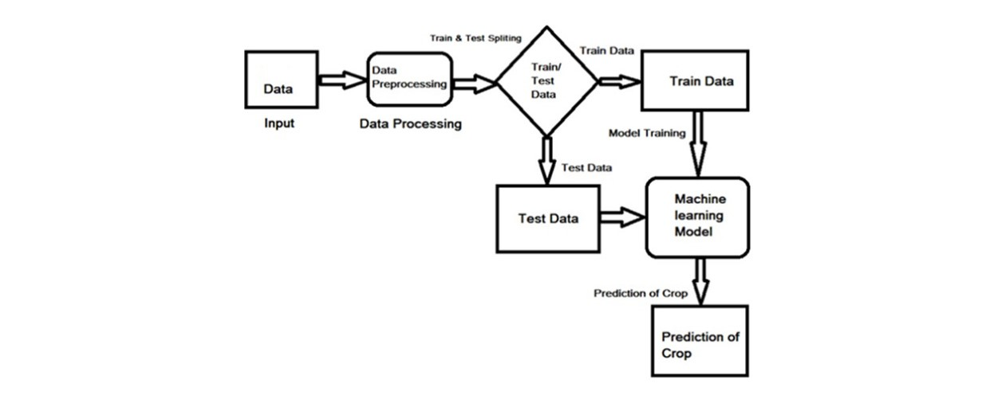
Proposed system architecture

Slide 11
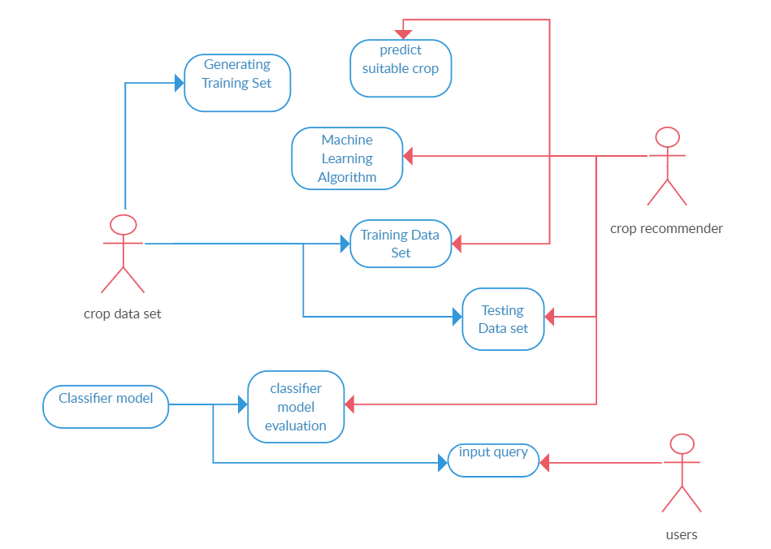
Use Case Diagram:

Slide 12
Feature extracting in the proposed method
We use different environmental factors like Ph value, rainfall, and humidity to extract the best features for our prediction.
We use different classification machine learning algorithms to get the best features from our dataset.
The machine learning algorithms can learn from our dataset and generate the desired features.

Slide 13
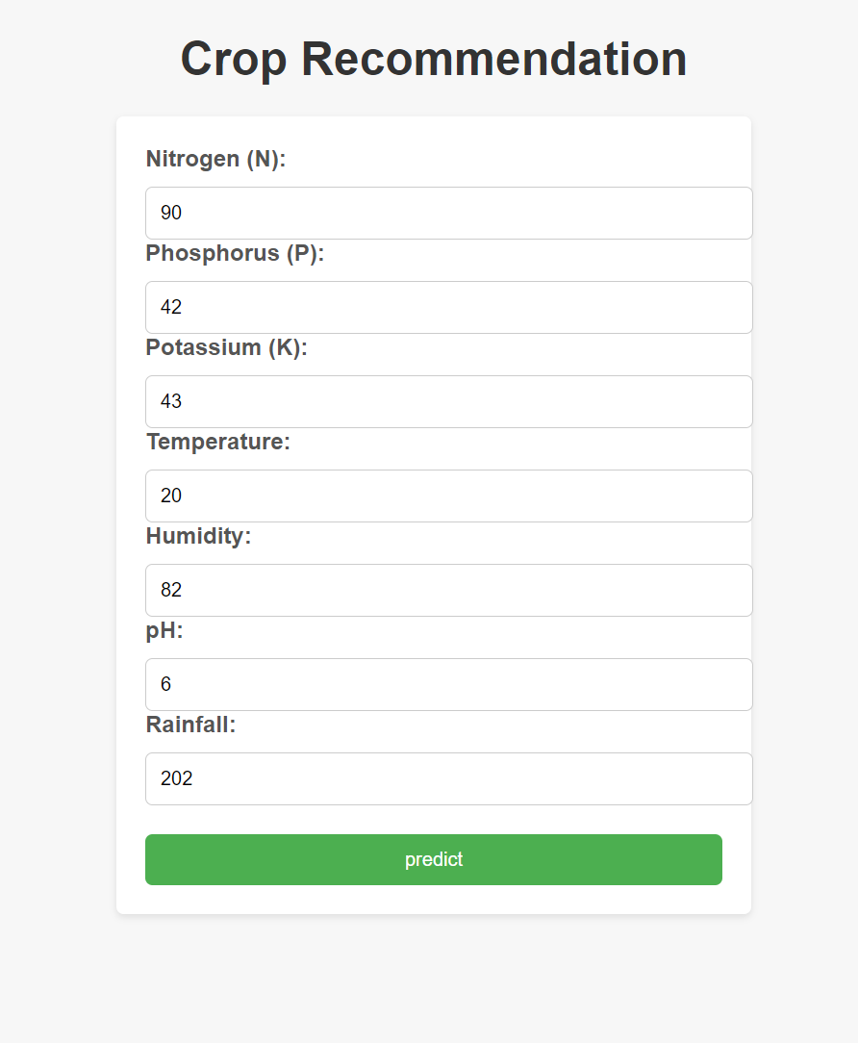
Results:

Slide 14
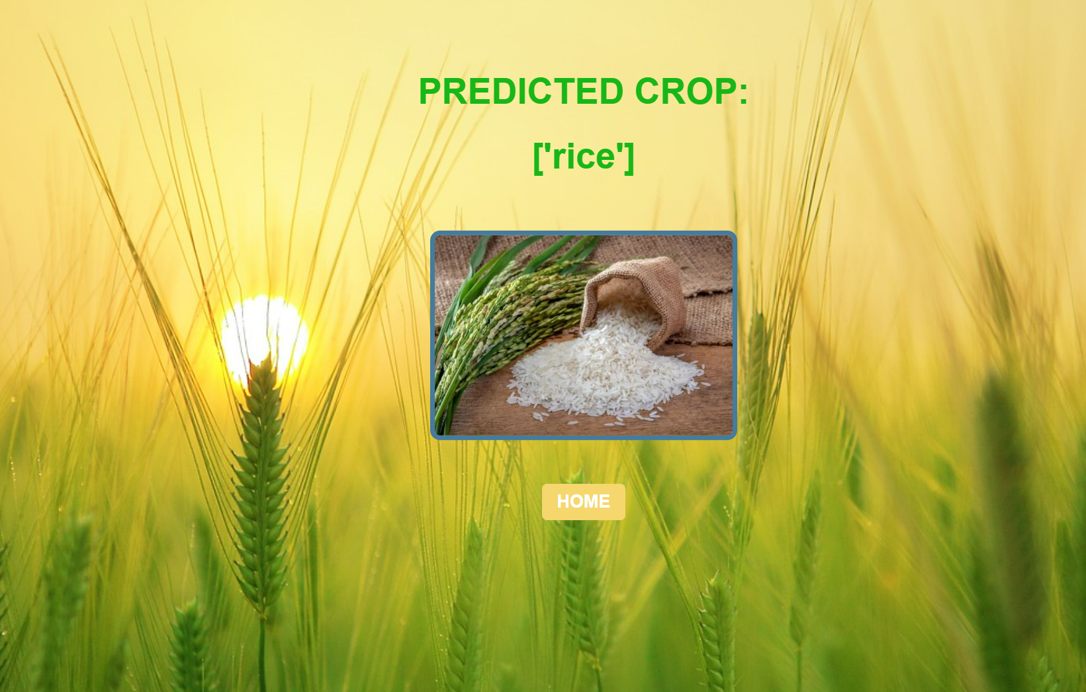
Results:

Slide 15
Conclusion
To eliminate the disadvantages in the existing IOT based farm monitoring we have included the machine learning method before farmers staring the crop.
So we can suggest them the good crop for their crop using the different machine learning algorithms.
We also decrease the use of fertilizes for the crop because we analyse the farm land before we staring to grow the crop.
And our machine learning models can perform good on large amount dataset and can generate good results.

Slide 16
Thank you!!

