Slide 1
Fancy Math for a Stupid Chat
By Milkey Mouse

Slide 2
I just feel like somebody’s watching me
School tracks all Wi-Fi, Bluetooth, and radio communications from any school computer
DyKnow makes the situation even worse if you’re not in Safe Mode
If you’re on your own device and connected to LWSD-GUEST they also track you
They scramble signals from cell towers so nobody uses their data plan
Their Microsoft Exchange server is set to keep all emails and conversations for 100 days after deletion, even if perma-deleted by the user
But the one thing they DON’T track…

Slide 3
AUDIO!

Slide 4
Audio as a Transport
It’s just too weird for them to think of
Why would DyKnow need audio mirroring?
Worst case scenario some kid is listening to Justin Bieber, right?
WRONG!
By using sound you can transfer quite a bit of data (I’ll get back to this in a second)

Slide 5
But wait, there’s more
The Mosquito Tone
Invented by a shopkeeper and an age-discriminatory sonic weapon
It would make an interesting argumentative essay
Very high-pitched
Can only be heard by people under 25 (so no teacher snooping!)
The cutoff age can change by changing the frequency minute amounts
No known side effects

Slide 6
Transmission Formats (or encodings, as they’re known in the 1337 h4x0r biz)
Using different frequencies (and rounding to the nearest bin in case of error) for multiple characters
Morse code (…---…)
Pretty much the original, used as early as 1844
Very good margins for error with only 2 possibilities
But slooow
If each dot took 0.2 seconds and each dash took 0.5, this would take 1.8 seconds to transmit the word “sos”
ASCII
128 characters of stuff
What early computers/computer enthusiasts used
Only Latin characters, numbers, and some punctuation
Needless to say, that’s not what they use today
Margin for error would be too small with 128 discrete frequencies/”bins”
Base64
Uses only 64 characters to represent any other character, it just takes more of them
Doubles the size of each bin for the frequencies
Base32
Like Base64, but uses 32 characters instead of 64 and the resulting messages are even longer
Doubles the margins again from Base64
So I chose Base32, because after testing even Base64 didn’t have small enough bins.
On the bright side, the bins of each frequency are so large that each character can be transmitted in under 0.1 seconds.

Slide 7
Now how to generate the sound?
“Hello World”
If using Base32/Base64, encode the message now
Get a numerical index for each character
For each resulting number, multiply by 100 and add 17000 Hz (just a little bit below the Mosquito Tone). Save this to an audio file in memory, so it never gets stored on the hard drive and becomes trackable.
Play the audio file at full volume. (Since the sounds are so high-pitched, it doesn’t matter how loud it is.
“JJBSWY3DPEBLW64TM MQ= = = = = =”
[9, 9, 1, 18, 22, 24, 27, 3, 15, 4, 1, 11, 22, 30, 28, 19, 12, 33, 12, 16, 32, 33, 32, 33, 32, 33, 32, 33, 32, 33, 32]

Slide 8
But there’s another problem…

Slide 9
WARNING: MATH INCOMING

Slide 10
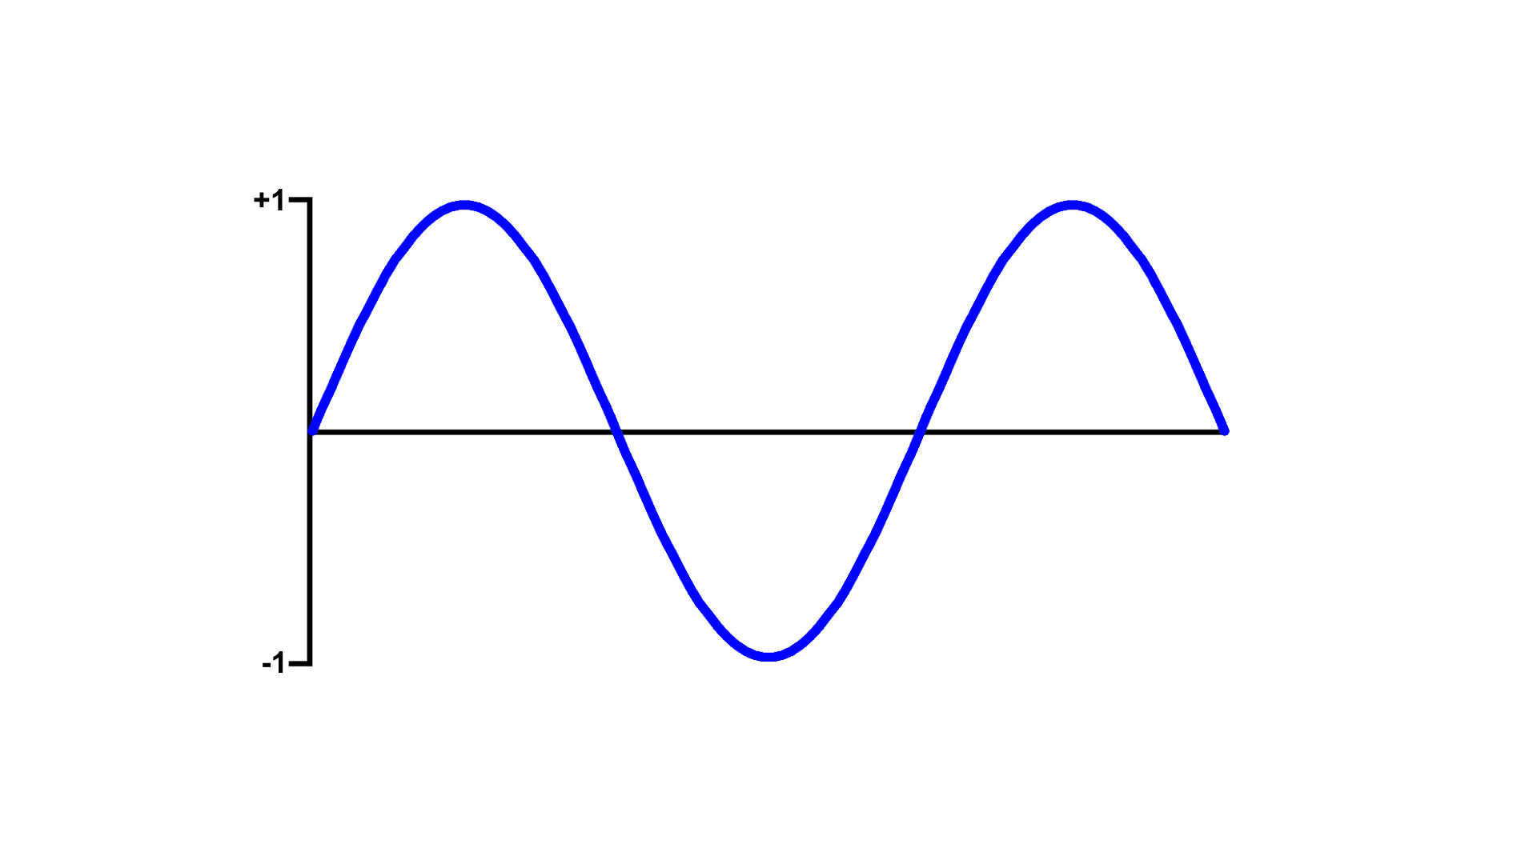

The Zero-Crossing Algorithm
Just count the times the wave crosses zero!
3 ÷ 2 = 1.5
1
2
3
I saw a sine
And it was made of points and lines

Slide 11
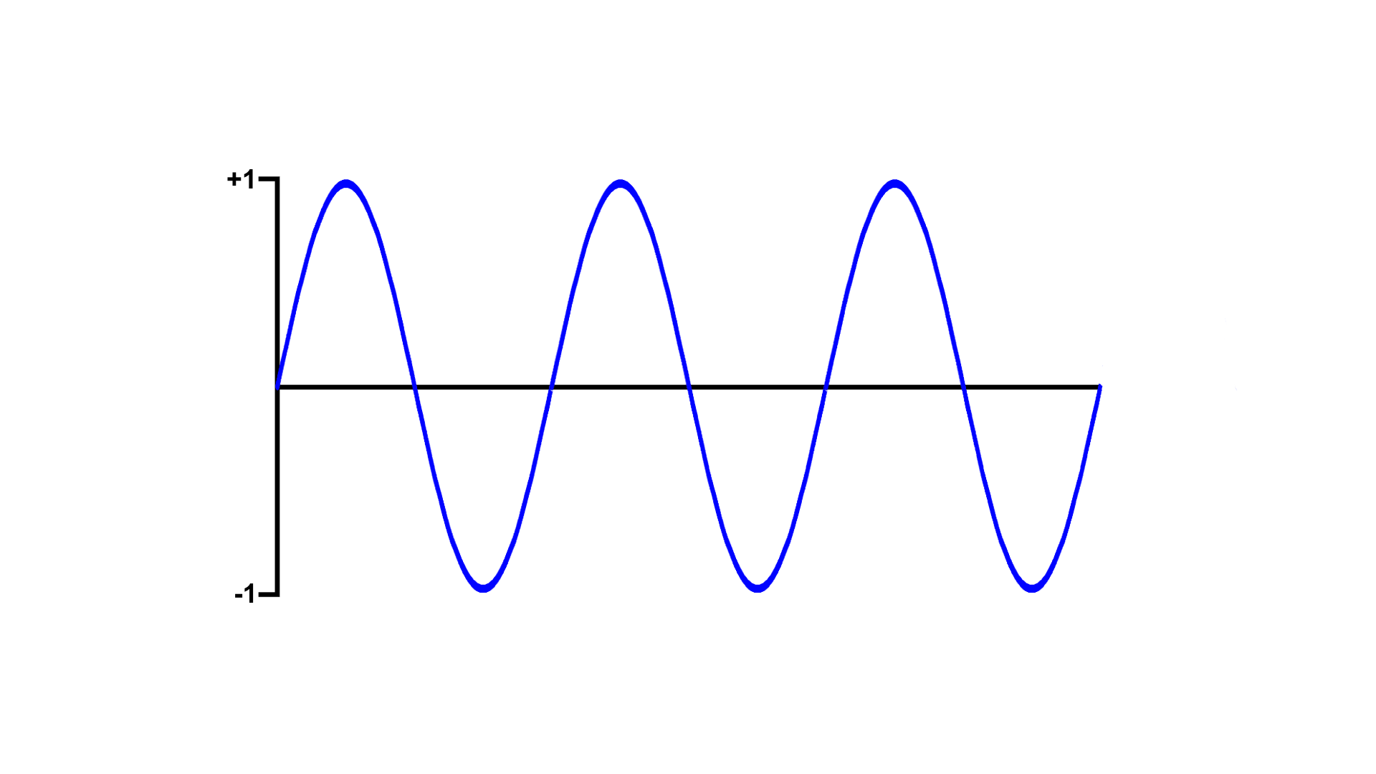
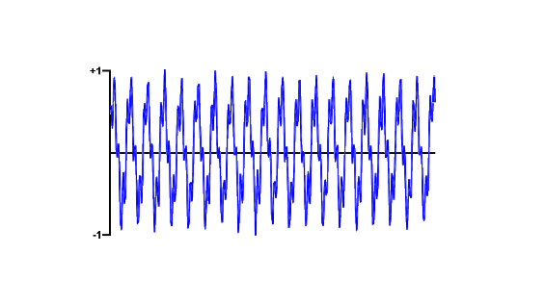
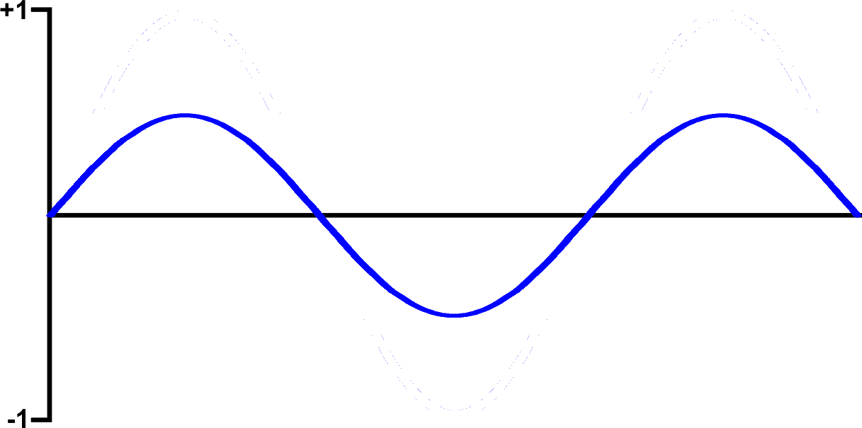
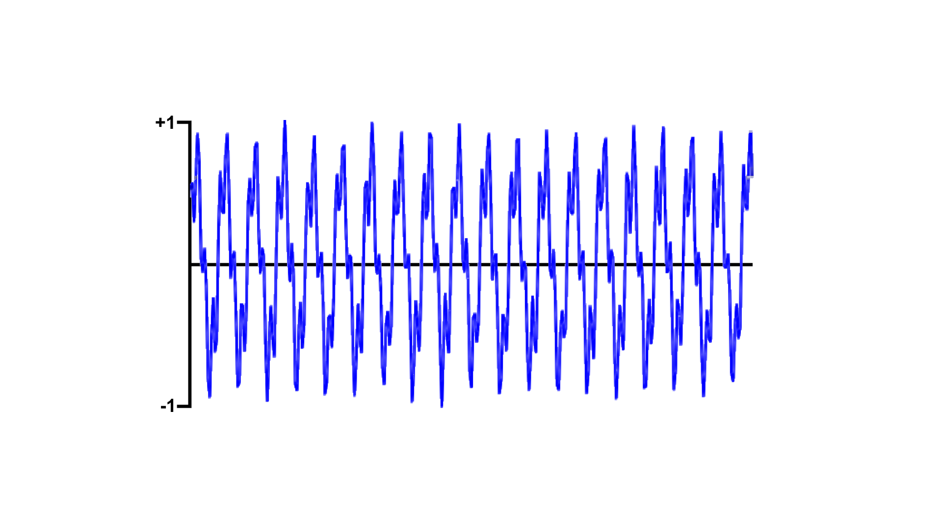
Problems with the Zero-Crossing Algorithm
+
=
Ultrasonic frequency
Audible frequency (e.g. talking)
A weird thing
closer to this one
Result is the same as that of the ultrasonic transmission
All fine and dandy when the ultrasound is louder than the speech…

Slide 12
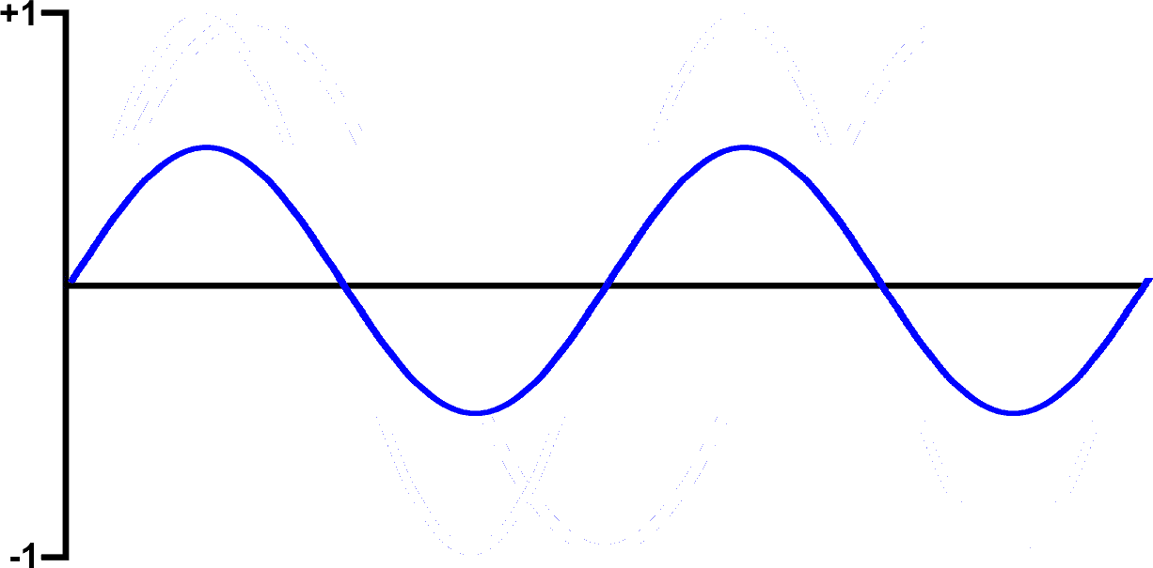
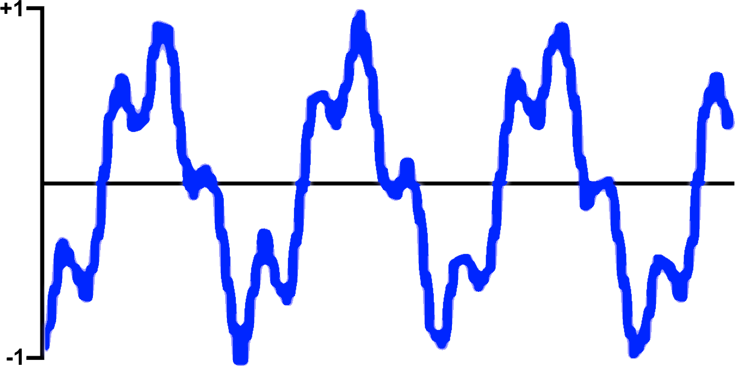
Problems with the Zero-Crossing Algorithm
+
=
Ultrasonic frequency
Audible frequency (e.g. talking)
An even weirder thing
closer to this one
Result is the same as the talking!
☹
…but when talking is louder than the transmission it wonks out (the technical term)

Slide 13
So with any noise in the background the Zero Crossing Algorithm won’t work.

Slide 14
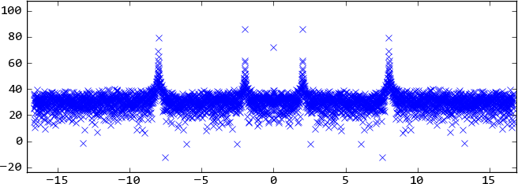
Enter Fast Fourier Transform (FFT)
(pronounced four-ee-yay)
FFT!
Wonky wave
An FFT outputs a nice pretty histogram of possible frequencies.

Slide 15
How does it do this?

Slide 16
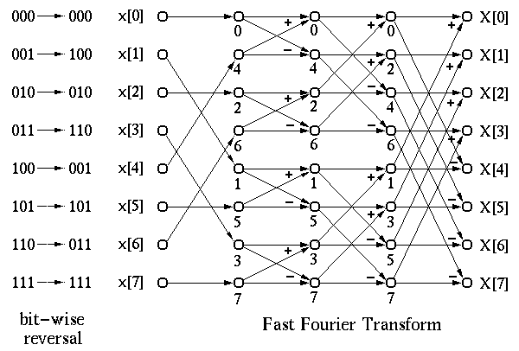
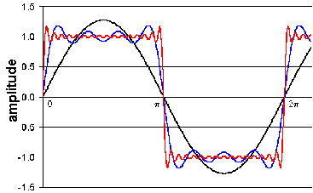
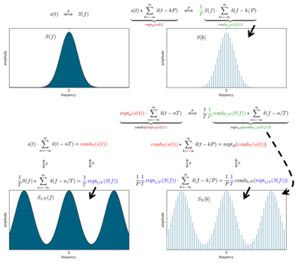
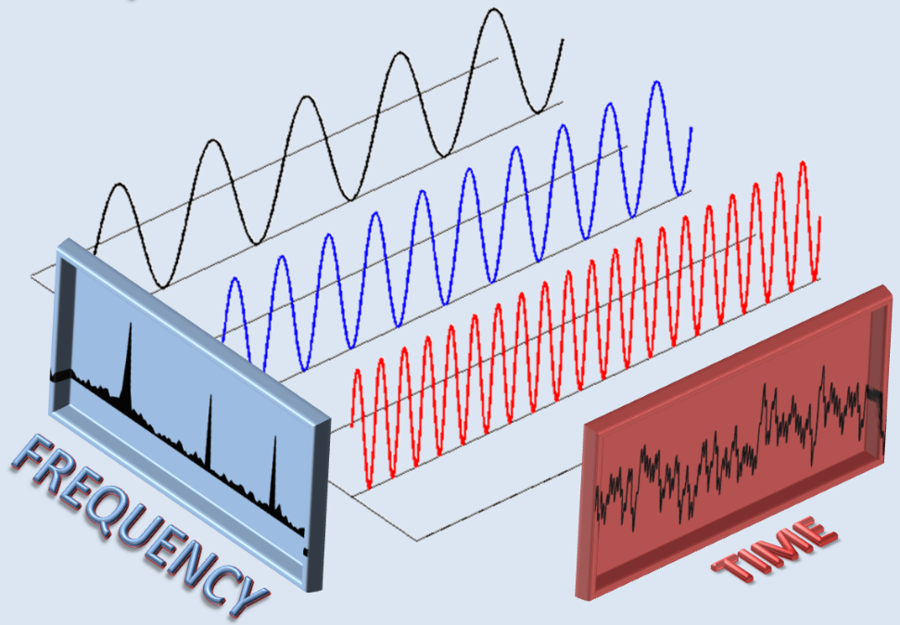
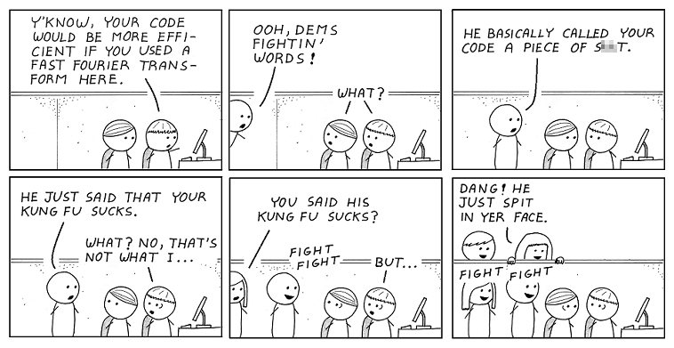
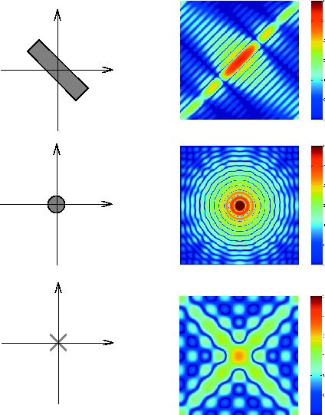
Math too complicated to go into here.

Slide 17
Enter Fast Fourier Transform (FFT)
(pronounced four-ee-yay)
Now let’s take a look at that histogram, shall we?
Possible Frequencies in Captured Sound
Amplitude
Frequency

Slide 18
Enter Fast Fourier Transform (FFT)
(pronounced four-ee-yay)
First order of business: cut off the audible range
Possible Frequencies in Captured Sound
Amplitude
All of these are probably talking, as they’re in the audible range…
Frequency

Slide 19
Enter Fast Fourier Transform (FFT)
(pronounced four-ee-yay)
Then we get the frequency over the threshold
Possible Frequencies in Captured Sound
…so we chop them all off!
And voila! Here’s the frequency we were looking for.
Amplitude
Next we find the highest one above our threshold…
Frequency

Slide 20
As evidenced by the heights of the original audible peaks, the FFT algorithm filters noise very well and can be used to pick up transmissions even from across the room!
Possible Frequencies in Captured Sound
Amplitude
All of these are probably talking, as they’re in the audible range…
Frequency

Slide 21
Conversion back to text is pretty much the same but backwards
Stream audio from the mic and run FFTs until you get outlier frequencies (the FFT conveniently has bin sizes of 100 by default)
With the same conversion table as last time, turn the numbers back into letters and process the data.
Use Base64/Base32 if needed to decode the message into a string again.
[9, 9, 1, 18, 22, 24, 27, 3, 15, 4, 1, 11, 22, 30, 28, 19, 12, 33, 12, 16, 32, 33, 32, 33, 32, 33, 32, 33, 32, 33, 32]
“JBSWY3DPEBLW64TMMQ======”
“Hello World”

Slide 22
But what if you’re really far away?

Slide 23



Take clues from torrents and make it P2P

Slide 24
And have error correction
lolwut
OK
Sos
OK

Slide 25
And have error correction
Oh OK
He said, “Sos”

Slide 26
Or even pipe internet
You can’t have “blocked.com”
Get me “blocked.com”
Crappy School Internet
Fine then. Ultrasound Node, get me “blocked.com”
Here is blocked.com
Legit Internet

Slide 27
Messages are above the hearing ranges of most people above 25

Slide 28
And who knows, maybe we won’t get caught this time.

Slide 29
Time for a demo!

