Slide 1
Satya Kumari Potabathula
Final Project
3/21/2024 Annual Review

Slide 2
PROJECT TITLE
KEY LOGGER AND SECURITY
3/21/2024 Annual Review

Slide 3


AGENDA
Problem Statement
Project Overview
End Users
Solution and Value Proposition
The Wow Factor in our solution
Modelling
Results
3/21/2024 Annual Review

Slide 4

PROBLEM STATEMENT
Develop a robust and secure keylogger software that effectively logs keystrokes on a target system while implementing strong encryption and access controls to prevent unauthorized access to the logged data and ensuring privacy and data integrity.
3/21/2024 Annual Review

Slide 5

PROJECT OVERVIEW
Objective:
Develop a keylogger program that runs in the background and logs all keystrokes made by the user. The keylogger should capture each keystroke, including special keys (like Enter, Shift, Backspace, etc.), and save the logged data to a file for later review.
Overview:
A keylogger bot is a sophisticated tool that captures and records all user interactions with the keyboard. This includes every keystroke made and every button clicked. This bot then compiles the data obtained into user understandable format. Furthermore this is capable of tracking and recording users data.
3/21/2024 Annual Review

Slide 6

WHO ARE THE END USERS?
Cybersecurity Professionals:
They use keyloggers to detect and analyze potential security threats, test the strength of security measures, and conduct penetration testing and sql injectons.
IT Security Professionals:
The primary end users for this keylogger security are IT professionals who are responsible for their organization network and devices protection from cyber threats.
Remote employees:
This keylogger tool can help protect employees accessing company systems and data from their personal devices outside the office network.
Cyber criminals:
Unfortunately, keyloggers are also used maliciously to steal sensitive information like passwords and net banking details etc.,. Unauthorised access leads to several consequences. Always ensure you have proper authorisation before using such tools.
3/21/2024 Annual Review

Slide 7

YOUR SOLUTION AND ITS VALUE PROPOSITION
Use Anti-Malware and Anti-Virus Software regularly update and run comprehensive scans with reputable anti-malware and anti-virus software to detect and remove keyloggers. Use real-time protection features to block suspicious activities and files.
Implement Two-Factor Authentication (2FA)Enable 2FA for all accounts whenever possible. Even if a keylogger captures your password, the attacker would still need the second factor to gain access.
Keep Software Updated regularly update your operating system, browsers, and all installed software to patch known vulnerabilities that keyloggers might exploit.
Use a Virtual Keyboard for entering sensitive information, use a virtual on-screen keyboard to avoid keystroke logging.
Employ Password Managers use password managers to generate and enter passwords automatically. This limits the exposure of typing sensitive data.
Monitor Network Activity utilize network monitoring tools to detect unusual data transmissions that might indicate the presence of a keylogger sending captured data to an attacker.
3/21/2024 Annual Review

Slide 8

THE WOW IN YOUR SOLUTION
The “wow” factor in the ethical use of a keylogger lies in its ability to provide comprehensive, real-time data about keyboard activities. Here are a few points that make it stand out:
Self-Monitoring and Troubleshooting: As a troubleshooting tool, keyloggers can be employed with a user's consent to analyze their keystrokes and identify potential causes of technical difficulties
Cybersecurity Testing and Penetration Testing: To simulate real-world attacks, penetration tests may incorporate keyloggers, uncovering weaknesses in software, logins, and network security.
Stealth Operation: Keyloggers can operate in a stealth mode, remaining undetected while they monitor keyboard activities. This allows for unobtrusive monitoring and minimizes the risk of alerting potential cybercriminals.
Versatility: Keyloggers can be used in a variety of scenarios, from parental control and employee monitoring to cybersecurity and law enforcement investigations. Remember, while these features can be impressive, they also highlight the potential for misuse. It’s crucial to always use such tools ethically and legally, respecting privacy rights and adhering to all relevant laws and regulations.
3/21/2024 Annual Review
8

Slide 9
MODELLING
Components of keylogger models:
Data Capture Mechanisms: How keystrokes are captured
Polling: Regularly checking keyboard buffer.
Hooking: Intercepting keystrokes via system hooks.
Data Storage and Transmission: Methods for storing and sending captured data
Local storage: Data saved on the device.
Remote Transmission: Data sent to a remote server.
Evasion Techniques: Methods to avoid detection
Rootkit Integration: Embedded within the OS.
Obfuscation: Hiding code to avoid detection by anti-malware.
3/21/2024 Annual Review
9

Slide 10
MODELLING
Flow Diagram:
Initialisation:
Set up the main GUI window.
Initialise global variables for key logging.
Event Capture:
Start capturing key events when the “Start” button is pressed.
Log key press and release events.
Data Logging:
Continuosly update text and json log files with captured key events.
Stop logging:
Stop capturing key events when the “Stop” button is pressed.
Update the GUI status to indicate the keylogger is stopped.

Slide 11
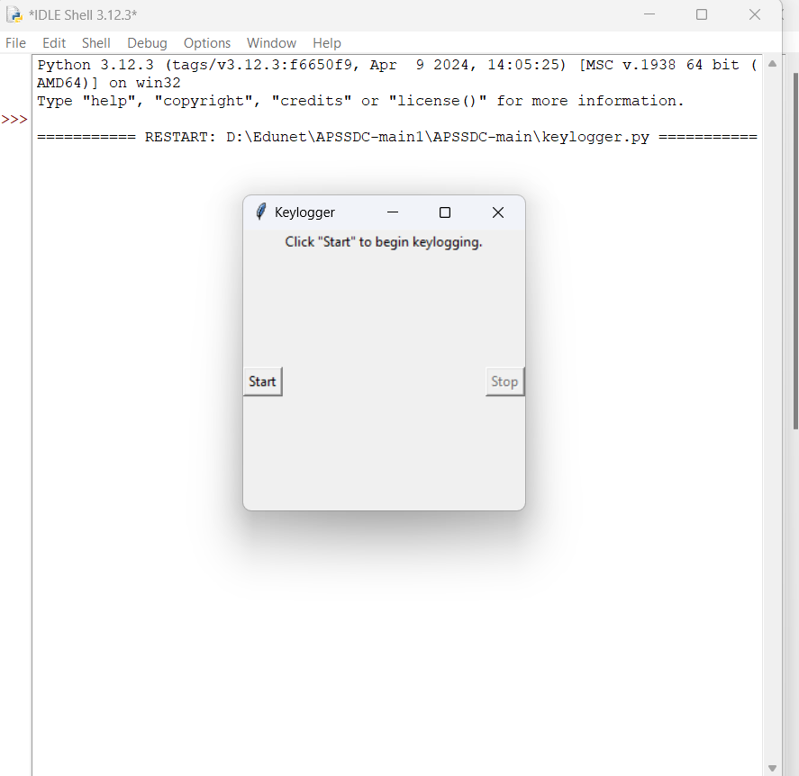
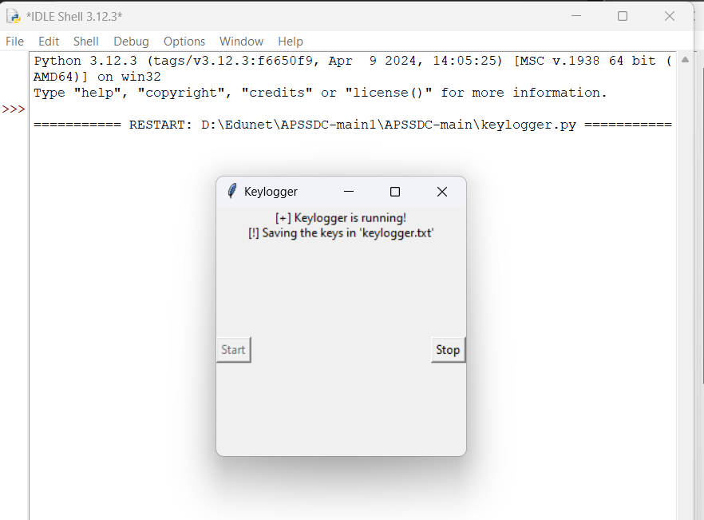
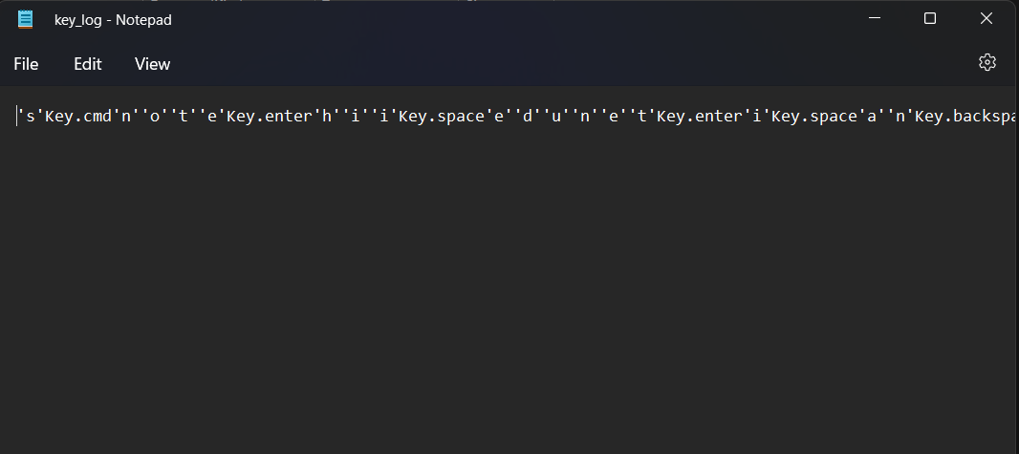
RESULTS
3/21/2024 Annual Review
11

Slide 12
PROJECT LINK
21p31a0561/Apssdc (github.com)

Slide 13
RESULTS
Successfully implemented a keylogger that captures keystrokes and records them into both text and json files.
Real time keylogging with start and stop functionality controlled via a sample GUI.
The keylogger project demonstrated the capability to effectively capture and log keystrokes in real time.
The GUI provides a user friendly way to control the keylogger, making it accessible and easy to use.
Emphasized the ethical use of keyloggers and the importance of implementing security measures to project against malicious use.

