Slide 1


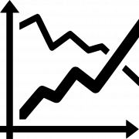
STATISTICAL STOCK ANALYSIS
PRESENTED BY
SRIPRADA SRIRAM

Slide 2
CONTENTS
Data Description
Descriptive Statistics Comparison
Performance Analysis
Trends of Stocks
Volume of Stocks
Time Series Analysis
Market's Regression Analysis
Appendix
Conclusion

Slide 3




DATA DESCRIPTION
Overview:
The dataset comprises live stock values of three major companies: Microsoft, Apple, and Tesla.
Data has been extracted from Yahoo Finance and covers the period from 2018 to 2023, providing daily stock values for each company.
Additionally, the dataset includes S&P 500 values for the same time period, offering a broader market perspective.
Variable Description:
For each trading day, the dataset includes the following variables: Date, Open, High, Low, Close, Adjusted Close, Volume, MS%change, Apple%change, Tesla%change, SP_500%change.
These variables represent daily stock values for Microsoft, Apple, and Tesla, as well as the percentage change in the S&P 500 index.
Importance of Beta B1:
According to the Capital Asset Pricing Model (CAPM), the slope coefficient Beta (B1) in a simple regression of the excess return on the stock (e.g., Apple%change) versus the stock return on the market (S&P_500%change) serves as a measure of the relative risk of the stock.
Stocks with higher Betas are considered more risky and are expected to have higher returns in the market.

Slide 4
COMPARING THE DESCRIPTIVE STATS
MICROSOFT
TESLA
APPLE
SP 500
 | Adj Close | Descriptive Statistics(MSFT)
 | Mean | 190.8267835
 | Standard error | 2.103222362
 | Median | 198.8247145
 | Mode | 89.883148
 | Standard Deviation | 75.18836093
 | Sample Variance | 5653.28962
 | Kurtosis | -1.310573841
 | Skewness | 0.140260764
 | Range | 259.869614
 | Minimum | 80.055191
 | Maximum | 339.924805
 | Sum | 243876.6293
 | Count | 1278
Adj Close | Descriptive Statistics(TESLA)
Mean | 131.7902812
Standard error | 3.272219195
Median | 97.6400035
Mode | 23.620667
Standard Deviation | 116.9789759
Sample Variance | 13684.08079
Kurtosis | -1.260371058
Skewness | 0.468792298
Range | 398.038668
Minimum | 11.931333
Maximum | 409.970001
Sum | 168427.9793
Count | 1278
Adj Close | Descriptive Statistics(APPLE)
Mean | 97.38823308
Standard error | 1.302620443
Median | 94.1483495
Mode | 41.246353
Standard Deviation | 46.56754217
Sample Variance | 2168.535984
Kurtosis | -1.580637888
Skewness | 0.123055369
Range | 146.650146
Minimum | 34.309586
Maximum | 180.959732
Sum | 124462.1619
Count | 1278
Adj Close | Descriptive Statistics(SP 500)
Mean | 3457.23
Standarderror | 18.65160759
Median | 3298.03
Mode | 2783.02
Standard Deviation | 666.7786672
Sample Variance | 444593.7911
Kurtosis | -1.298909977
Skewness | 0.33118575
Range | 2559.16
Minimum | 2237.40
Maximum | 4796.56
Sum | 4418340.01
Count | 1278

Slide 5
INFERENCE OF DESCRIPTIVE STATISTICS
For Microsoft (MSFT), the adjusted closing price (Adj Close) has a mean of approximately $190.83 with a standard error of about $2.10. The data is relatively symmetric, with a median close to the mean and a skewness close to zero. The range of the data is substantial, spanning nearly $259.87, from a minimum of around $80.06 to a maximum of approximately $339.92. The distribution has a slightly negative kurtosis, indicating that it is less peaked than a normal distribution.
For Tesla (TESLA), the adjusted closing price (Adj Close) exhibits greater variability compared to Microsoft, with a larger mean of around $131.79 and a wider range of approximately $398.04. The standard deviation and sample variance are also higher, indicating higher volatility in Tesla's stock prices. The distribution is moderately skewed to the right, with a positive skewness of about 0.47. The kurtosis is slightly negative, similar to Microsoft.
Apple's (APPLE) adjusted closing price (Adj Close) falls between Microsoft and Tesla in terms of both mean and variability. The mean is around $97.39, with a range of approximately $146.65. The distribution is approximately symmetric, with a skewness close to zero, and slightly less peaked than a normal distribution based on the negative kurtosis.
The S&P 500 index (SP 500) has the highest mean among the four datasets, with a value of about 3457.23. The data also has the largest range, spanning approximately 2559.16 points. Similar to the individual stocks, the distribution is approximately symmetric with a skewness close to zero, indicating a relatively balanced market performance. The kurtosis is slightly negative, suggesting a distribution that is slightly less peaked than a normal distribution.

Slide 6
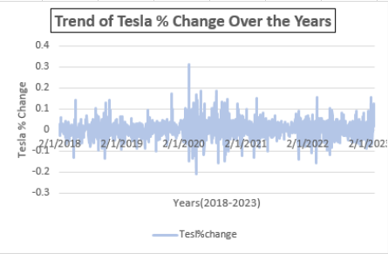
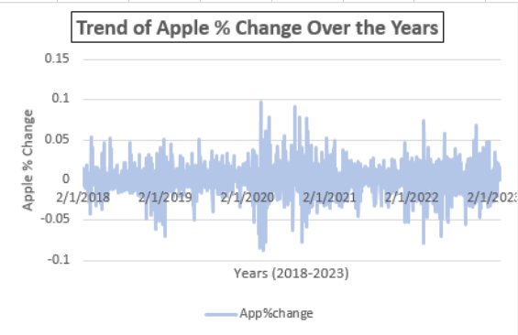
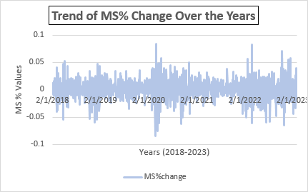
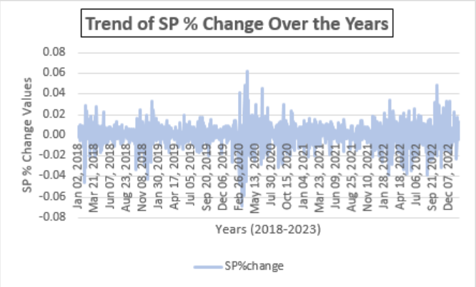
PERFORMANCE ANALYSIS ON % OF CHANGE OVER YEARS
TESLA
APPLE
MSFT
SP

Slide 7
INFERENCE ON PERFORMANCE ANALYSIS ON % CHANGE
Microsoft's average daily percentage change is approximately 0.00098, indicating relatively stable day-to-day fluctuations in stock prices. The total percentage change over the period is 1.25, suggesting modest overall growth in stock prices.
Tesla's average daily percentage change is significantly higher at approximately 0.00263, indicating higher volatility and larger fluctuations in stock prices compared to Microsoft. The total percentage change over the period is 3.35, suggesting substantial overall growth in stock prices.
Apple's average daily percentage change falls between Microsoft and Tesla at approximately 0.00117, indicating moderate fluctuations in stock prices. The total percentage change over the period is 1.50, suggesting moderate overall growth in stock prices.
The S&P 500 index's average daily percentage change is relatively low at approximately 0.00039, reflecting relatively stable day-to-day fluctuations in the broader market. The total percentage change over the period is 0.50, suggesting modest overall growth in the stock market.

Slide 8
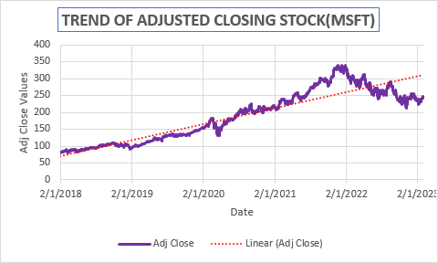
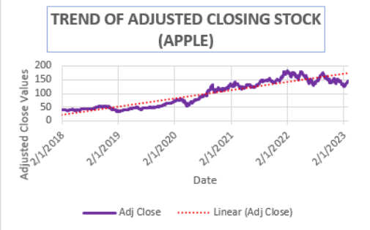
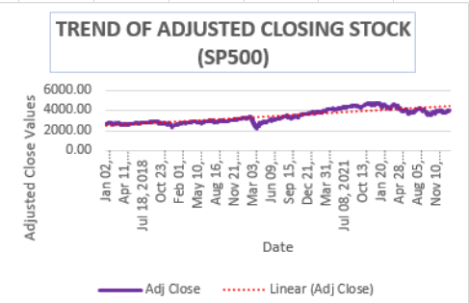
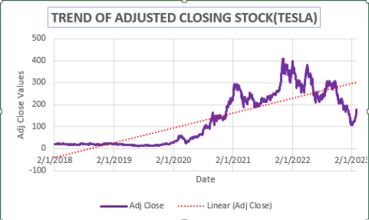
TREND OF ADJUSTED CLOSE STOCK
MICROSOFT
APPLE
SP 500
TESLA

Slide 9
INFERENCE ON TREND OF ADJUDSTED CLOSE STOCK
Microsoft's stock exhibited a generally upward trend from 2018 to 2023. Notable peaks occurred in 2018, 2019, 2020, and 2023, corresponding to strong quarterly earnings reports, successful product launches (such as Azure services and Office 365), and strategic acquisitions like GitHub. Drops were observed during broader market downturns, such as in late 2018 due to trade tensions and the COVID-19 pandemic-induced sell-off in early 2020. However, MSFT recovered quickly due to its resilient business model and digital transformation initiatives.
Apple's stock experienced fluctuations throughout the period, with notable peaks in 2018, 2020, and 2023. The peaks were often associated with product announcements (like new iPhone models or services launches) and strong quarterly earnings. Drops occurred during periods of iPhone sales concerns, such as in 2018 when the company revised its sales forecast, and in 2020 amid supply chain disruptions and store closures due to the pandemic. However, AAPL rebounded due to robust demand for its products and services.
Tesla's stock exhibited extreme volatility, characterized by sharp increases and declines. Notable peaks occurred in 2020 and 2021, driven by record vehicle deliveries, profitability milestones, and inclusion in major stock indices. Drops were observed during periods of regulatory scrutiny, production challenges (such as battery supply issues), and CEO Elon Musk's controversial statements on social media. Despite the volatility, TSLA's stock generally trended upwards due to optimism surrounding its electric vehicle technology and renewable energy initiatives.
The S&P 500 index showed overall growth from 2018 to 2023, with several peaks and troughs along the way. Notable peaks occurred in 2018, 2019, 2020, and 2023, driven by factors such as strong corporate earnings, economic growth, and fiscal stimulus measures. Drops were observed during periods of geopolitical tensions (such as the U.S.-China trade war), concerns about rising interest rates, and the onset of the COVID-19 pandemic in early 2020, which led to a significant market downturn. However, it rebounded quickly.

Slide 10
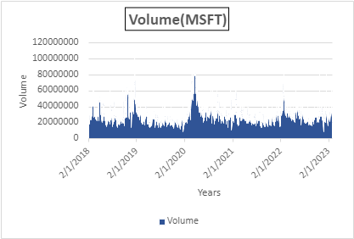
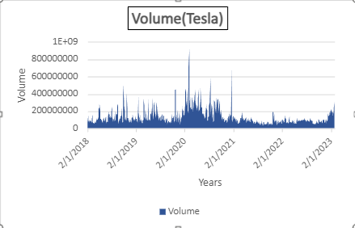
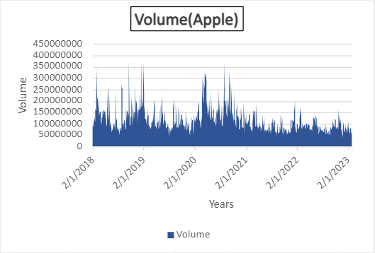
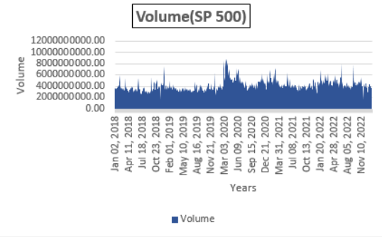
VOLUME OF STOCKS
Microsoft's stock is experiencing high volume, indicating strong investor interest and potential price movement.
Tesla's stock has seen a sudden spike in volume, suggesting a significant news event or change in market sentiment.
Apple's stock is showing consistently low volume, possibly indicating lack of interest or participation in the stock.
The S&P 500's volume analysis, when combined with other indicators, can provide insights into broader market trends and investor sentiment.

Slide 11
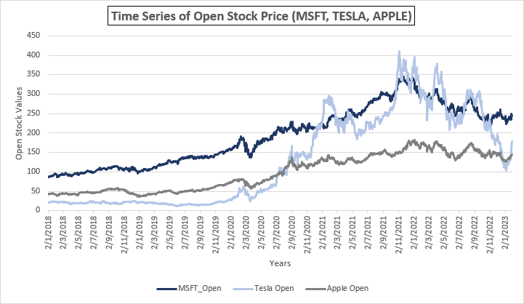
TIME SERIES ANALYSIS
TESLA's open stock prices tops the most over the given time frame. There appears to be a general upward trend in the stock prices Mar and Sep of 2020 , Jan of 2021 and Nov 2021 being the highest among all 3 companies, with occasional periods of decrease.
APPLE's open stock prices have shown fluctuations over time, with some periods of increase and decrease. The stock prices seem to have experienced a notable increase from around mid-2020 to early 2021, followed by some fluctuation.
MSFT's open stock prices have shown fluctuations similar to the other companies. There seems to be a general upward trend in the stock prices,2021 being highest with occasional periods of decrease.

Slide 12
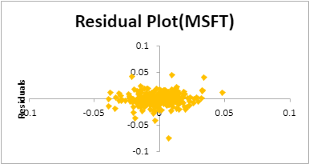
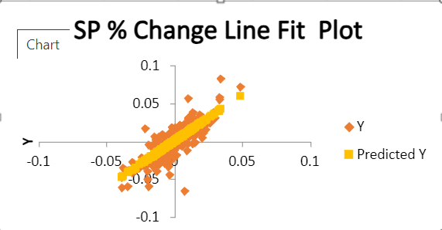
REGRESSION ANALYSIS (MICROSOFT)
SUMMARY OUTPUT
Regression Statistics
Multiple R | 0.777176063
R Square | 0.604002633
Adjusted R Square | 0.603692047
Standard Error | 0.011341909
Observations | 1277
ANOVA
 | df | SS | MS | F | Significance F | Significance F
Regression | 1 | 0.250166436 | 0.250166436 | 1944.718376 | 9.7095E-259 | 1
Residual | 1275 | 0.1640146 | 0.000128639
Total | 1276 | 0.414181036
 | Coefficients | Standard Error |  | t Stat | P-value | Lower 95% | Lower 95% | Lower 95.0% | Upper 95.0%
Intercept | 0.000505973 | 0.00031757 |  | 1.593264488 | 0.111348727 | -0.000117044 | 0.999882956 | -0.000117044 | 0.001128991
X Variable 1 | 1.221495021 | 0.027698952 |  | 44.09896116 | 9.7095E-259 | 1.167154487 | 2.167154487 | 1.167154487 | 1.275835555

Slide 13
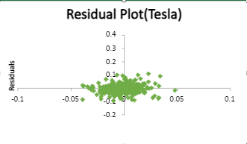
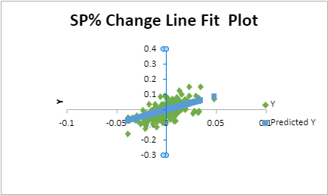
REGRESSION ANALYSIS (TESLA)
SUMMARY OUTPUT
Regression Statistics
Multiple R | 0.481352026
R Square | 0.231699773
Adjusted R Square | 0.231097184
Standard Error | 0.038246366
Observations | 1277
ANOVA
 | df | SS | MS | F | Significance F
Regression | 1 | 0.562451635 | 0.562451635 | 384.507514 | 4.91479E-75
Residual | 1275 | 1.865050248 | 0.001462785
Total | 1276 | 2.427501882
 | Coefficients | Standard Error | t Stat | P-value | Lower 95% | Upper 95% | Lower 95.0% | Upper 95.0%
Intercept | 0.001914305 | 0.001070887 | 1.787588839 | 0.074079808 | -0.000186589 | 0.0040152 | -0.000186589 | 0.0040152
X Variable 1 | 1.831554187 | 0.093404405 | 19.60886315 | 4.91479E-75 | 1.648310967 | 2.014797406 | 1.648310967 | 2.014797406

Slide 14
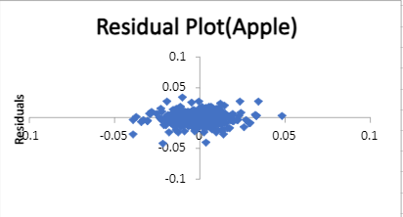
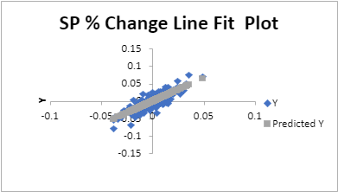
REGRESSION ANALYSIS (APPLE)
SUMMARY OUTPUT
Regression Statistics
Multiple R | 0.741103689
R Square | 0.549234678
Adjusted R Square | 0.548881137
Standard Error | 0.01390214
Observations | 1277
ANOVA
 | df | SS | MS | F | Significance F
Regression | 1 | 0.300248556 | 0.300248556 | 1553.522823 | 7.4539E-223
Residual | 1275 | 0.246418593 | 0.000193269
Total | 1276 | 0.546667149
 | Coefficients | Standard Error | t Stat | P-value | Lower 95% | Upper 95% | Lower 95.0% | Upper 95.0%
Intercept | 0.000655733 | 0.000389256 | 1.68458103 | 0.092314173 | -0.000107919 | 0.001419385 | -0.000107919 | 0.001419385
X Variable 1 | 1.33818958 | 0.033951489 | 39.41475388 | 7.4539E-223 | 1.271582655 | 1.404796505 | 1.271582655 | 1.404796505

Slide 15
INSIGHTS OF REGRESSION ANALYSIS
MICROSOFT
The regression model indicates a strong positive relationship between Microsoft's stock (dependent variable) and the S&P 500 index (independent variable), with an R-squared value of 0.604.
The coefficient of the independent variable (S&P 500) suggests that for every unit increase in the S&P 500, Microsoft's stock is expected to increase by approximately 1.22 units.
The p-value for the coefficient is very low (9.7095E-259), indicating that the relationship is statistically significant at any reasonable significance level.
TESLA
The regression model for Tesla also shows a positive relationship, albeit weaker than Microsoft, with an R-squared value of 0.232.
For Tesla, every unit increase in the S&P 500 is associated with an increase in Tesla's stock by approximately 1.83 units.
Similar to Microsoft, the p-value for the coefficient is extremely low (4.91479E-75), indicating a highly significant relationship.
APPLE
Apple's regression model indicates a stronger positive relationship with the S&P 500 compared to Tesla but weaker than Microsoft, with an R-squared value of 0.549.
For Apple, every unit increase in the S&P 500 corresponds to an increase in Apple's stock by approximately 1.34 units.
As with the other companies, the p-value for the coefficient is very low (7.4539E-223), signifying a highly significant relationship between Apple's stock and the S&P 500.

Slide 16
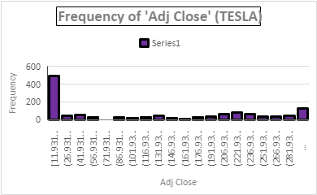
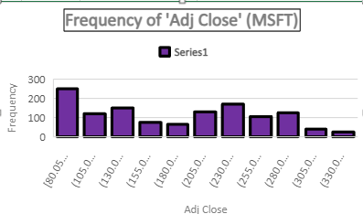
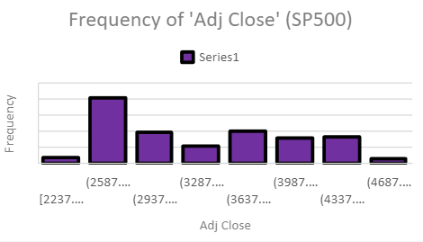
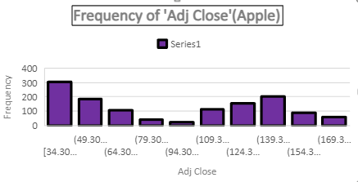
APPENDIX
The Original Dataset can be accessed from the link below: Click here for dataset
The dataset was mostly clean except for some duplicate values and NULL values which has been removed.
These Histograms represent the frequency of the adjusted close stocks for MSFT, APPLE and TESLA.

Slide 17
CONCLUSION
The regression analysis conducted on the stock prices of Microsoft, Tesla, and Apple demonstrates a significant relationship between these companies' stock prices and the S&P 500 index. This highlights the importance of considering broader market trends when analyzing individual stock performance and making investment decisions.
Investors interested in time series analysis of these company's stock prices may want to explore patterns such as seasonality, trends, and volatility, using statistical techniques like moving averages, exponential smoothing, and autoregressive integrated moving average (ARIMA) models to gain insights into potential future price movements.
The range of the adjusted closing prices varies across the datasets, with Tesla demonstrating the widest range, followed by the S&P 500 index, Microsoft, and Apple. This indicates that Tesla's stock prices experienced the most significant fluctuations over the observed period. The relatively narrower range for Apple suggests more stable stock prices compared to Tesla.
The differences in variability and range across the datasets have implications for investment risk. Tesla's higher variability and wider range suggest higher investment risk compared to the other datasets. Conversely, Apple's narrower range and lower variability indicate relatively lower investment risk.
Overall Overall, while the S&P 500 index demonstrates the highest average market performance, Tesla's stock prices exhibit the highest variability and risk. Investors seeking higher returns may consider investing in Tesla, but they should be prepared for greater fluctuations in stock prices. Conversely, investors seeking stability may find Apple to be a more suitable option. Microsoft falls between these extremes, offering moderate returns with moderate risk.

Slide 18
THANKYOU

