Slide 1


FRONT END ENGINEERING
PROJECT
NAME: VIDHI THAKUR
ROLL NO: 2110992088
GROUP : G-19

Slide 2

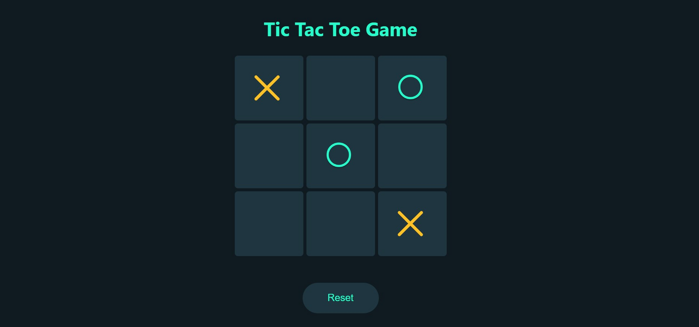
TIC-TAC-TOE

Slide 3
ABOUT THE PROJECT
The "Tic Tac Toe Game using React" is a web-based implementation of the classic Tic Tac Toe game, built using the popular JavaScript library, React. It offers an interactive and enjoyable gaming experience for users of all ages while also serving as a practical exercise in web development, React programming, and front-end design.

Slide 4


GOALS AND OBJECTIVES
Objective 1
Objective 2
Objective 3
To demonstrate the use of React for building interactive web applications.
To create a fun and educational game for players to enjoy.
To provide an open-source codebase that can be used as a learning resource for React beginners..

Slide 5


FEATURES
INTERACTIVE GAMEPLAY
REACT-POWERED
RESPONSIVE DESIGN
Our Tic Tac Toe game provides a user-friendly interface for two players to engage in a classic match of Tic Tac Toe. The players can take turns marking the grid, and the game keeps track of the progress.
The game is built using React, a powerful JavaScript library for building user interfaces. This allows for efficient component management and state handling.
The project is designed to be responsive, ensuring that it works seamlessly on various screen sizes, including desktops, tablets, and smartphones.

Slide 6


01
02
03
Game Logic: The game logic ensures that it follows the traditional rules of Tic Tac Toe. It correctly detects a win, draw, or ongoing game and displays the outcome to the players.
Turn-Based Play: Players take turns to make their moves, and the current player's turn is clearly indicated, making the game easy to follow.
Game Reset: After a game is completed, players have the option to restart the game and play again, ensuring hours of entertainment.

Slide 7

PROJECT WOKRING

Slide 8


Slide 9
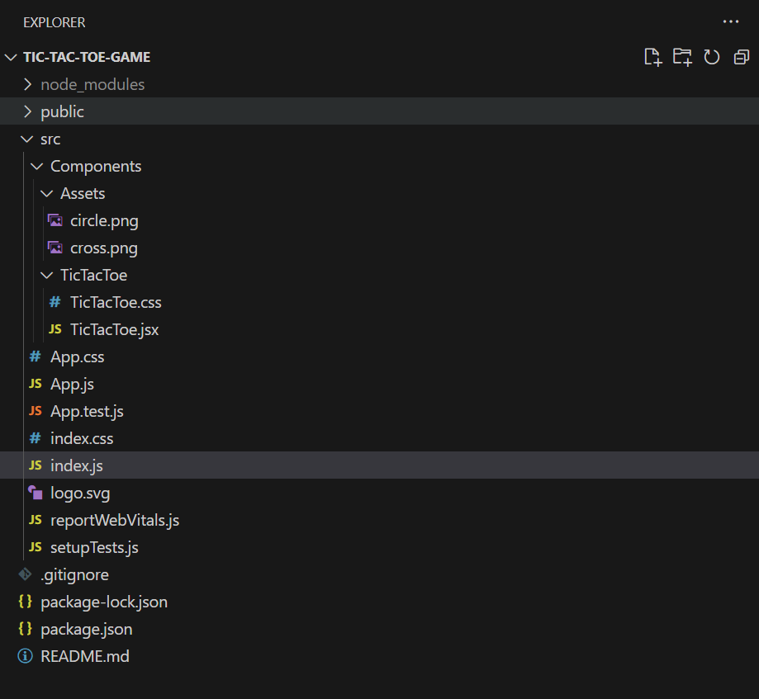

FOLDER STRUCTURE

Slide 10
CONCLUSION
In conclusion, our Tic Tac Toe React project represents a harmonious blend of classic gaming nostalgia and modern web development technologies. Throughout this presentation, we've explored the journey of creating this interactive web-based game, and we hope you've enjoyed the insights we've shared.
Drew Holloway
Ceo Of Ingoude Company
Ceo Of Ingoude Company

Slide 11
THANK YOU

