Slide 1


O N L I N E E X A M
P O R T A L

Slide 2
Introduction:
An online exam portal is a digital platform designed to conduct various types of assessments and examinations over the internet. It offers a convenient and efficient way for educational institutions, businesses, and organizations to assess the knowledge, skills, and abilities of candidates or participants. This type of portal has gained significant popularity due to its flexibility, scalability, and accessibility.

Slide 3

Mentor:
DR.A.R.Deepa
S.NO | ID.NO | NAME
1 | 2200030092 | Akash.J
2 | 2200032000 | RamaKoteswaRao.D
3 | 2200032005 | Surya Prabhath.G
Team members
22SDCI01R-PFSD-
CLUSTER3-3033

Slide 4
Roles:
2200030092 – Akash .J (Backend) 2200032000 – Rama Koteswara rao (Coding) 2200032005 – Surya Prabhath (Frontend)

Slide 5
Problem Statement
We are going to make an attractive examination portal in which user can create an account after which user have to sign in to attempt the test.
Most of the currently existing portals we know have some problems like crashing or getting hanged.
We will try to overcome these problems.
We tried to make this site robust, reliable and it takes less bandwidth to move from one page to next page.
We have also working on encryption decryption of the password using some algo.

Slide 6
Importance of online exam portal:
Conducting exams online eliminates the need for costly logistics and paperwork, leading to significant cost and time savings. It simplifies the examination process by automating tasks such as question paper generation, grading, and result processing, reducing administrative burdens on educational institutions.

Slide 7
The portal aims to provide educators with a user- friendly and customizable platform for creating, managing, and conducting online exams while ensuring a seamless experience for students.
This project presents the design and development of an Online Exam Portal using the Python Django framework.
Abstract
The Online Exam Portal offers a range of features, including user authentication, exam creation, question bank management, real-time exam monitoring, and result analysis.
Using Django's authentication system, users can register, log in, and access their respective accounts.

Slide 8





Module
Django: Django is a Python framework that is used to develop web applications. It is a popular choice for developing online exam portals because it is easy to use, secure, and scalable.
In addition to these modules, you will also need to install some other Python libraries, such as:
numpy: NumPy is a library for scientific computing. It is used to perform mathematical operations on the data in the online exam portal.
pandas: Pandas is a library for data analysis. It is used to manipulate and analyze the data in the online exam portal.
matplotlib: Matplotlib is a library for plotting graphs and charts. It is used to visualize the data in the online exam portal.

Slide 9

Module
once you have installed all of the necessary modules and libraries, you can start developing the online exam portal. The following are some of the key features that you need to implement:
User management: The online exam portal should allow users to create accounts and log in.
Exam management: The online exam portal should
allow teachers to create and manage exams.
Question management: The online exam portal should
allow teachers to create and manage questions.
Student management: The online exam portal should allow teachers to view student results and track their progress.
Security: The online exam portal should be secure and
protect the data of users and students.

Slide 10
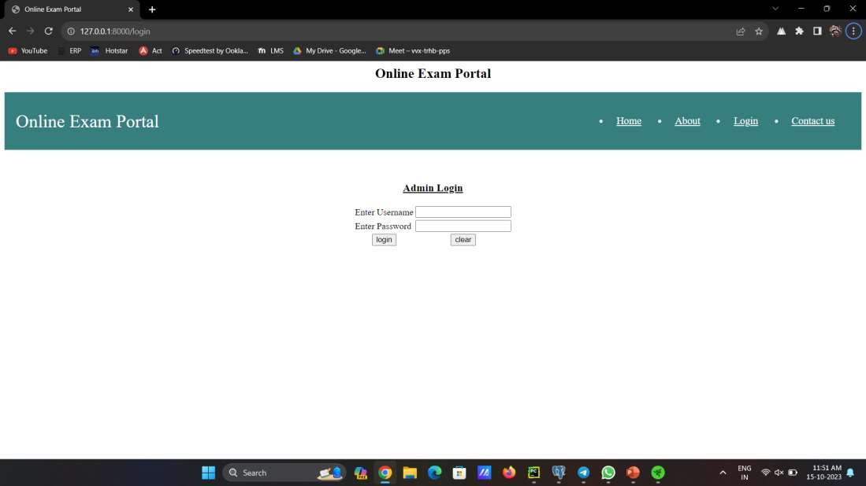

Slide 11


