Slide 1
Monitoring and Logging System with Amazon CloudWatch
Project by 2200030103
Under the guidance of Dr. S. Kavitha

Slide 2
Abstract
This project demonstrates a scalable monitoring and alerting framework using Amazon CloudWatch for EC2 instances. It integrates AWS services including EC2, IAM, SNS, and CloudWatch for proactive detection and response to system events.

Slide 3
Introduction
CloudWatch provides real-time monitoring and automated alerting for AWS resources. This project highlights how CloudWatch enhances visibility, performance, and operational management in cloud infrastructure.

Slide 4
Literature Review
Cloud-native monitoring tools are essential for distributed cloud environments. CloudWatch stands out by integrating logs, metrics, and alerts in a unified platform, supporting modern DevOps and SRE practices.

Slide 5
Objectives and Problem Statement
The goal is to create a centralized monitoring and logging system using CloudWatch. The system addresses the challenges of visibility, alerting, and data centralization in cloud environments.

Slide 6
Technical Implementation
Metrics and logs were collected via CloudWatch Agent. Logs were analyzed using CloudWatch Logs Insights. SNS was used for alerting. Dashboards and alarms were customized for real-time monitoring.

Slide 7
Analysis & Problem-Solving
Challenges such as log volume, alert fatigue, and performance degradation were addressed using automated analysis, custom alarms, and IAM for access control.

Slide 8
Conclusion
Amazon CloudWatch proved to be an effective, secure, and scalable monitoring tool for cloud environments, providing real-time insights and operational intelligence.

Slide 9
Future Work
Enhancements could include ML-based anomaly detection, advanced visualization tools, hybrid cloud monitoring, and incident management system integration.

Slide 10
Architecture Overview
Architecture Diagram:
EC2 -> CloudWatch Agent -> CloudWatch Metrics & Logs -> SNS -> Admin Alerts
IAM roles control access to all components.

Slide 11
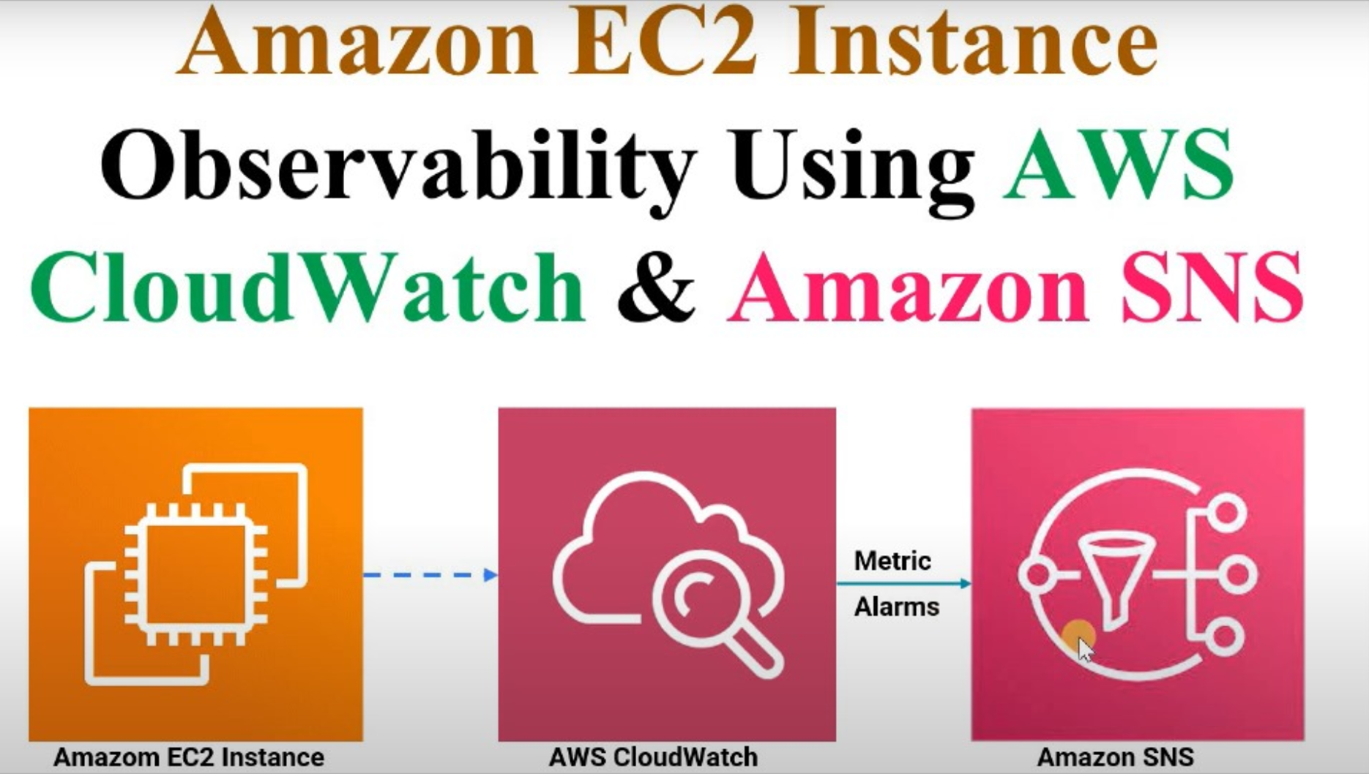
Architecture Diagram

