Slide 1
Amplifier Project 2
404 Braincells - Insurance

Slide 2










Technologies Used

Slide 3
GitFlow and Branching Architecture
Central Team GitHub Repository
Link to repo here
Branching was done on a per-feature basis
Initial connection branch
‘Per question’ branching
Registering and login
Presentation branch

Slide 4
Team Structure
Front End
Joshua Cho
Twain Toussaint
Back End
Collen Lynch
Michael Lee
Jacob of all trades
Jacob Ramsey

Slide 5
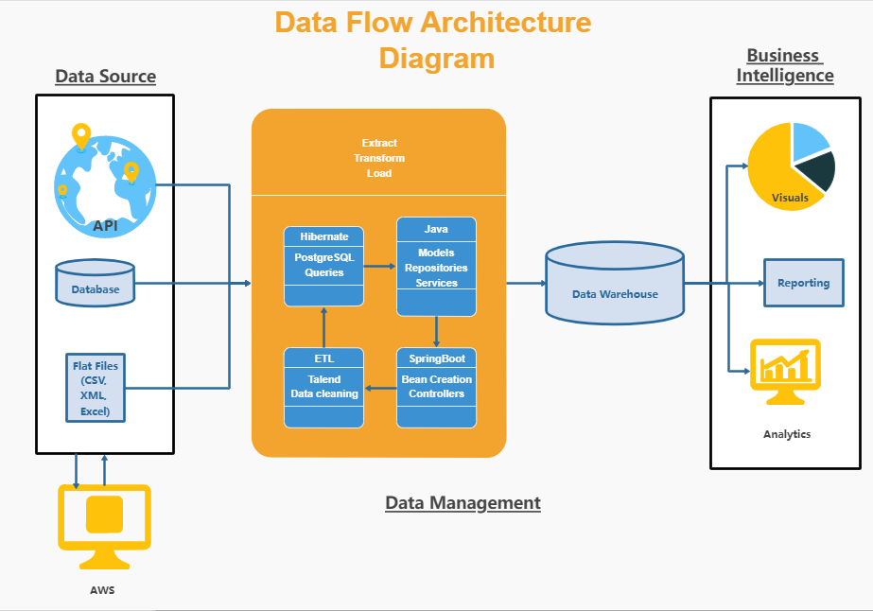
Architecture

Slide 6
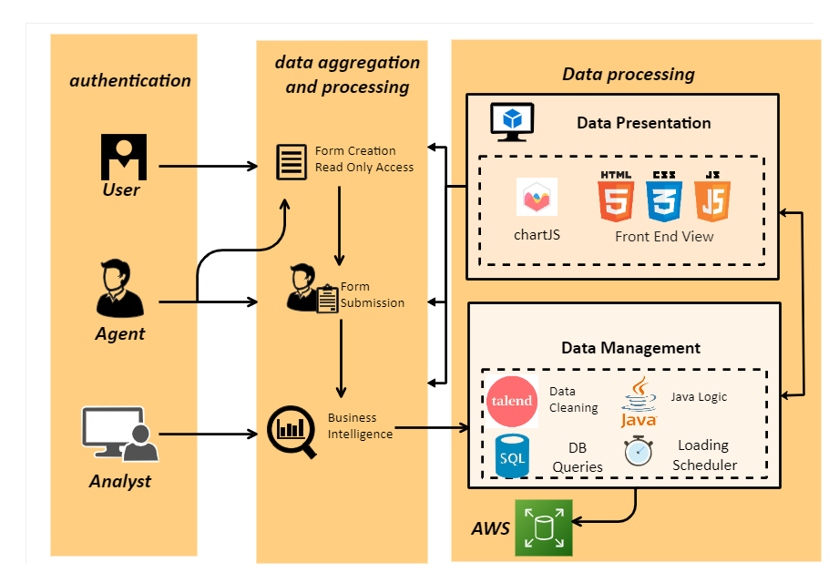
Pipeline Structure

Slide 7
Features Implemented
User | Agent | Analyst
Form Creation | Form Creation | Data Gathering
Read Only Permissions | Read Only Permissions | ETL Tools
 | Form Submission | Graphical Visualization
 |  | Parameter Control
 |  | Transaction Management
 |  | RDS Management

Slide 8
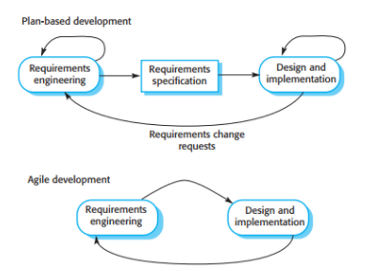
Team Workflow Implementation
Agile/Scrum
Simultaneous front end and back-end development
Daily scrums and offline communication
Technology conflict resolutions
Waterfall
Per question development
On demand function development
Image 7.1 - Agile Framework

Slide 9
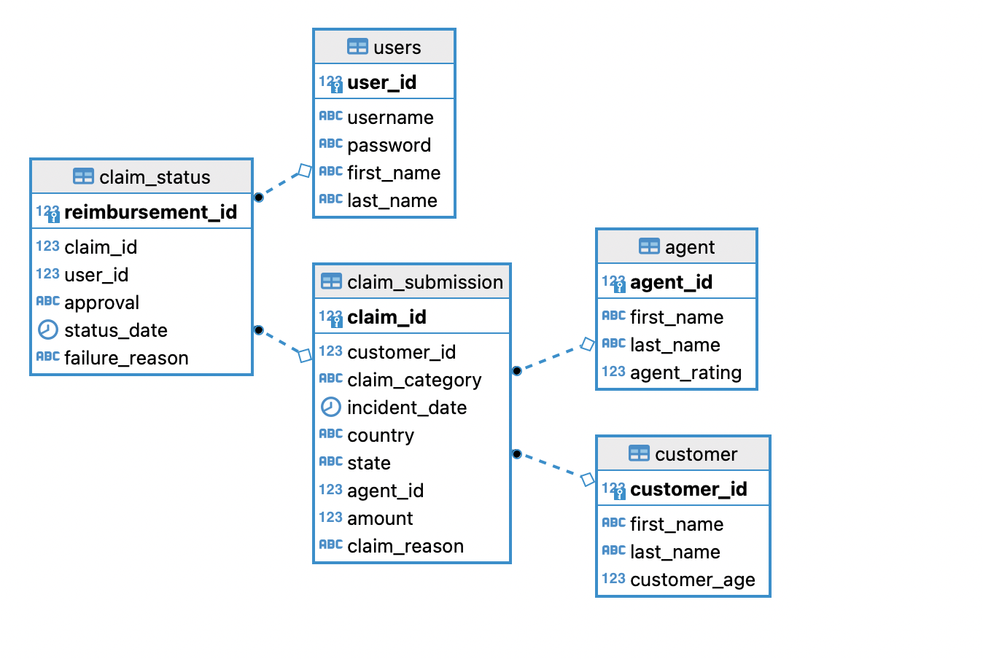
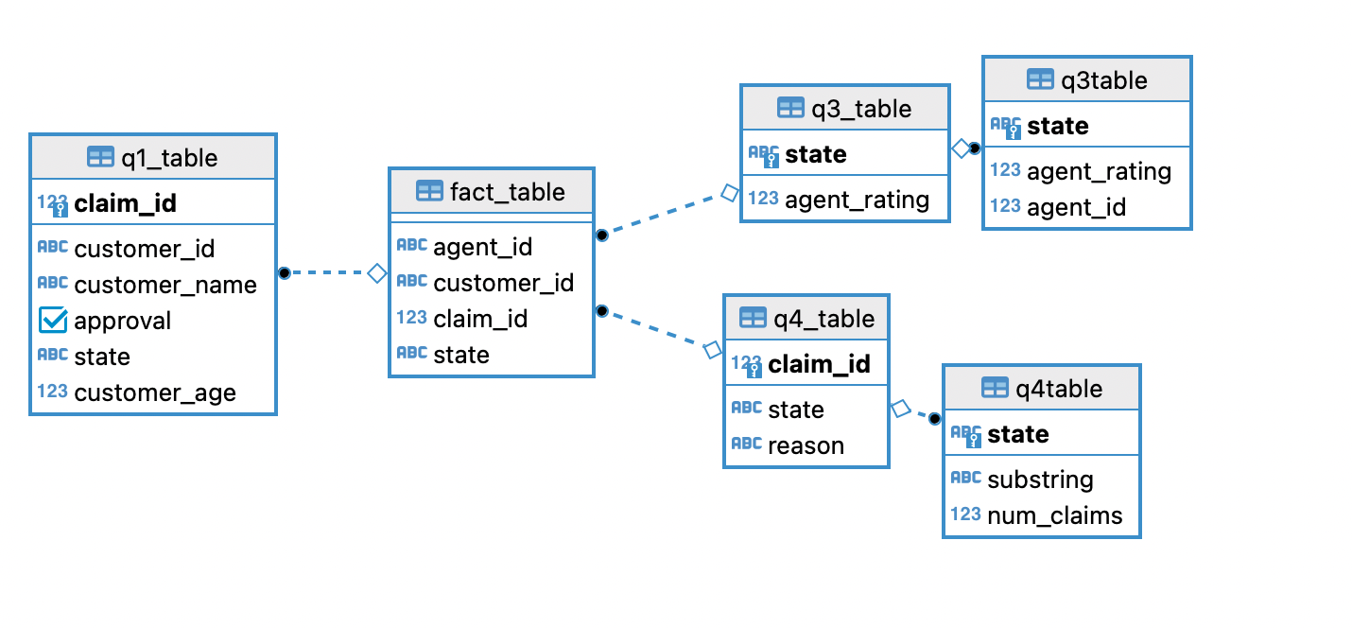
ERD Diagram
Table 8.1 (left) is the ERD Diagram displaying key and foreign key relationships between main data collected per reimbursement claim processing.
Table 8.1
Table 8.2 (right) are unique schemas inside our DBeaver constructed to answer specific questions and gather specific business intelligence data in Snowflake schema form.
Table 8.2

Slide 10
Outstanding Defects
As much as we would like to boast that our application is capable of it all…
Application is limited to pre-created csv file
Limited flexibility and rigid features.
Some manual transforms done outside of ETL.

Slide 11
Challenges and Pinch-points
Front End
JavaScript redirects
Button Functions
Chart Sizing/Placement
Back End
Authentication
JPA Repo Queries
Table 4
Talend
tMap inconsistencies
Data cleaning trial and error
Connection Lines
Version Control
Push/Pull Conflicts
Merges
Branching

Slide 12
Thank you for your attention!
Any Questions?

