Slide 1
Amplifier Project 2
404 Braincells - Insurance

Slide 2








Technologies Used

Slide 3
GitFlow and Branching Architecture
Central Team GitHub Repository
Link to repo here
Branching was done on a per-feature basis
Initial connection branch
‘Per question’ branching
Registering and login
Presentation branch

Slide 4
Team Structure
Front End
Joshua Cho
Twain Toussaint
Back End
Collen Lynch
Michael Lee
Jacob of all trades
Jacob Ramsey

Slide 5
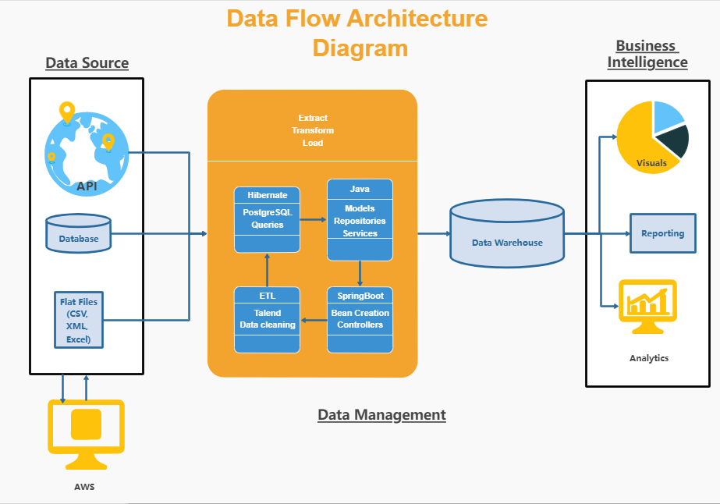
Architecture

Slide 6
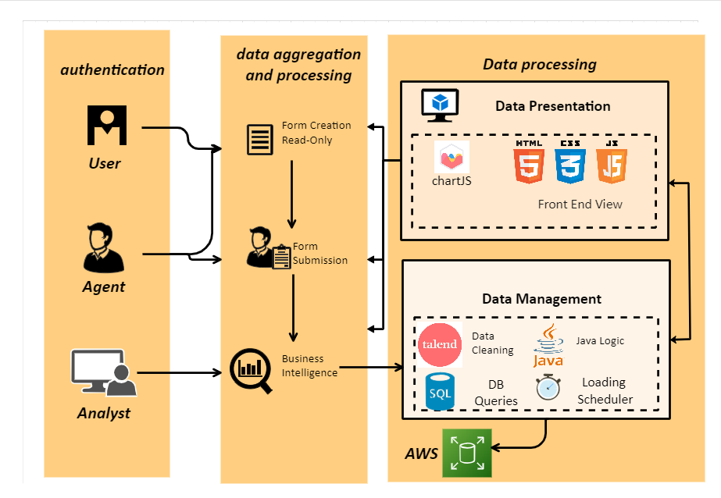
Pipeline Structure

Slide 7
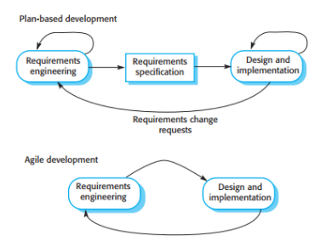
Team Workflow Implementation
Agile/Scrum
Simultaneous front end and back-end development
Daily scrums and offline communication
Technology conflict resolutions
Waterfall
Per question development
On demand function development

Slide 8
ERD Diagram

Slide 9
Features Implemented

Slide 10
Outstanding Defects

Slide 11
Challenges and Pinch-points

Slide 12
Thank you for your attention!
Any Questions?

