Slide 1
Amplifier Project 2
404 Braincells - Insurance

Slide 2










Technologies Used

Slide 3
GitFlow and Branching Architecture
Central Team GitHub Repository
Link to repo here
Branching was done on a per-feature basis
Initial connection branch
‘Per question’ branching
Registering and login
Presentation branch

Slide 4
Team Structure
Front End
Joshua Cho
Twain Toussaint
Back End
Collen Lynch
Michael Lee
Jacob of all trades
Jacob Ramsey

Slide 5
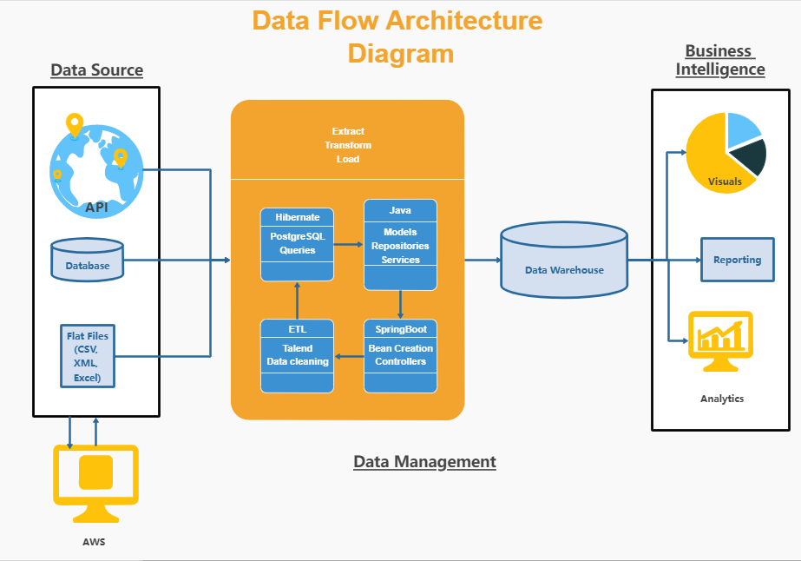
Architecture

Slide 6
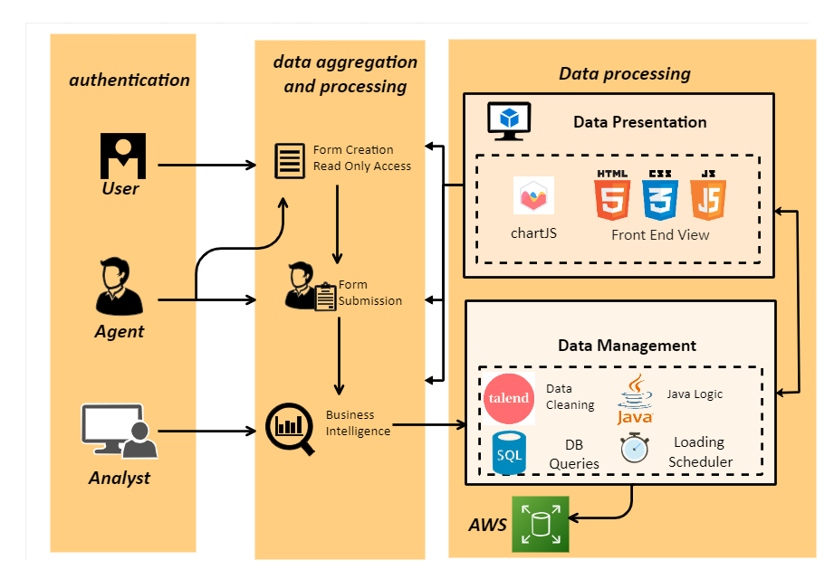
Pipeline Structure

Slide 7
Features Implemented

Slide 8
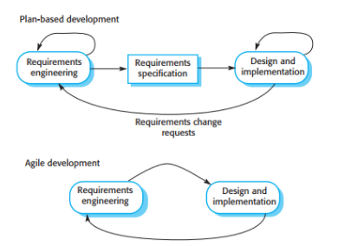
Team Workflow Implementation
Agile/Scrum
Simultaneous front end and back-end development
Daily scrums and offline communication
Technology conflict resolutions
Waterfall
Per question development
On demand function development

Slide 9
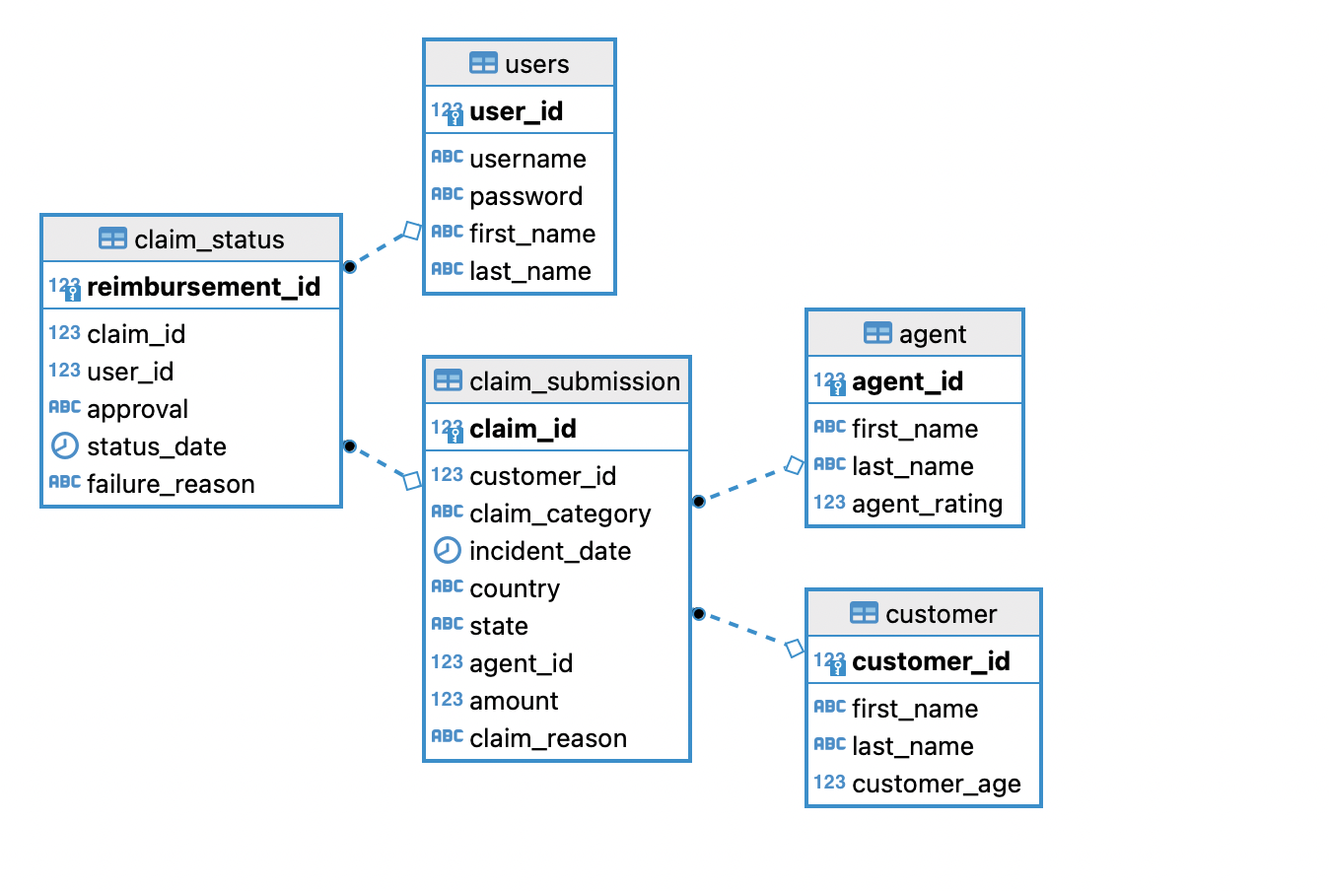
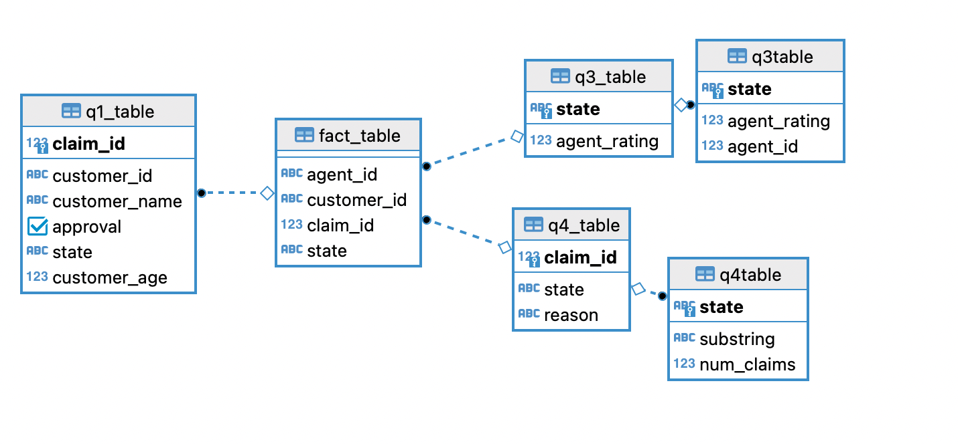
ERD Diagram
Table 8.1 (left) is the ERD Diagram displaying key and foreign key relationships between main data collected per reimbursement claim processing.
Table 8.1
Table 8.2 (right) are unique schemas inside our DBeaver constructed to answer specific questions and gather specific business intelligence data.
Table 8.2

Slide 10
Outstanding Defects

Slide 11
Challenges and Pinch-points

Slide 12
Thank you for your attention!
Any Questions?

