Slide 1
Week 4 Day 1
Google Cloud Compute Engine

Slide 2
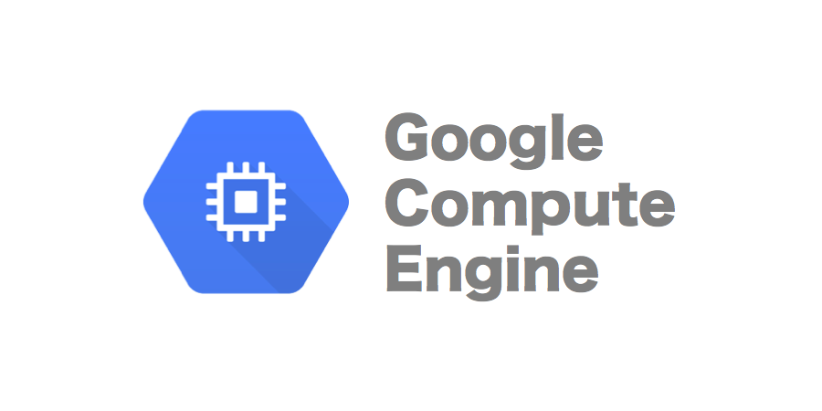
GCP Compute Engine
Google cloud virtual machine running in Google’s data centers
VM’s create a great “sandbox” environment
Includes a full virtual operating system
Great for hosting java applications we want access to from anywhere in the world
Image source: https://cloudcomputinggate.com/wp-content/uploads/2021/10/Google-Cloud-Compute-Engine.png

Slide 3
Compute Engine: Why?
It is cheaper
Access your resources from anywhere
Various machine configurations
Machines for specific purposes

Slide 4
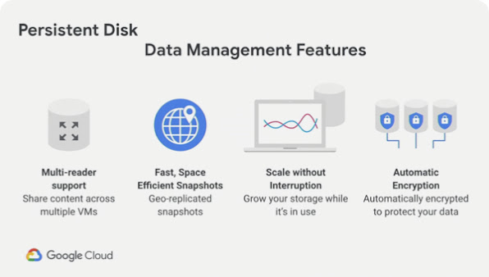
Persistent Disk
Storage capabilities for virtual instances
Standard
SSD
Local SSD
Image source: https://lh3.googleusercontent.com/Xh2Cdw_HEDV1W5rXTjazu8USLZegWreUbXS3VthRLk1uRPHx9mac1LoS2RStVSUlhibVrguJaJ3O=e14-rj-sc0xffffff-h338-w600

Slide 5
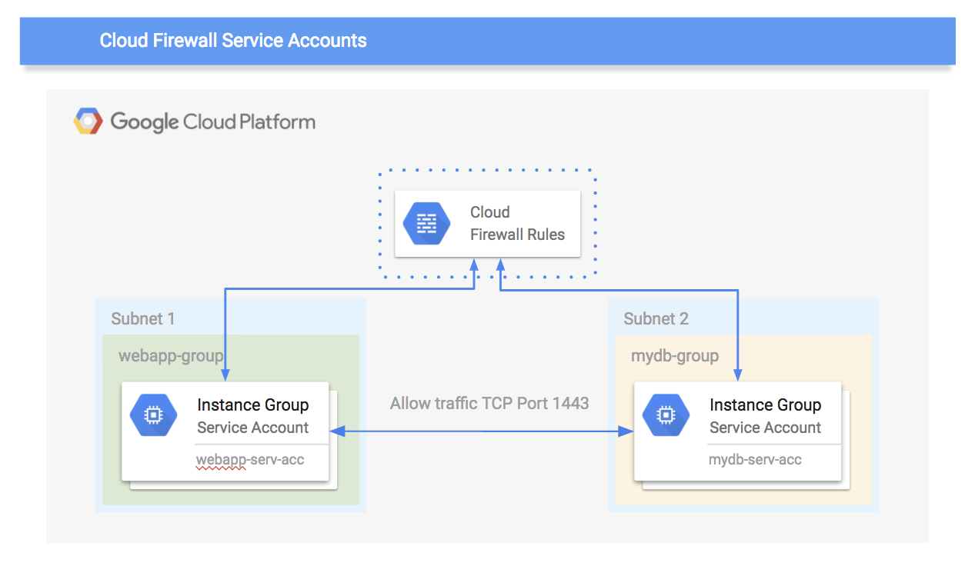
Security Groups
Virtual Private Cloud (VCP) firewalls
Allow or deny connections to VM’s
These rules will protect your VM at all times
Function as a distributed firewall
Works on a per-instance basis
Image source: https://4.bp.blogspot.com/-yjH4EGfeMQY/Wk3Ovm7IauI/AAAAAAAAE48/MfqSi6t6NKMU4ip81FS8C8XPILHLhstLQCLcBGAs/s1600/firewall.png

Slide 6
Create and SSH into a Compute Engine Instance

