Slide 1
Week 1 Day 2
Java Fundamentals

Slide 2
Java: Constructors
Special methods that declare how objects are to be created
Return the object type
Three types:
default
Created at run time if no other constructor exists
Arguments
Manually created, takes in any number of arguments
No-arg
Manually created, takes in no arguments

Slide 3
Java: this vs this() vs super()
The keyword ‘this’ is used to refer to the object itself
The keyword ‘this()’ used in the constructor
Can call another constructor of the current class
The keyword ‘super()’ used in the constructor
Can call a constructor in the parent class

Slide 4
Java: Strings
Strings are immutable, constant objects from the String class
String pool stores strings
Prevents duplicates to save memory
StringBuilder and StringBuffer
Classes that hold mutable sequences of characters

Slide 5
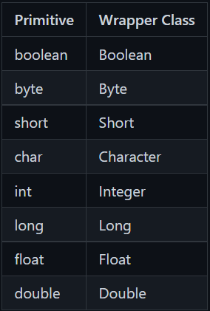
Java: Wrapper Classes
Allow you to treat primitives as objects
Autoboxing
Pass a primitive into a parameter asking for a wrapper
Unboxing
Pass a wrapper into a parameter asking for a primitive

Slide 6
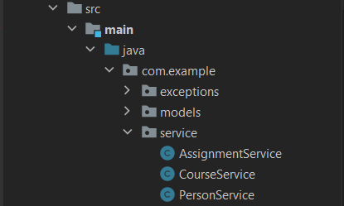
Java: Package and Imports
Packages create a folder structure for your project
Use lowercase reverse domain naming
com.example.package
Import packages with import statements inside of classes
java.lang is automatically imported to all classes

Slide 7
Java DEMO

Slide 8
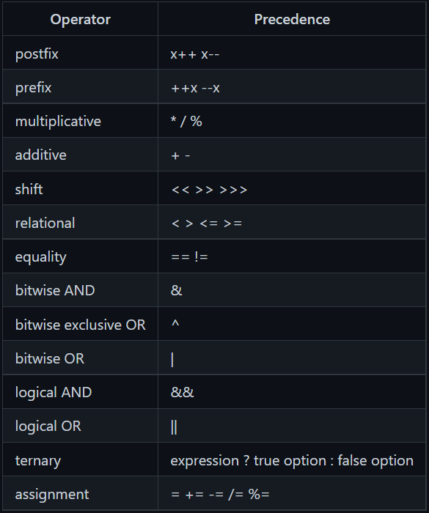
Java: Operators
AND
true AND true = true
true AND false = false
OR
true OR false = true
false OR false = false
Logical AND and OR short circuit
If the outcome can be determined by only one side, it won’t even look at the other side

Slide 9
Java: Arrays
Block of memory that stores a group of sequential elements
Must be the same data types
Fixed size
Syntax:
Access by their indexes
Starts at 0
Length property returns the size
Multidimension Arrays
Arrays inside of arrays

Slide 10
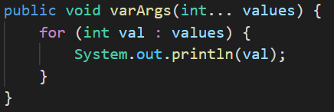
Java: VarArgs and Foreach
Variable Arguments in methods
Uses the … notation in the method parameters
Converted to an array at runtime
Can only be one, must be last in the list
Any array in a parameter list can be converted to varargs notation

Slide 11
Java: Control Flow
Break the normal flow of an application with loops, and conditionals
Conditionals
if/else
if/else if
tenary
switch statement
try/catch
Looping
for loops
enhanced for loops
while loops
do-while loops
Break
Loops, if, switch, break out of the code block
Continue
ONLY loops, break out of the current iteration of the loop

Slide 12
Java DEMO

Slide 13
Java: Object Oriented Programming
There are four pillars of object-oriented programming
Remember APIE
Abstraction
Hiding details of implementation
Polymorphism
Object taking many forms
Inheritance
Objects taking states and behaviors from a super class
Encapsulation
Data hiding

Slide 14
Java OOP: Encapsulation
Hiding data, but giving access through mutators
Java uses access modifiers to hide data
Mutators
Methods available to other classes to share the states we are hiding
Denoted by getters and setters,
getName()
setName()

Slide 15
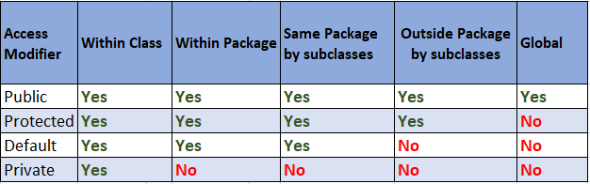
Java: Access Modifiers
Four access modifiers which restrict access to different layers of the application
They can be placed in front of
Classes
Interfaces
Enums
Class members
Image Source: https://javahungry.blogspot.com/2019/12/access-modifiers-in-java.html

Slide 16
Java: Non-Access Modifiers
Gives java extra functionality, important ones include
Static: gives class member class/static scope
Final: denotes the member is unchangeable
Abstract: classes can not longer be directly instantiated, methods cannot be implemented
Transient: marks class member as non-serializable

Slide 17
Java: Variable Scopes
Instance Scope
Belongs to the object
Class/Static Scope
Belongs to the class
Method Scope
Only available in the method block
Block Scope
Only available in the specific block of code

Slide 18
Java: Order of Initialization
When java initializes classes, it does so in this order
Static fields and variables
Static initializers
Instance fields/variables
Instance initializers
Constructors

Slide 19
Java: POJO vs Bean
POJO: Plain Old Java Object
Bean
A POJO and
Serializable
All fields are private
Getters and Setters
Must have no-args constructor
Fields only accessed with mutators and constructors

Slide 20
Java DEMO

