Slide 1
Week 1 Day 3
Java OOP, Testing, and Gradle

Slide 2
Java OOP: Inheritance
Base class (parent) passes traits and behaviors to sub-class (child)
All non-private fields/methods are passed to the sub-class
Shadowing
Variables with the same name in super and sub-classes will be shadowed
The variable of the parent class is overridden by the value of the child class

Slide 3
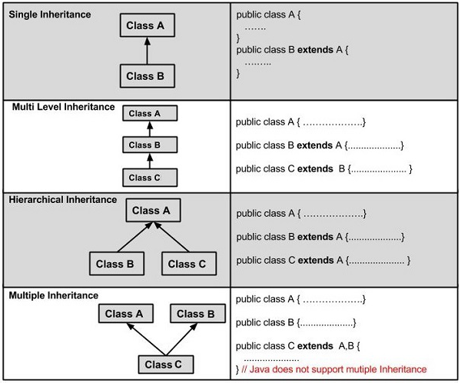
Java OOP: Types of Inheritance
Single Inheritance
Multi-level Inheritance
Hierarchical Inheritance
No multiple inheritance allowed with classes,
Possible with interfaces

Slide 4
Java: Object Class
Object class is the root of every class in Java
All java classes will inheriently have these methods
Object clone()
boolean equals(Object o)
void finalize()
Class<?> getClass()
int hashCode()
void notify(), notifyAll()
String toString()
void wait(), wait(long timeout), wait(long timeout, int nanos)

Slide 5
Java Inheritance DEMO

Slide 6
Java OOP: Abstraction
Centralize common characteristics and generalize behavior into conceptual classes
Abstract Classes
General classes that cannot be instantiated
Created with the abstract keyword
Contains abstract and concrete methods
Use the extends keyword
Interfaces
Contracts for classes with methods to implement
Inherently public abstract
All methods are public abstract
Uses the implements keyword

Slide 7
Java: Marker Interface
Interface that contains no methods or constants
Mean to provide runtime information
Examples
Serializable
Cloneable

Slide 8
Java Abstraction DEMO

Slide 9
Java OOP: Polymorphism
The ability for an object to take on many forms
Method Overloading
Methods with same name, but different signatures
Method Overriding
Method in child class with same name and signature as method in parent class
Covariant return type
While overriding you can change the return type, access modifier, and exception type
Casting
Upcasting assigns child object to parent
Downcasting assigns parent object to child

Slide 10
Java Polymorphism DEMO

Slide 11
Java: Scanner Class
Used to scan program input
Popularly used to collect user information from the terminal
Comes from java.utils package
Use it with System.in to take in user input

Slide 12
Java: Annotations
Special constructs in Java with the @ symbol followed by the name of the annotation
Used to provide metadata to the compiler
Placed over classes, methods, interfaces, and fields
Used by java libraries to abstract functionality
Processed by the Reflections API
@Override, @Test …

Slide 13
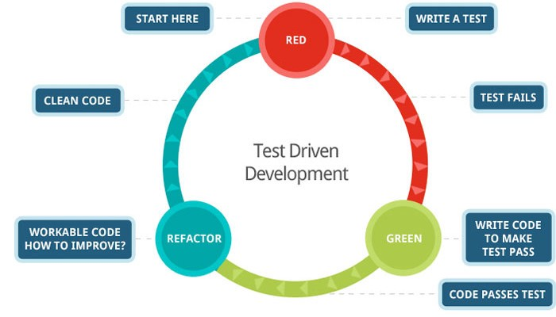
Testing: Test Driven Development
Process of writing tests before our code
Red/Greed Testing

Slide 14
Testing: Unit Testing
Testing of individual software components
White box testing
Helps reduce debugging time
Increases code coverage
Increases confidence in making changes to the code base

Slide 15
Testing: JUnit
Java Unit Testing Framework
Uses annotations to create tests and testing environments
@Test, @BeforeTest, @Before, @After, @AfterClass
Built-in methods to verify the state of your application during the test
assertTrue(), assertFalse(), assertEquals(), assertNotEquals(), assertThat()

Slide 16
Testing: Mockito
Java framework that allows us to mock the functionality of other methods
Black box testing
Stub
Fake class with preprogrammed values
Mock
Fake class that can be examined after the test is finished

Slide 17
Testing: Mocking Objects
Mockito uses annotations to implement mocking
Put @Mock over the object you want to mock
Use @InjectMocks above objects that have dependencies
To setup the mocks you will have to use MockitoAnnotations.opensMocks(this) to register the annotations

Slide 18

Java: Introduction to Gradle
Build tool for Java and other programming languages
Uses a task and plugin model to easily build projects
Allows you to use dependency repo’s like Maven
Scripts are built written in Groovey or Kotlin

Slide 19
Gradle: Features
High Performance
Hashing methods
Build Caching
JVM Foundation
Conventions
Convention over configuration
Extensibility
IDE Support

Slide 20
Gradle: Build Scripts
Gradle builds consists of one or more projects
Projects could be
Building JAR’s/distributatbles
Generating Documentation
Performing deployment processes
Work is done by tasks
The build script is stored in build.gradle

Slide 21
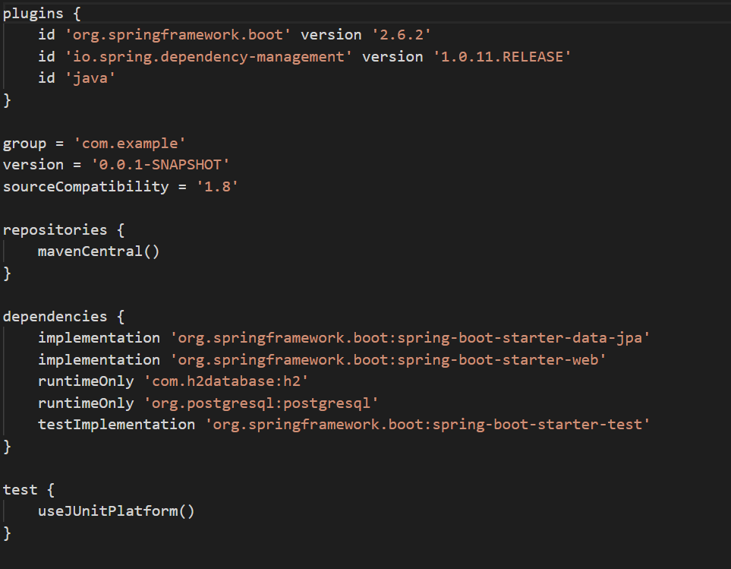
Gradle: Example build.gradle

Slide 22
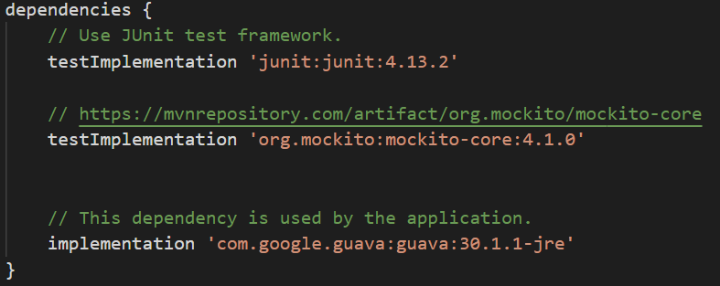
Gradle: Dependencies
Dependencies are declared in the dependencies block
Three types of dependencies
implementation
Api
testImplementation

Slide 23
Creating a Gradle project DEMO

