Slide 1
Week 6 Day 2
Spring Boot, Web/MVC and Hibernate

Slide 2

Spring Boot Intro
Open-source Spring framework
Rapidly creates Java projects
Simplifies project creation
Lets you pick and choose spring frameworks
Configures said frameworks for you
Built in tomcat server
Autoconfiguration with @SpringBootApplication
@SpringBootConfiguration
@EnabledAutoConfiguration
@ComponentScan

Slide 3
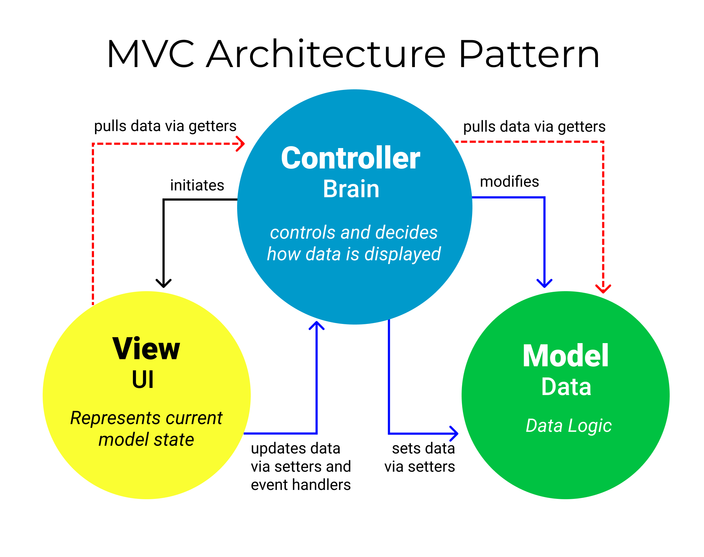
MVC Review
Model View Controller pattern used to design user interfaces and structure applications
Image source: https://www.freecodecamp.org/news/the-model-view-controller-pattern-mvc-architecture-and-frameworks-explained/

Slide 4
Spring MVC
Request driven structure centered around a central servlet using Front Controller design pattern
Uses servlets under the hood
Front Controller Design
Provides a single handler for all incoming requests (front controller)
Dispatches the requests through a helper api (dispatcher)
Helper classes hold logic for specific features (controllers)
InternalViewResourceResolver
Used to get views for our controllers

Slide 5
Spring MVC: Annotations
@Controller
Marks class as a controller
@RequestMapping
Used to map a uri to a class or method
@RequestBody
Gain access to the request body
@ResponseBody
Automatically convert the methods returned object to a json object to be sent in the request
@RestController
Combines @RequestMapping and @ResponseBody

Slide 6

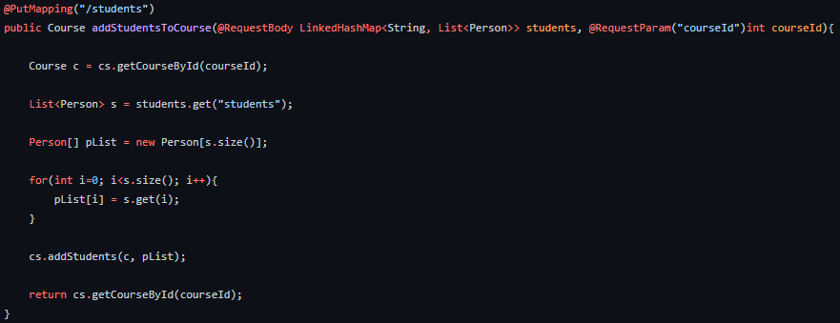
Spring MVC: Path and Query Parameters
Path Variables/Parameters allow you to add values after a slash in your uri
http://url/get/{variable}
Query Parameters allow you to use ? In the uri then define your key and value
http://url/get?var=name

Slide 7
DEMO: Spring MVC Project

Slide 8
Object Relation Mapping
Converts data between relational databases and object-oriented programming languages
Map objects to a table
Hide details of sql from code
Automatic versioning and time stamping
Good for large projects
Injected transaction management
Configurable logging
Faster development

Slide 9
Hibernate
ORM Tool for Java Programming
Used behind the scenes for Spring Data JPA
Flexible and powerful ORM solution
Defined under org.hibernate
Uses HQL to query objects
Uses Hibernate Sessions to make CRUD

Slide 10
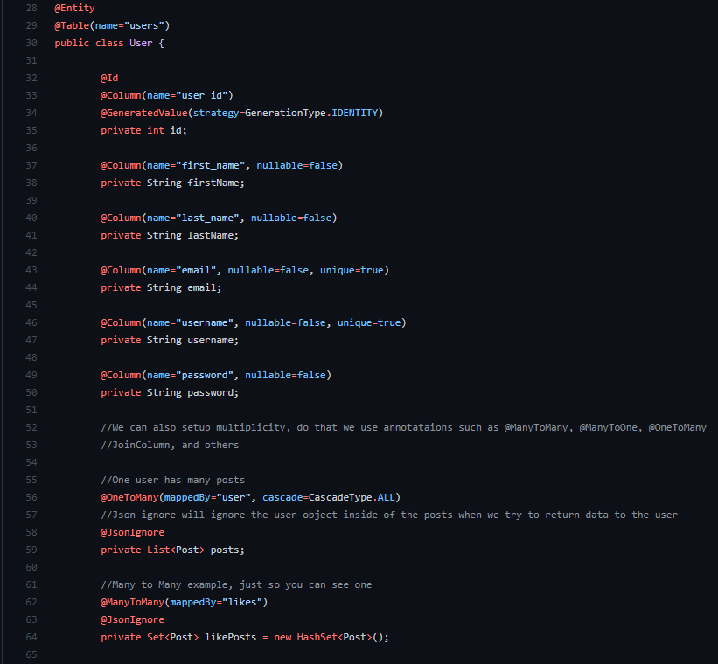
Hibernate Annotation
@Entity
@Table
@Column
@Id
@ManyToMany
@ManyToOne
@OneToMany

Slide 11
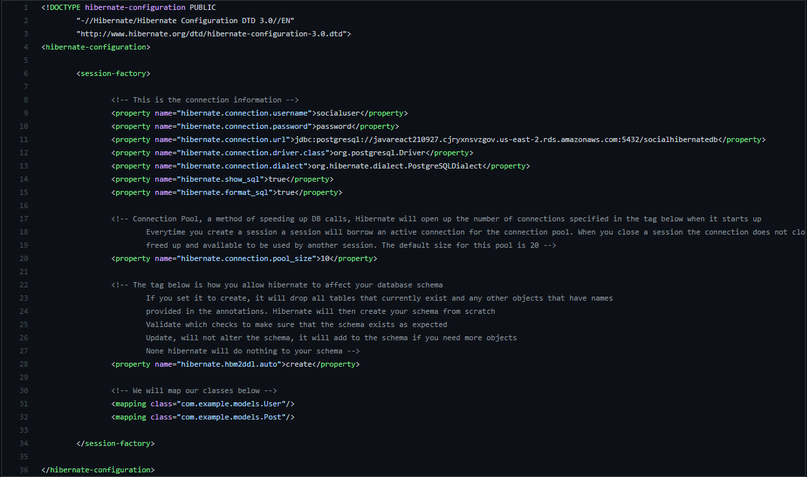
Hibernate: Using it to map classes
Setup the hibernate.cfg.xml
Annotate your model classes with annotations
Use hibernate sessions to make queries

