Slide 1
Week 6 Day 3
Spring Data

Slide 2
Spring Data
Family of frameworks for ORM and data persistence
Specifically using Spring Data JPA
Uses JPA and Hibernate behind the scenes
Allows us to implement data layer extremely quick
Abstracts away hibernate and JPA, giving us implementation for more common DAO methods

Slide 3
Spring Data JPA: Java Persistence API
Spring Data Module that uses the Java Persistence API
Decreases time to implement data layers
Gives implementation for DAO methods from method stubs
JPA is the standard Java API for managing objects in databases
Found in javax.persistence
Uses JPQ language for querying objects
Uses EntityManager for CRUD

Slide 4
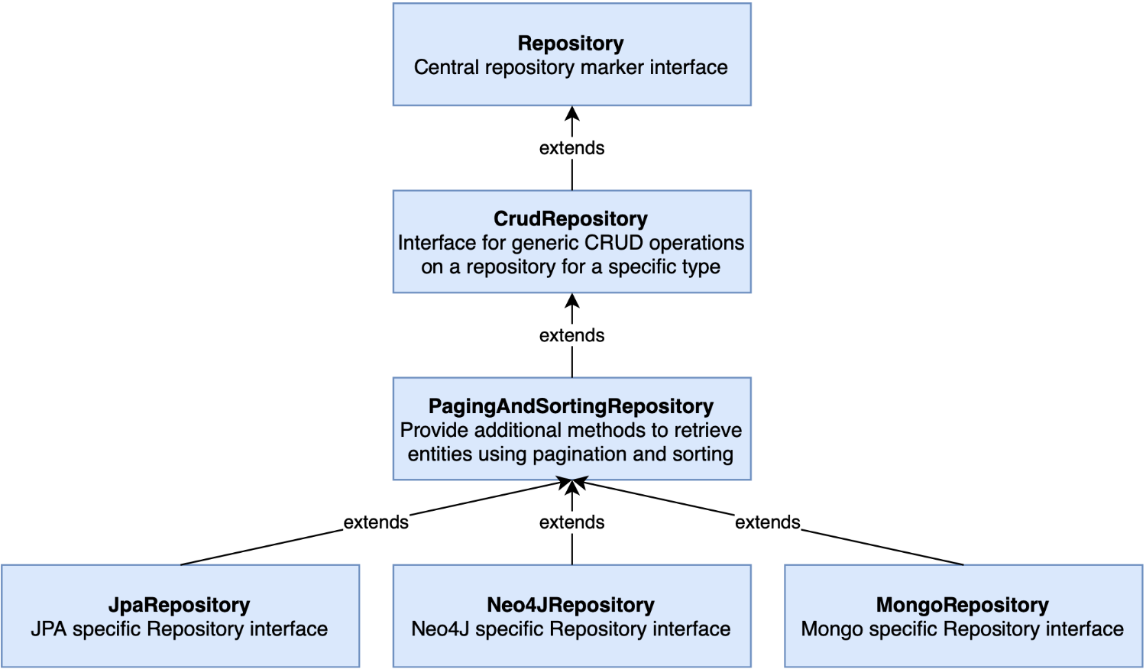
Spring Data JPA: Hierarchy
Basic CRUD functionality is provided by the JpaRepository interface
Image source: https://livebook.manning.com/book/cloud-native-spring-in-action/chapter-5/v-3/

Slide 5
Spring Data JPA: Features
Building sophisticated repositories
Support for QueryDSL
Transparent Auditing of domain classes
Pagination support
Dynamic Query Execution
Support for integration of custom data access code
Automatic custom queries
Validation of @Query annotated queries
Support for XML based entity mapping
JavaConfig based repositories

Slide 6
Spring Data JPA: Querying
There are three main ways to query data
Predefined CRUD Methods
https://docs.spring.io/spring-data/jpa/docs/current/api/org/springframework/data/jpa/repository/JpaRepository.html
Custom queries via method signature
Table 2.3 > https://docs.spring.io/spring-data/jpa/docs/1.5.0.RELEASE/reference/html/jpa.repositories.html
Custom queries with @Query Annotation

Slide 7
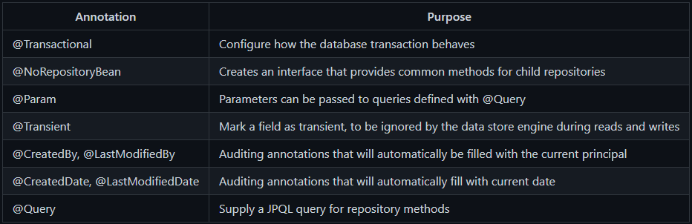
Spring Data JPA: Annotations

Slide 8
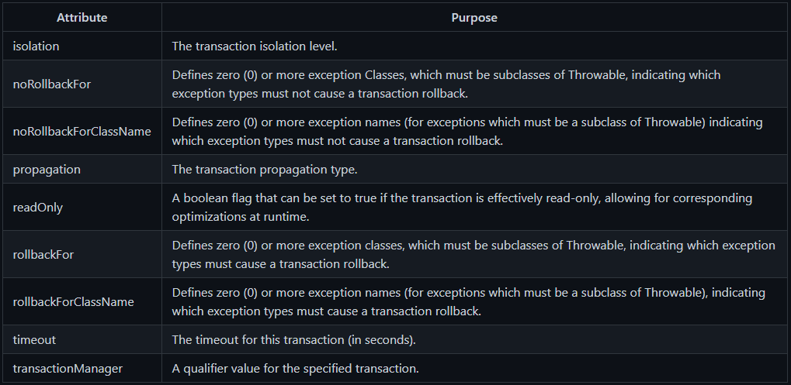
Spring Data JPA: @Transactional
Allows Spring to manage our database transactions
Best practice to use @Transactional over your Service classes
Springs treats the Classes/Methods marked with @Transactional as separate transactions

Slide 9
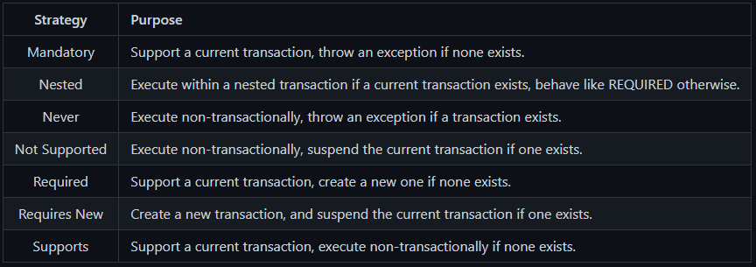
@Transactional Propagation Strategy
Defines how Spring should manage multi-level queries
One service class calling another

Slide 10
DEMO: Spring Boot/Data

Slide 11
OWASP: Sensitive Data Exposure
Anytime an application is storing sensitive data and it is exposed
Any site that stores sensitive info like
Credit cards
Passwords
Social Security, are at risk

Slide 12
Protect against Sensitive Data Exposure
Data should be classified
Apply controls to the data
Encrypt data at rest
Use strong cyphers
Don’t store sensitive data you don’t have to

