Slide 1
Week 3 Day 4
Asynchronous Javascript

Slide 2
Asynchronous Programming
Asynchronous Code:
No need to wait for a task to finish
Start a function and move onto other code
Useful for:
Lengthy functions
API calls
Processes that block the main execution

Slide 3
Asynchronous Javascript
Javascript is single threaded
Method calls are added to a stack
Each method gets called one at a time
Browser has extra threads to be used
JS implements a queue of functions processed by the browser’s threads
This queue is used by the event loop

Slide 4
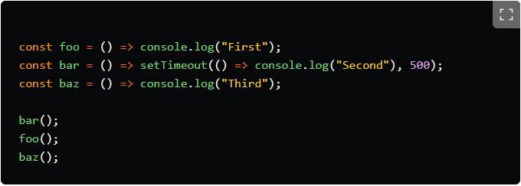
Javascript: Event Loop
Source: https://dev.to/lydiahallie/javascript-visualized-event-loop-3dif

Slide 5
Javascript: Event Loop Steps
Asynchronous call gets added to the stack
JS decides to hand it off to the web api where it processes
Other functions can be added and executed on the call stack while the web api works
Once the web api has a response it gets added to the queue
The event loop checks the queue when the call stack is empty to see if something needs to be added to the call stack
Our response/callback is added to call stack and process as normal

Slide 6
Javascript: AJAX
Asynchronous Javascript and XML:
Exchanging data from a webserver asynchronously
Uses the browsers built in XMLHttpRequest object
Workflow:
Event occurs
XMLHttpRequest object created
XHR objects makes async request
Server processes req
Server sends response
Browser processes the returned data
Page updated with the new content

Slide 7
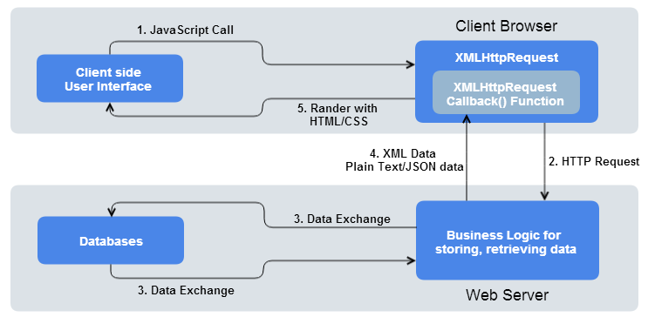
Javascript: How to make a request
Create the XHR object with new XMLHttpRequest()
Set the readystatechange callback function
Use .open(method, url, async)
Use .send()
Source: https://way2tutorial.com/images/ajax_how_it_works.png

Slide 8
Javascript: Server Responses and XHR readyState
.onreadystatechange monitors the readyState
readyState tells when the response is ready, the states include
0 = not initialized
1 = connection established
2 = request received by server
3 = server processing request
4 = response ready
Server sends back a response in the form of:
responseText
responseXML
status
statusText

Slide 9
Javascript: JSON in AJAX
XHR can only send text
Convert the object to text with JSON.stringify()
Convert the response text to json
JSON.parse()

Slide 10
AJAX DEMO

Slide 11
Javascript: Promises
Used as placeholders for future data
Objects which use callback function called executor which runs when created
Executor calls resolve when the data is there
Executor calls reject when an error occurs
Status property gives us info on the state
Pending
Fulfilled
Rejected

Slide 12
Javascript: Handling Promises
Promises use consuming functions to handle when a promise is successful for results in an error
.then() is used to consume the result
.catch() is used to handle an error
.finally() is ran no matter what
You can chain together as many .then() as you like

Slide 13
Javascript: Fetch API
More modern and versatile way of making AJAX Requests
Built into the browser, uses .fetch() method
Returns a promise that is retrieved from the response
Successful request resolves
error response is rejected
Methods to access the response body:
response.text()
response.json()
response.formData()
response.blob()
response.arrayBuffer()

Slide 14
Fetch Demo

Slide 15
Javascript: async/await
ES8 feature which simplifies async javascript
Use the async keyword to denote a function runs asynchronously
Implicitly returns a promise
Use await keyword if you explicitly want to wait for the promise to resolve/reject
Only available in an async function
The program can still continue, but the function does not finish until the wait is over

Slide 16
Async/Await Demo

Slide 17
AJAX Hands On
Create an HTML Page that has an input field and a button
On submission make a call to the PokeAPI to get information about the pokemon in the input field
Once you receive the information, display the pokemons name and the image
PokeAPI: https://pokeapi.com/api/v2/pokemon/{id or name}

Slide 18
Javascript: Timing Events
Functions attached to the global window which allow us to automate or run tasks after a specified amount of time
setTimeout()
Execute a callback after x amount of milliseconds
.clearTimeout() is used to cancel a timeout
setInterval()
Execute a callback once every x amount of milliseconds
.clearInterval() to stop the interval

Slide 19
Timing Demo

Slide 20
OWASP: Cross Site Scripting
Client-side code injection
Attacker attempts to steal data by injecting scripts into a webpage
Prevention:
Do NOT embed user input directly into code
Sanitize Data
Use a Security Encoding Library

Slide 21
OWASP: Broken Authentication
Allowing users access without proper credentials
Credential Stuffing
Automated Attacks
Default passwords
Prevention:
Multifactor authentication
Password complexity
Failed login attempts
Firewalls

