Slide 1
Week 3 Day 5
Frontend Hosting and Session Management

Slide 2
GCP Cloud Storage
Object storage by google
Can store literally anything
Stored in buckets
Simply create a bucket
Upload the files
Grant access to whoever

Slide 3
Storing our Webpages on Cloud Storage

Slide 4
Session Management: Cookies
Key value pairs of information shared between client/server
Sent in the header
Verify they are present
Non-persistent
Expires when the browser is closed
Persistent
Expires when you decide (ex. when a user logs out)

Slide 5
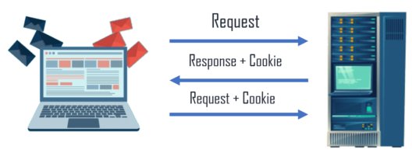
Session Management: Cookies
Set a cookie with document.cookie = ‘the cookie’
Only store none important information
Cookies can be seen by everyone
Cookies only work if they files are being hosted by a server
Static locally served files will not allow cookies
Image source: https://www.edureka.co/blog/wp-content/uploads/2019/08/cookie-528x206.png

Slide 6
Session Management: Sessions API
An API which allows you to identify and store user information based on http requests
Built in session management with Javalin
Access these through the context
context.req.sessionAttribute(“key”,”value”)
context.req.getSession().sessionAttribute(“key”)
context.req.getSession().invalidate()

Slide 7
Websockets
Full-duplex communication channel over a TCP connection
Send one request to connect
Then receive messages without additional requests
Connection stays open
Reducing latency
Complexity
Great for realtime applications

Slide 8
Demo: Wrapping up SMS

